Slide 1
Regional Drug Epidemiology Network
Presented by Vanessa Salmo, MPH
Epidemiology & Evaluation Director
Community Coalition Alliance, Inc.
Notes:
Hi All,
I want to thank you again for being here today. I am Vanessa Salmo, CCAs Epidemiology and Evaluation Director

Slide 2
Florida Department of Children and Families
Baker Act Dashboard
The data highlights characteristics and trends of involuntary Baker Act examinations in Florida including factors related to the initiation of examination.
The data within the dashboard are provisional and updated frequently.
Notes:
Today I will present some of the data from the Florida youth substance abuse survey or the fysas
We have been working with our interns to extract data from FL Health Charts, we also recently received this data in raw form, and we are working on analyzing and sharing 2023 data which is state level data
If you have an interest in this survey data, I encourage you to attend our regional drug epidemiology network meeting which is being held in Jacksonville on march 28 . During the meeting a representative from the FYSAS survey is coming to present

Slide 3
Involuntary Examinations in Florida
July 1, 2022 – June 30, 2023
Involuntary Examinations
174,429
Distinct Individuals Examined
125,526
High Utilizers
9,785
Notes:
In fiscal year 22-23, there were over 125 individuals who were baker acted in Florida. Of those, around 9700 were high utilizers.

Slide 4
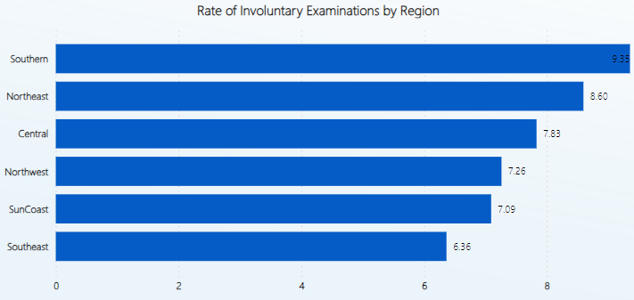
Involuntary Examinations in Florida
July 1, 2022 – June 30, 2023
The Southern and Northeast regions of Florida have the highest rate of involuntary examinations per 1,000 residents for the previous fiscal year.
Notes:
The Southern and Northeast regions also have the highest rate of high utilizers and distinct individuals

Slide 5
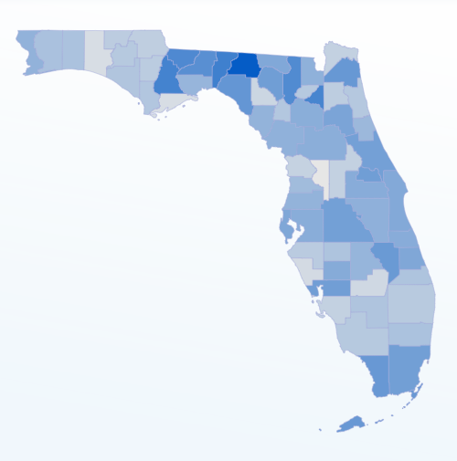
Rate of Involuntary Examinations in Florida Per 1,000 Residents
July 1, 2022 – June 30, 2023
Rank of Northeast Florida Counties:
Duval – 9th
Volusia – 17th
Baker – 29th
Flagler – 36th
St. Johns – 47th
Clay – 55th
Nassau – 57th
Notes:
Madison County has the highest rate of involuntary examinations in Florida with 15.12 per 1000 residents having baker acts

Slide 6
Rate of High Utilizers in Florida Per 1,000 Residents
July 1, 2022 – June 30, 2023
Rank of Northeast Florida Counties:
Duval – 8th
Volusia – 15th
Baker – 16th
Nassau – 39th
Flagler – 42nd
Clay – 48th
St. Johns – 61st
Notes:
Jefferson County and Madison County have the highest rate of high utilizers in Florida
As you can see several rural northeast florida counties have high rates which might signify limited access to routine mental health care without a baker act
You also see that the rank order changes when assessing high utilization

Slide 7
Involuntary Examinations in Northeast Florida
July 1, 2022 – June 30, 2023
Involuntary Examinations
24,139
Distinct Individuals Examined
17,479
High Utilizers
1,574
Notes:
In the Northeast region there were over 24 thousand involuntary examinations between July 1 2022 and June 30 2023.
Northeast accounts for 13.8% of involuntary examinations and 16% of the high utilizers in Florida

Slide 8
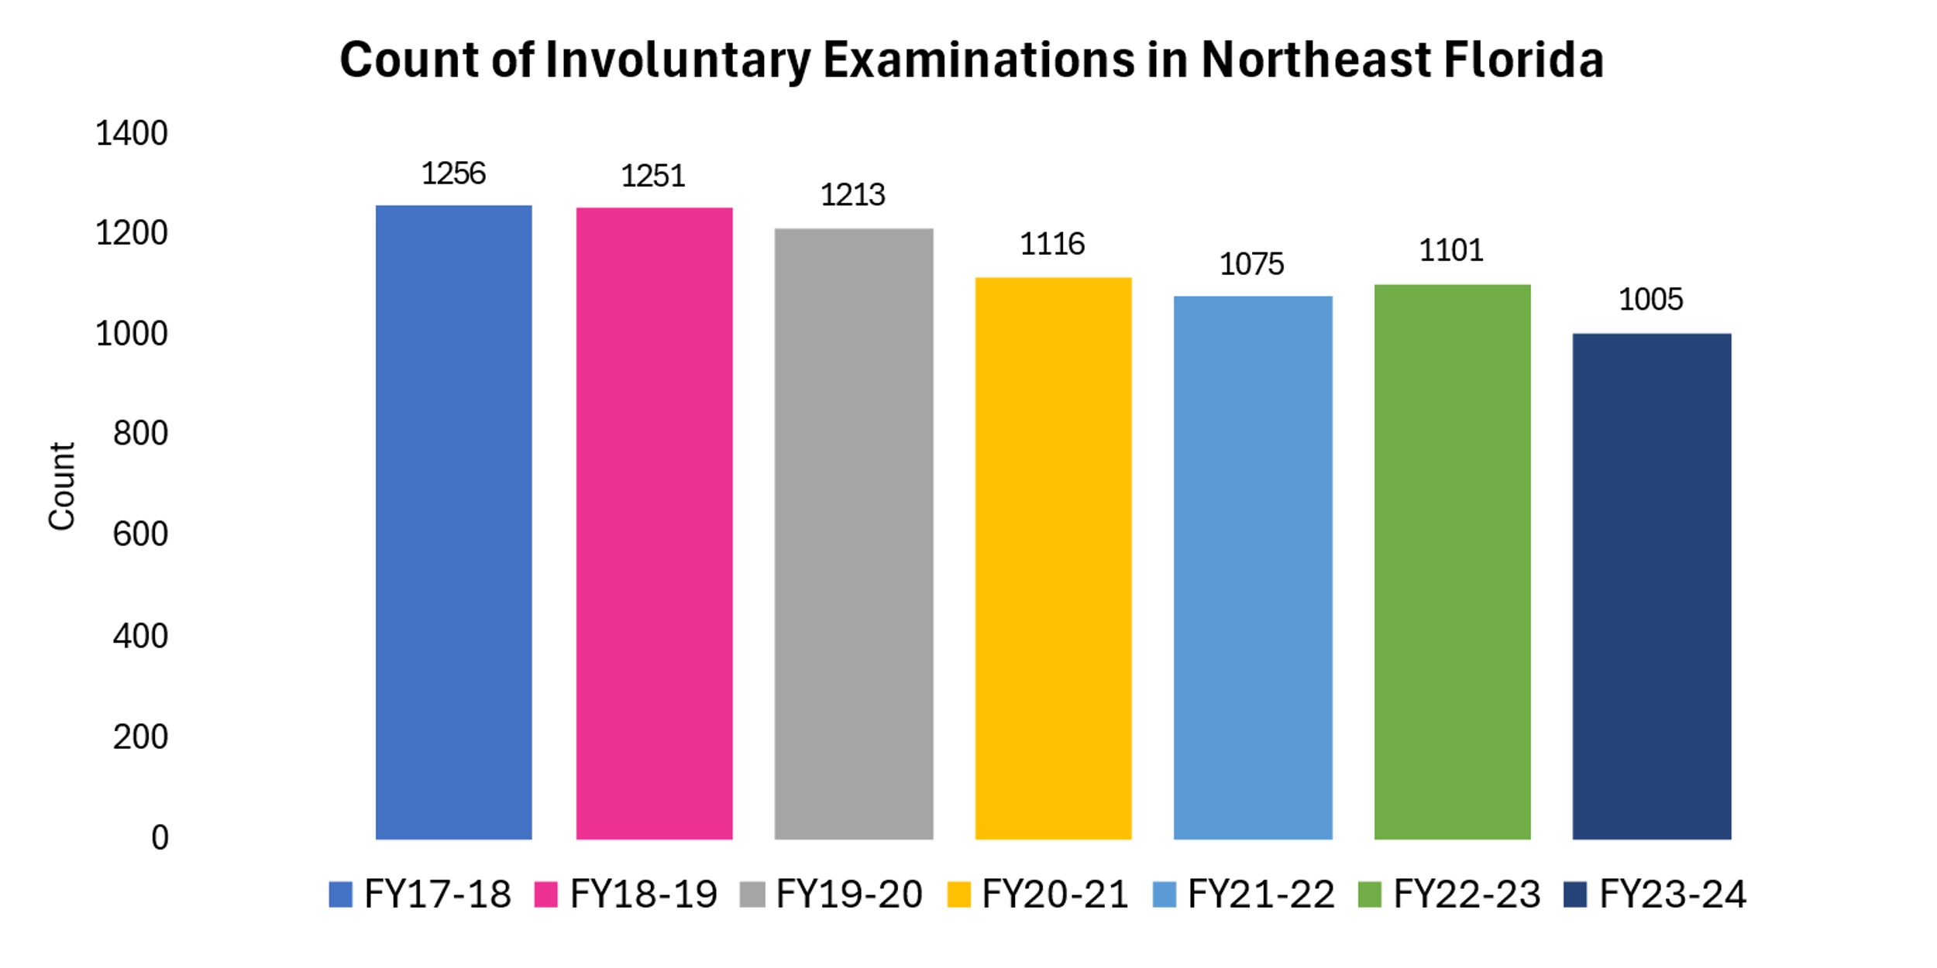
Involuntary Examinations in Northeast Florida
FY 17-18 through FY 23-24
In Northeast Florida involuntary examinations have decreased since fiscal year 17-18.
Notes:
In Northeast Florida involuntary examinations have decreased Over time

Slide 9
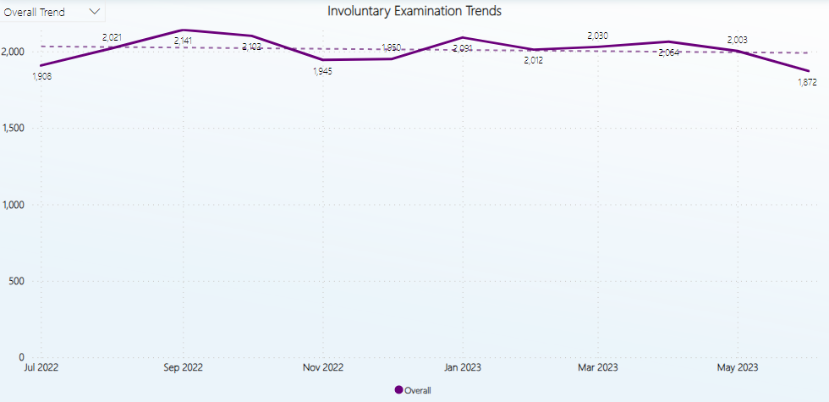
Involuntary Examinations in Northeast Florida
July 1, 2022 – June 30, 2023
Notes:
Here we see the monthly count of Involuntary Examinations in Northeast Florida for FY 22-23
This seems to peak in September (which is around the time school begins)
In January around the holidays
And during the summer months

Slide 10
Involuntary Examinations in Northeast Florida
FY 17-18 through FY 23-24
Notes:
This shows the longitudinal change for several counties in Northeast Florida. In Duval County we have seen decreases in involuntary examinations. We do see increases in some counties

Slide 11
Involuntary Examinations in Northeast Florida
FY 17-18 through FY 23-24
Notes:
I wanted to remove duval county which has a higher overall count and when included on the graphs can mask trends.
Here we see that so far in fiscal year 23-24, clay county has had a 25% increase compared to FY 22-23 surpassed counts for the 4 previous years
We also see that Nassau has had an 8% increase and St. Johns has had a 6.2% increase,
BUT keep in mind that the FY doesn’t end until June 30 2024 so these counts and percentage increases are provisional and will likely increase.

Slide 12
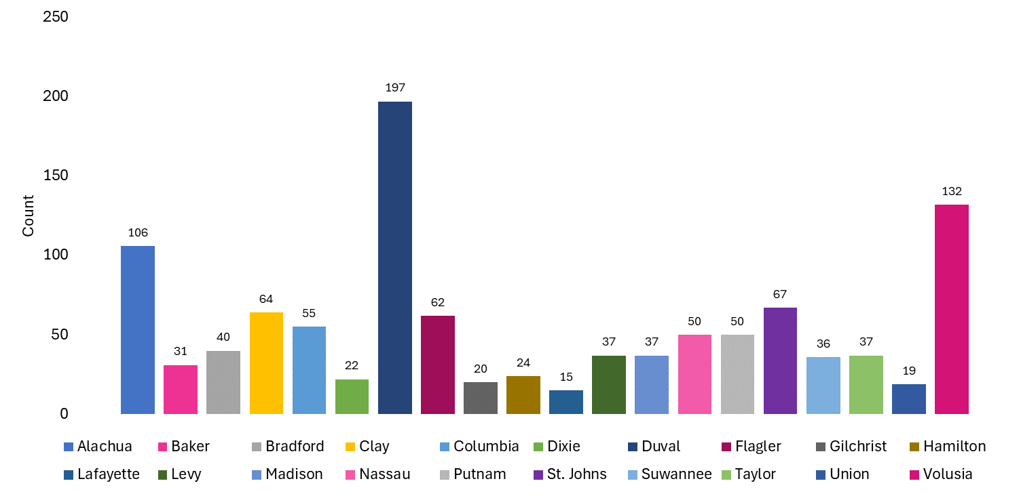
Involuntary Examinations in Northeast Florida by County
July 1, 2022 – June 30, 2023
Notes:
The counties in Northeast Florida with the highest count of involuntary examinations include Duval, Volusia, Alachua, St. Johns, Clay, and Flagler. These six counties account for 57% of the involuntary examinations in Northeast Florida.

Slide 13
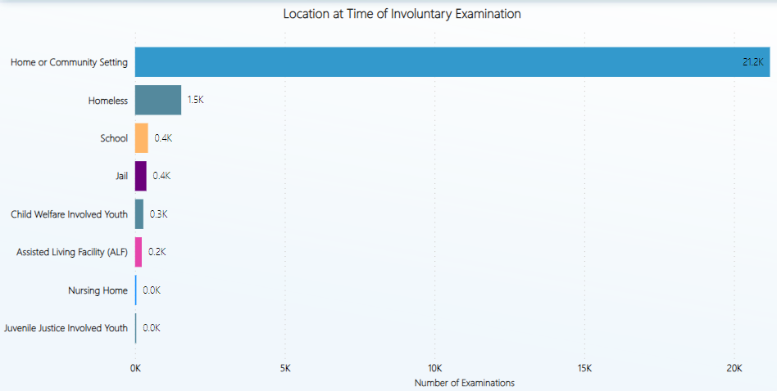
Involuntary Examinations in Northeast Florida
July 1, 2022 – June 30, 2023
Notes:
At the time of the baker act most people are at home or in the community setting. Approximately 1500 people are experiencing homelessness. Around 400 at in school and another 400 are in jail. 300 youth are involved in the child welfare system. And about 200 are in an assisted living facility.

Slide 14
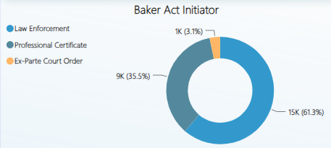
Involuntary Examinations in Northeast Florida
July 1, 2022 – June 30, 2023
Notes:
61.3% of Baker Acts are initiated by law enforcement
35.5% are initiated by a health professional
And
3.1% are court ordered

Slide 15
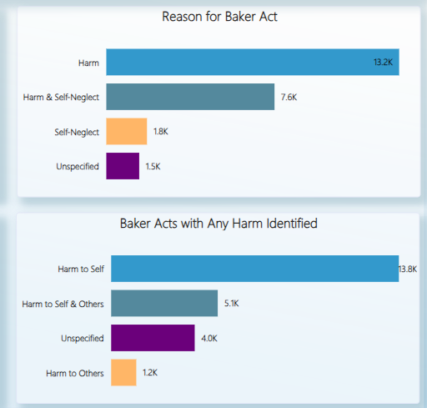
Involuntary Examinations in Northeast Florida
July 1, 2022 – June 30, 2023
Notes:
In around 13 thousand cases harm was the reason for the baker act
Harm and self neglect was the reason for nearly 8 thousand baker acts in northeast florida
Self neglect alone was identified in nearly 2000 baker acts
------
Where harm was identified – harm to self was the contributing factor for nearly 14K cases
Whereas harm to self and others was the reason for 5 thousand baker acts
In 1200 cases, harm to others was identified as a reason for the baker act

Slide 16
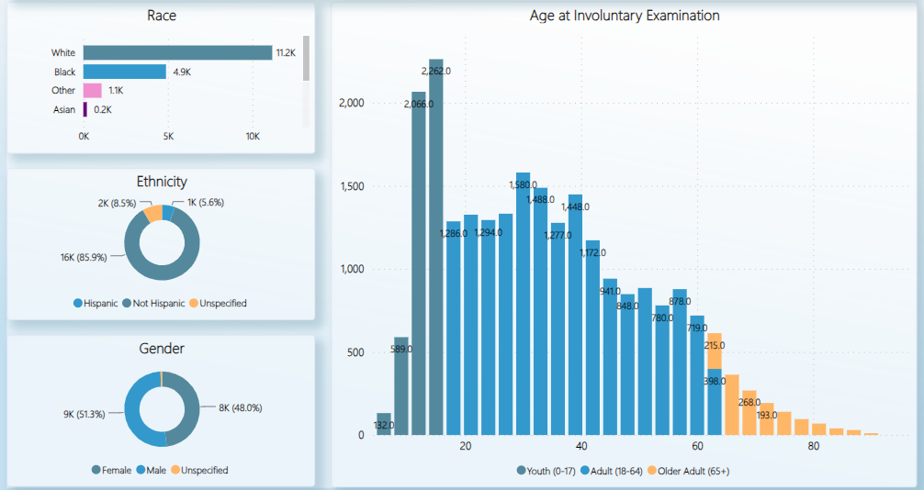
Involuntary Examinations in Northeast Florida
July 1, 2022 – June 30, 2023
Notes:
When examining the demographics of those who have experienced a baker act, we find that around 64% are white, 28% are Black, and around 1% are Asian.
5.6% are Hispanic,
51.3% are make and 48% are female
Youth ages 12-17 are experiencing the highest number of baker acts & among this age group around 7& are Hispanic, and around 60% are female.
Among adults – the 30-32 year olds have the highest number of baker acts

Slide 17
Repeat Examinations in Northeast Florida
July 1, 2022 – June 30, 2023
Repeat Examinations
42.3%
High Utilizers
9%
Median Days Between Repeat Examination
76 days
Notes:
In northeast Florida 42.3% of individuals have multiple baker acts
9% of individuals are high utilizers
And there are about 76 days in between repeat examinations

Slide 18
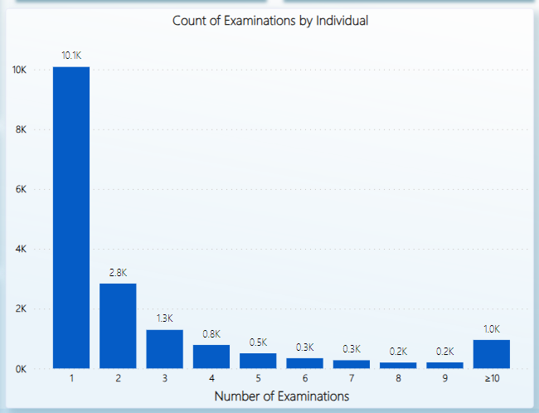
Repeat Examinations in Northeast Florida
July 1, 2022 – June 30, 2023
Most individuals have one (10.1K) repeat examination.
2.8K individuals have two repeat examinations.
Notes:
Most individuals have one (10.1K) repeat examination.
2.8K individuals have two repeat examinations.

Slide 19
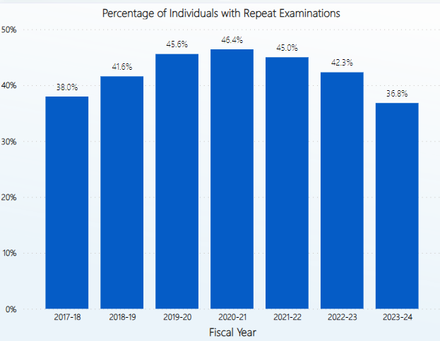
Repeat Examinations in Northeast Florida
FY 17-18 through FY 23-24
Repeat examinations peaked in FY20-21 and have since decreased.
Keep in mind that FY23-24 is provisional and incomplete.
Notes:
Repeat examinations peaked in FY20-21 and have since decreased.
Keep in mind that FY23-24 is provisional and incomplete.

Slide 20
Notes:
https://solutions.crediblemind.com/a-2-pronged-approach-to-community-wide-mental-health-support/

Slide 21
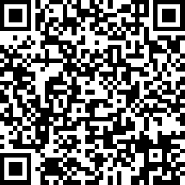
Resource Directory

Slide 22
Florida Youth Substance Abuse Survey
(FYSAS)
Data is collected at the county, regional, and state levels on even years
& at the state level only on odd years
Regional data years included: 2018-2022
State data years included: 2018-2023
*2024 is a new county-level release year
Data will be shared when available
Notes:
I know we heard from our FYSAS expert today but I did want to share some of the ACEs data since CCA coordinates a workgroup that addresses this topic.

Slide 23
Regional Adverse Childhood Events (ACES)
*Only collected for high school, Ages 15-17
(FYSAS, 2022)
Notes:
Adverse Childhood Experiences (ACEs) are defined as potentially traumatic events that occur in childhood. ACEs can include violence, abuse, and growing up in a family with mental health or substance use problems.
Positive Childhood Experiences (PCEs) are defined as childhood experiences which stem from safe, stable, nurturing relationships and environments, and have the power to prevent or protect children from traumatic events, toxic stress, or Adverse Childhood Experiences (ACEs).
This data was only collected among high school students
When compared to the state, our region has a higher percentage of students reporting ACEs in all categories with the most common being divorce or separation, mental illness in the household, and emotional neglect

Slide 24
Regional Bullying
(FYSAS, 2022)
Notes:
Bullying although it is not a part of the original ACE study it is a potentially traumatic experience
This data shows that bullying is more commonly reported among middle school students
For all age group being taunted or teased is most common
In middle school being kicked or shoved is second most common
In high school, being a victim of cyber bullying is second most common

Slide 25
Regional Positive Childhood Experiences (PCES)
The northeast region reports lower protective factor prevalence when it comes to school opportunities and rewards for prosocial involvement, but has comparable rates of opportunities for family, peer, and individual prosocial involvement.
Other student reports of protective factors in the northeast region of Florida:
37.5% of students reported being in school sports
30.6% of students reported being in organized sports outside of school
9.7% of students reported being in the school band
25.2% reported being in school clubs
10.7% reported being in community clubs
(FYSAS, 2022)
Notes:
The FYSAS measures PCEs through measuring opportunities and rewards for prosocial involvement
The northeast region reports lower protective factor prevalence when it comes to school opportunities and rewards for prosocial involvement, but has comparable rates of opportunities for family, peer, and individual prosocial involvement.
It is good that we see over 30% of students involved in sports activities and a quarter of students are involved in school clubs

Slide 26
Join our
Northeast Florida ACE Alliance (NFAA)
PACES Community
Review the website below for resources:
www.pacesconnection.com
Please join our PACEs blog
We would love to share your work on this site!
NFAA PACEs Connection
Next meeting is April 5th at 10am
Share with your community partners
This flyer is available today!
Notes:
CCA coordinates a bi-monthly workgroup meeting where We would love to invite you to join this collaborative workgroup. In this meeting we are going to collaboratively develop an educational curriculum that can help communities become more PACEs informed. We also offer opportunities for continuing education and training which can help us become trauma informed leaders.
In the months where the workgroup is not meeting, CCA is going to offer opportunities for continuing education on resilience and other topics. We also learn about positive and adverse childhood experiences through data share outs.
This is our flyer and we would like to ask for you to take some from the table to share with your local community partners
Our next meeting is April 5th at 10am

Slide 27
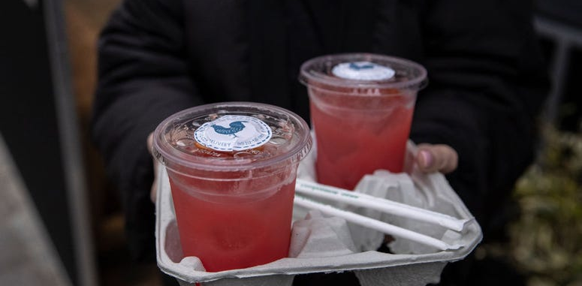
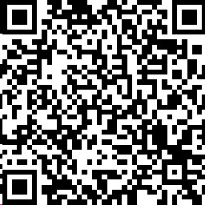
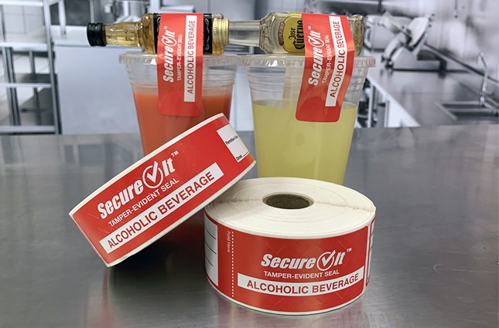
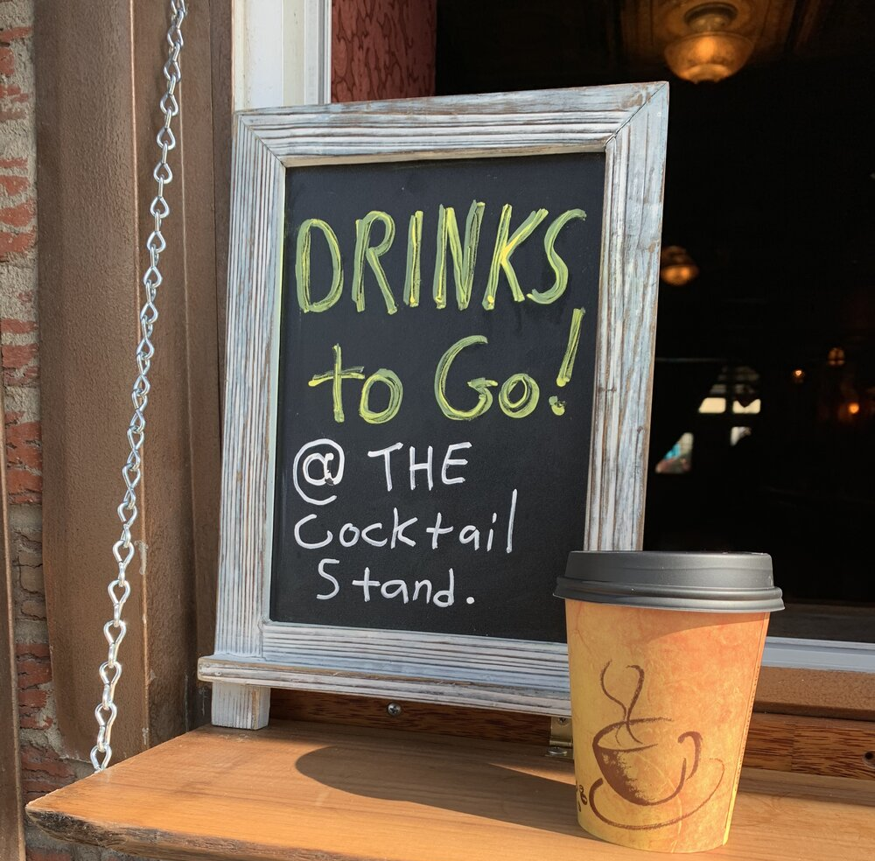
To-Go Drinks
Notes:
Jacksonville City Council will strengthen the required safety procedures and education for to-go drink policy in Health Zone 2 by collaborating with JSO through regular compliance checks per quarter to hold restaurants accountable for adhering to the law to reduce public intoxication, DUIs and underage drinking.

Slide 28
2022
Case Disposition | # of Disposition Type | Percentage
Official Notice | 87 | 66%
Compliance | 43 | 33%
Pending Admin Action | 1 | 0.5%
Admin Stipulation | 1 | 0.5%
Total | 132
13% of compliance checks were completed in the Jacksonville region.
Official Notice: 45%
Remaining did not follow policy resulting in 100% noncompliance.
2023
Case Disposition | # of Disposition Type | Percentage
Official Notice | 27 | 66%
Compliance | 14 | 34%
Pending Admin Action | 0 | 0%
Admin Stipulation | 0 | 0%
Total | 41
Notes:
In February 2022, the bureau of Law Enforcement initiated a “Drinks to Go” Operation to ensure licensed establishments complied with the language of the new law.
The operation required specific offices around the state to initiate an operation and visit applicable establishment to determine if they were complying with the paraments set forth within the law. The goal was to provide guidance and education to those establishments who were found to be out of compliance.
Establishments where the only violation was that they did not sell food during the same order were marked as in compliance even though this is a component of the law.

Slide 29
-Ordered to-go at end of meal
-Not sealed but it was in a plastic bag
-No attached receipt
-Ordered to-go at end of meal
-Sealed
-No bag
-No attached receipt
-Ordered to-go at end of meal
-Brought glass & empty cup
-No bag
-Receipt was electronic & did not ask to print it
-Ordered to-go at end of meal
-Not sealed but in a plastic bag
-Offered to print credit card receipt (does not show sale of food)
Notes:
Senate Bill 148 amended Florida Statute 561.20(2)(a)4, F.S., which authorized public food service establishments that have a specialty alcoholic beverage license for consumption on premises, to sell manufacturer-sealed containers of wine, malt beverages, or any alcoholic beverage drink prepared by the vendor. This included any wine-based and liquor-based drinks, sold in containers and sealed by the licensee or employees for consumption off of the licensed premises.

Slide 30
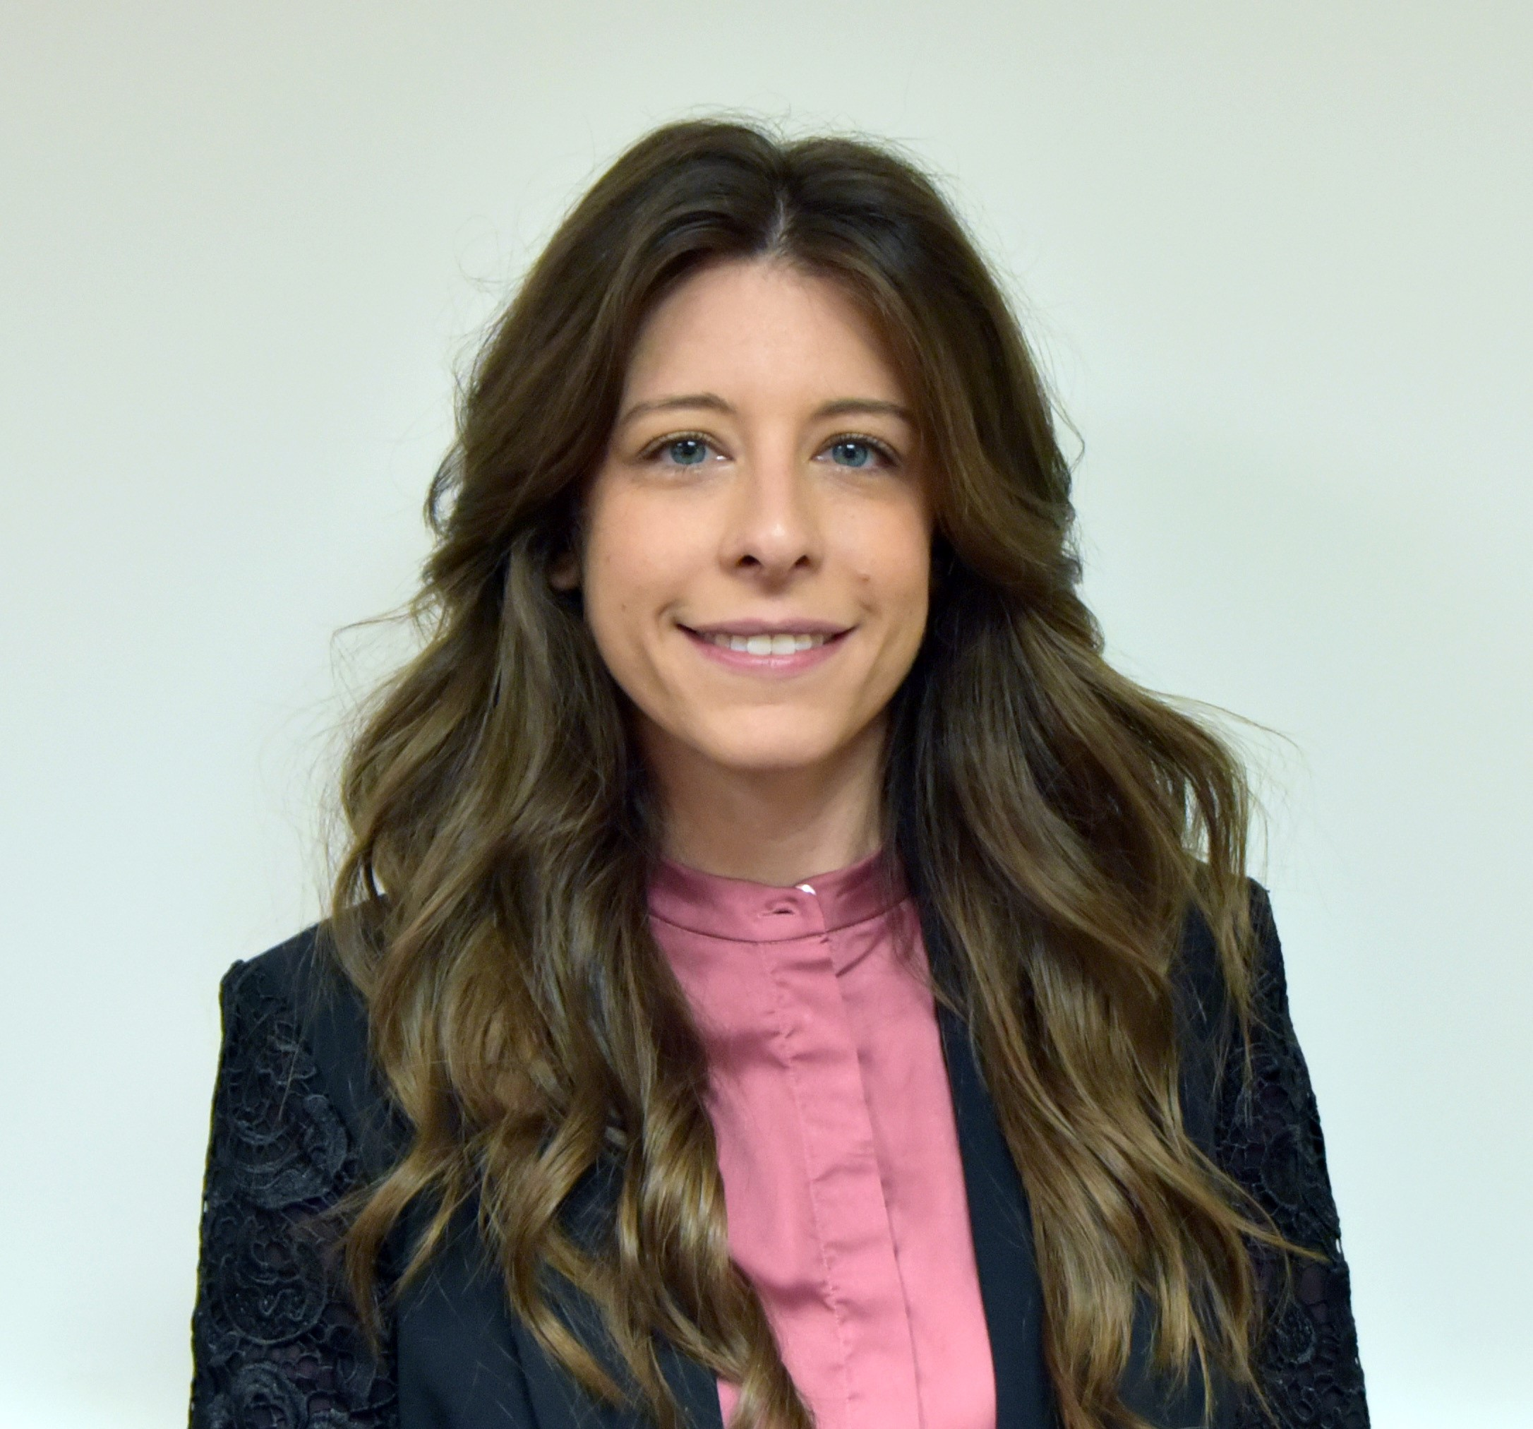
We are here to support you!
Vanessa Salmo, MPH
Epidemiology & Evaluation Director
Community Coalition Alliance, Inc.
vsalmo@ccafl.org
Notes:
Thank you so much for your time, If you have any questions I am happy to answer them today and if you would like to brainstorm about community data or evaluation please reach out to me anytime!

