Slide 1

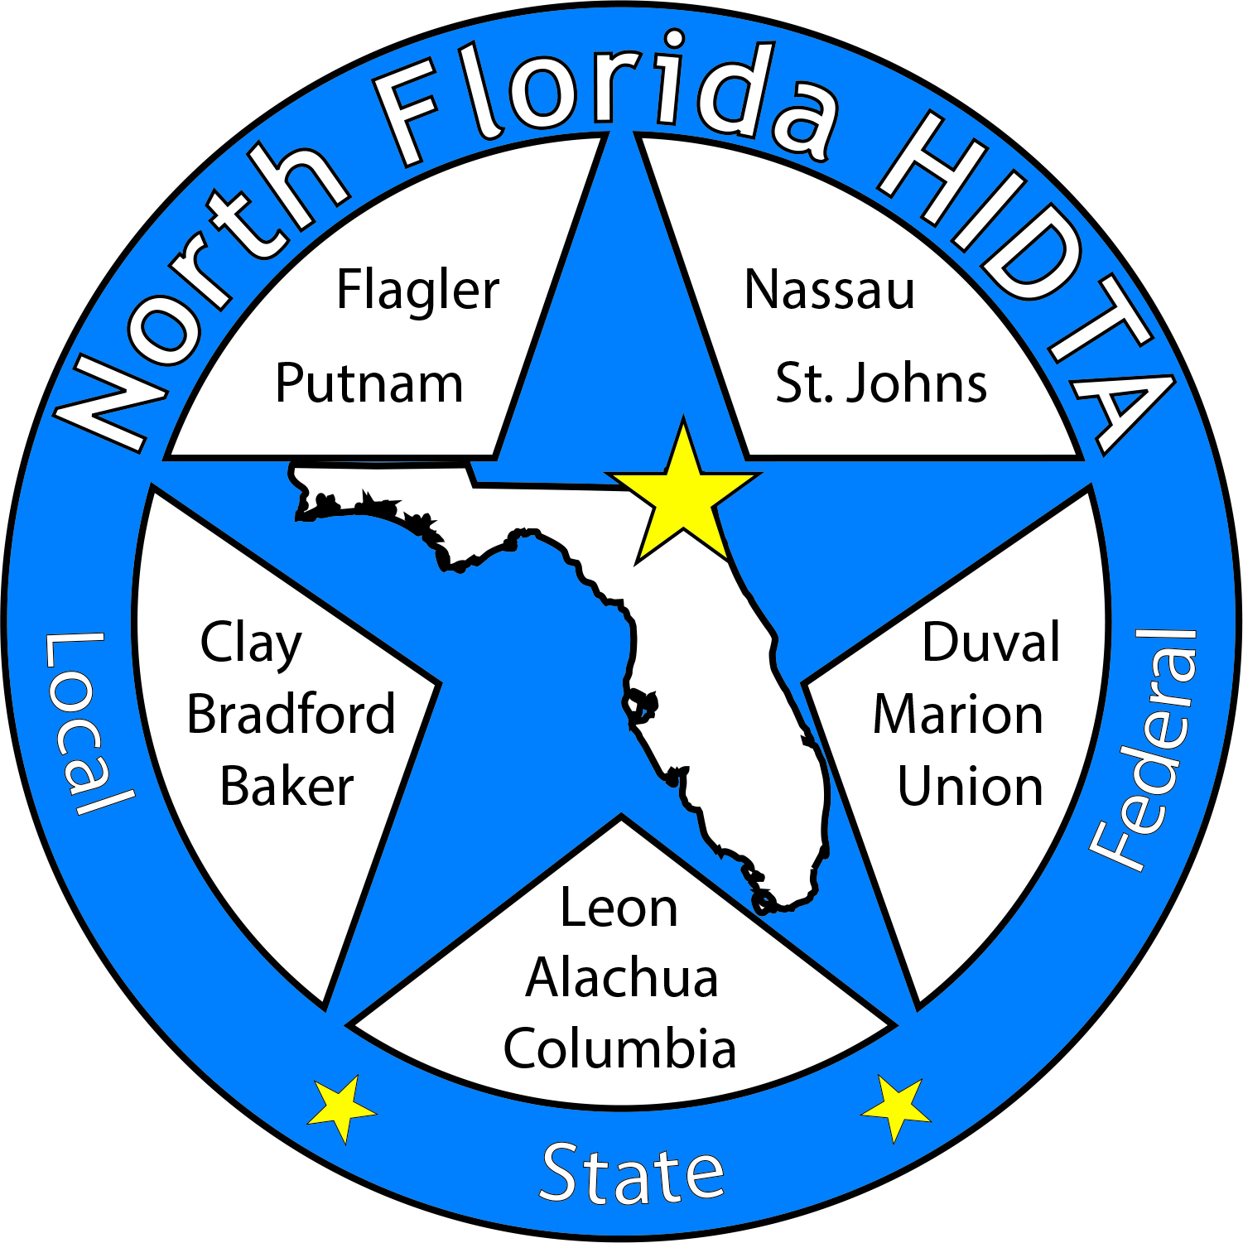
Duval DEN
January 24, 2024

Slide 2
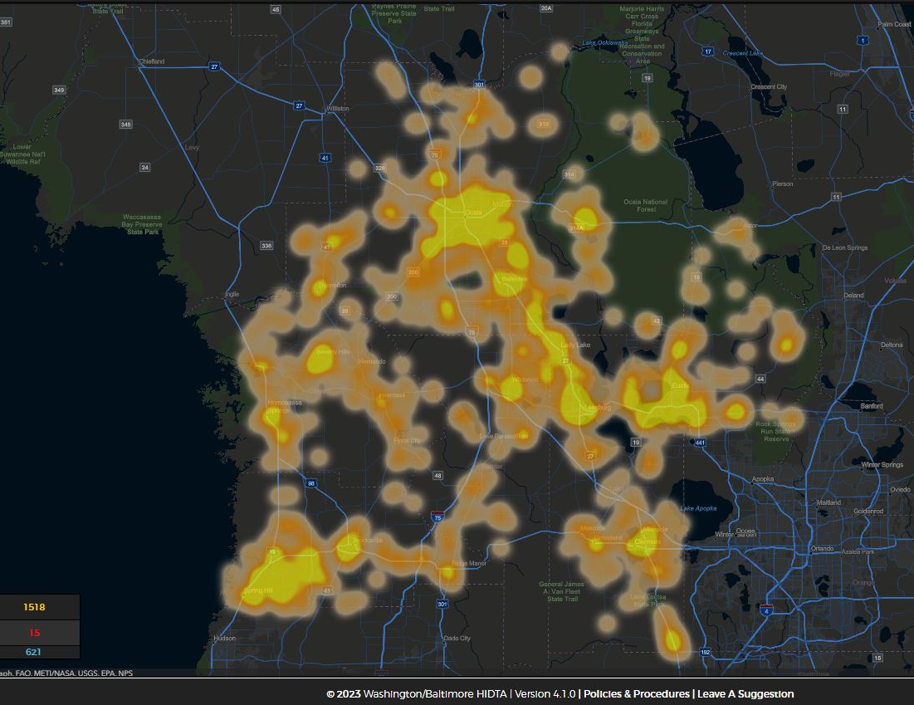
Today’s Focus
Welcome & Introductions
Data & Information Shares
Subcommittees
Open Discussion

Slide 3

Membership – Circuit 4 Partners

Slide 4

DEN Meetings
January – In Person
February – Virtual
March – RDEN
April – Virtual
May – In Person

Slide 5

DATA & INFORMATION SHARES

Slide 6

April 27, 2024

Slide 7


Thank You For Attending
Advocacy Day 2024

Slide 8
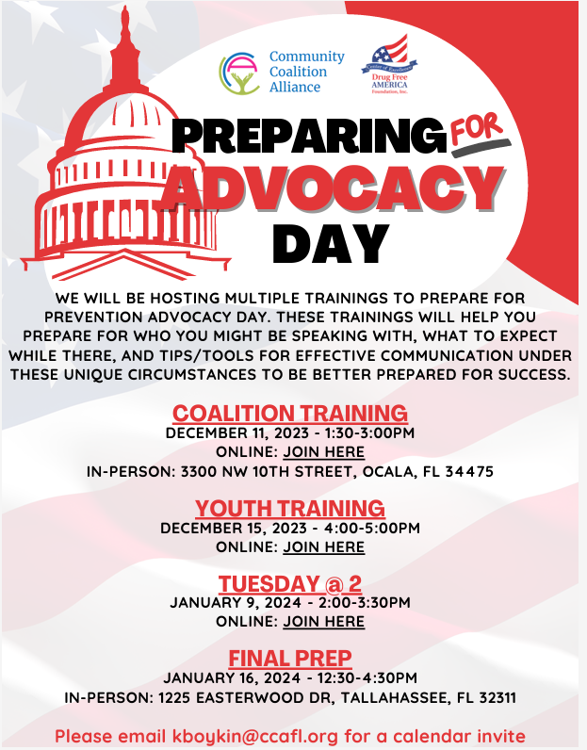
Timeline
8
Prep Trainings
Initial Planning – 9.26.23
Adult training – 11.11.23
Youth Training - 12.15.23
Tuesday@2 - 1.9.23
Final - 1.16.23 (in person)
Individual trainings can be requested: lholley@ccafl.org
January 16, 2023
Attend meeting to receive packets, group assignments, and t-shirts.
Attend training to coordinate with your group and discuss topics.
Reception 5:30pm-7:30pm (The Edison: 470 Suwannee Street)).
January 17, 2023
Building opens at 8am.
Group picture in rotunda at 8:15 AM
Press Conference with Senator Harrell
Appointments and drop offs
Input Survey – Focus Area

Slide 9
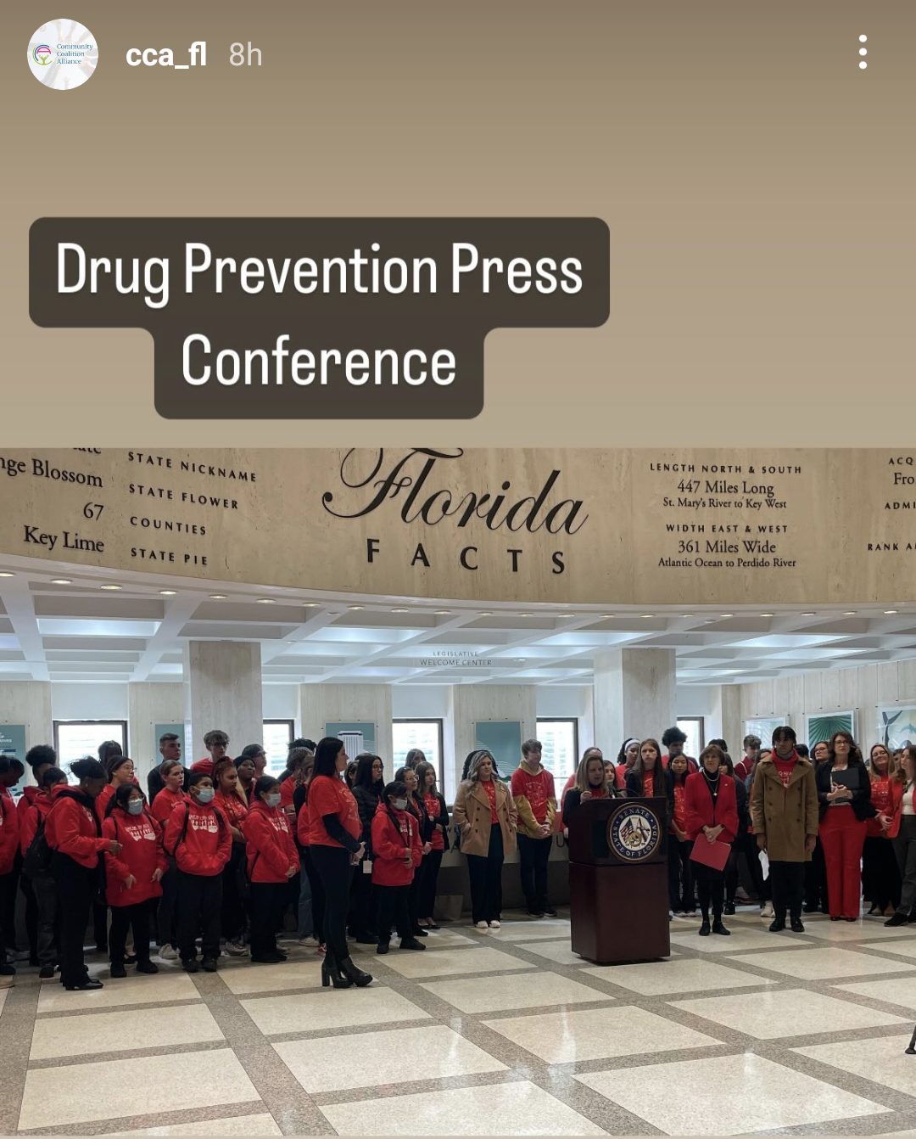
Press Conference
Senator Harrel
Amy Ronshausen DFAF
Kathleen Roberts CCA
Caleb Curry Hamilton Youth
  – Hamilton Prevention Coalition
Ashley Neal - FASA

Slide 10


Slide 11

Most YOUTH Submissions!

Slide 12


Slide 13


Slide 14


Slide 15



Slide 16
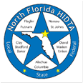

Deborah Babin
&
Scott Delano

Slide 17

ORS Team Updates
January DEN Meeting
January 24, 2024
Notes:
Lindsey

Slide 18
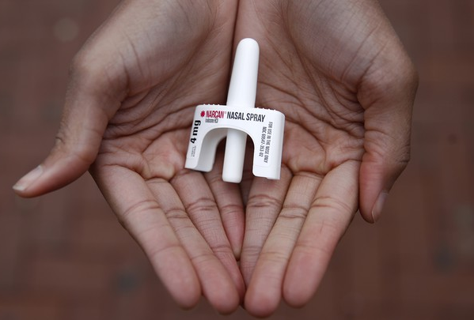

Laura Viafora Ray - JFRD

Slide 19

Overdose Data Surveillance & Trends in Jacksonville

Slide 20

Jacksonville Fire & Rescue Department Overdose Data
Data Source
  Jacksonville Fire & Rescue Department, City of Jacksonville, Florida
  Captain Michael Bernard - Office of Information Services (with additional analysis and chart/graph development by Laura Viafora Ray, MPH, CPH, Program Coordinator - Opioid Abatement)
Definitions
  Dispatched as Overdose = a 9-1-1 call in which the caller stated that the victim was suffering from a known or suspected overdose
  Naloxone Administered = the count of naloxone administered, which may include repeat doses to same patient
  Opioid-Related Overdose (known or suspected) = the following conditions existed: naloxone administered and nature of call at scene is “ingestion/poisoning/OD,” OR naloxone administered and clinical impression is “opioid-related,” OR overdose reported with the following substances: “Fentanyl, Carfentanil or Heroin,” OR overdose reported with naloxone administration, OR treatment protocol = “Overdose-Narcotic/Opioid”
    This query was updated in October 2023; ‘New Query’ is identical to ‘Old Query’ plus treatment protocol = “Overdose-Narcotic/Opioid”
  Bystander Narcan Use Prior to Arrival of JFRD = the following conditions existed: “Suspected Drug Overdose” = Yes AND “Opioid Antagonists Administered (PTA JFRD) = Nasal Naloxone/Narcan, OR narrative search for key terms “nasal” and “Narcan” and “naloxone” with a review of the narrative to ensure the incident applies to the intended definition and removal of duplicates so the same incident is not counted twice
Additional Notes
  A 911 call received as overdose and/or naloxone administration does not necessarily confirm an overdose, opioid use, or opioid misuse
  Each of the definitions and events listed above are independent of the other and are not mutually exclusive
Notes:
Notes:
The query for “Opioid-Related Overdose was amended in October of 2023 to also include incidents in which the protocol chosen was “Overdose-Narcotic/Opioid” and this slide reflects the updated definition that corresponds to the updated query. The query had been previously amended in April 2021.
“Naloxone Doses Administered”:
-On a DENs call several months ago, we were discussing the measures "Number of Opioid-Related Overdoses" and "Naloxone Doses Given" over time and as a ratio of calls to doses to see if that could be any indication of the potency of street drugs in a given time frame. I had an opportunity to discuss this with Mark in detail, so I wanted to share some takeaways from that conversation:
-JFRD's protocol for dosage of naloxone has changed multiple times over the years, and it depends on patient factors. For example, a patient experiencing cardiac arrest will be given 2 mg dose of naloxone at a minimum, compared to a range of 0.4 mg to 1.0 mg for a patient not experiencing cardiac arrest.
-Two doses of nasal Narcan will always equal 8 mg, because each plunger contains 4 mg, but two doses of IV naloxone given by JFRD will vary depending on the protocol at the time of the overdose incident and patient factors. In other words, there is not a standard "dose" of naloxone for the purposes of that data point.
-The EMT/firefighter's goal when giving a patient naloxone is for the patient to begin breathing, not necessarily regain consciousness. This is considered compassionate care because giving too high of a dose of naloxone will cause the patient to experience worse withdrawal symptoms. When a community member is giving Narcan, their goal is for the person to wake up, even if this means giving a much higher dose.
-The bad news is that due to these factors, these data points cannot be used to make any assessment about potency of street drugs. The good news is at least we have more clarification about this data and its limitations, so we won't make erroneous conclusions.

Slide 21
# of Suspected Opioid-Related (O-R)
Overdose (OD) Patients By Year
 | 2019-2020 | 2020-2021 | 2021-2022 | 2022-2023
% Change | +24% | +2% | -14% | -14%

Slide 22
Suspected Opioid-Related (O-R) Overdose (OD) Patients by Incident Zip Code January 2023 - December 2023
Zip Code (Health Zone) | Count | % of O-R OD | Trend (Compared to Jan-Dec 2022)
32210 (Southwest) | 223 | 8% | 29% Decrease
32218 (Outer Rim) | 206 | 8% | 32% Decrease
32244 (Southwest) | 153 | 6% | 32% Decrease
32208 (Urban Core) | 147 | 6% | 9% Increase
32207 (Arlington) | 140 | 5% | No Change
32209 (Urban Core) | 139 | 5% | 16% Decrease
32254 (Urban Core) | 139 | 5% | 21% Decrease
32205 (Southwest) | 132 | 5% | 21% Increase
32211 (Arlington) | 130 | 5% | 10% Decrease
32216 (Arlington) | 126 | 5% | 4% Increase
TOTAL (Top 10) | 1,535 | 58%
TOTAL (Other 25 Zips) | 1,127 | 42%
TOTAL (All 35 Zips) | 2,662 | 100%
Notes:
-Updated through December 2023

Slide 23
Suspected Opioid-Related (O-R) Overdose (OD) Patients by Incident Zip Code January 2023 - December 2023
Top 10 Zip Codes | Count | Population Size | Rate per 1,000 pop.
32202 (Urban Core) | 89 | 6,544 | 13.60
32254 (Urban Core) | 139 | 14,545 | 9.56
32204 (Urban Core) | 53 | 8,673 | 6.11
32205 (Southwest) | 132 | 29,605 | 4.46
32208 (Urban Core) | 147 | 33,286 | 4.42
32206 (Urban Core) | 78 | 18,283 | 4.27
32220 (Outer Rim) | 51 | 13,037 | 3.91
32207 (Arlington) | 140 | 36,207 | 3.87
32211 (Arlington) | 130 | 34,168 | 3.80
32219 (Outer Rim) | 55 | 14,474 | 3.80
32209 (Urban Core) | 139 | 36,656 | 3.79
TOTAL (Top 11) | 1,014
TOTAL (Other 24 Zips) | 1,648
TOTAL (All 35 Zips) | 2,662
Zip codes highlighted in orange appear on both lists: Top 10 for Count and Top 11 for Rate
Notes:
-Updated through December 2023
-Zip codes highlighted in orange = both in the top 10 for count and the top 11 for rate per 1,000 (due to their being a tie for 9th place)
-Population size data source: Decennial Census (2020)

Slide 24
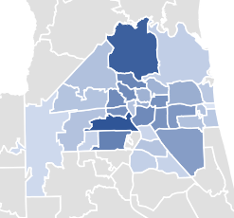
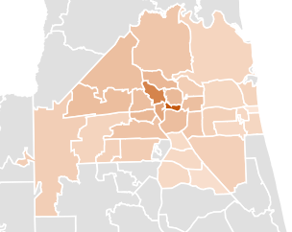
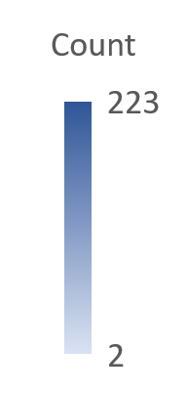
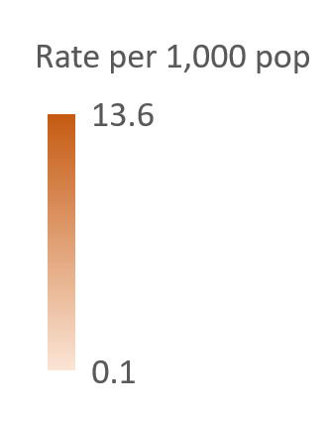
Opioid-Related Overdoses by Count and Rate
January 2023 - December 2023

Slide 25
% of Suspected Opioid-Related (O-R) Overdose (OD) Patients
Race/Year | 2014 | 2015 | 2016 | 2017 | 2018 | 2019 | 2020 | 2021 | 2022 | 2023
Black or African American | 8% | 8% | 10% | 9% | 10% | 11% | 14% | 18% | 21% | 23%
Hispanic or Latino | 2% | 2% | 2% | 3% | 4% | 3% | 4% | 3% | 5% | 6%
Other/ Unknown | 2% | 3% | 2% | 4% | 4% | 4% | 3% | 4% | 2% | 2%
White | 88% | 87% | 86% | 84% | 82% | 82% | 79% | 75% | 72% | 69%
% of Suspected Opioid-Related (O-R) Overdose (OD) Patients
Gender/Year | 2014 | 2015 | 2016 | 2017 | 2018 | 2019 | 2020 | 2021 | 2022 | 2023
Male | 53% | 55% | 64% | 62% | 61% | 64% | 66% | 68% | 66% | 66%
Female | 47% | 45% | 36% | 38% | 39% | 36% | 34% | 32% | 34% | 34%
Old Query | New Query
Notes:
-Updated through October 2023

Slide 26
% of Suspected Opioid-Related (O-R) Overdose (OD) Patients
Age Range | 2014 | 2015 | 2016 | 2017 | 2018 | 2019 | 2020 | 2021 | 2022 | 2023
19 or younger | 6% | 2% | 2% | 2% | 2% | 1% | 1% | 1% | 2% | 2%
20-29 | 26% | 30% | 30% | 26% | 26% | 21% | 20% | 15% | 14% | 13%
30-39 | 23% | 27% | 33% | 36% | 37% | 35% | 35% | 36% | 32% | 32%
40-49 | 18% | 17% | 17% | 18% | 17% | 22% | 21% | 23% | 24% | 25%
50-59 | 17% | 15% | 12% | 12% | 11% | 12% | 13% | 14% | 15% | 15%
60-69 | 6% | 6% | 5% | 5% | 5% | 6% | 7% | 9% | 10% | 10%
70 or older | 3% | 2% | 1% | 1% | 2% | 2% | 2% | 2% | 3% | 3%
Some years add up to 99% or 101% due to rounding
Old Query | New Query
Notes:
-Updated through october 2023

Slide 27
December 2023 Snapshot
189 opioid-related overdose patients across 186 opioid-related incidents
  4% decrease compared to November 2023
  21% decrease compared to December 2022
Top zip code - 32209
  18 patients (10%)
68% male; 32% female
60% white; 29% black/AA; 7% Hispanic; 4% other
30% between ages 30-39
67% residence; 12% roadway; 10% business or hotel; 11% other

Slide 28
Bystander Narcan Use Prior to Arrival (PTA) of JFRD
 | 2019-2020 | 2020-2021 | 2021-2022 | 2022-2023
% Change in Opioid-Related OD Calls | +24% | +2% | -14% | -14%
% Change in Use of NARCAN PTA by Bystanders | +59% | +79% | +5% | +23%
Notes:
Notes:
-Narcan nasal spray was first FDA approved in November 2015, but the first report of Narcan use PTA JFRD was not until 2017.

Slide 29

Contact Me
Laura Viafora Ray, MPH, CPH
Program Coordinator - Opioid Abatement
Office: (904) 255-7730
Cell: (904) 575-0495
Email: lvray@coj.net
Connect on LinkedIn

Slide 30
COJ Opioid Abatement Program Update

Slide 31
Opioid Abatement Update
Tentatively awarded agencies announced on January 22
  24 programs across 19 agencies
  $6.2 million
FY 2024-2025 grant cycle to begin in April
Programs operating in Duval County for residents of Duval County related to opioid use disorder
Distro list

Slide 32

Opioid Abatement Program Staff

Slide 33
DEN Projects
Settlement Funds

Slide 34




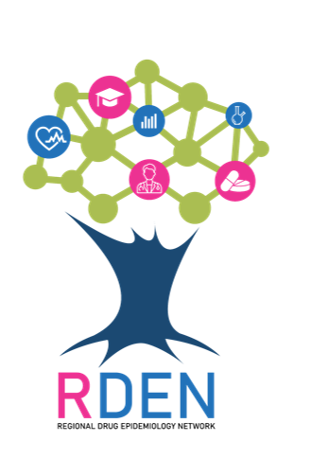

Slide 35





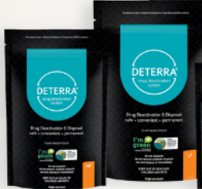

Messaging
With CEUs
Community
Resources

Slide 36
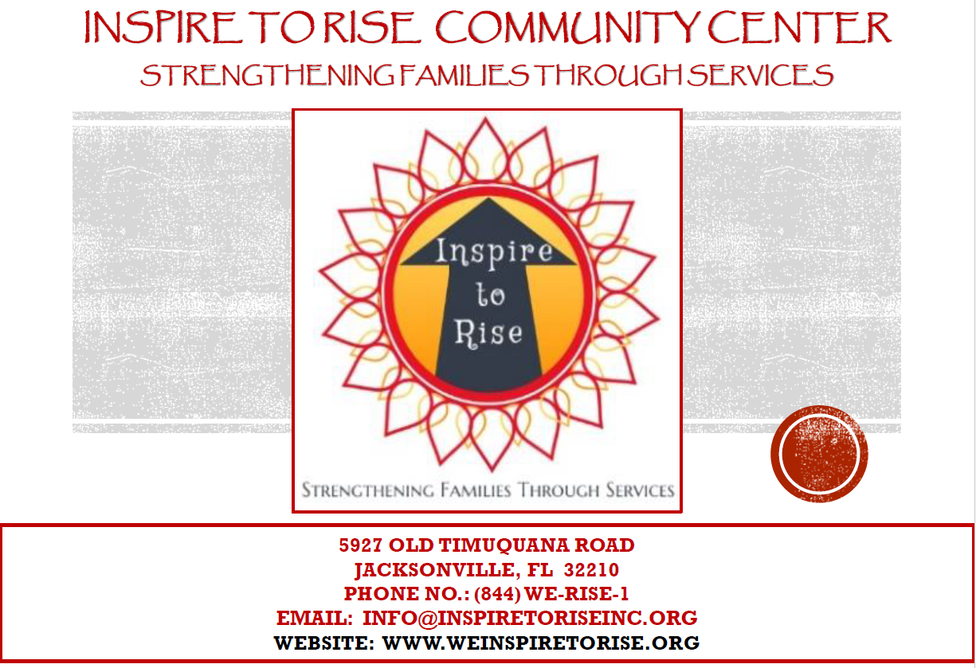
Aida Seeraj

Slide 37
Kelsey Spangle
Department of Health
Duval

Slide 38

Florida Department of Health
OD2A Surveillance
Kelsey Spangle, MS, MPH, CPH
Epidemiologist

Slide 39
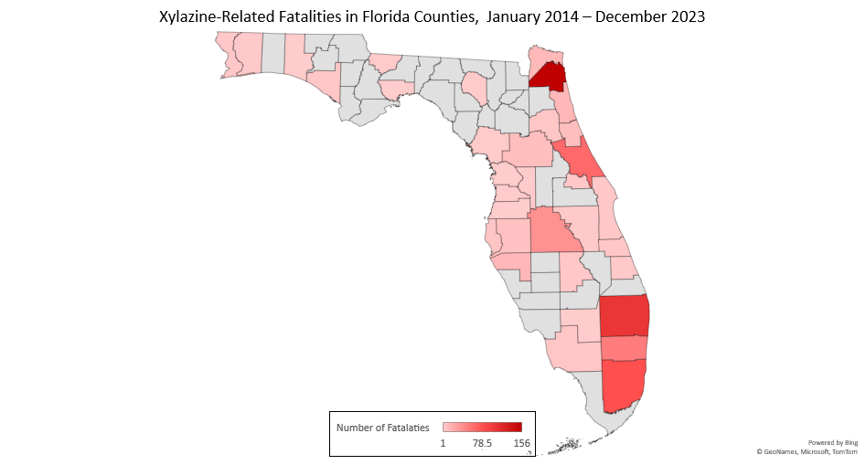
Xylazine Fatalities
LEE
MIAMI-DADE
Duval: 156
DUVAL
CLAY
ST. JOHNS
LEE
MIAMI-DADE
Volusia: 63
DUVAL
PALM BEACH
CLAY
NASSAU
POLK
PALM BEACH
DUVAL
MIAMI-DADE
VOLUSIA
Palm Beach: 104
POLK
Lee: 55
DUVAL
Broward: 51
PALM BEACH
LEE
Miami-Dade: 79
MIAMI-DADE
VOLUSIA
DUVAL
MIAMI-DADE
PALM BEACH
BROWARD
VOLUSIA
Data Source: ESSENCE-Florida
Notes:
The death records data from ESSENCE provided xylazine as identified in the initial literal cause of death. The map demonstrates count data for xylazine fatalities in counties across the state of Florida from January 2014 through December 2023. The death record data in the year 2023 is highly provisional and subject to change, due to the nature of time it takes to investigate deaths and finalize the documentation for cause of death. The more xylazine fatalities, the darker red the counties are.
The graph to the right shows the top xylazine fatalities by county year over year. In 2014, there was one fatality in Lee county. There is no data shown for any fatalities from 2015 through 2017.
There was one fatality in Miami-Dade county in 2018.
In the remaining years, the data is shown for the five most frequent xylazine fatalities by county.

Slide 40
Demographics of Xylazine Fatalities
Race | 2014 | 2018 | 2019 | 2020 | 2021 | 2022 | 2023 | Grand Total
White |  | 1 | 18 | 72 | 151 | 225 | 242 | 709
Black |  |  | 2 | 11 | 25 | 36 | 30 | 104
American Indian | 1 |  |  |  |  |  |  | 1
Asian Indian |  |  |  |  |  |  | 1 | 1
Chinese |  |  |  |  |  | 1 |  | 1
Korean |  |  |  |  |  | 1 | 1 | 2
Vietnamese |  |  |  |  |  |  | 1 | 1
More than One Race |  |  |  |  | 1 | 2 | 1 | 4
Other Races |  |  |  |  | 1 | 2 | 2 | 5
Grand Total | 1 | 1 | 20 | 83 | 179 | 269 | 278 | 831
Data Source: ESSENCE-Florida
Notes:
This table provides a breakdown of demographics of xylazine fatalities from January 2014 through December 2023. People of white race had the highest number of xylazine fatalities with Black/African Americans with the second highest number of fatalities. There was one fatality for American Indian, Asian Indian, Chinese, and Vietnamese. There was two deaths for Koreans. There were four deaths for more than one race and there were five deaths for other races.

Slide 41
Demographics of Xylazine Fatalities
Data Source: ESSENCE-Florida
Notes:
From here, the data shown in the previous table is provided in graph format to visualize the trends of xylazine fatalities by race from January 2014 through December 2023. These graphs also provide the data points in a table just below the graph itself. Whites demonstrate an increase of xylazine fatalities year over year with 242 deaths in 2023, up from 224 in 2022.
Blacks/African Americans demonstrated increasing numbers of xylazine fatalities from 2019 (2) through 2022 (36), but had a slightly lower number of fatalities in 2023 (30).

Slide 42
Demographics of Xylazine Fatalities
Data Source: ESSENCE-Florida

Slide 43
Xylazine Fatalities
Data Source: CDC Morbidity and Mortality Weekly Report (MMWR); ESSENCE-Florida
Notes:
For the national data, SUDORS cases that had xylazine listed as a contributing cause of death by the medical examiner or coroner were defined as xylazine-involved. Thus, a xylazine-involved case would also be considered to be xylazine-positive by definition; however, a xylazine-positive case would not always mean that xylazine contributed to the death (i.e., xylazine-involved).
The death records data from ESSENCE provided xylazine as identified in the initial literal cause of death.
CDC National Data N = 531 (January 2019 – December 2019)
Florida N = 652 (January 2014 – June 2023)
Duval County N = 122 (January 2014 – June 2023)
Notes from the Field: Xylazine Detection and Involvement in Drug Overdose Deaths — United States, 2019 | MMWR (cdc.gov)

Slide 44
Xylazine Fatalities
Xylazine Co-occurring Drugs Listed as Cause of Death Comparing National, state of Florida, and Duval County
Drug | Duval Percent (2014 - 2023) | Florida Percent (2014 - 2023) | National Percent (2019)
Fentanyl | 99.3% | 98.9% | 99.1%
Cocaine | 39.3% | 34.0% | 29.6%
Methamphetamine | 34.3% | 23.9% | 11.7%
Opioid | 16.4% | 11.3% | 13.4%
Alcohol | 11.4% | 14.0% | 12.6%
Benzodiazepine | 11.4% | 9.5% | 19.8%
Heroin | 0.7% | 6.7% | 28.4%
Total Number of People | 122 | 652 | 531
Data Source: CDC Morbidity and Mortality Weekly Report (MMWR); ESSENCE-Florida

Slide 45
Drug Classification Key
Fentanyl | Cocaine | Methamphetamine | Alcohol | Prescription Opioids | Benzodiazepines | Heroin
Fentanyl | Cocaine | Methamphetamine | Alcohol | Oxycodone | Alprazolam | Heroin
Para-Fluorofentanyl |  |  | Ethanol | Oxymorphone | Flualprazolam
Fluorofentanyl |  |  |  | Hydrocodone | Temazepam
 |  |  |  | Buprenorphine | Clonazepam
 |  |  |  | Isotonitazene | Chlordiazepoxide
 |  |  |  | Tramadol | Nordiazepam
 |  |  |  | Morphine

Slide 46
Xylazine Fatalities
Data Source: ESSENCE-Florida

Slide 47
Xylazine Fatalities
Xylazine Co-occurring Drugs Listed as Cause of Death Comparing Northern Florida Counties Using Count Data
Drug | Duval | Clay | Nassau | St. Johns | Marion | Flagler | Baker | Columbia | Leon | Putnam | Alachua
Fentanyl | 139 | 19 | 12 | 11 | 9 | 6 | 2 | 2 | 2 | 2 | 1
Cocaine | 55 | 10 | 4 | 2 | 4 | 3 | 0 | 0 | 0 | 0 | 1
Methamphetamine | 48 | 7 | 4 | 2 | 3 | 1 | 0 | 0 | 1 | 1 | 0
Alcohol | 16 | 3 | 1 | 1 | 2 | 2 | 0 | 0 | 0 | 0 | 0
Opioid | 23 | 2 | 2 | 2 | 1 | 0 | 1 | 0 | 1 | 0 | 0
Benzodiazepine | 16 | 3 | 2 | 2 | 0 | 1 | 0 | 0 | 0 | 0 | 0
Heroin | 1 | 0 | 0 | 0 | 0 | 0 | 0 | 1 | 0 | 0 | 1
Total Number of People | 298 | 44 | 25 | 20 | 19 | 13 | 3 | 3 | 4 | 3 | 3
Data Source: ESSENCE-Florida

Slide 48
Xylazine Co-occurring Fatalities
Data Source: ESSENCE-Florida

Slide 49
Xylazine Fatalities
Data Source: ESSENCE-Florida

Slide 50
Xylazine Fatalities
Data Source: ESSENCE-Florida

Slide 51
Xylazine Fatalities
Data Source: ESSENCE-Florida

Slide 52
Naloxone Distribution Through Partners
Data Source: Self-reported from partner organizations

Slide 53
Fentanyl Test Strip Distribution Through Partners
Data Source: Self-reported from partner organizations

Slide 54

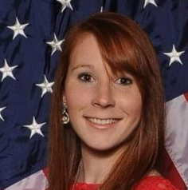
Learn More
 | Kelsey Spangle, MS, MPH, CPH Epidemiologist Florida Department of Health Kelsey.Spangle@flhealth.gov 904-253-1859

Slide 55
Maria Schedin
UNF
CCA University Consultant

Slide 56
Florida Youth Tobacco Survey (FYTS)
FYTS tracks indicators of tobacco use and exposure to secondhand smoke among Florida public middle and high school students and provides data for monitoring and evaluating tobacco use among youth.
In Florida, the FYTS data is collected at the state level each year, and it is collected at the county level every other year.
In 2023, state level data was collected.

Slide 57
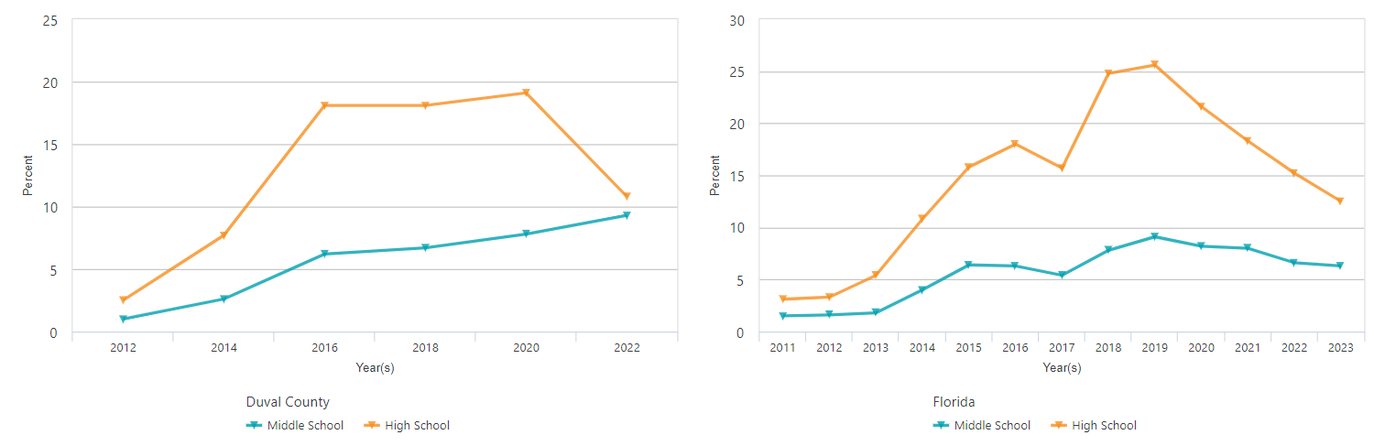
Students Who Have Used an Electronic Vapor Product in the Past 30 Days
In Duval and in Florida, high school (HS) students have decreased past 30-day use of vaping products.
In 2022, Duval middle school (MS) students saw increases while this indicator remained stable in 2023 for Florida MS.
Notes:
In Duval and in Florida, HS students have decreased past 30-day use of vaping products.
In 2022, Duval MS students saw increases while this indicator remained stable in 2023 for Florida MS.

Slide 58
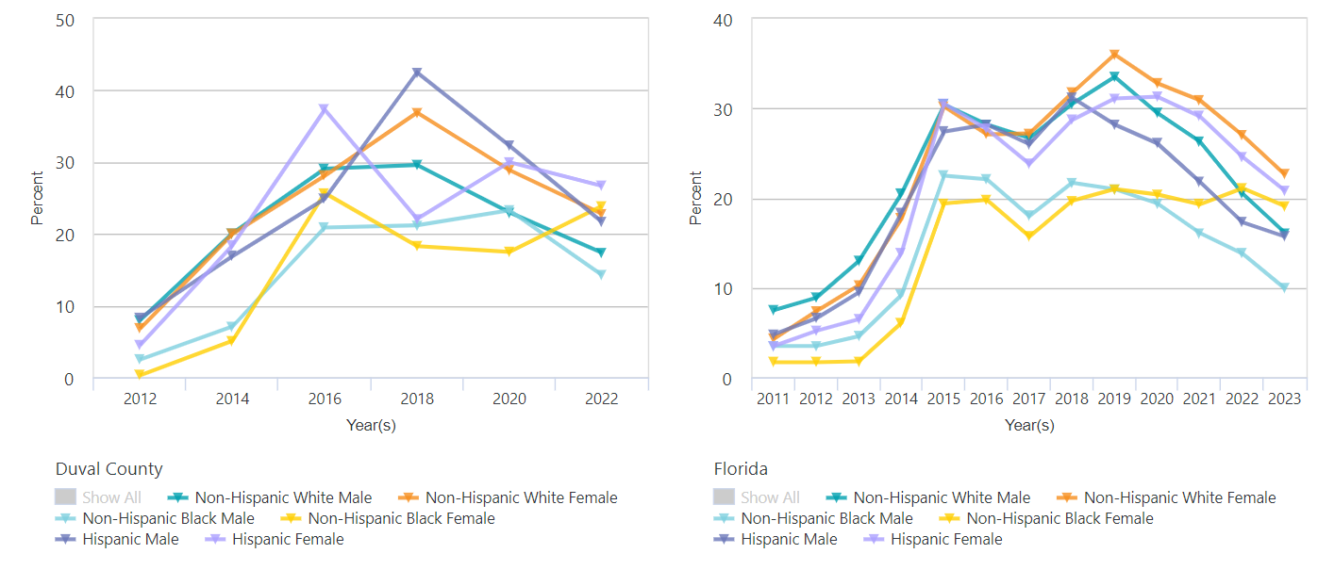
Students Who Have Ever Used an Electronic Vapor Product
Notes:
This slide is a little busy because it breaks down student use of lifetime vaping use by race/ethnicity/and sex.
I thought it was interesting that although most groups decreased vaping use, non-Hispanic black females had increases compared to 2020 in Duval and very little change in Florida overall.

Slide 59
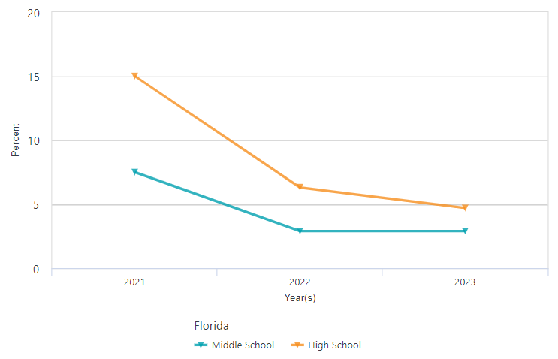
Students Who Have Used a Flavored Electronic Vapor Product in the Past 30 Days
In Florida in 2023 (3.9%), there has been a 7.9% decrease in past 30-day flavored electronic vapor product use by MS and HS students compared to 2021 (11.8%).
Notes:
Questions about flavored tobacco products were added to the survey in 2021 and were only asked at the county level in 2022.
In Florida in 2023 (3.9%), there has been a 7.9% decrease in Past 30-day Flavored Electronic Vapor Product use compared to 2021 (11.8%).
In 2022, 1.6% of MS and HS students reported past 30 day Flavored Electronic Vapor Product use
One interesting trend is that in Duval County, middle school students (1.8%) reported higher past 30 day Flavored Electronic Vapor Product use compared to HS students (1.8%) which is opposite of the Florida trends for school level and also different than most of the other vaping trends presented today.

Slide 60
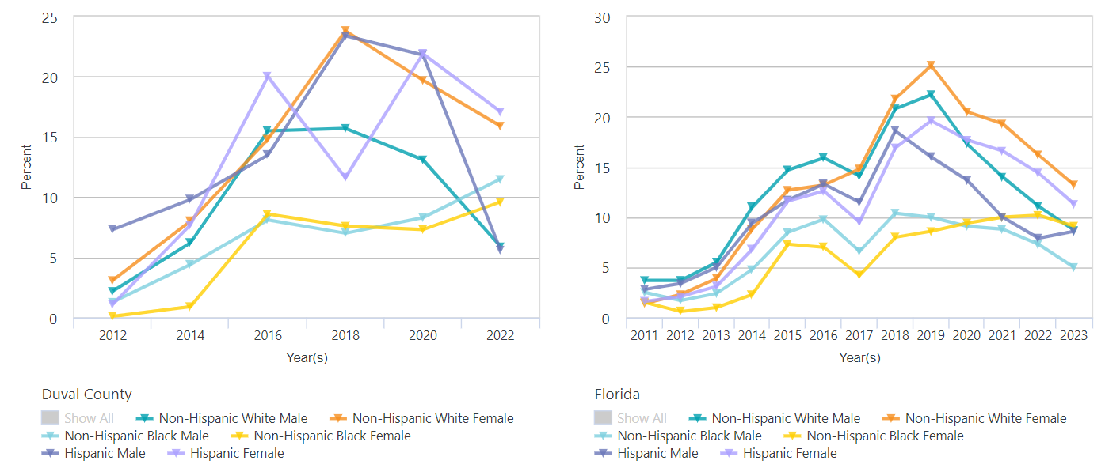
Students Who Have Used a Flavored Electronic Vapor Product in the Past 30 Days
Notes:
This is the same data from the previous slide broken down by race, ethnicity, and sex.
In Duval County, although non Hispanic black males and females don’t have the highest percents overall these groups have had increases whereas other groups have deceases.

Slide 61
Students Who Have Ever Used a Flavored Electronic Vapor Product
In Florida in 2023, MS students had very little change (-0.5%) whereas HS students saw a 3.9% decrease.
In Duval County in 2022, HS students (2.7%) reported higher lifetime use of Flavored Electronic Vapor Product use compared to MS students (2%).
Notes:
Lifetime use of Flavored Electronic Vapor Products has similar trends as past 30 days use.
In Duval County, HS students (2.7%) reported higher lifetime use of Flavored Electronic Vapor Product use compared to MS students (2%).

Slide 62
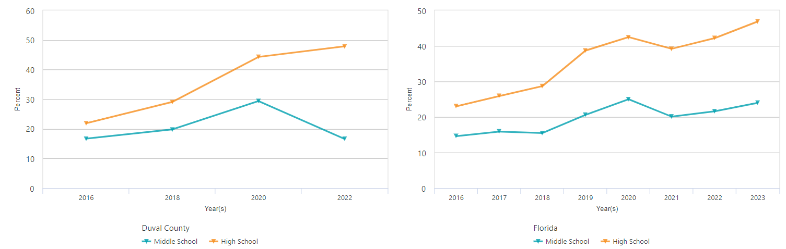
Student Users of Electronic Vapor Products Who Have Used an Electronic Vapor Product With Marijuana Oil
In 2022, Duval County HS students had increased use while MS students decreased use.
In 2023, Florida both middle and high schoolers were increasingly vaping marijuana.
Notes:
In 2022, in Duval County, 36.5% of students used Electronic Vapor Products With Marijuana Oil and this was equal to the statewide percent of 36.5%.
When broken down by school level, Duval County high schoolers (HS) had increased use of electronic vapor products with marijuana oil while middle schoolers (MS) had decreased use between 2020 and 2022.
In 2023, the state data showed a 3.3% increase to 39.8% statewide. With both middle and high school students increasing use of marijuana vaping products.

Slide 63
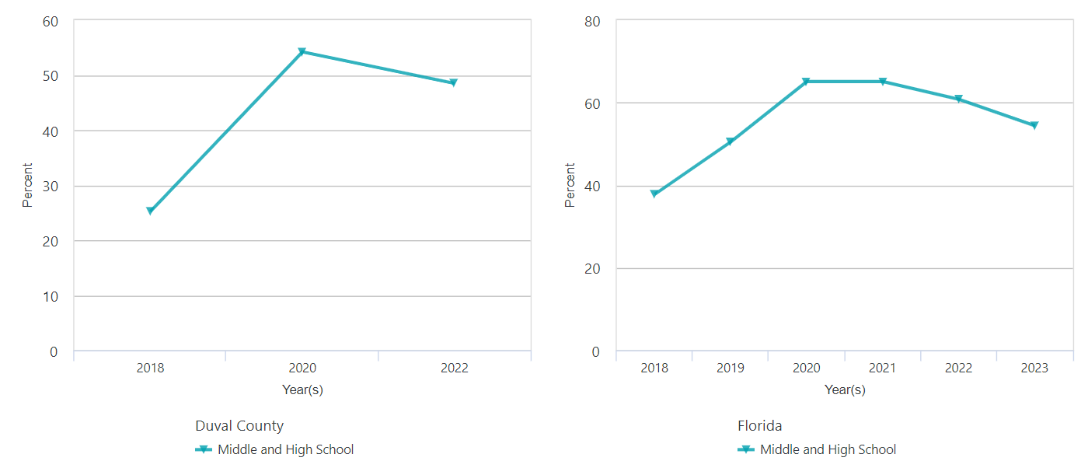
Student Users of Electronic Vapor Products Who Have Used an Electronic Vapor Product With Nicotine
In 2023, 59.1% of Florida HS students and 44.1% of Florida MS students had vaped nicotine.
Notes:
In 2023, 59.1% of Florida high school students and 44.1% of Florida middle school students had vaped nicotine.
Overall, trends of vaping nicotine seem to be decreasing in the last few years; yet, Since 2018 – There has been a 24.4% increase in vaping nicotine among HS students and an 26% increase among MS students in Duval County.

Slide 64
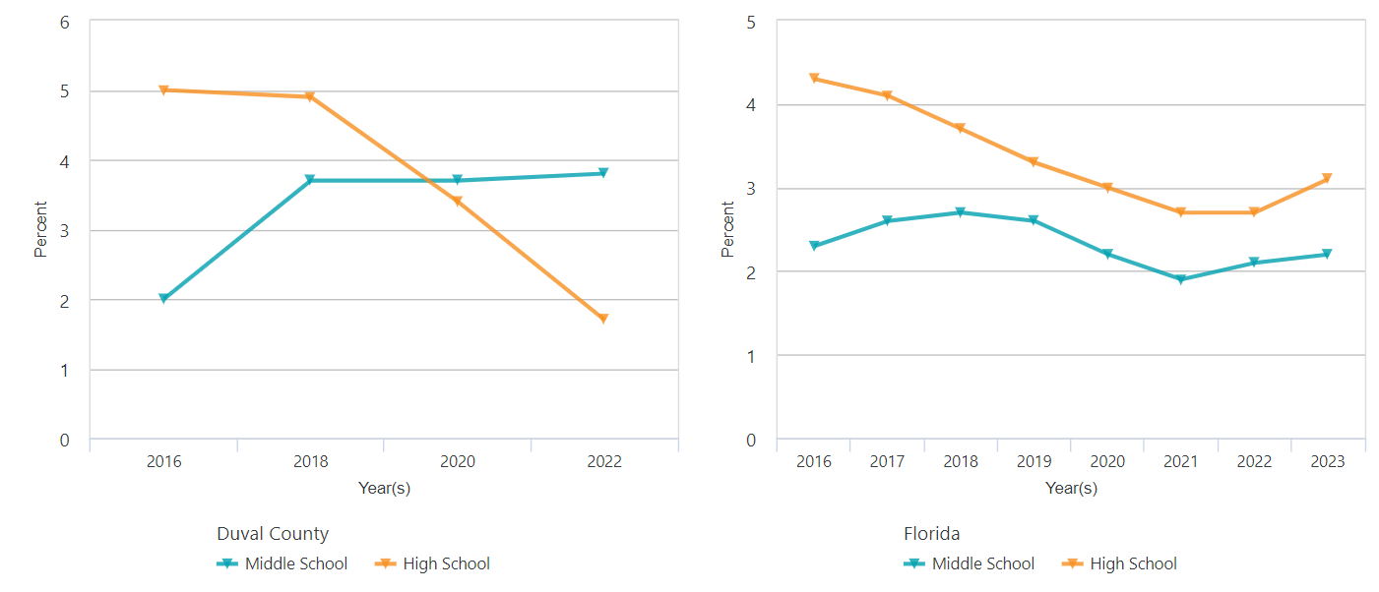
Students Who Have Ever Been Offered Electronic Vapor Products by Their Parents
In 2022, Duval MS students had no change while HS students had decreases.
In 2023, the indicator increased for both HS and MS students.
Notes:
On the left we see that from 2016-18 Duval MS students had an increase in being offered vaping products by their parents, Since 2018 there has been no change for middle school students while Duval HS students had decreases in being offered vaping products by their parents.
The chart on the right shows that between 2021- 2023, this indicator increased for Florida MS and HS students

Slide 65


We are here to support you!
Vanessa Salmo, MPH
Epidemiology & Evaluation Director
Community Coalition Alliance, Inc.
vsalmo@ccafl.org
Notes:
Thank you so much for your time, If you have any questions I am happy to answer them today and if you would like to brainstorm about community data or evaluation please reach out to me anytime!

Slide 66
Sober Living & Recovery Supports
Data
Subcommittees

Slide 67

Thank You
67
Kathleen Roberts
KRoberts@ccafl.org
Deborah Babin
DBabin@nfhitda.org

