Slide 1


Duval DEN
January 25, 2023

Slide 2
Updates - Duval
Welcome & Introductions
Data & Information Shares
Subcommittees
Open Discussion

Slide 3

DATA & INFORMATION SHARES

Slide 4
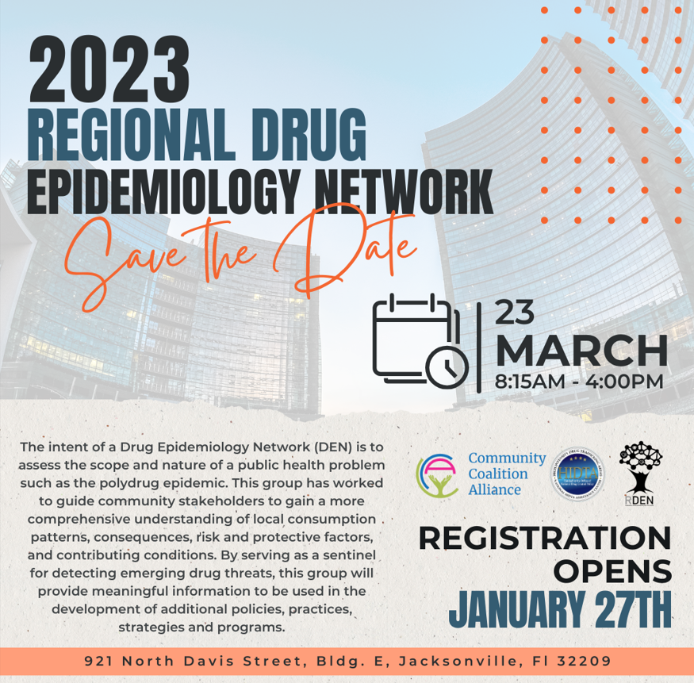
Regional DEN
March 23

Slide 5
X Waiver
Section 1262 of the Consolidated Appropriations Act, 2023 (also known as Omnibus bill), removes the federal requirement for practitioners to submit a Notice of Intent (have a waiver) to prescribe medications, like buprenorphine, for the treatment of opioid use disorder (OUD).

Slide 6
Naloxone Discussion
Tues@2pm
Information Shares
Q&A

Slide 7

Deborah Babin
&
Scott Delano

Slide 8
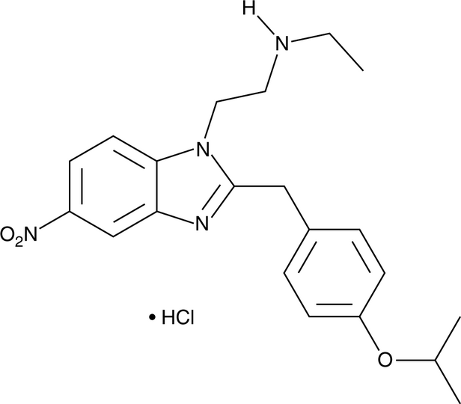
N -Desethyl Isotonitazene
New Potent Synthetic Opioid

Slide 9
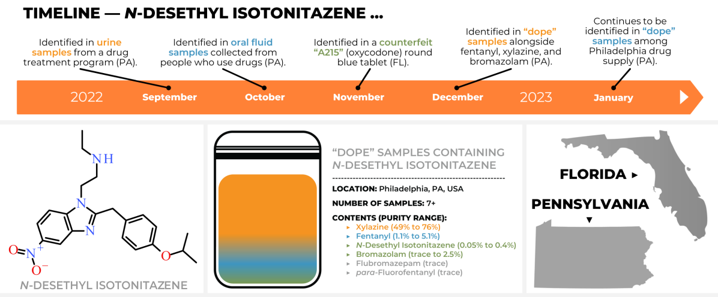

Slide 10
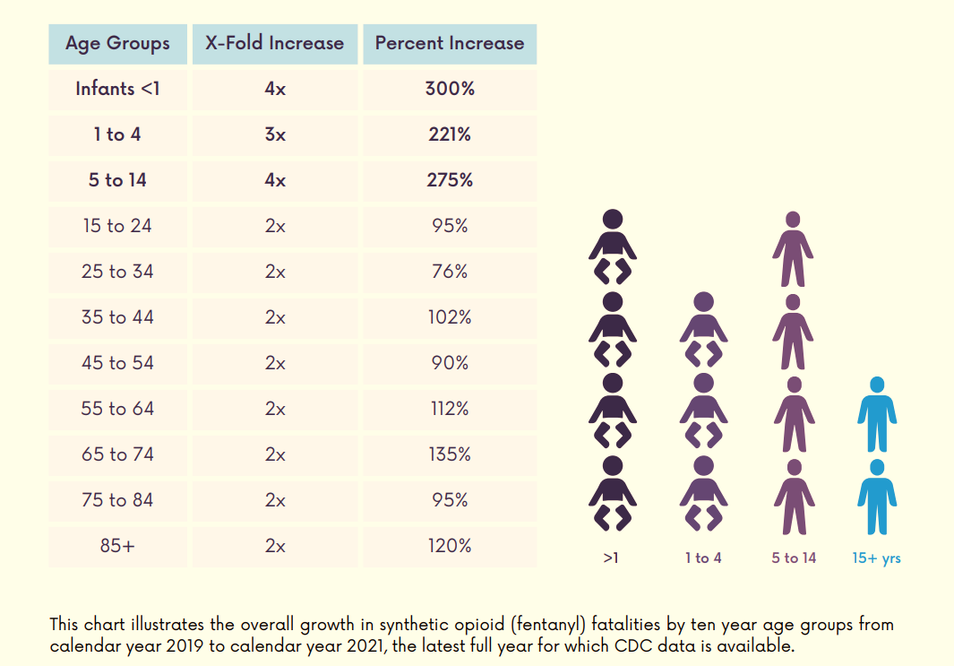
Synthetic opioid (fentanyl) fatalities among children are rising faster than any other age group, and more than tripled in just two years.

Slide 11
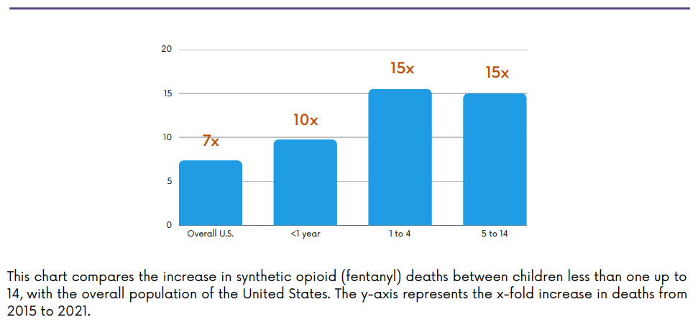
Synthetic opioid (fentanyl) deaths among infants increased nearly 10 fold since 2015, and 15 fold among children ages 1 to 14: more than 1,400%.

Slide 12
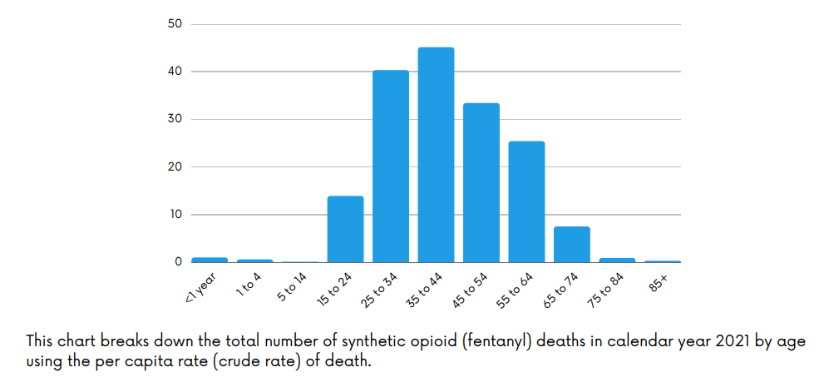

Slide 13
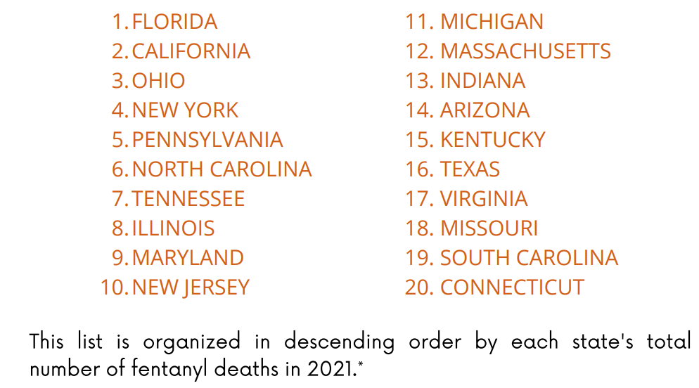
Top 20 states with the highest total number of fentanyl deaths

Slide 14
FYSAS
The Florida Youth Substance Abuse Survey (FYSAS) is part of the multi-survey Florida Youth Survey (FYS) project.
In 2022, students were surveyed in all 67 Florida counties.
Participation from 384 public middle schools and 352 public high schools.
Final sample size is 47,572 across grades 6 through 12.
61.5% administered online and 38.5% with booklets

Slide 15
Past 30 Days
Alcohol and vaping nicotine are the highest prevalence substance use categories across age groups.
Marijuana use, vaping marijuana, and binge drinking are also higher prevalence.
Among H.S. students, marijuana use is nearly as prevalent as vaping nicotine.
Rates of use for other drug categories, including cigarettes, are very low.

Slide 16
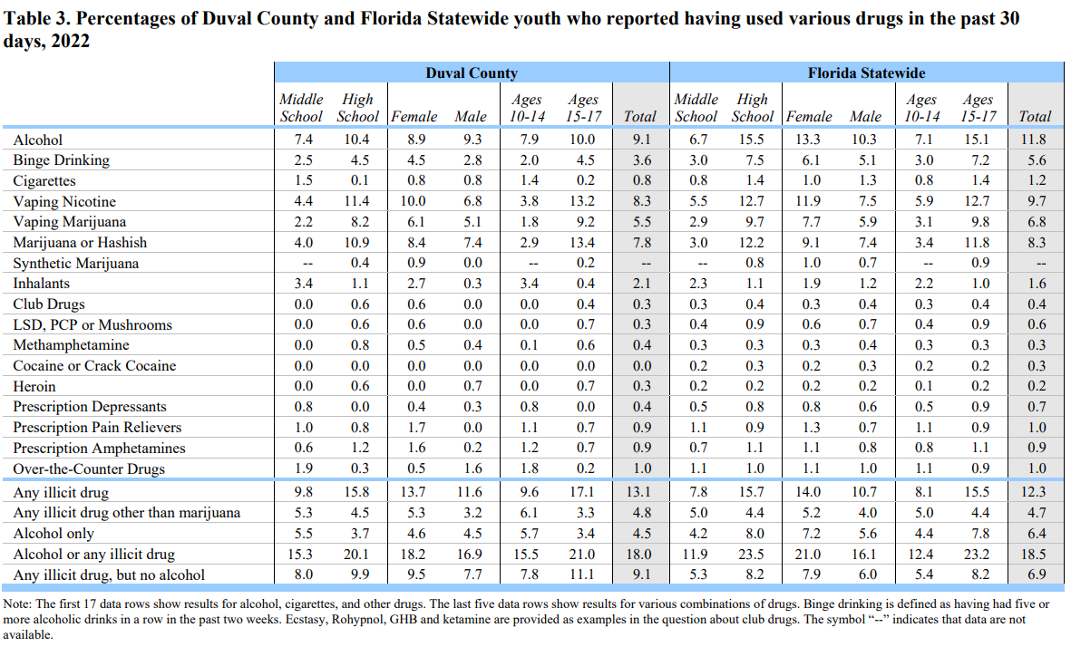

Slide 17

FSU Project to Provide Opioid Epidemic Assistance in Rural Communities Receives $1.3 Million Grant

Slide 18


Slide 19
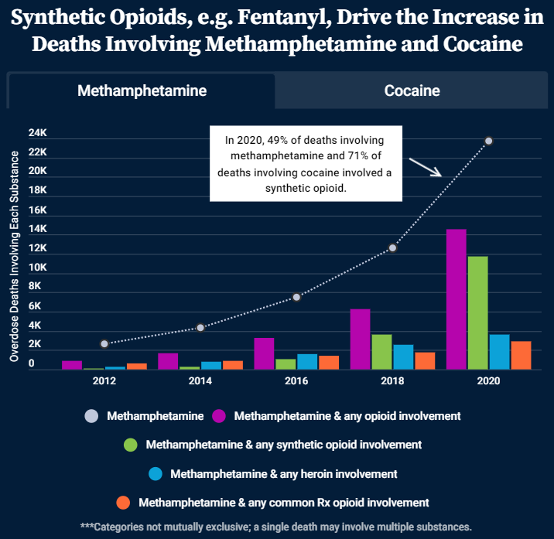
Stimulants & Opioids

Slide 20
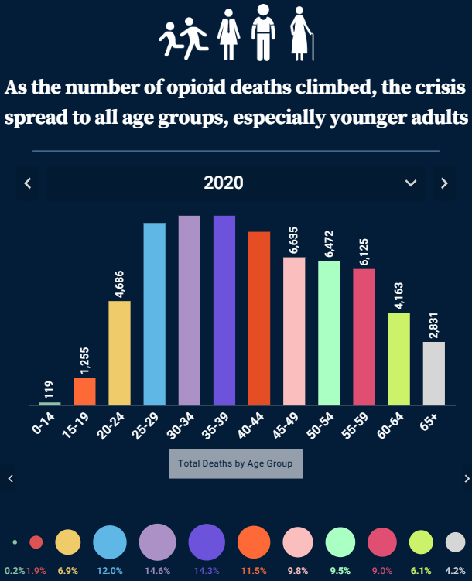
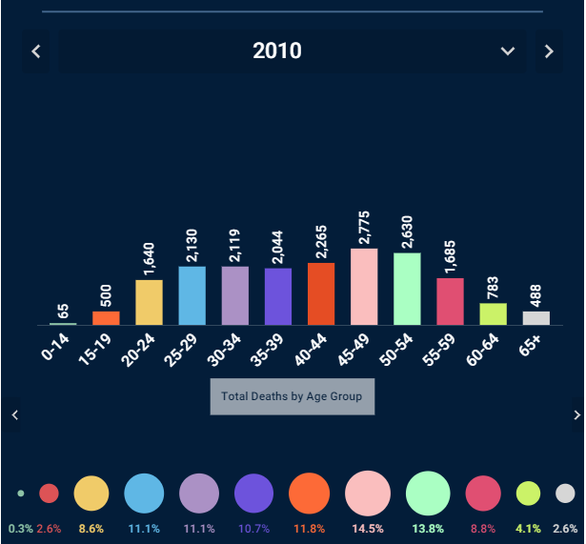
Change over Time →

Slide 21
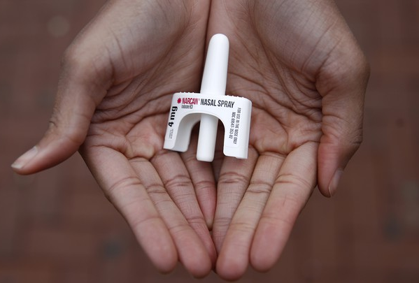

Laura Viafora Ray - JFRD

Slide 22
Diana Prieto
Duval Department of Health

Slide 23

Florida Department of Health
OD2A Surveillance
Diana Prieto, MPH, CPH
Epidemiologist
LaTerica Thomas, MPH, CPH
Epidemiologist
Notes:
Good Morning everyone, today we will be presenting data on drug-related ED visits. Today’s presentation will provide a brief 4-year look at how drug-related ED visits have changed from 2019 – 2022., which will be explored more in-depth in the coming months.
-
*Data pulled from ESSENCE-FL , which is the local Electronic Surveillance System for the Early Notification of Community based Epidemics, for data collection and reporting. Please keep in mind that data is provisional and subject to change at any time.

Slide 24
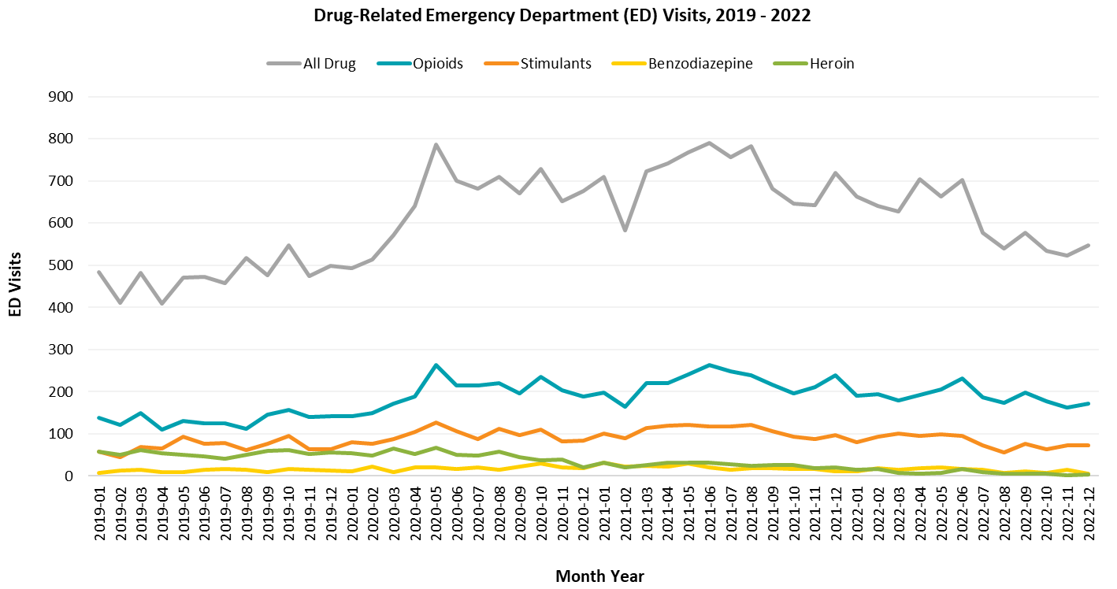
Emergency Department (ED) Visits in Duval County
Notes:
Overall, drug-related ED visits saw decreases in 2022 compared to the high numbers we saw in 2020 and 2021. The second half of 2022 saw lower number of drug-related ED visit for all categories; however, we did see a bit of an increase in the month of September and in December.

Slide 25
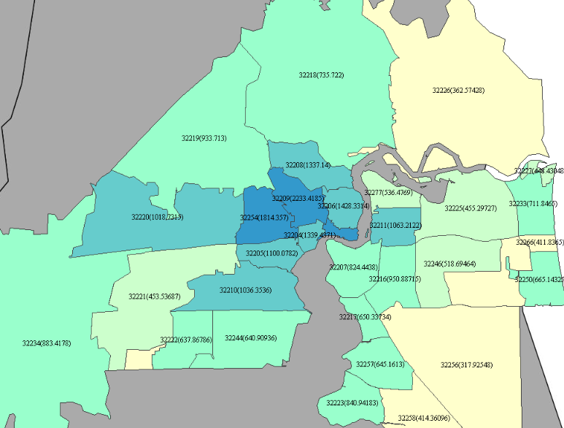
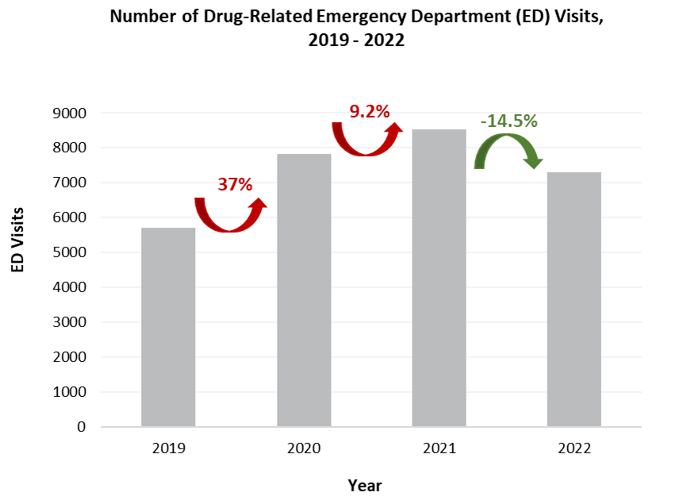

Drug-Related Emergency Department (ED) Visits in Duval County
Drug-Related ED Visits, Rate per 100,000 Residents in 2022
Notes:
This slide gives a look at drug-related ED visits in two different ways.
The chart to the left shows the percent difference of ED visits compared to the year prior.
2020 had the highest percent increase of 37 percent from 2019, which continued to increase in 2021.
In 2022 however, overall drug-related ED visits have seen a 14.5% decrease compared to 2021.
The map to the right gives the rate of drug-related ED visits in 2022. Zip codes 32209, 32254, and 32202 have the highest rate per 100,000 residents in Duval County.

Slide 26
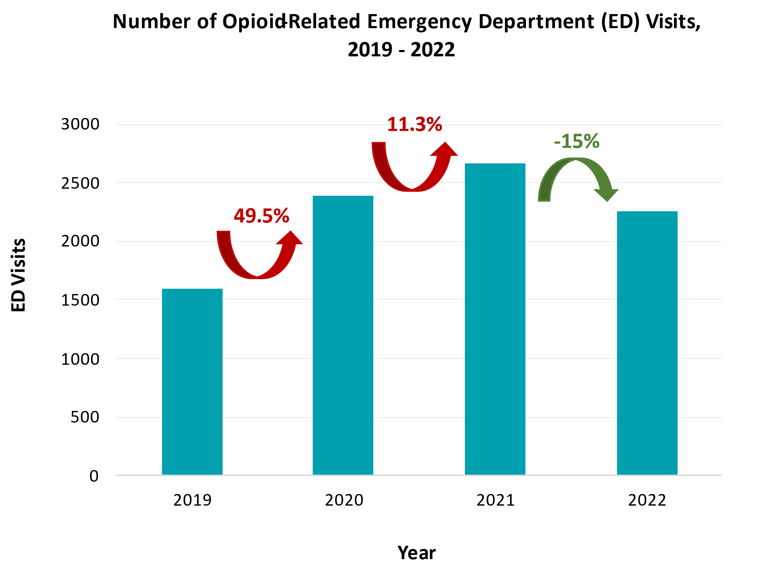
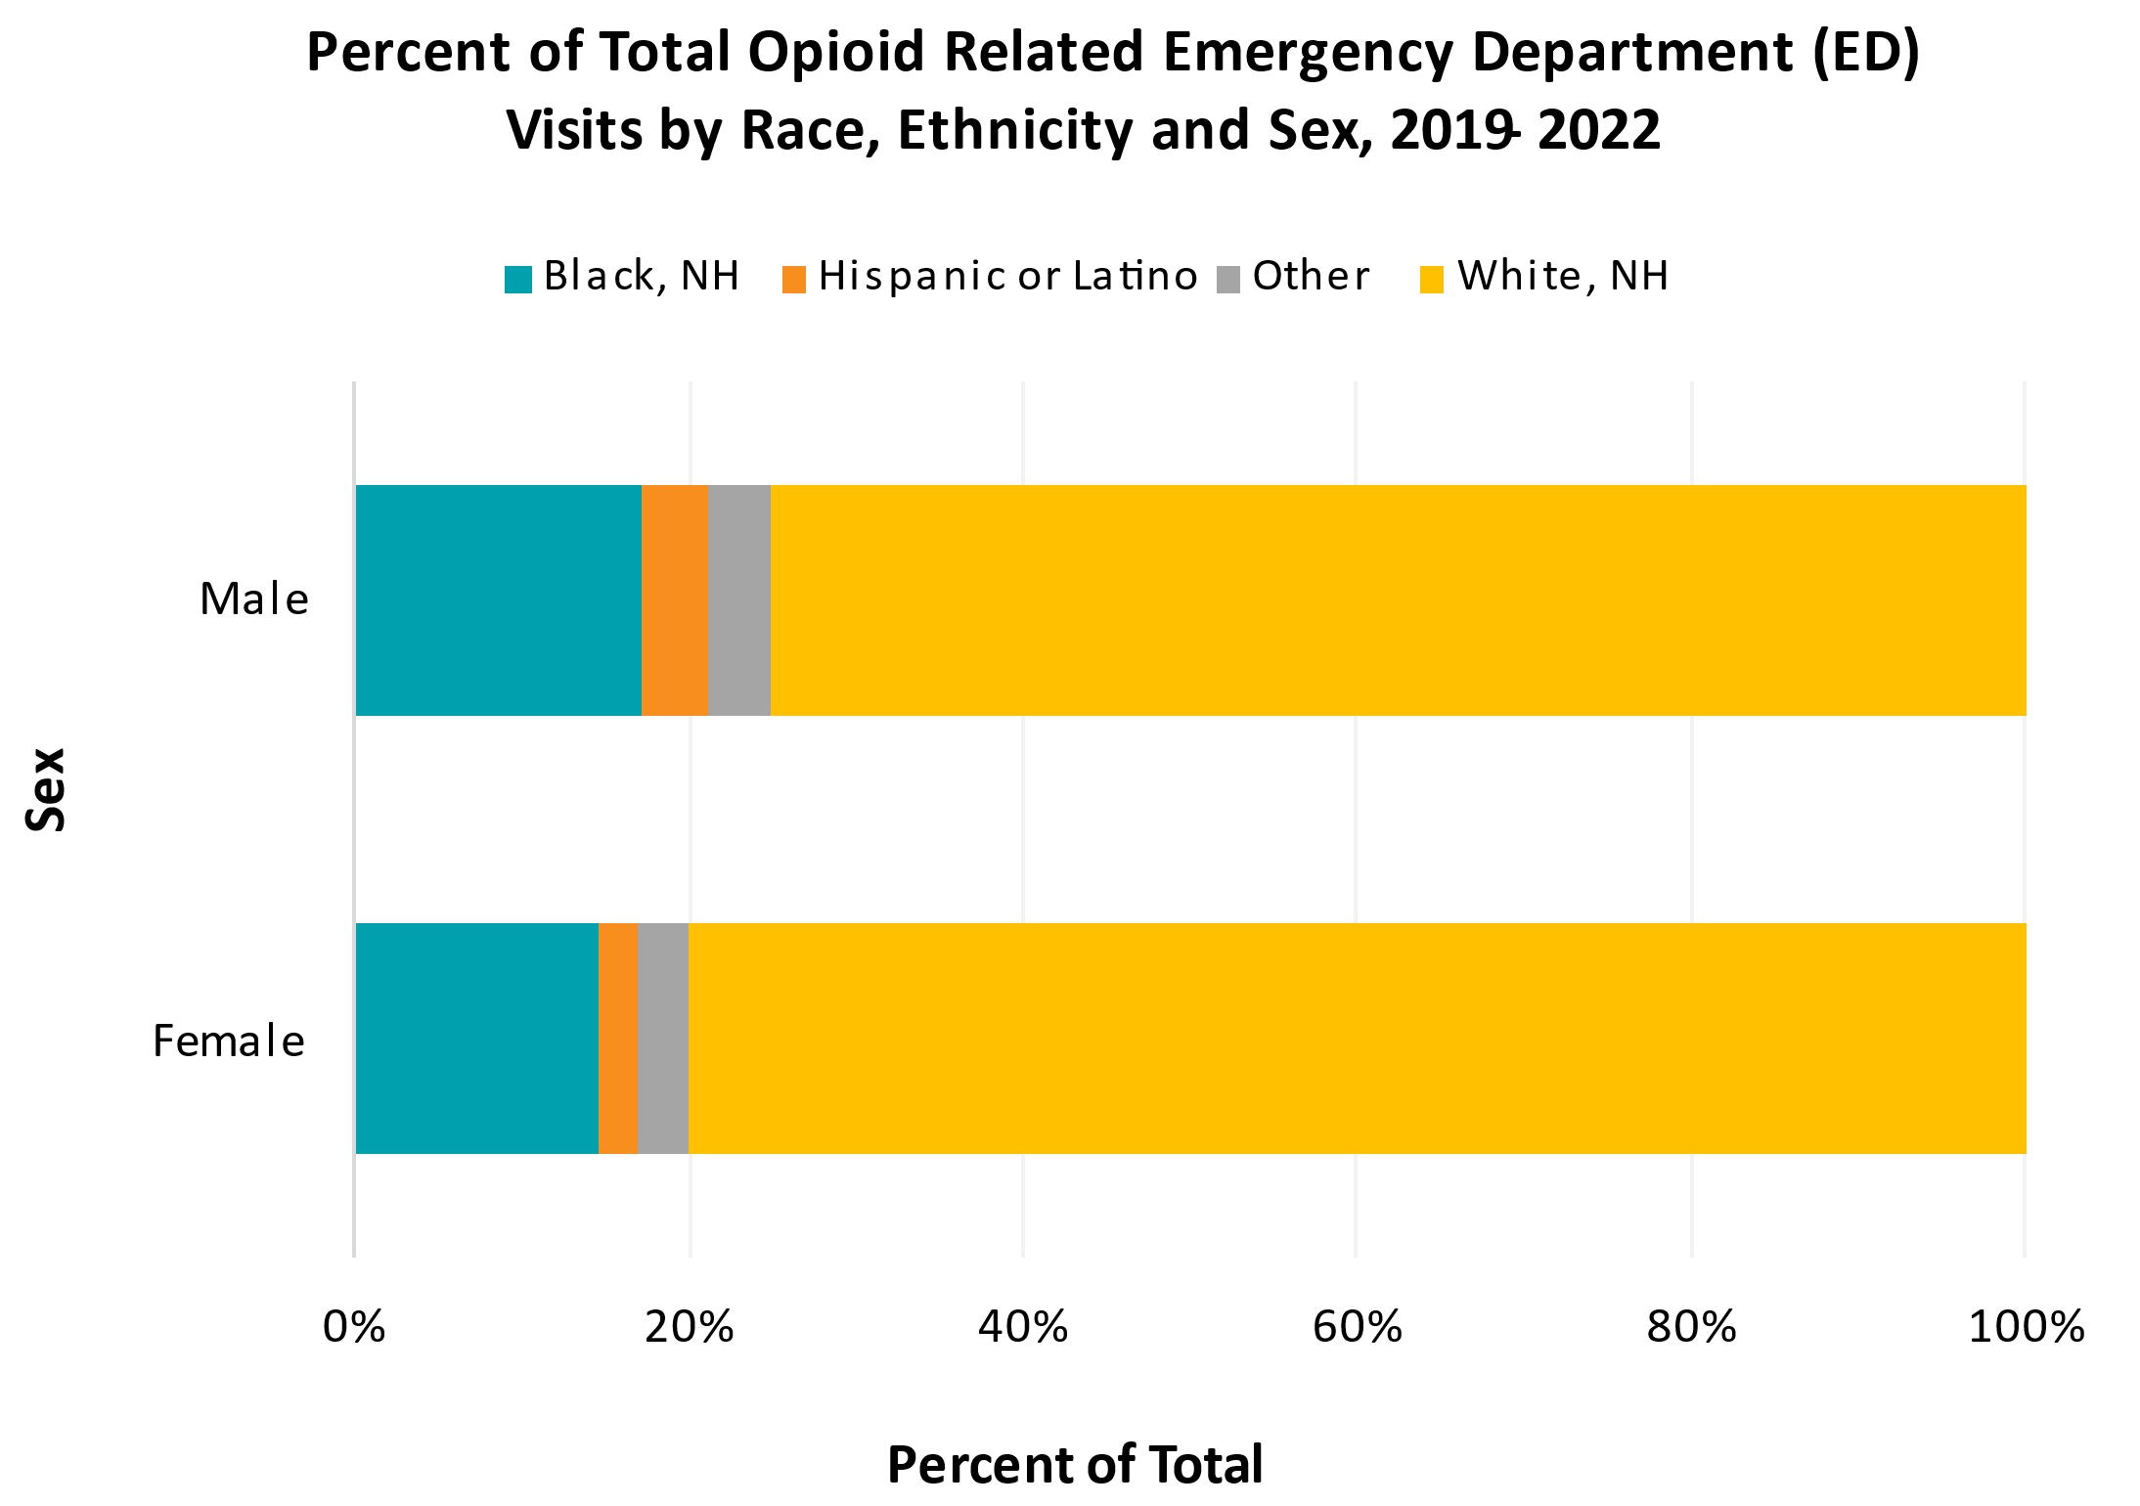
Opioid-Related Emergency Department (ED) Visits in Duval County
Notes:
This slide shows how opioid-related ED visits have changed over the years.
Most drug-related ED visits follow the same pattern of seeing increases in 2020 and 2021, with 2020 having the largest percent increase.
For opioid-related ED visits, 2022 saw a 15% decrease compared to 2021.
The chart to the right shows the breakdown of race and ethnicity of all opioid-related ED visits that occurred from 2019 to 2022.
While Whites, non-Hispanics make up the majority of the ED visits, it is important to note that when comparing the rate of opioid-related ED visits among each race, Whites, non-Hispanics were the only race to see a rate decrease in 2022 to 317.2 per 100,000 residents compared to the three-year average rate of 345.7.
Conversely in 2022, Blacks, non-Hispanics saw a rate increase to 160.2 compared to the previous average rate of 111.2 of previous years.
Hispanics also saw a slight rate increase to 75.7 from the previous rate of 67.9.

Slide 27
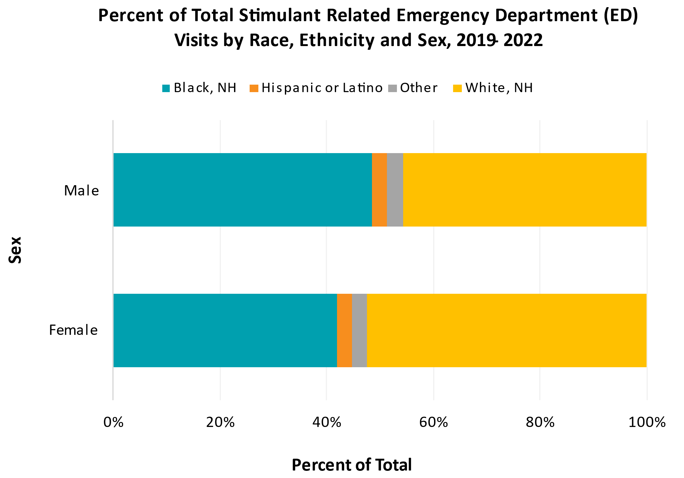
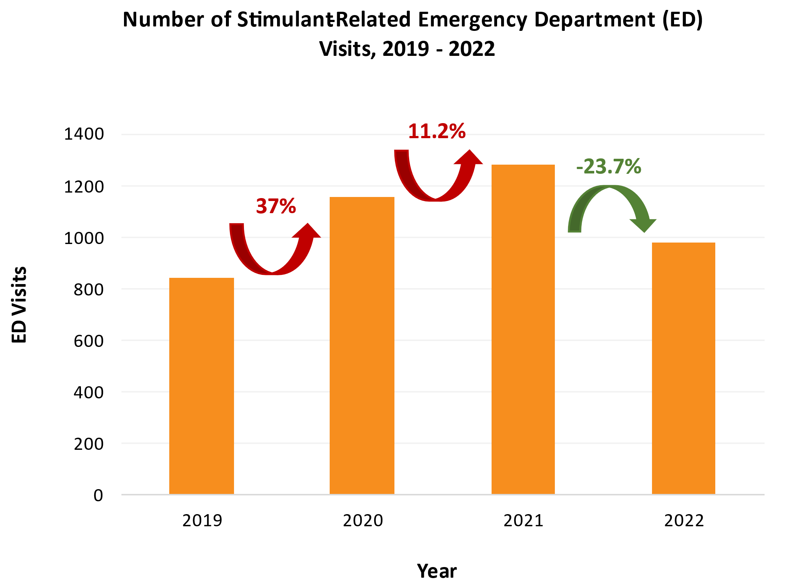
Stimulant-Related Emergency Department (ED) Visits in Duval County
Notes:
This slide looks into stimulant-related ED visits.
For stimulant-related ED visits, 2022 saw a 23.7% decrease compared to 2021.
The chart to the left shows the breakdown of race and ethnicity of all stimulant-related ED visits that occurred from 2019 to 2022.
Unlike with opioid-related ED visits and (the other drug types to be covered in the coming slides), stimulant-related ED visits are almost evenly divided, if not slightly skewed more toward Blacks, non-Hispanics.
Moreover, in 2022, Blacks non-Hispanics only saw a 7% decrease in rate (159.8 per 100,000 residents) compared to the previous 171.7.
Whites, non-Hispanics saw a 17.7% decrease in rate to 87.6 from the previous 106.4.
Hispanics saw no change in rate their rate of 29 per 100,000.

Slide 28
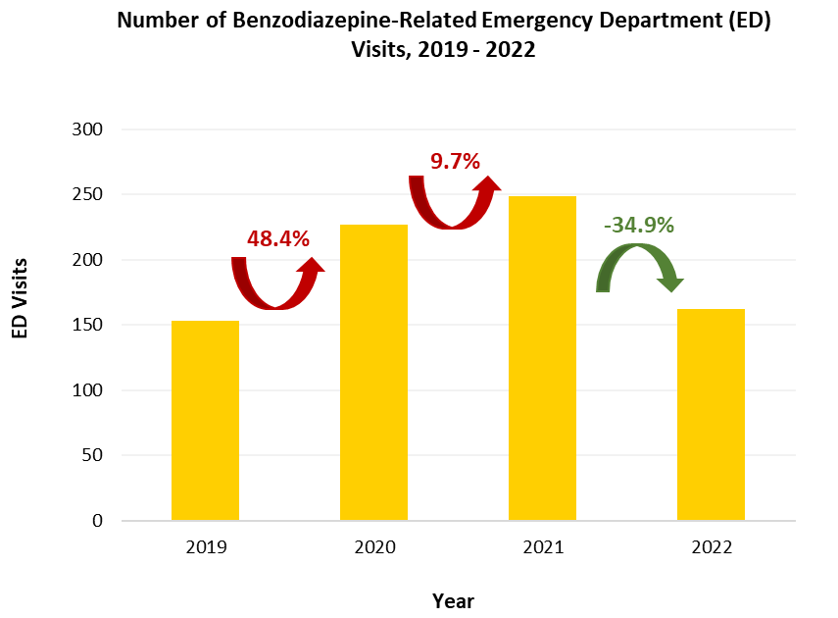
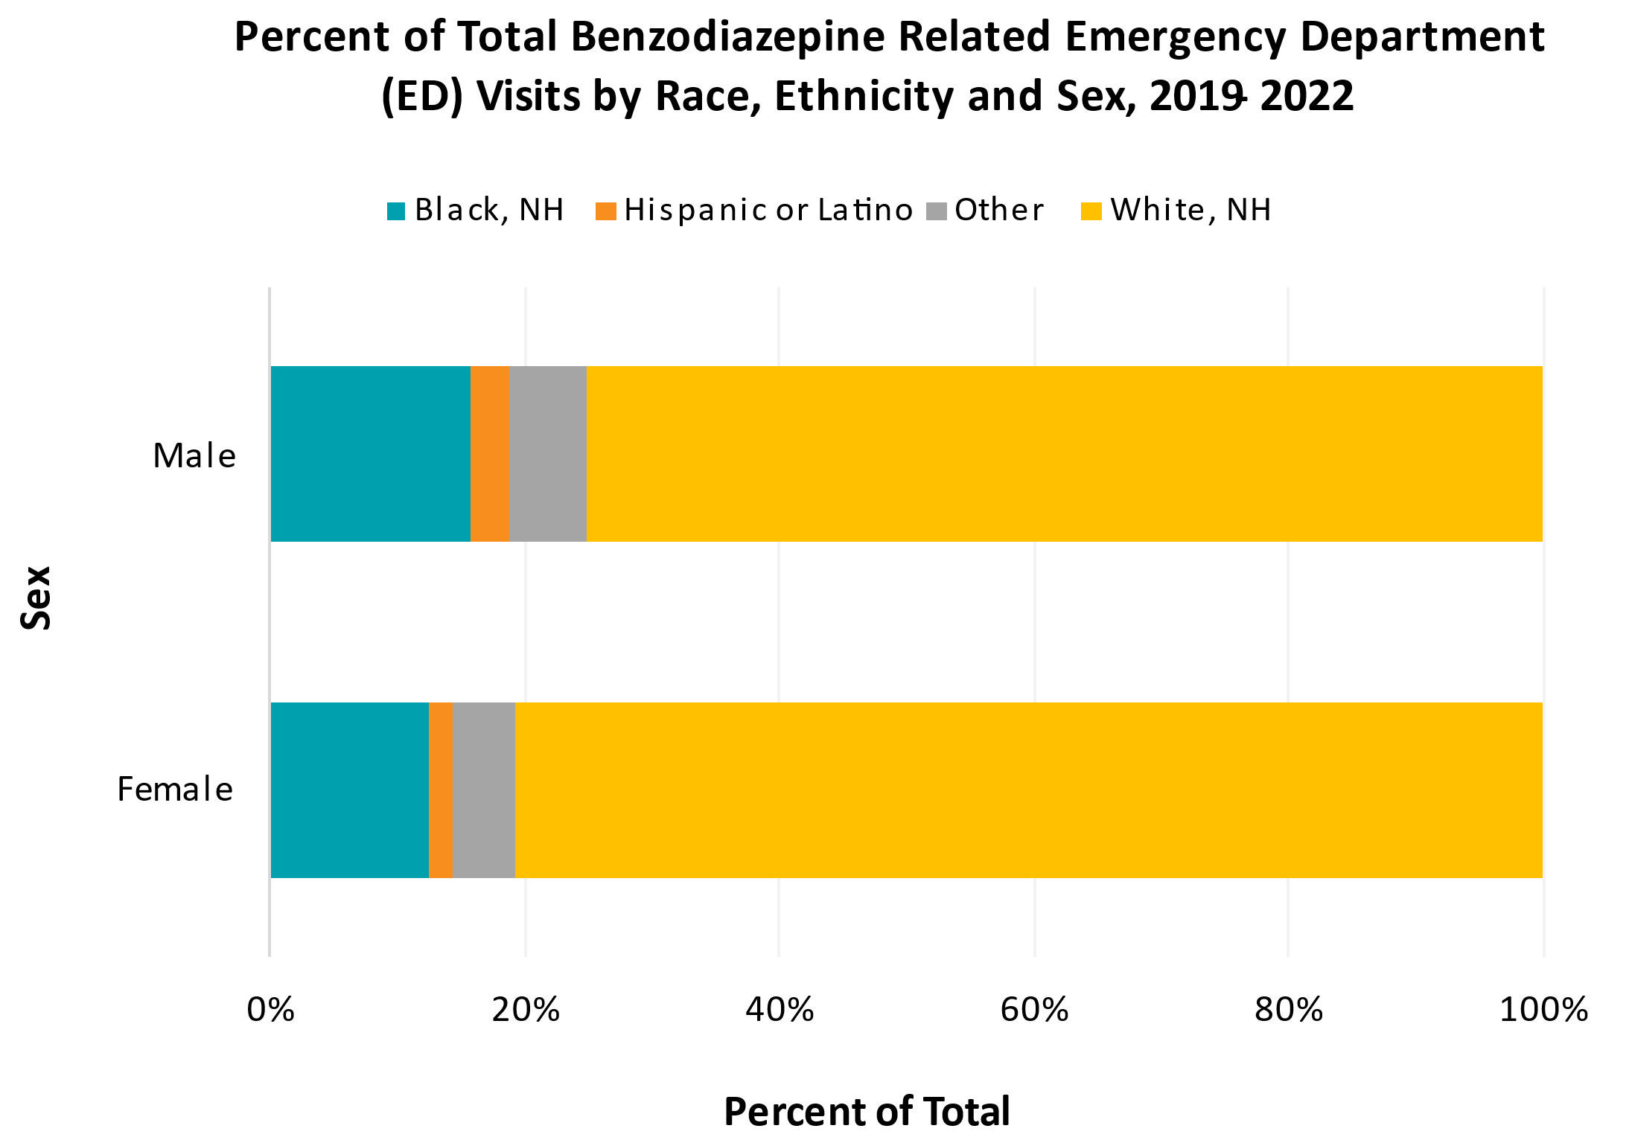
Benzodiazepine-Related Emergency Department (ED) Visits in Duval County
Notes:
This slide looks into benzodiazepine-related ED visits.
For benzodiazepine-related ED visits, 2022 saw a 34.9% decrease compared to 2021.
The chart to the right shows the breakdown of race and ethnicity of all benzodiazepine-related ED visits that occurred from 2019 to 2022.
Benzodiazepine-related ED visits also follows the race breakdown of Whites, non-Hispanics making up most of the visits.
That said, Whites, non-Hispanics saw the largest decrease in their rate (23.9 per 100,000 compared to the previous 32.6).
Blacks, non-Hispanics saw a slight decrease to 8.9 from 9.4, and Hispanics saw a slight decrease to 3.7 from the previous 4.8.

Slide 29
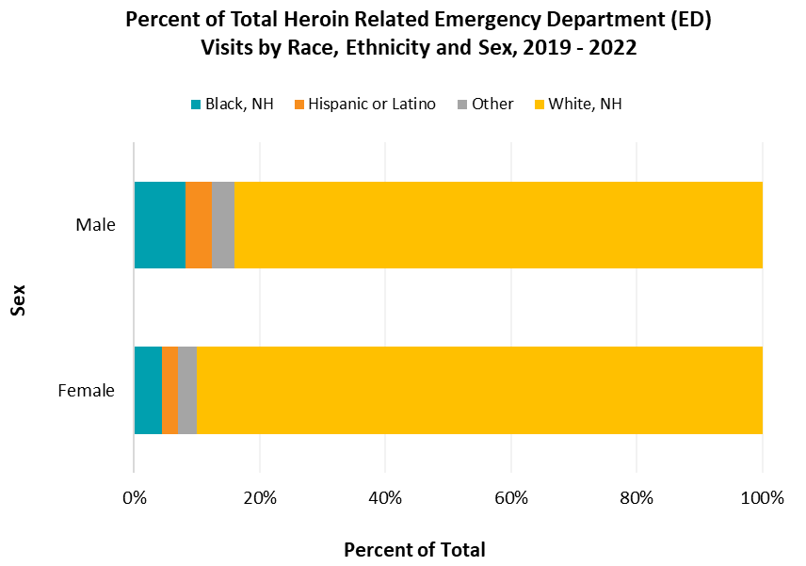
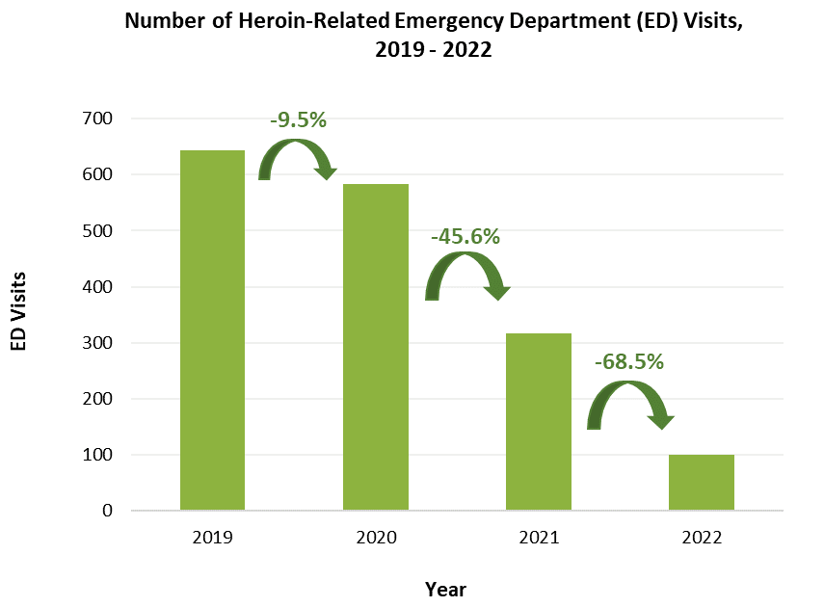
Heroin-Related Emergency Department (ED) Visits in Duval County
Notes:
This slide looks into Heroin-Related ED visits.
Unlike the previous slides, Heroin-Related ED visits have continued to decrease since 2019.
For 2022, Heroin-Related ED visits saw the largest percent decrease of 68.5% compared to 2021.
The chart to the left shows the breakdown of race and ethnicity of all Heroin-Related ED visits that occurred from 2019 to 2022.
Whites, NH also make up the majority of Heroin-Related ED visits.
Blacks, non-Hispanics saw a slight decrease to 8.9 from 9.4, and Hispanics saw a slight decrease to 3.7 from the previous 4.8.

Slide 30



Learn More
 | Diana Prieto, MPH, CPH Epidemiologist Diana.Prieto@flhealth.gov 904-253-1409
 | LaTerica Thomas MPH, CPH Epidemiologist CDC Foundation LaTerica.Thomas@flhealth.gov 904-253-1407
Notes:
This concludes the ED surveillance updates for this month. If you have any questions or would like to explore more data, please contact our OD2A surveillance team.

Slide 31


Slide 32
Pilot Project
Goal: Implement a pilot project to replicate EB Addiction Stabilization Model
$1 million per county: CDC Crisis Response Public Health Workforce Supplemental
  Expires July 30, 2023
Use standardized criteria to select pilot counties based on need and capacity.
FDOH, DCF, & AHCA
  Assist with funding for products and services not allowed (MAT)

Slide 33
Subcommittees
Innovative Project Stakeholders Group
Sober Living & Recovery Supports
Data

Slide 34
THANK YOU!!!!!
Kathleen Roberts
Director@ccafl.org
Deborah Babin
DBabin@nfhitda.org
Building  Expanding  Innovating  Changing  Communities for 10 Years

