Slide 1

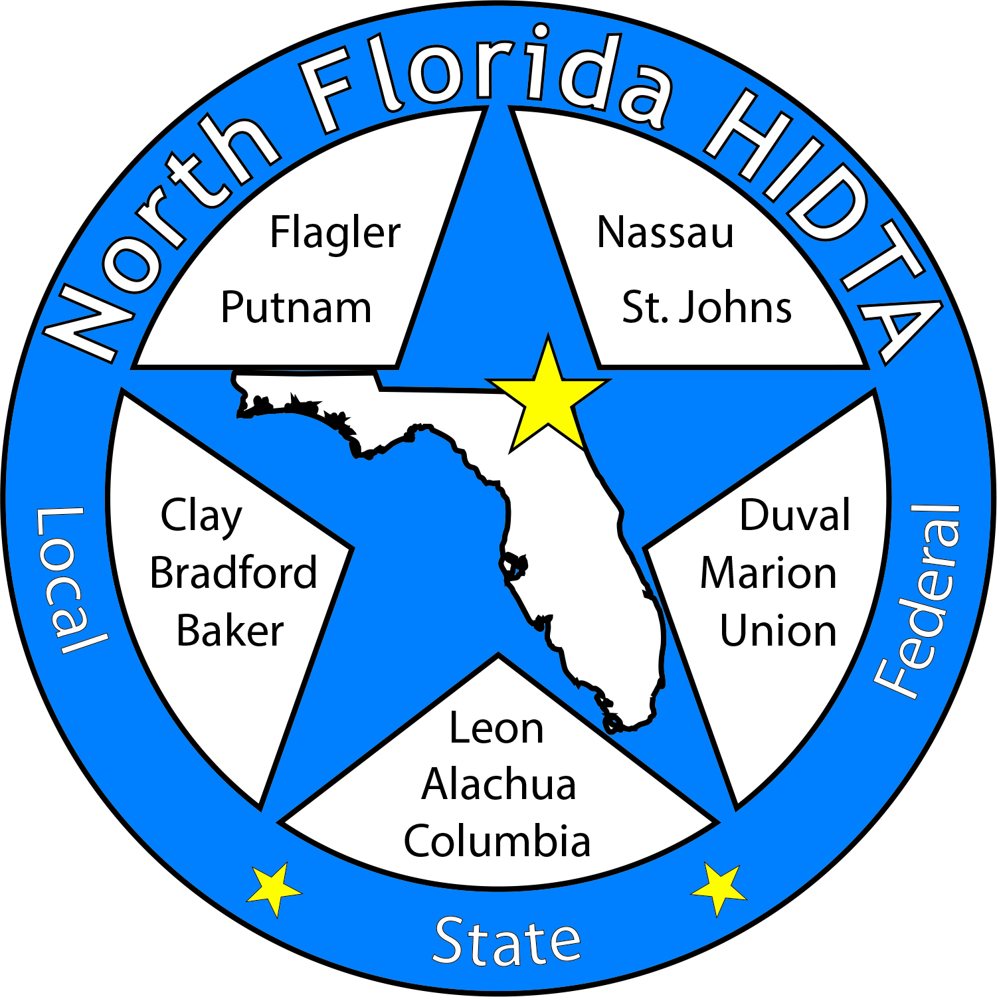
Duval DEN
November 29, 2023

Slide 2
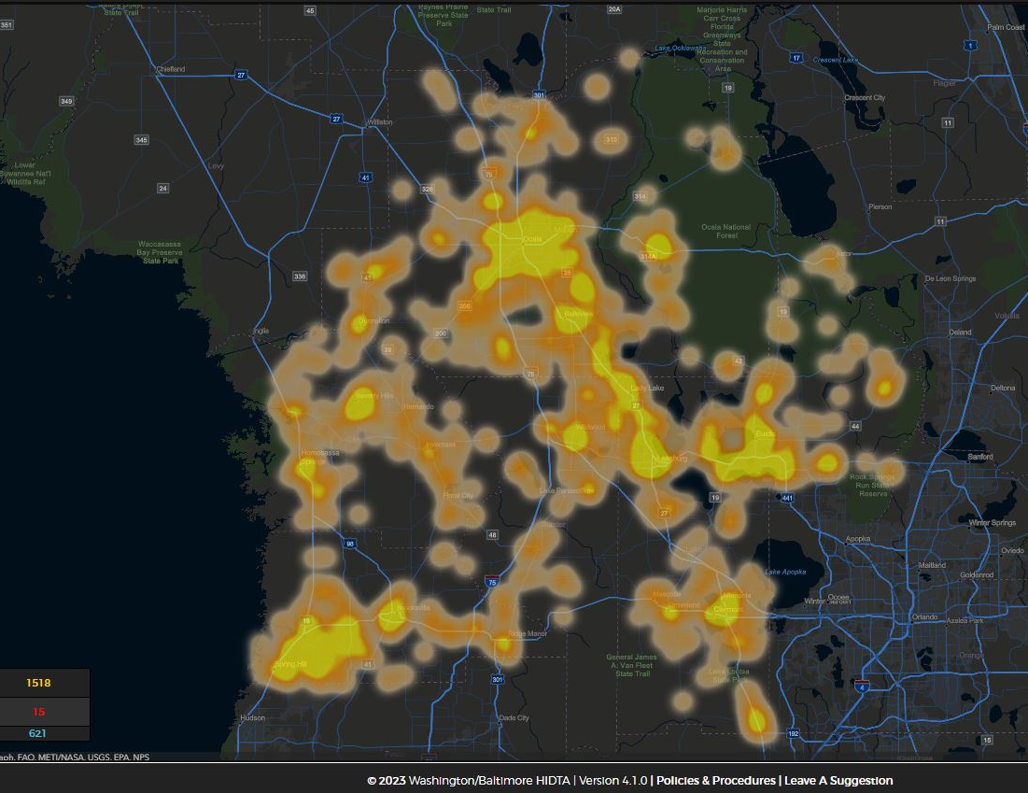
Today’s Focus
Welcome & Introductions
Data & Information Shares
Subcommittees
Open Discussion

Slide 3

Expanding Membership – Circuit 4 Partners

Slide 4

DEN Meetings
December – NO MEETING
January – In Person
February – Virtual
March - RDEN

Slide 5

DATA & INFORMATION SHARES

Slide 6

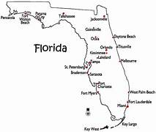
FYSAS 2023
33 counties selected – 28 participated
    Sample Size: 9,101
Alcohol past 30 day use
    MS: 7.4%
      Binge Drinking: 3.2%
    HS: 13.8%
      Binge Drinking: 6.1%
Vaping past 30 day
    MS: 1 in 20 students
    HS: 8.4% Marijuana & 3.7% Nicotine
Marijuana
    MS: 2.3%
    HS: 10.2%

Slide 7
FYSAS Showing Improvements
2004
42% of HS reported past 30 day Alcohol compared to 13.8%
20.3% of MS reported past 30 day Alcohol compared to 7.4%
15% of HS reported past 30 day Cigarette Use compared to 1.2%
7.1% of MS reported past 30 day Cigarette Use compared to 1.3%

Slide 8
FYSAS – Additional Products
Have you heard of Delta 8 or Delta 10 THC?
  29% of HS said “YES”
  9.5% Students who reported using Delta 8 or Delta 10 (Lifetime)
    Compared to marijuana 19.7% (Lifetime)
Have you heard of Kratom?
  8.8% of HS said “YES”
  1.5% Students who reported using Kratom (Lifetime)

Slide 9
FYSAS – Campaign Awareness
Have you heard of One Pill Can Kill?
  32.9% of HS and MS said “YES”
    Black Students: 28.2%
    White Students: 37%
Are you likely to use the crisis line 988?
  16% of students said “YES”
    12.5% Of Female Students
    19.6% Of Male Students

Slide 10
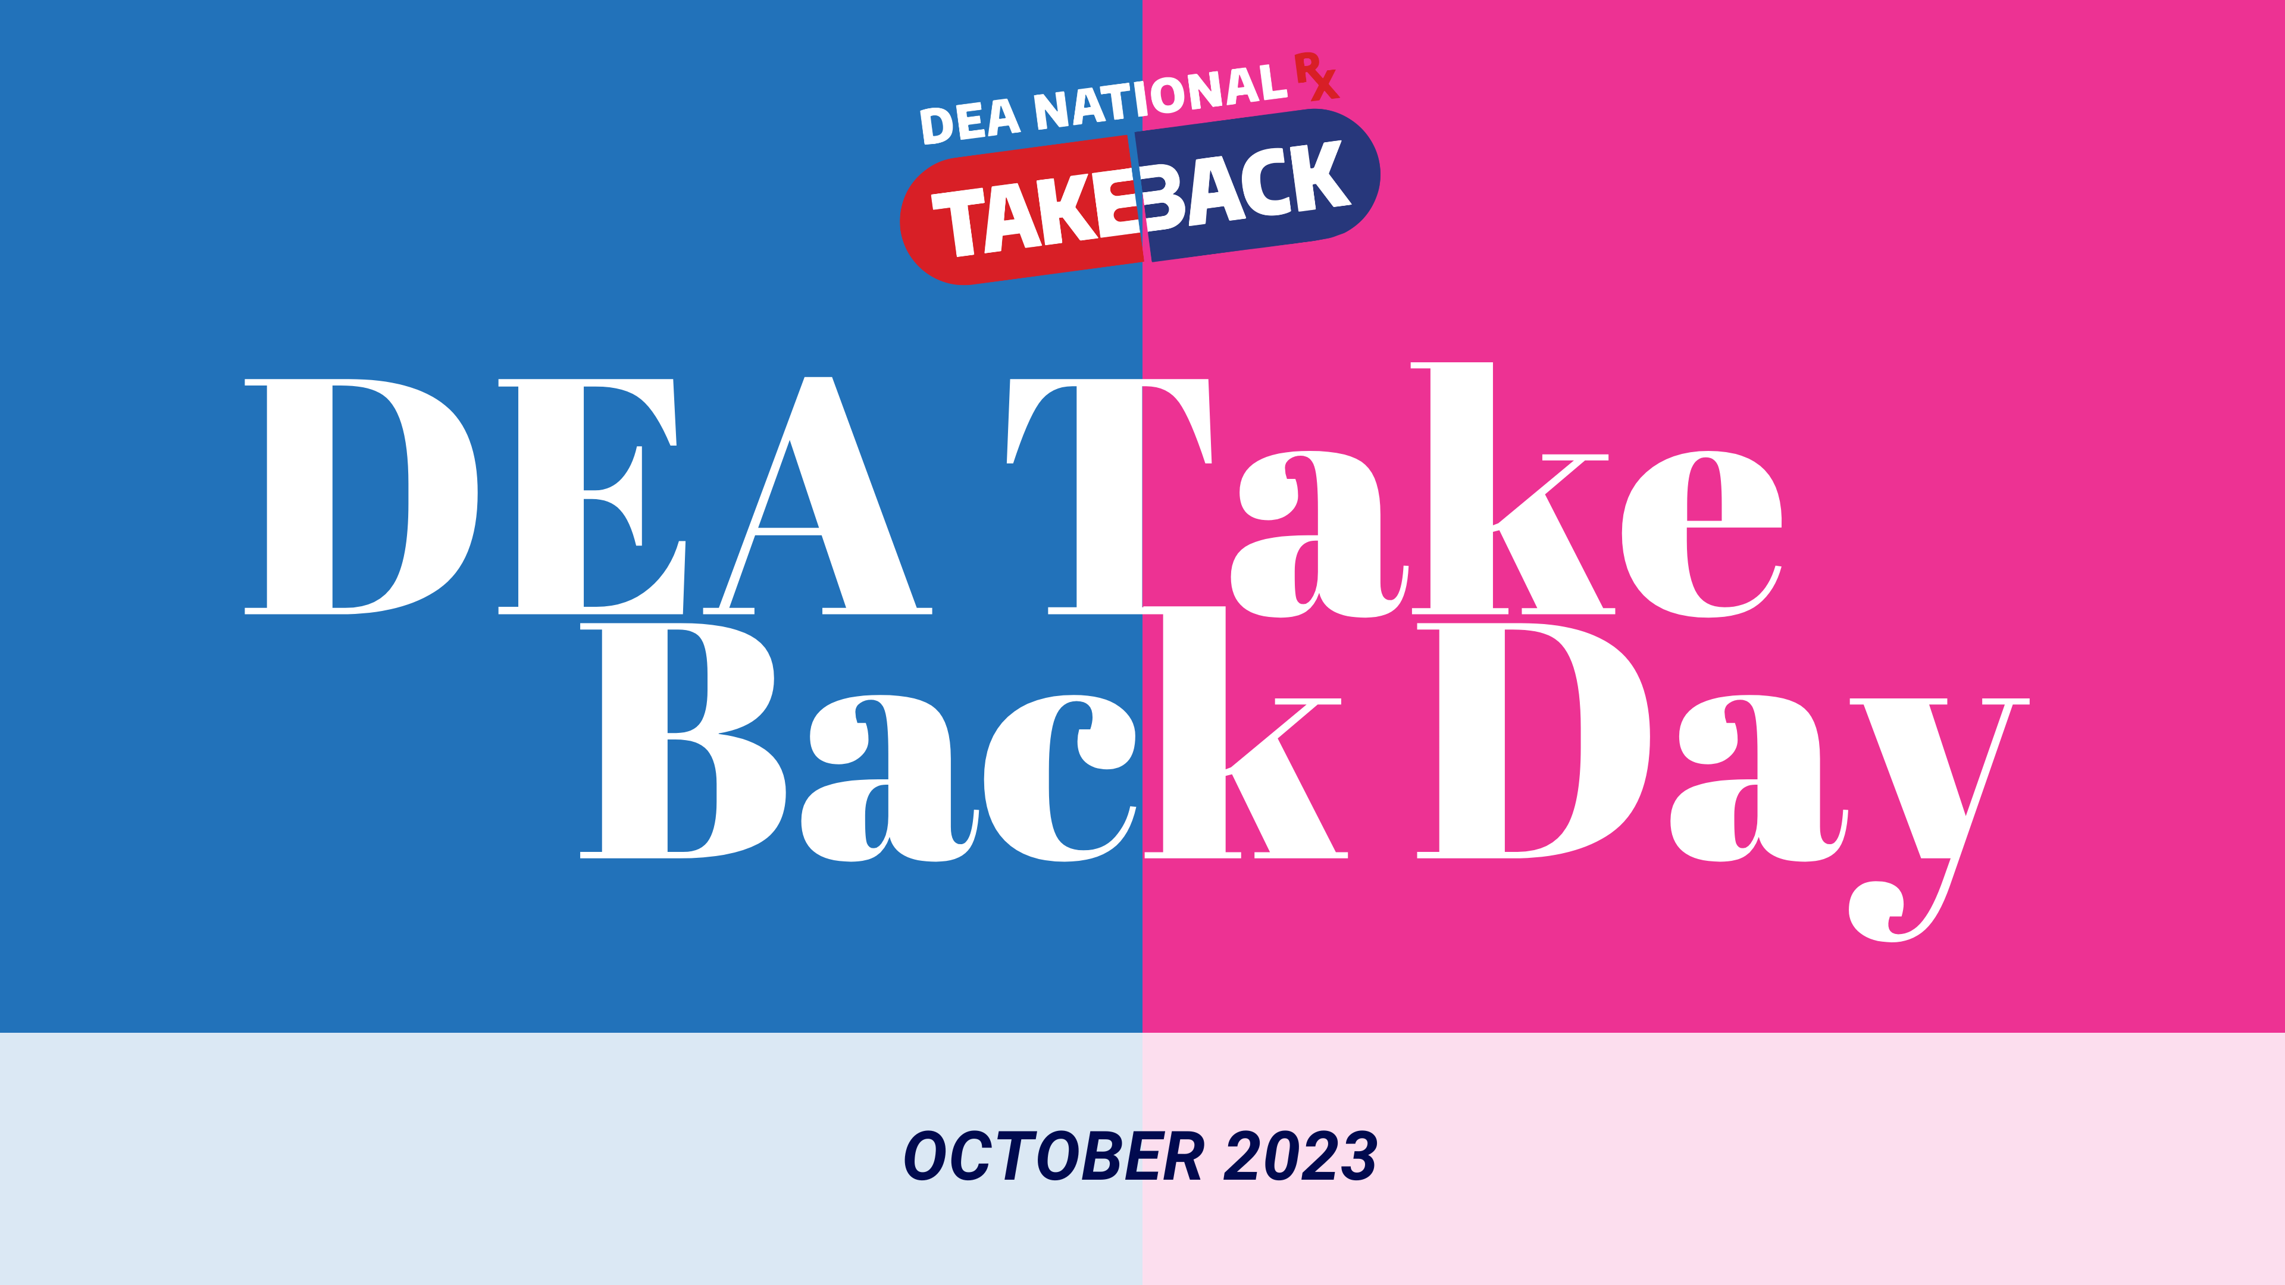

Slide 11
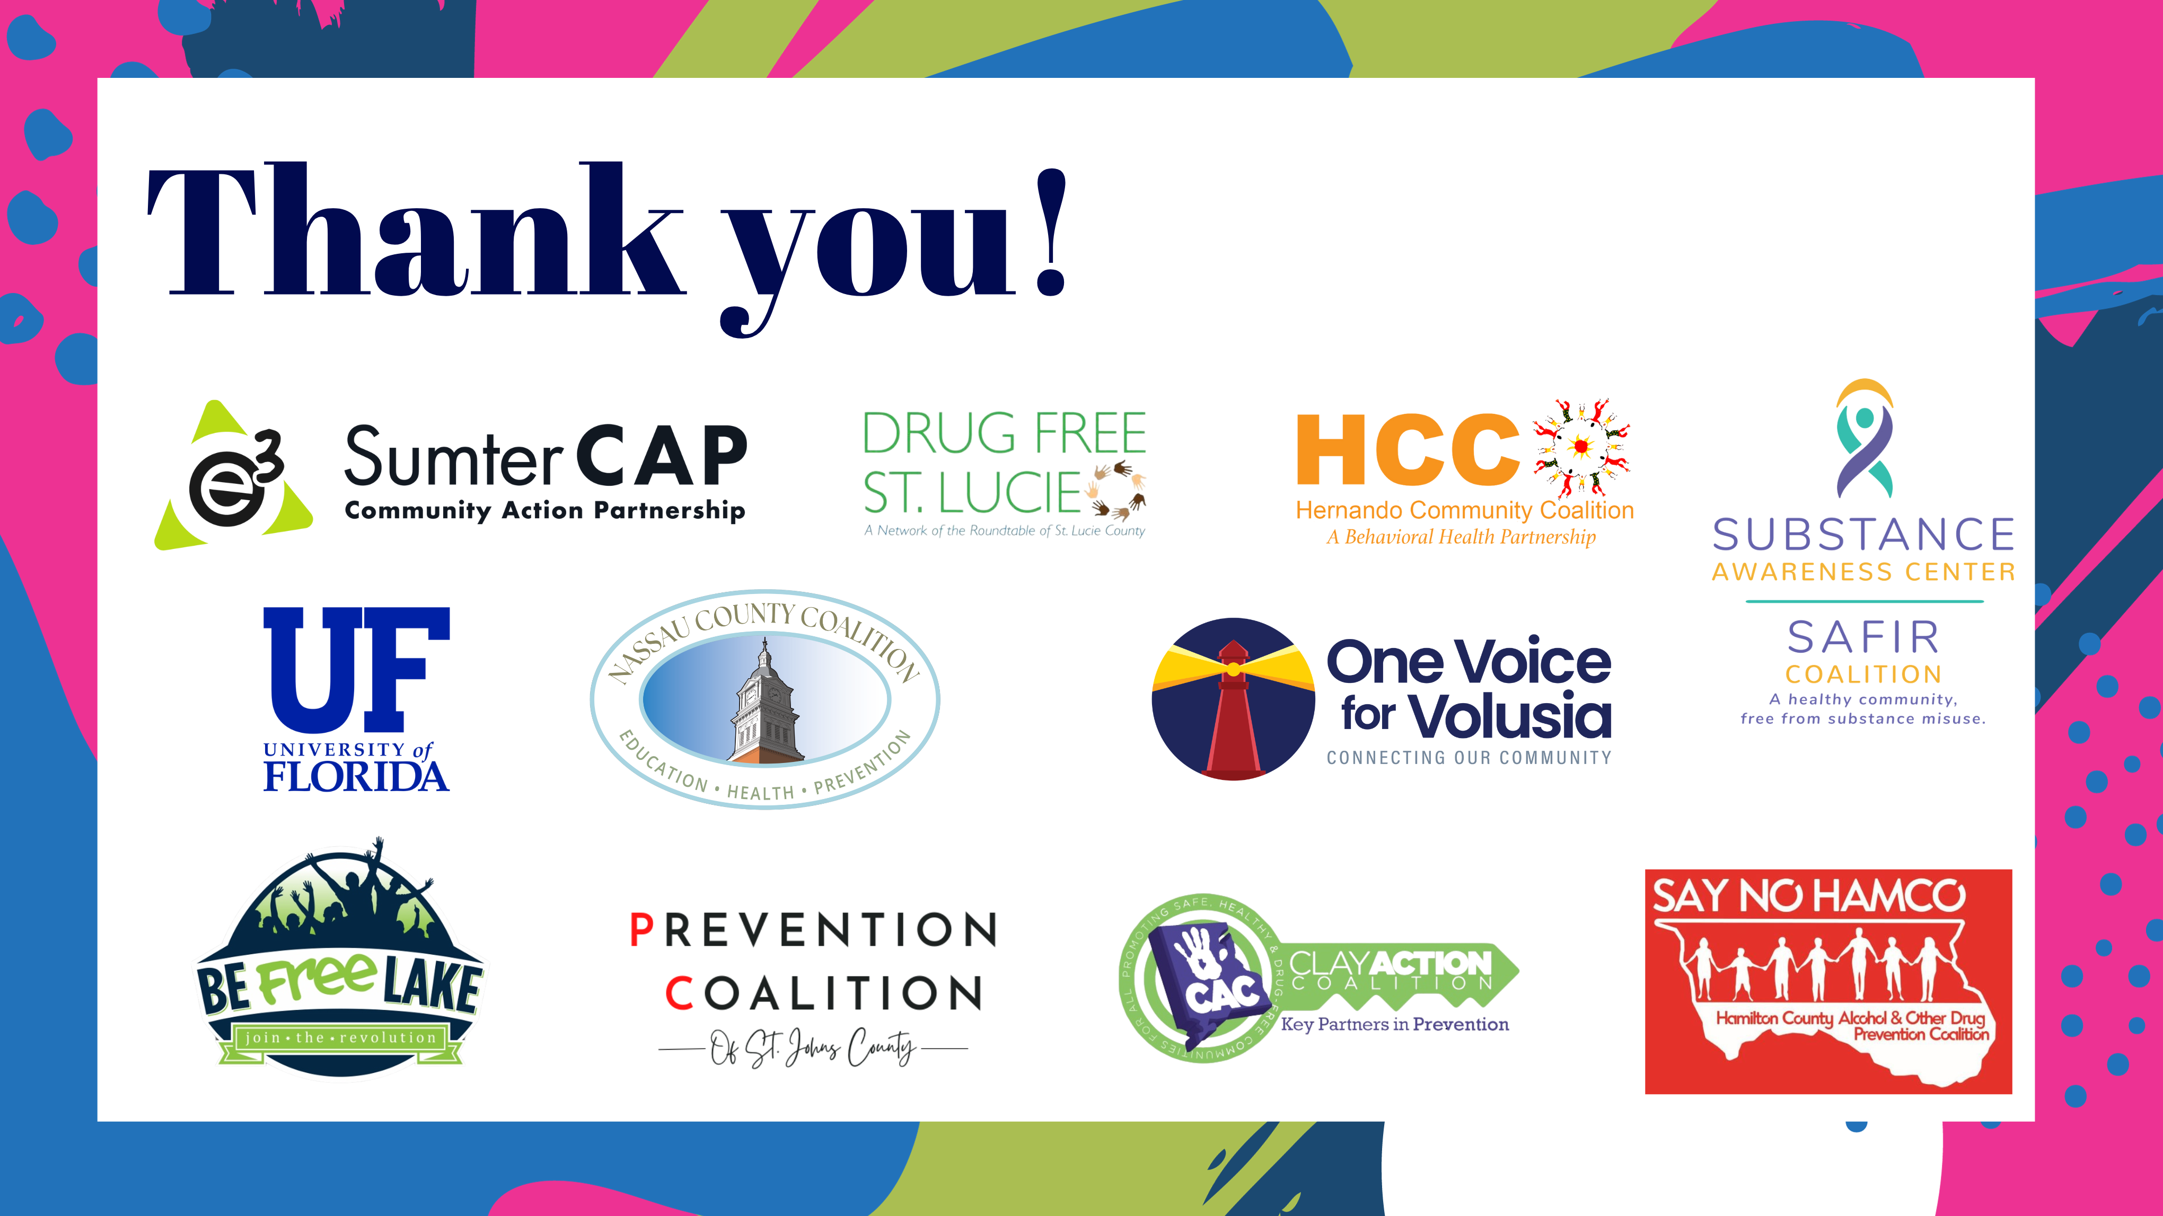

Slide 12
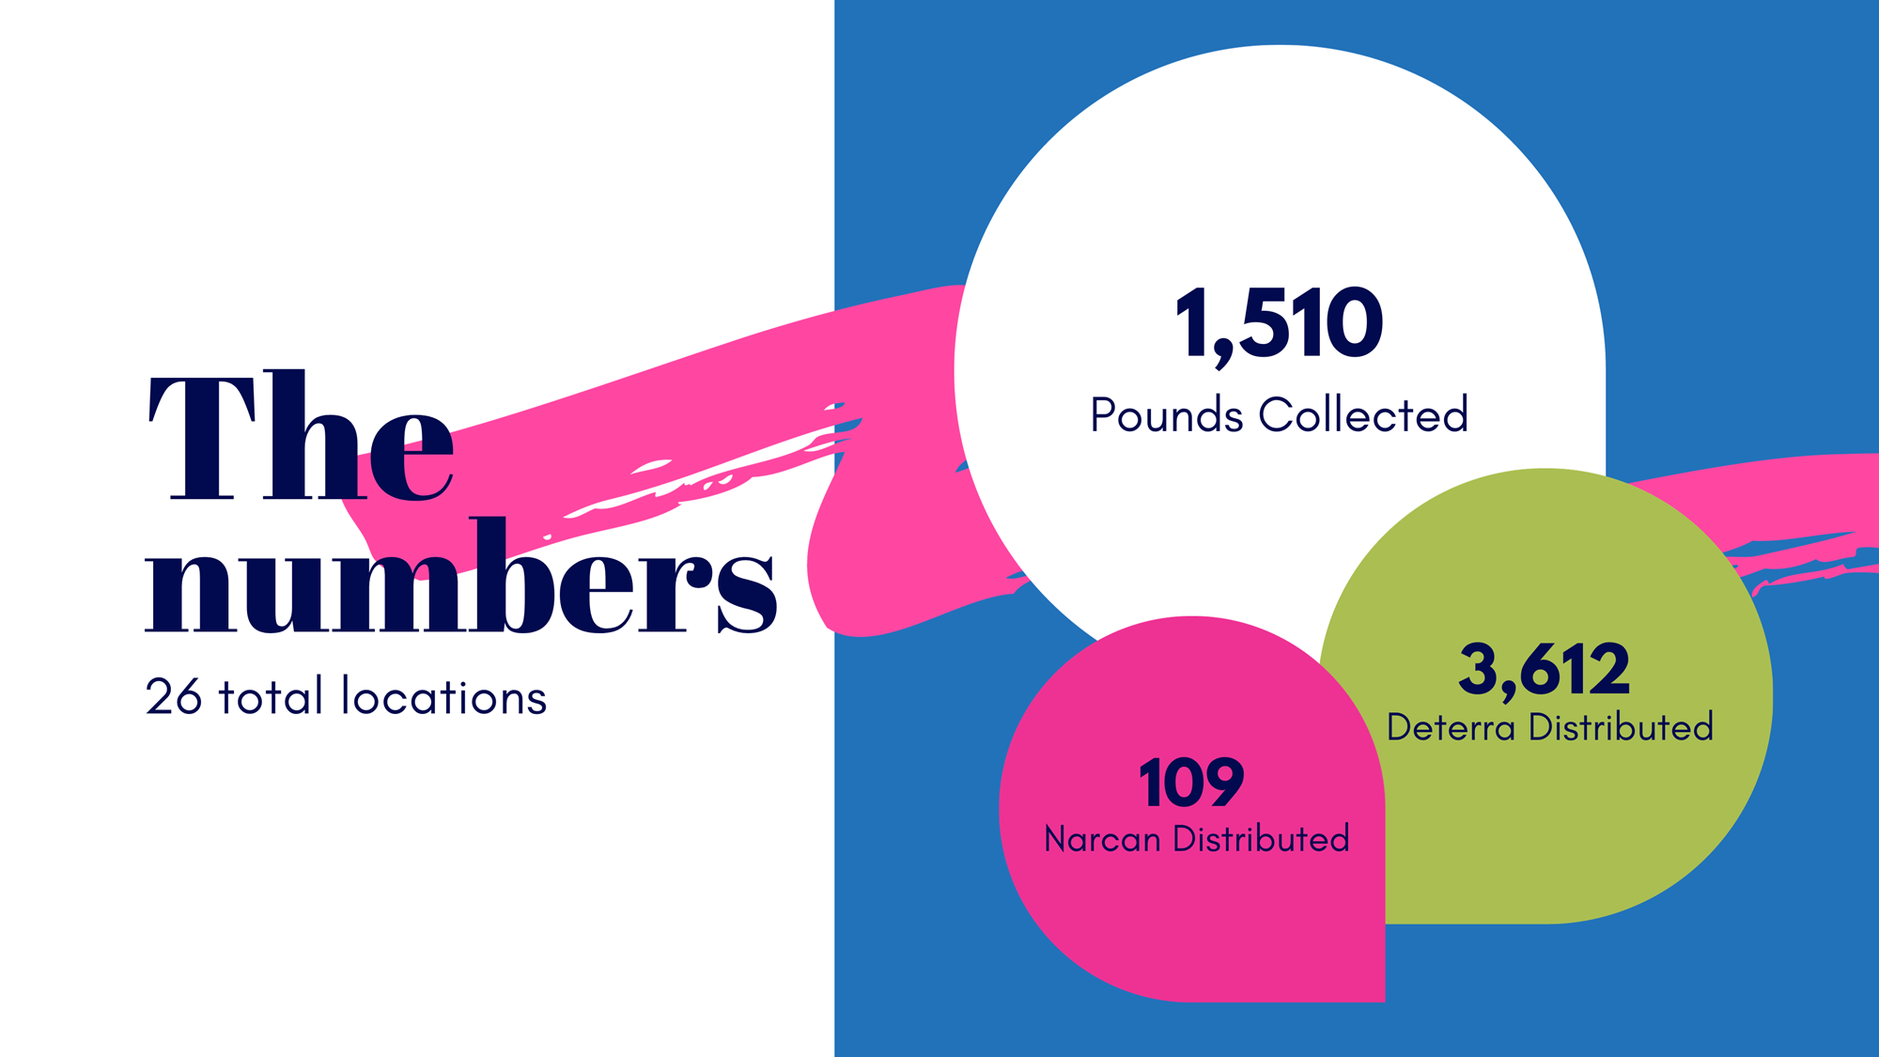

Slide 13


Slide 14
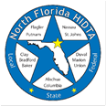

Deborah Babin
&
Scott Delano

Slide 15

ORS Team Updates
October DEN Meeting
November 29, 2023
Notes:
Lindsey

Slide 16
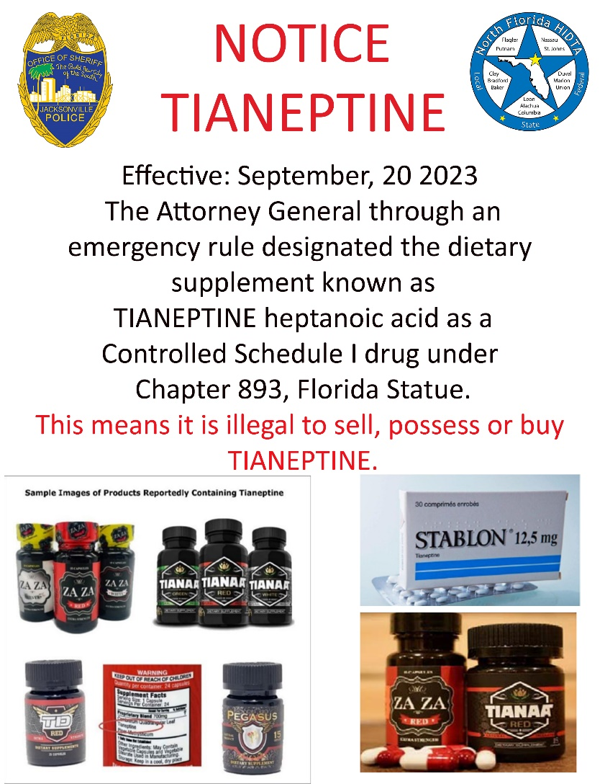

Slide 17
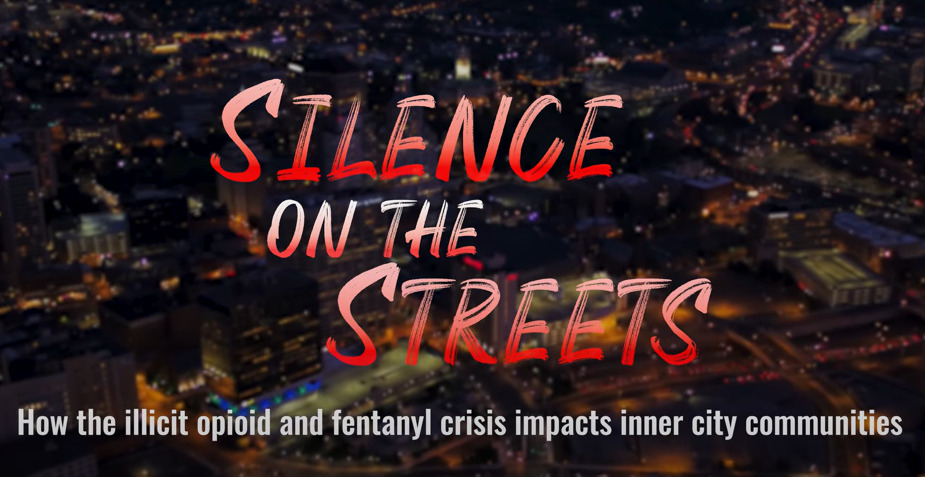
Available January of 2024.
The documentary's intent is to invite community members to have meaningful conversations and to serve as a catalyst for change in how we perceive and address addiction within marginalized communities.
"Silence on the Streets" is a ground-breaking documentary that explores the journey of addiction through the perspective of inner-city minorities and Native Americans.
https://www.youtube.com/watch?v=X7IAJ-YRc6Q

Slide 18
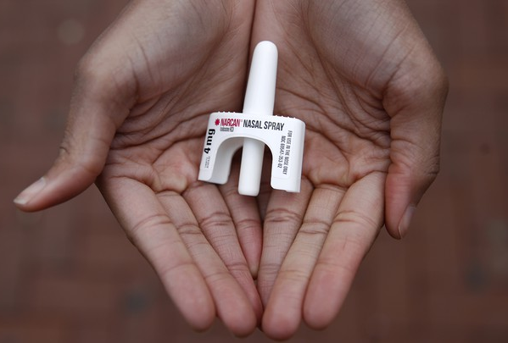

Laura Viafora Ray - JFRD

Slide 19

Overdose Data Surveillance & Trends in Jacksonville

Slide 20

Jacksonville Fire & Rescue Department Overdose Data
Data Source
  Jacksonville Fire & Rescue Department, City of Jacksonville, Florida
  Captain Michael Bernard - Office of Information Services (with additional analysis and chart/graph development by Laura Viafora Ray, MPH, CPH, Program Coordinator - Opioid Abatement)
Definitions
  Dispatched as Overdose = a 9-1-1 call in which the caller stated that the victim was suffering from a known or suspected overdose
  Naloxone Administered = the count of naloxone administered, which may include repeat doses to same patient
  Opioid-Related Overdose (known or suspected) = the following conditions existed: naloxone administered and nature of call at scene is “ingestion/poisoning/OD,” OR naloxone administered and clinical impression is “opioid-related,” OR overdose reported with the following substances: “Fentanyl, Carfentanil or Heroin,” OR overdose reported with naloxone administration, OR treatment protocol = “Overdose-Narcotic/Opioid”
    This query was updated in October 2023; ‘New Query’ is identical to ‘Old Query’ plus treatment protocol = “Overdose-Narcotic/Opioid”
  Bystander Narcan Use Prior to Arrival of JFRD = the following conditions existed: “Suspected Drug Overdose” = Yes AND “Opioid Antagonists Administered (PTA JFRD) = Nasal Naloxone/Narcan, OR narrative search for key terms “nasal” and “Narcan” and “naloxone” with a review of the narrative to ensure the incident applies to the intended definition and removal of duplicates so the same incident is not counted twice
Additional Notes
  A 911 call received as overdose and/or naloxone administration does not necessarily confirm an overdose, opioid use, or opioid misuse
  Each of the definitions and events listed above are independent of the other and are not mutually exclusive
Notes:
Notes:
The query for “Opioid-Related Overdose was amended in October of 2023 to also include incidents in which the protocol chosen was “Overdose-Narcotic/Opioid” and this slide reflects the updated definition that corresponds to the updated query. The query had been previously amended in April 2021.
“Naloxone Doses Administered”:
-On a DENs call several months ago, we were discussing the measures "Number of Opioid-Related Overdoses" and "Naloxone Doses Given" over time and as a ratio of calls to doses to see if that could be any indication of the potency of street drugs in a given time frame. I had an opportunity to discuss this with Mark in detail, so I wanted to share some takeaways from that conversation:
-JFRD's protocol for dosage of naloxone has changed multiple times over the years, and it depends on patient factors. For example, a patient experiencing cardiac arrest will be given 2 mg dose of naloxone at a minimum, compared to a range of 0.4 mg to 1.0 mg for a patient not experiencing cardiac arrest.
-Two doses of nasal Narcan will always equal 8 mg, because each plunger contains 4 mg, but two doses of IV naloxone given by JFRD will vary depending on the protocol at the time of the overdose incident and patient factors. In other words, there is not a standard "dose" of naloxone for the purposes of that data point.
-The EMT/firefighter's goal when giving a patient naloxone is for the patient to begin breathing, not necessarily regain consciousness. This is considered compassionate care because giving too high of a dose of naloxone will cause the patient to experience worse withdrawal symptoms. When a community member is giving Narcan, their goal is for the person to wake up, even if this means giving a much higher dose.
-The bad news is that due to these factors, these data points cannot be used to make any assessment about potency of street drugs. The good news is at least we have more clarification about this data and its limitations, so we won't make erroneous conclusions.

Slide 21
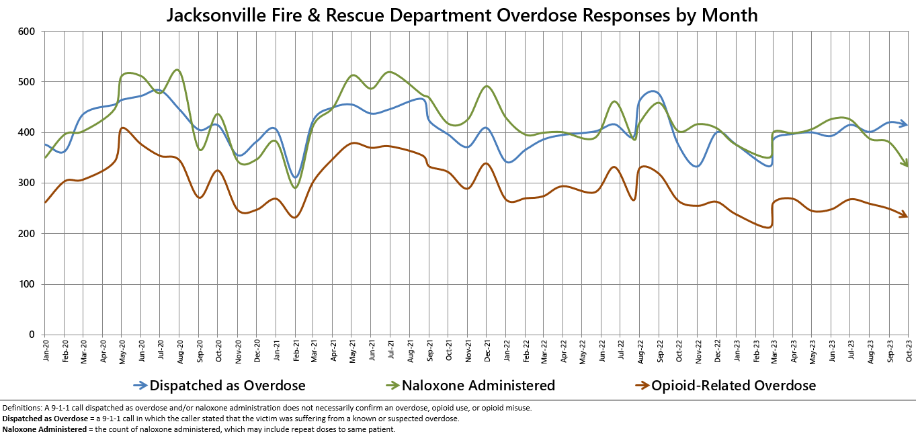

Slide 22
# of Suspected Opioid-Related (O-R)
Overdose (OD) Patients By Year
 | 2019-2020 | 2020-2021 | 2021-2022 | 2022-2023 (Jan-Oct)
% Change | +24% | +2% | -14% | -13%

Slide 23
Suspected Opioid-Related (O-R) Overdose (OD) Patients by Incident Zip Code January 2023 - October 2023
Zip Code (Health Zone) | Count | % of O-R OD | Trend (Compared to Jan-Oct 2022)
32210 (Southwest) | 193 | 8% | 24% Decrease
32218 (Outer Rim) | 160 | 7% | 38% Decrease
32244 (Southwest) | 137 | 6% | 31% Decrease
32208 (Urban Core) | 129 | 6% | 19% Increase
32207 (Arlington) | 125 | 5% | 17% Increase
32254 (Urban Core) | 118 | 5% | 22% Decrease
32205 (Southwest) | 115 | 5% | 21% Increase
32209 (Urban Core) | 114 | 5% | 20% Decrease
32211 (Arlington) | 109 | 5% | 12% Decrease
32216 (Arlington) | 106 | 5% | No Change
TOTAL (Top 10) | 1,306 | 57%
TOTAL (Other 24 Zips) | 970 | 43%
TOTAL (All 34 Zips) | 2,276 | 100%
Notes:
-Updated through September 2023

Slide 24
Suspected Opioid-Related (O-R) Overdose (OD) Patients by Incident Zip Code January 2023 - October 2023
Top 10 Zip Codes | Count | Population Size | Rate per 1,000 pop.
32202 (Urban Core) | 79 | 6,544 | 12.07
32254 (Urban Core) | 118 | 14,545 | 8.11
32204 (Urban Core) | 45 | 8,673 | 5.19
32205 (Southwest) | 115 | 29,605 | 3.88
32208 (Urban Core) | 129 | 33,286 | 3.88
32207 (Arlington) | 125 | 36,207 | 3.45
32206 (Urban Core) | 63 | 18,283 | 3.45
32220 (Outer Rim) | 44 | 13,037 | 3.38
32211 (Arlington) | 109 | 34,168 | 3.19
32219 (Outer Rim) | 46 | 14,474 | 3.18
TOTAL (Top 10) | 873
TOTAL (Other 24 Zips) | 1,403
TOTAL (All 34 Zips) | 2,276
Zip codes highlighted in orange appear on both lists: Top 10 for Count and Rate
Notes:
-Updated through September 2023
-Zip codes highlighted in orange = both in the top 10 for count and the top 10 for rate per 1,000
-Population size data source: Decennial Census (2020)

Slide 25
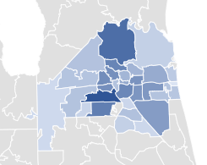
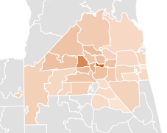
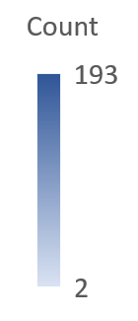
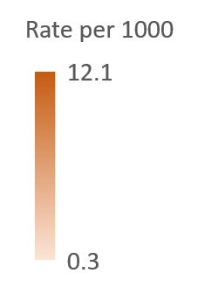
Opioid-Related Overdoses by Count and Rate
January 2023 - October 2023

Slide 26
% of Suspected Opioid-Related (O-R) Overdose (OD) Patients
Race/Year | 2014 | 2015 | 2016 | 2017 | 2018 | 2019 | 2020 | 2021 | 2022 | 2023 (Jan-Oct)
Black or African American | 8% | 8% | 10% | 9% | 10% | 11% | 14% | 18% | 21% | 22%
Hispanic or Latino | 2% | 2% | 2% | 3% | 4% | 3% | 4% | 3% | 5% | 6%
Other/ Unknown | 2% | 3% | 2% | 4% | 4% | 4% | 3% | 4% | 2% | 2%
White | 88% | 87% | 86% | 84% | 82% | 82% | 79% | 75% | 72% | 70%
% of Suspected Opioid-Related (O-R) Overdose (OD) Patients
Gender/Year | 2014 | 2015 | 2016 | 2017 | 2018 | 2019 | 2020 | 2021 | 2022 | 2023 (Jan-Oct)
Male | 53% | 55% | 64% | 62% | 61% | 64% | 66% | 68% | 66% | 66%
Female | 47% | 45% | 36% | 38% | 39% | 36% | 34% | 32% | 34% | 34%
Old Query | New Query
Notes:
-Updated through October 2023

Slide 27
% of Suspected Opioid-Related (O-R) Overdose (OD) Patients
Age Range | 2014 | 2015 | 2016 | 2017 | 2018 | 2019 | 2020 | 2021 | 2022 | 2023 (Jan-Oct)
19 or younger | 6% | 2% | 2% | 2% | 2% | 1% | 1% | 1% | 2% | 1%
20-29 | 26% | 30% | 30% | 26% | 26% | 21% | 20% | 15% | 14% | 14%
30-39 | 23% | 27% | 33% | 36% | 37% | 35% | 35% | 36% | 32% | 32%
40-49 | 18% | 17% | 17% | 18% | 17% | 22% | 21% | 23% | 24% | 25%
50-59 | 17% | 15% | 12% | 12% | 11% | 12% | 13% | 14% | 15% | 15%
60-69 | 6% | 6% | 5% | 5% | 5% | 6% | 7% | 9% | 10% | 10%
70 or older | 3% | 2% | 1% | 1% | 2% | 2% | 2% | 2% | 3% | 3%
Some years add up to 99% or 101% due to rounding
Old Query | New Query
Notes:
-Updated through october 2023

Slide 28
October 2023 Snapshot
232 opioid-related overdose patients across 232 opioid-related incidents
  6% decrease compared to October 2022
  7% increase compared to September 2023
Top zip code - 32218
  18 patients (8%)
72% male; 28% female
70% white; 19% black/AA; 11% other
30% between ages 40-49
55% residence; 22% roadway; 9% business or hotel; 14% other

Slide 29
Bystander Narcan Use Prior to Arrival (PTA) of JFRD
 | 2019-2020 | 2020-2021 | 2021-2022 | 2022-2023 (Jan-Oct)
% Change in Opioid-Related OD Calls | +24% | +2% | -14% | -13%
% Change in Use of NARCAN PTA by Bystanders | +59% | +79% | +5% | +30%
Notes:
Notes:
-Narcan nasal spray was first FDA approved in November 2015, but the first report of Narcan use PTA JFRD was not until 2017.

Slide 30
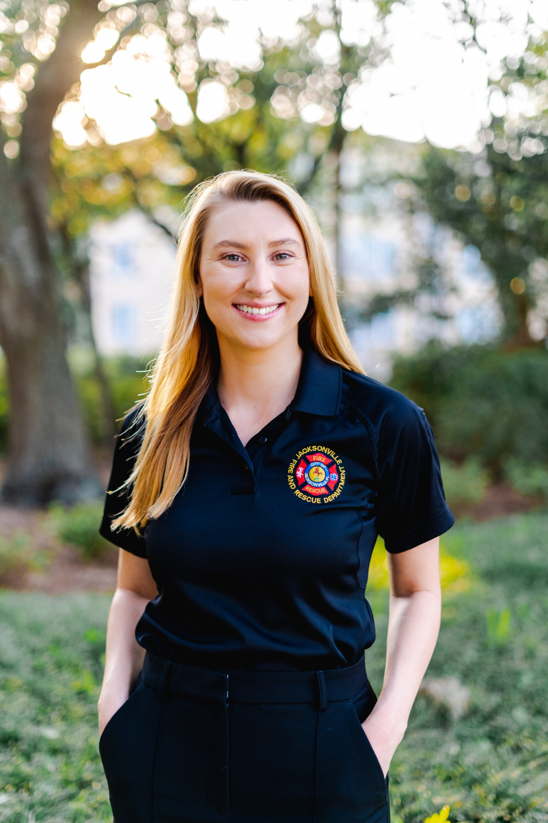
Contact Me
Laura Viafora Ray, MPH, CPH
Program Coordinator - Opioid Abatement
Office: (904) 255-7730
Cell: (904) 575-0495
Email: lvray@coj.net
Connect on LinkedIn

Slide 31
COJ Opioid Abatement Program Update

Slide 32
Opioid Abatement Update
FY 23-24 Opioid Settlement Proceeds Grants (OSPG) Application Cycle
Next Opioid & Substance Use Disorder (OSUD) Grants Committee Meeting
  Monday, December 4th at 2:00 PM at City Hall (Lynwood Roberts Room)​

Slide 33
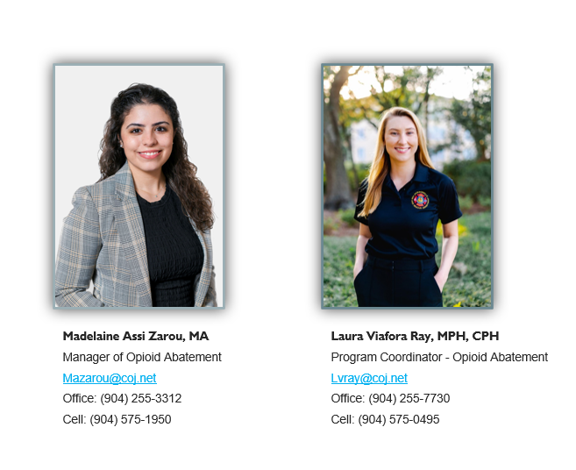
Opioid Abatement Program Staff
Notes:
Slide #50: Here is our office’s contact information. We are here to help!

Slide 34
Vanessa Salmo
Director of
Epidemiology & Evaluation
CCA

Slide 35
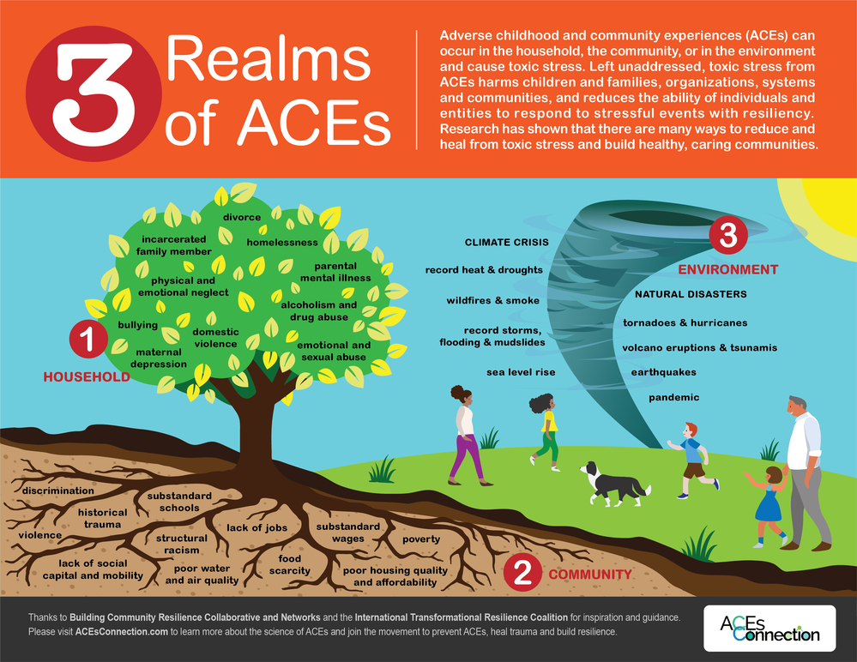
What are adverse childhood experiences?
Notes:
Hi Everyone,
My name is Vanessa Salmo, I am excited to have recently joined the CCA team as the Director of Epidemiology and Evaluation and have been collaborating with CCA and many of you for several years and I look forward to working with all of our partners in my new role!!
Today I will be presenting on Adverse childhood experiences, or ACEs, which are potentially traumatic events that occur in childhood (0-17 years).
They can be subdivided into where they occur.
For example in the household – like having a parent who struggles with substance use and mental illness, separation from a caregiver from divorce or incarceration, and abuse.
At the community level – things like community violence, poverty, food scarcity, or poor water quality lead to toxic stress
In the environment – hurricanes, the COVID pandemic, and heat are other examples of experiences that reduce a person or communities ability to respond to stress with resiliency.

Slide 36
National Snapshot
ACES ARE COMMON.
About 64% of U.S. adults reported they had experienced at least one type of ACE before age 18
Nearly 1 in 6 (17.3%) reported they had experienced four or more types of ACEs
PREVENTING ACES COULD POTENTIALLY REDUCE MANY HEALTH CONDITIONS.
By preventing ACEs, up to 1.9 million heart disease cases and 21 million depression cases potentially could have been avoided.
ACES ARE COSTLY.
ACEs-related health consequences cost an estimated economic burden of $748 billion annually in Bermuda, Canada, and the United States.
Inequities experiencing ACEs is linked to the historical, social, and economic environments in which some families live.
ACEs were highest among females, non-Hispanic American Indian or Alaska Native adults, and adults who are unemployed or unable to work.
SOME PEOPLE ARE AT GREATER RISK.
Centers for Disease Control and Prevention (CDC)
Notes:
At the national level aces are common – about 64% of adults in the US report having experienced at least 1 ACE and 17% report experiencing 4 or more ACEs
Investing in ACEs prevention can reduce heart disease by 1.9 million cases and 21 million depression cases.
While all children are at risk of ACEs, inequities are linked to historical, social, and economic social determinants of health and studies show ACEs have been highest among females, non Hispanic American Indian and Alaska native adults, and those who are unemployed or unable to work.
The health consequences related to ACEs cost an estimated $748 billion dollars annually.

Slide 37
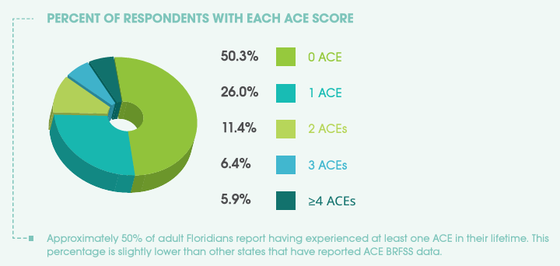
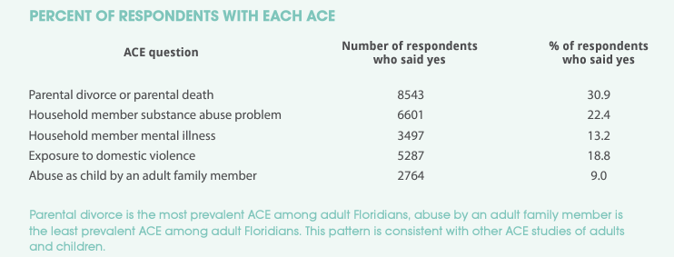
Historical Comparison – 2010 BRFSS
19% increase (2021)
At least 1 ACE:
50% of Floridians in 2010
Notes:
In the US we conduct The Behavioral Risk Factor Surveillance System (BRFSS) survey
And in 2010 A report was published analyzing the BRFSS ACEs data in Florida which showed that nearly approximately 50% of Floridians experienced at least 1 ACE.
CLICK - On the next slide you will see that in 2021 this has increased 19%
Approximately 22.4 percent of respondents report that a household member experiences SUD and 13.2 percent live with a household member who has a mental illness.

Slide 38
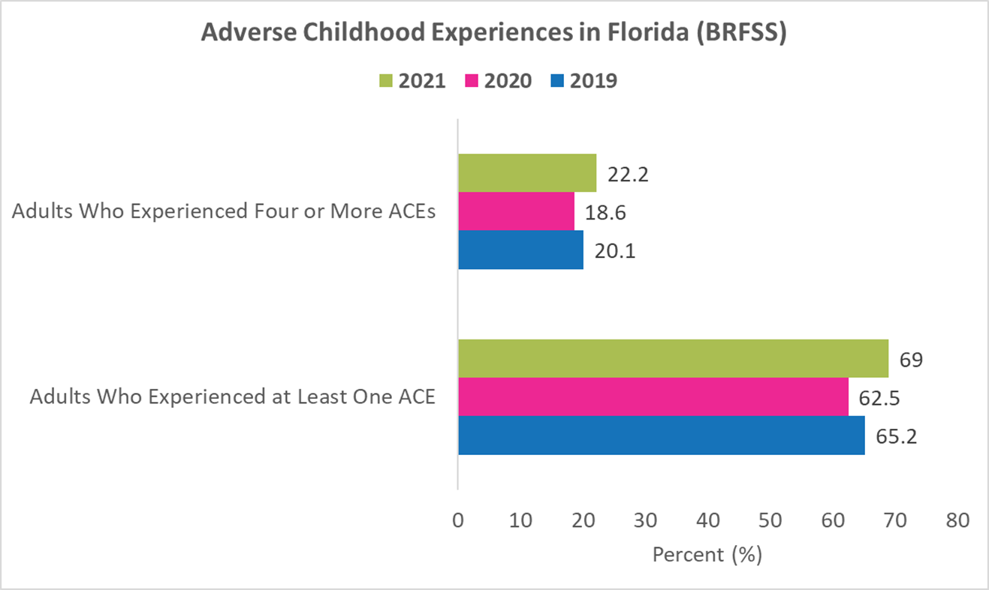
Florida Snapshot
69% of adults experienced at least one ACE in 2021
  3.8% increase since 2019
22.2% of adults experienced 4+ ACEs
  2.1% increase since 2019
Although there appears to have been a decrease in 2020, this is likely an anomaly attributed to barriers with survey administration due to the COVID-19 pandemic.
Florida Behavioral Risk Factor Surveillance System (BRFSS)
Notes:
In Florida, in 2021, 69% of adults experiences at least 1 ACE which is a 3.8% increase since 2019.
And 22.2% adults experienced 4+ ACEs which is a 2.1% increase since 2019.
Although there appears to have been a decrease in 2020, this is likely an anomaly attributed to barriers with survey administration due to the COVID-19 pandemic.
For example survey is administered by phone to people living in private residences or college campus and college campuses were closed during pandemic.

Slide 39
36.4%
A Parent or Adult in Their Home Swore at Them, Insulted Them or Put Them Down Before Age 18
31.3%
Their Parents Divorced or Separated Before Age 18
30.2%
Their Parents or Adults in Their Home Ever Hit, Beat, Kicked or Physically Hurt Them in Any Way Before Age 18
24.7%
Living With Anyone Who Was a Problem Drinker or Alcoholic Before Age 18
17.5%
Living With Anyone Who Was Depressed, Mentally Ill or Suicidal Before Age 18
RISK FACTORS
13.6%
Living With Anyone Who Used Illegal Street Drugs or Who Abused Prescription Medications Before Age 18
12.9%
Anyone at Least Five Years Older Than Them or an Adult Ever Touched Them Sexually Before Age 18
10.2%
Living With Anyone Who Served Time or Was Sentenced to Serve Time in a Prison, Jail or Correctional Facility Before Age 18
Notes:
This slide shows some of the top ACEs or risk factors from the BRFSS survey
CLICK – In Florida 24.7% of adults reported that before they were 18 they lived with someone who had alcohol use disorder and 13.6% of adults report living with someone with SUD.
CLICK - Also in 2010 we saw that 13.2 percent live with a household member who has a mental illness. And in 2021 this has increased to 17.5%

Slide 40
PROTECTIVE FACTORS
8.3%
There Was an Adult in the Household Who Made Them Feel Safe and Protected a Little or Some of the Time
87.6%
There Was an Adult in the Household Who Made Them Feel Safe and Protected Most or All of the Time
92.7%
There Was an Adult in the Household Who Tried Hard to Make Sure Their Basic Needs Were Met Most or All of the Time
6.3%
There Was an Adult in the Household Who Tried Hard to Make Sure Their Basic Needs Were Met a Little or Some of the Time
Can having a caregiver who lives with SUD or mental illness be a protective factor?
ABSOLUTELY!
Notes:
This slide shows some of the top protective factors that increase resiliency
ACEs research can sometimes lag when it comes to identifying protective factors and I like to point out that a child who grows up living with a caregiver in recovery who is actively managing their SUD or mental illness can be positively impacted because they learn coping strategies, witness resilience, and see their caregiver living a healthy life.

Slide 41

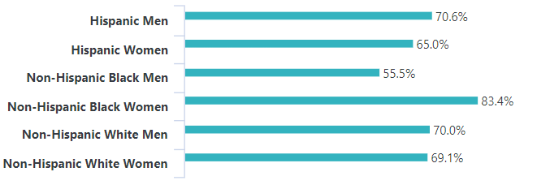



Adults Who Have Experienced 1+ ACE (2021)
Ages 18-44: 77.0%
Ages 45-64: 71.5%
Ages 65 & Older: 60.1%
Less Than High School: 70.7%
High School/GED: 68.5%
More Than High School: 68.3%
Less Than $25,000: 78.2%
$50,000 or More: 70.5%
$25,000-$49,999: 68.6%
Not Married/Couple: 70.9%
Married/Couple: 67.7%
Florida Youth Substance Abuse Survey (FYSAS)
Notes:
Now we will shift to looking at the FYSAS survey.
This slide provides demographic information for adults who experience at least one ACE
We found that non Hispanic black women had the highest percentage of experiencing at lease 1 ace
Next to each sex by race/ethnicity category the arrows represent percent change. All groups have seen increases since 2019 with Hispanic men having the largest increase and non Hispanic black men seeing the largest decreases
Those who are 18-44, those with less than a high school education, those who are not married and who’s income is less than 25 thousand dollars.
You will find the demographics shift when we look at those who experience 4 or more ACEs

Slide 42
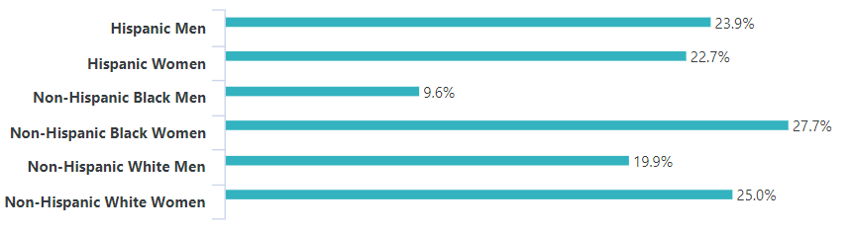
Adults Who Have Experienced 4+ ACEs (2021)
Ages 18-44: 33.6%
Ages 45-64: 24.4%
Ages 65 & Older: 11.2%
Less Than High School: 23.1%
High School/GED: 27.7%
More Than High School: 21.1%
Less Than $25,000: 26.5%
$25,000-$49,999: 21.1%
$50,000 or More: 23.9%
Not Married/Couple: 20.7%
Married/Couple: 24.5%
Florida Youth Substance Abuse Survey (FYSAS)
Notes:
Here we have demographics for adults who experience 4 or more ACEs
Still non Hispanic black women had the highest percentage at 27.7% but the shift comes when we look at those who identify as non-Hispanic white. When we looked at 1 or more ACEs white men and women were equally impacted but when we look at 4 or more ACEs white women tend to have higher percentages than men.
Again we see that Hispanic men have seen the largest increases in 2021 compared to 2019.
Those who are 18-44 and those with an income less than 25 thousand dollars still have the highest likelihood of experiencing 4+ ACEs BUT you will find the demographics shift when we look at education and marriage. Now we see those with high school diploma or GED and married couples have a higher percentage of experiencing 4+ ACEs.

Slide 43
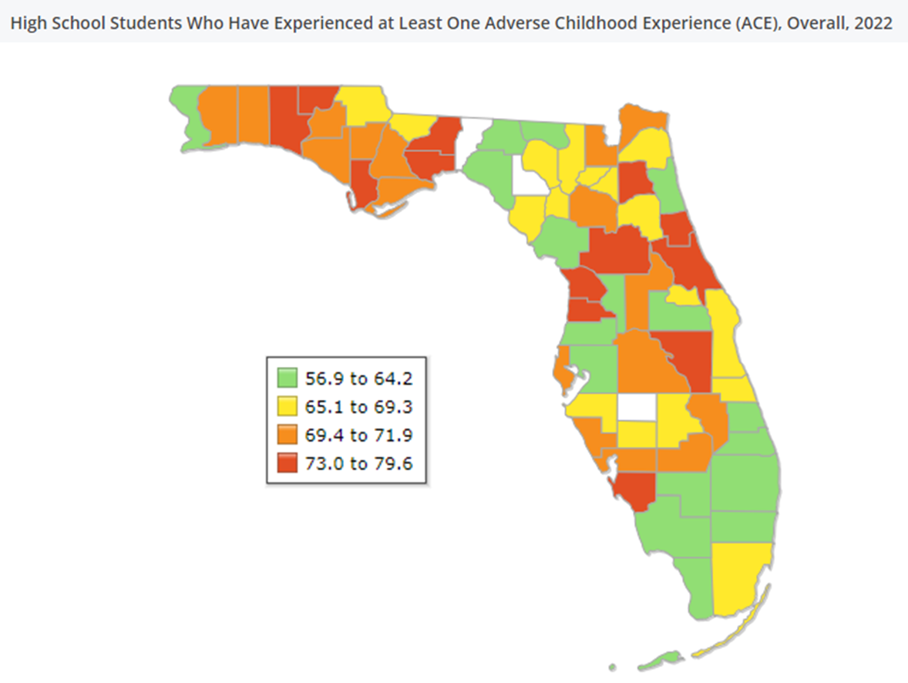
County Snapshot
In 2022, in Duval County, 67.1% of the High School Students Who Have Experienced at Least One ACE can be compared to 67.2% statewide.
Clay:
73.2%
Nassau:
71.3%
St. Johns:
62%
Florida Youth Substance Abuse Survey (FYSAS)
Notes:
Now lets get a little more granular to look at county data snapshots with data for high school students–
In 2022, in Duval County, 67.1% of the High School Students Who Have Experienced at Least One ACE can be compared to 67.2% statewide.
We can also compare this to surrounding counties - in Clay County, 73.2% of the High School Students Who Have Experienced at Least One Adverse Childhood Experience compared to
Nassau County with 71.3% and 62% in St. Johns County

Slide 44
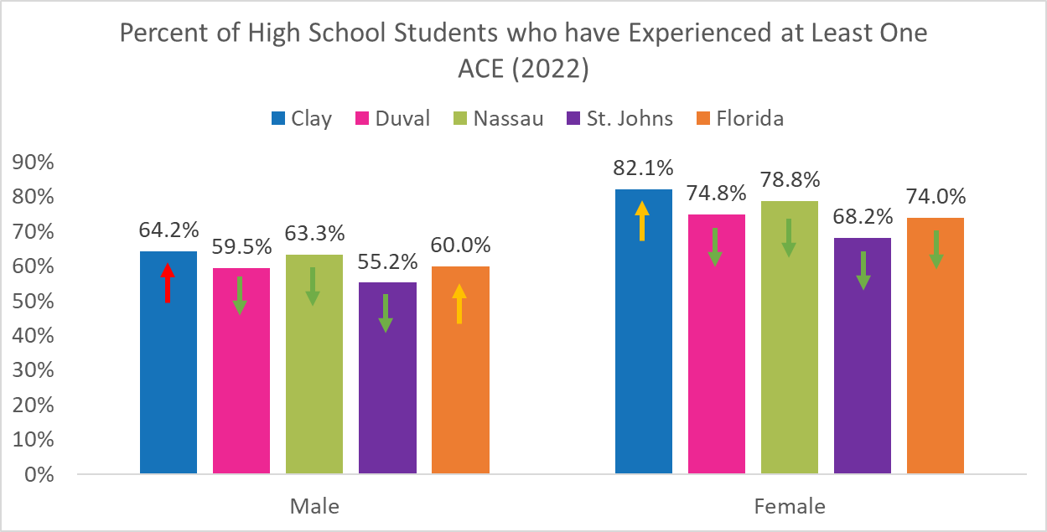
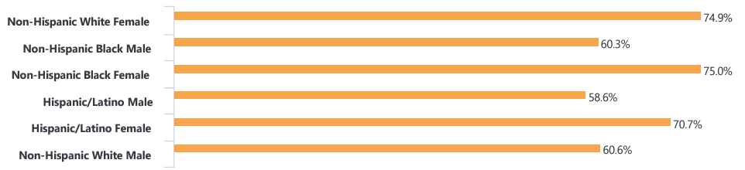
High School Students Have Experienced 1+ ACE (2022)
Florida Youth Substance Abuse Survey (FYSAS)
Notes:
Among high school students in Florida we have seen better outcomes with only very slight increases for some groups and decreases for other groups in 2022 compared to 2020.
CLICK - When comparing the county level data we find that– Clay and Nassau have more males who have experienced at least 1 ACE compared to Florida overall.
And for females, St. Johns has fewer females reporting experiencing at least 1 ACE compared to Florida overall.
Males in Clay county have seen the largest increase but males in Florida overall have also had increases. females in clay have also had an increase.

Slide 45
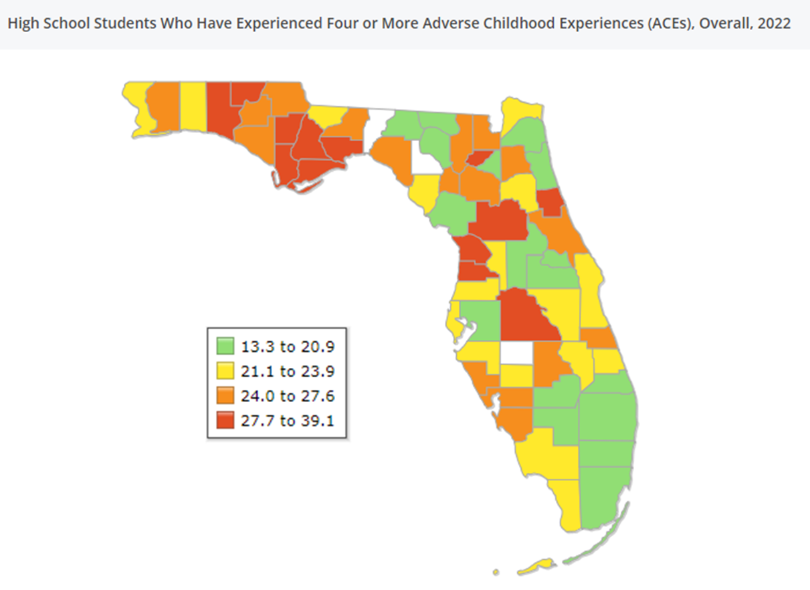
County Snapshot
In 2022, in Duval County, 18.5% of the High School Students Who Have Experienced Four or More ACEs can be compared to 21.4% statewide.
Clay:
26.2%
Nassau:
23.9%
St. Johns:
20.3%
Florida Youth Substance Abuse Survey (FYSAS)
Notes:
In 2022, in Duval County, 18.5% of the High School Students Who Have Experienced Four or More ACEs can be compared to 21.4% statewide.
And again compared to the region where Clay County there are 26.2%, 23.9% in Nassau County, and 20.3% in St. Johns County

Slide 46
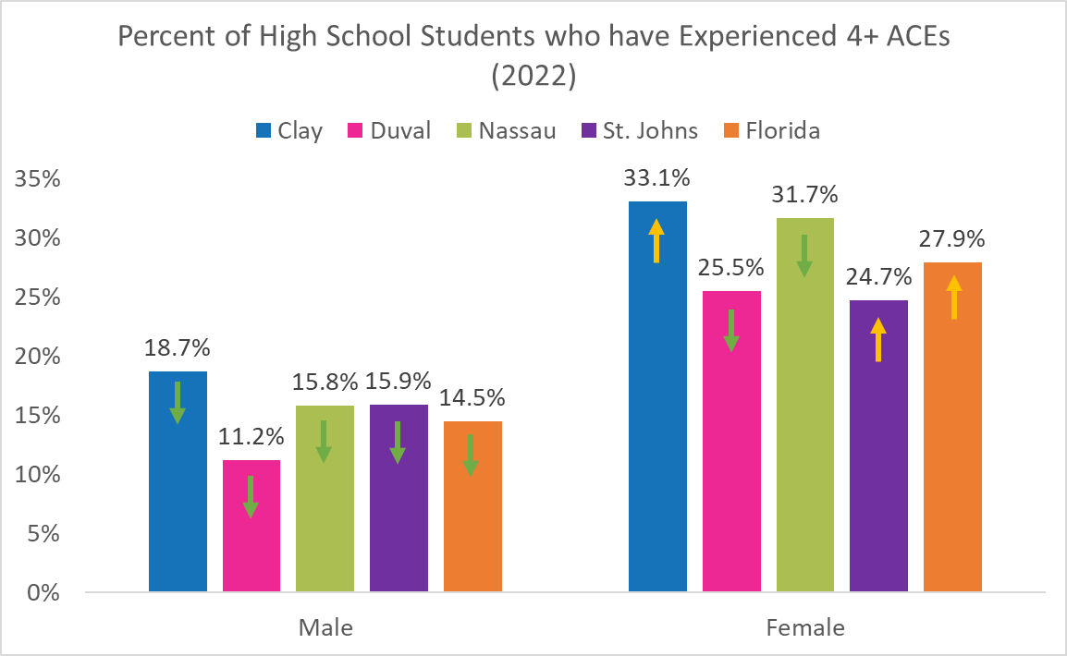
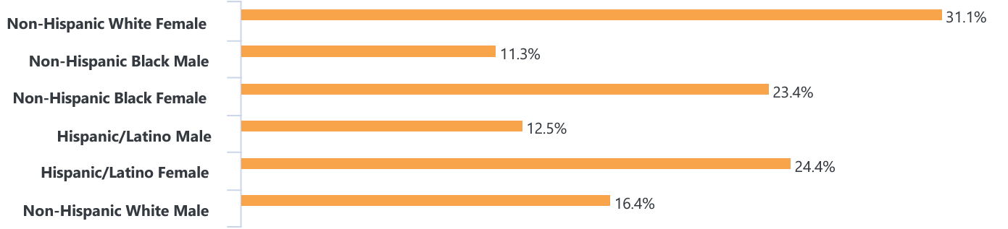
High School Students Who Have Experienced 4+ ACEs (2022)
Florida Youth Substance Abuse Survey (FYSAS)
Notes:
This slide provides demographic information for those who experience 4 or more ACEs
We found that non Hispanic white female high school students had the highest percentage of experiencing 4 or more aces yet this group has seen no change since 2020. Group that have had increases are non Hispanic black males, Hispanic or latino males, and non Hispanic white males.
CLICK - When looking at the county level data, female students in Clay and St. johns counties have seen slight increases in 2022 compared to 2020.

Slide 47

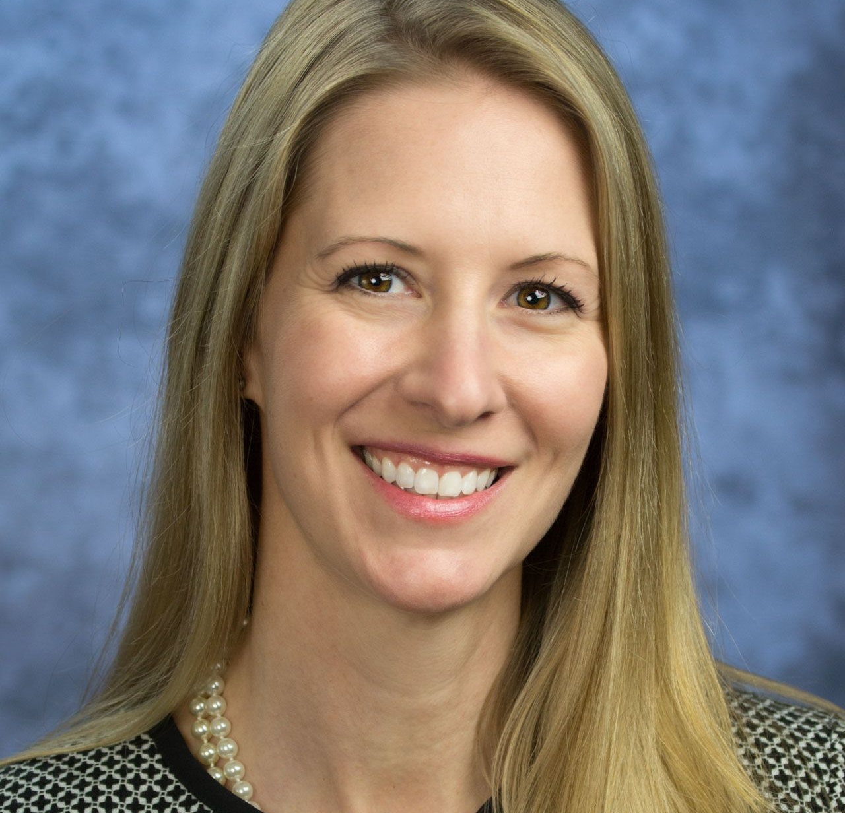
Join the
Northeast Florida ACE Alliance
(NFAA)
Dr. Lisa Merlo presenting Helping People Change Rather Than
“Be Changed”—
An Introduction to Motivational Interviewing
Next Meeting:
December 1, 2023 at 10am
Join Zoom Meeting:
https://us06web.zoom.us/j/85126718273?pwd=RDVMamFITFNZNGhtZmpmb0tDR2hzZz09
Meeting ID: 851 2671 8273
Passcode: 314773
Notes:
I also wanted to put a plug in for our Northeast Florida ACE Alliance.
Our last meeting of 2023 will be December 1st at 10am on Zoom. We have a special guest, Dr. Lisa Merlo, who is presenting – Helping People Change Rather than Be Changed. An introduction to Motivational Interviewing.
We hope that you will join us!!

Slide 48



New Year New NFAA
Membership
  Current meeting schedule – 1st Friday 10am
  Survey: Link Below or QR Code
    Northeast Florida ACE Alliance (NFAA) 2024
Your Voice Matters
  Strategic Planning
Notes:
Here is a flyer for our local Community PACEs initiative – which is a local chapter part of a national network. NFAA was launched in 2022 by a small group of enthusiastic people interested in ACEs. Over the past year and a half we have hosted presentations on ACEs from national and local speakers and have provided a Professional Certification in Trauma and Resilience from FSU to our members with the goal of increasing our knowledge on ACEs and related topics.
One of our goals for 2024 is to recruit a larger group of interdisciplinary stakeholders interested in addressing and preventing ACEs.
In the new year we will be conducting a collaborative strategic planning meeting where we hope to gather ideas from you on what has worked and what are your aspirations for our ACEs work locally. This process will allow us to develop collective goals that are representative of our communities across Northeast Florida.
Now is the perfect time to join, please fill out the short poll USING THE QR CODE to identify a day and time that will work best for our monthly meetings in 2024.

Slide 49

Tuesday @ 2pm – December 12th
Emily’s Backpack
An exercise to understand ACEs
https://ccafl.adobeconnect.com/neprevention
Notes:
Additionally, I will be presenting on ACEs at the Dec. 12th Tuesday at 2pm, we hope to see you there!!

Slide 50

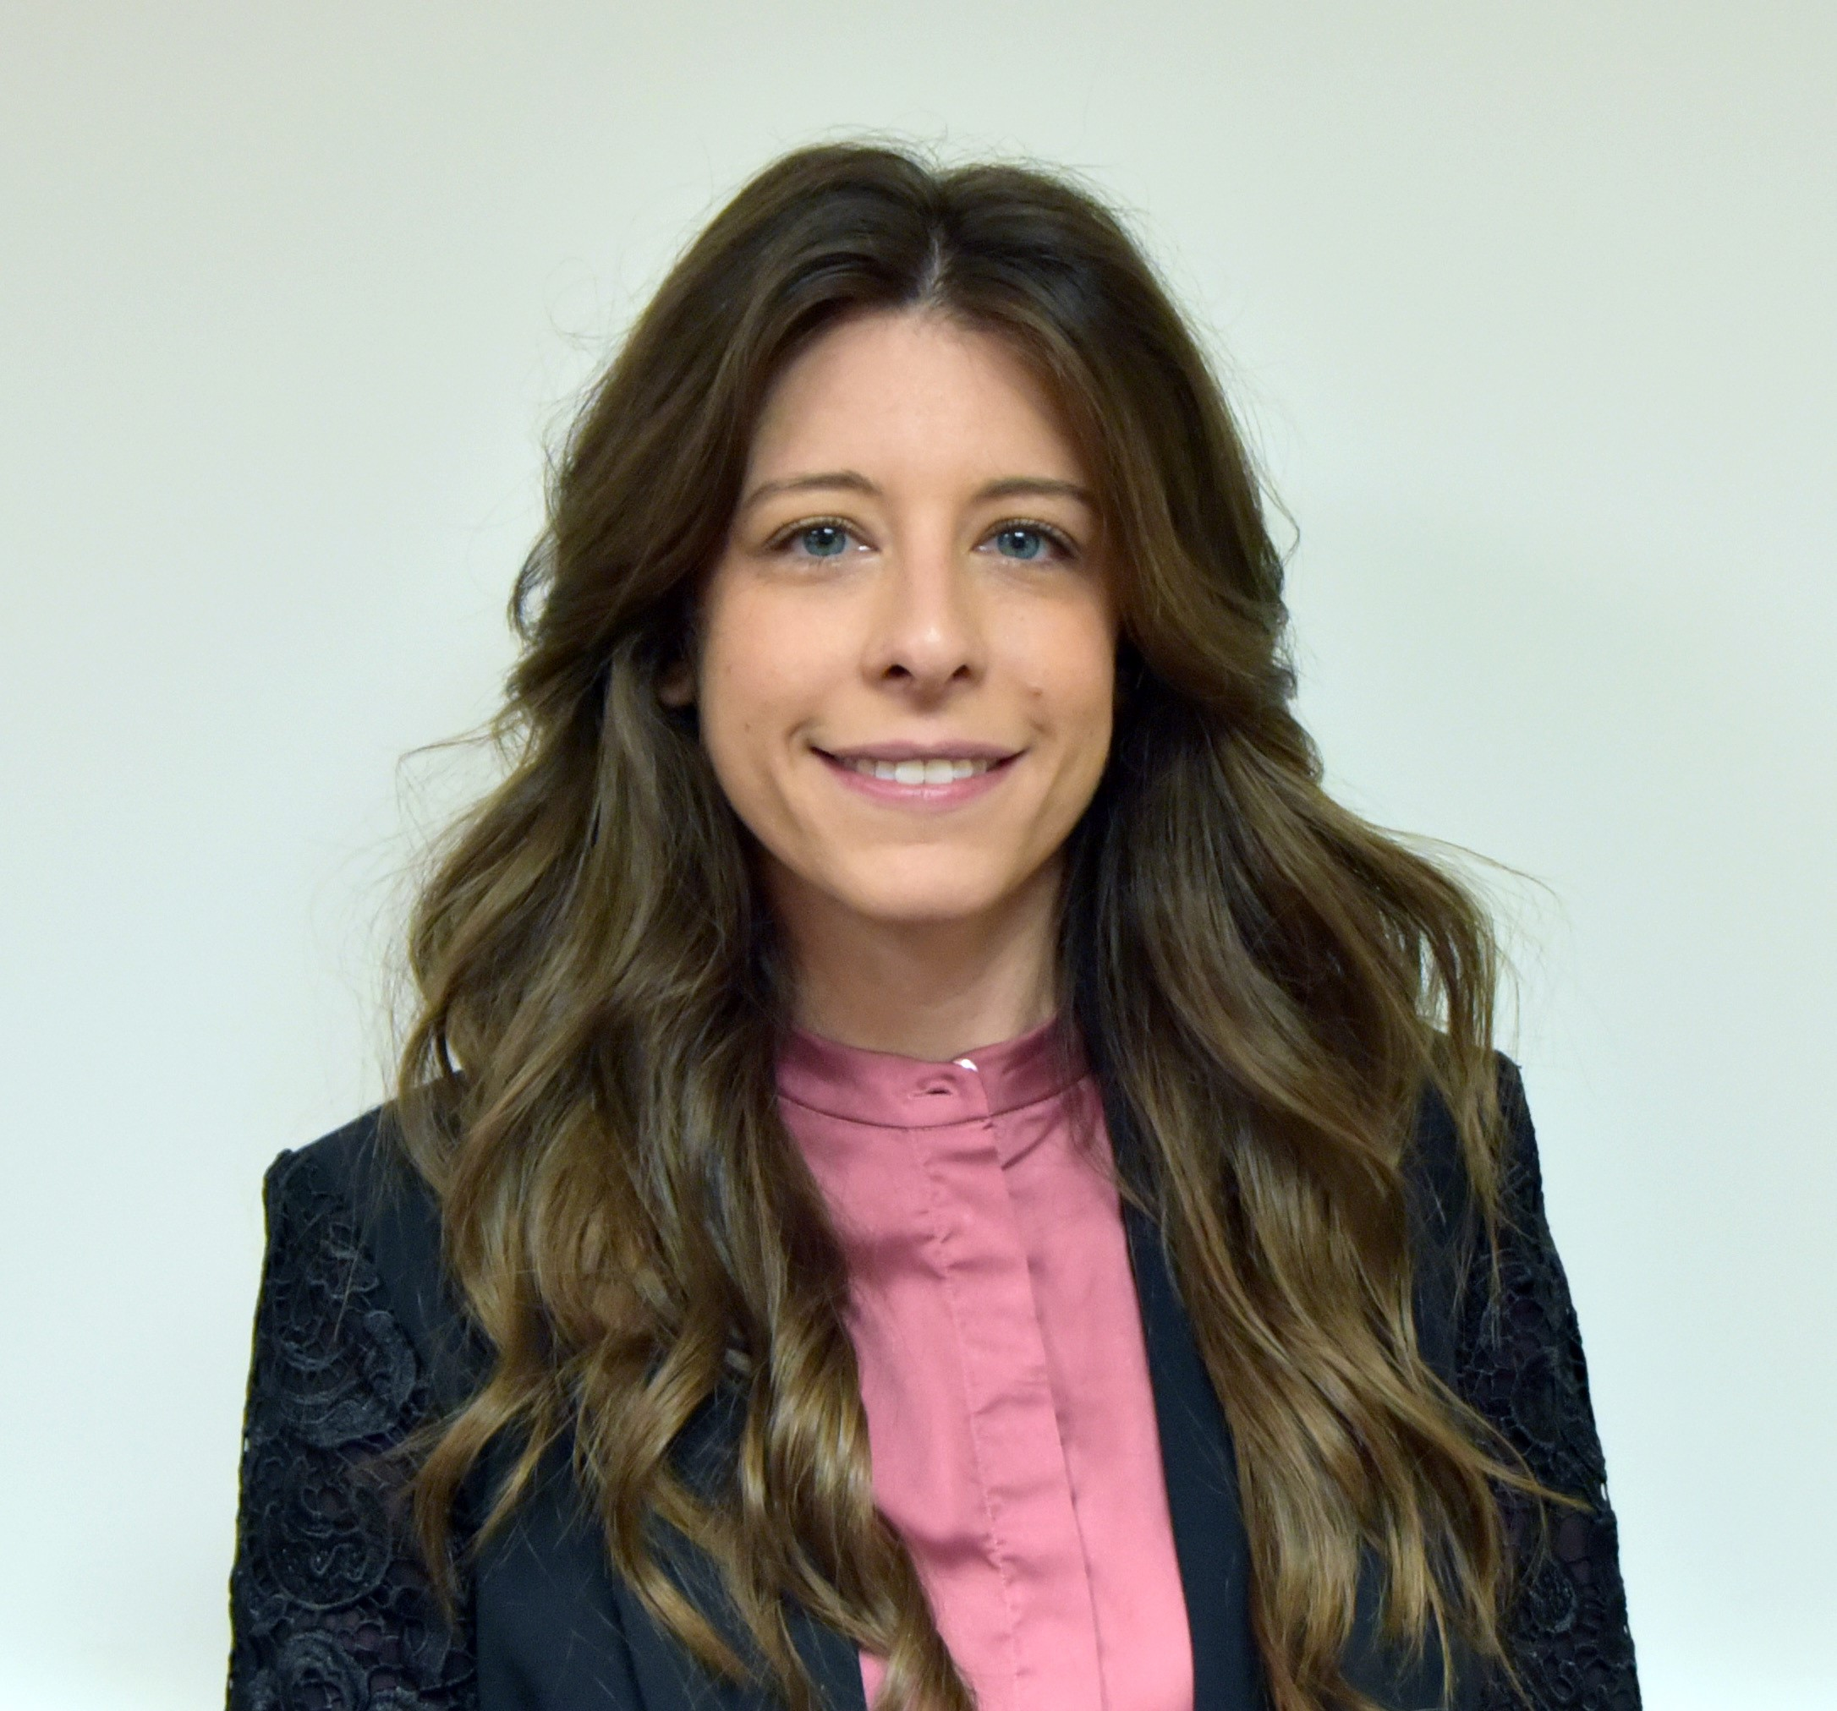
We are here to support you!
Vanessa Salmo, MPH
Epidemiology & Evaluation Director
Community Coalition Alliance, Inc.
vsalmo@ccafl.org
Notes:
Thank you so much for your time, If you have any questions I am happy to answer them today and if you would like to brainstorm about community data or evaluation please reach out to me anytime!

Slide 51
Sober Living & Recovery Supports
Data
Subcommittees

Slide 52

Thank You
52
Kathleen Roberts
KRoberts@ccafl.org
Deborah Babin
DBabin@nfhitda.org

