Slide 1
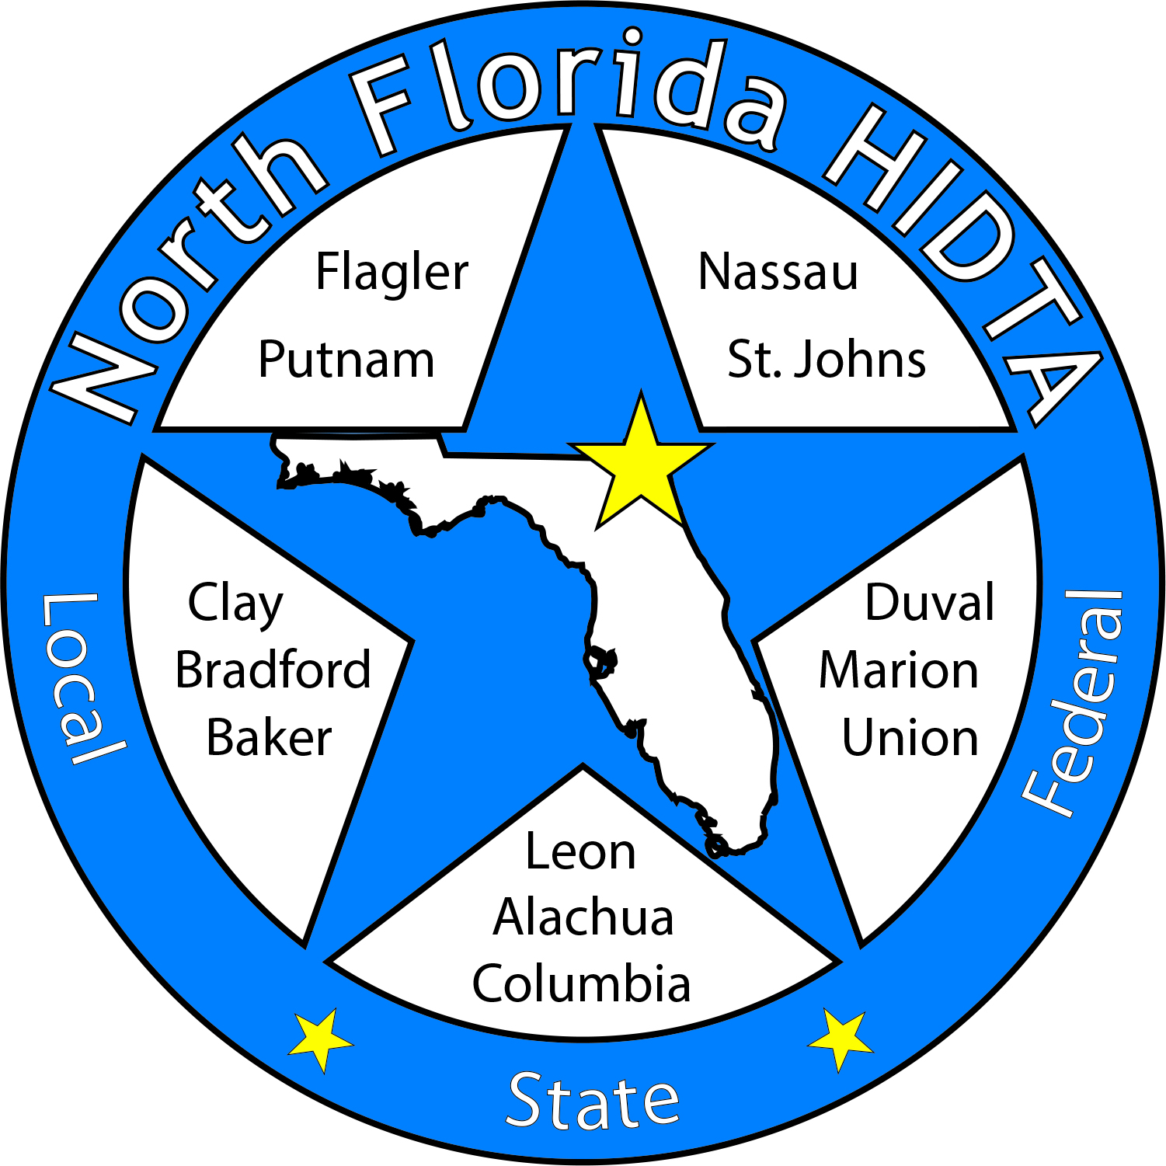
Duval DEN
January 24, 2024

Slide 2
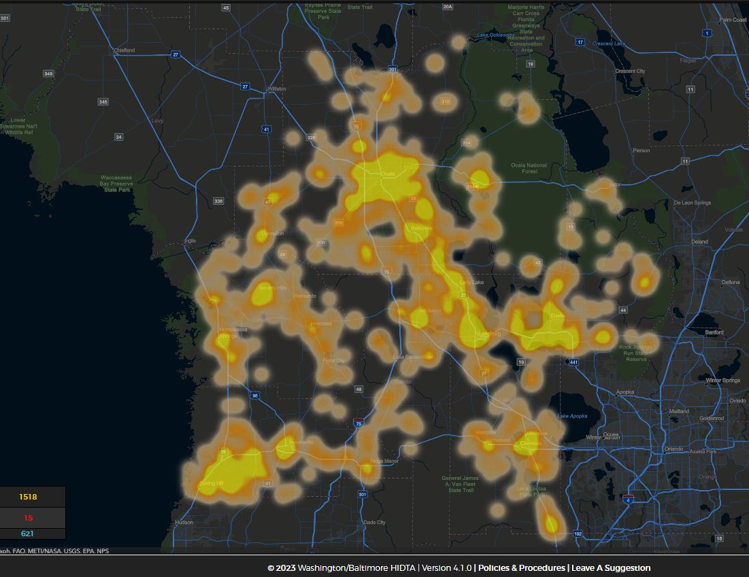
Today’s Focus
Welcome & Introductions
Data & Information Shares
Subcommittees
Open Discussion

Slide 3
Membership – Circuit 4 Partners

Slide 4
DEN Meetings
February – Virtual
March – RDEN
April – Virtual
May – In Person
June – In Person

Slide 7
DATA & INFORMATION SHARES

Slide 8
April 27, 2024

Slide 9
Thank You For Attending
Coalition Meeting 2024

Slide 10
Bringing Attention to the Youth’s Voice

Slide 11
Launching New Video Project
Collegiate Recovery Week
April 15th – 19th, 2024

Slide 12
Deborah Babin & Scott Delano

Slide 13
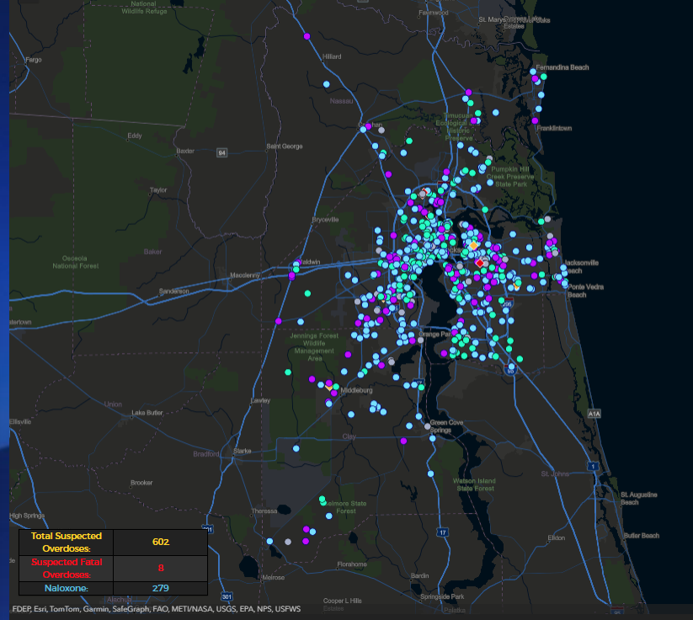
District 4: Jan 1, 2024 – Feb 28, 2024

Slide 14
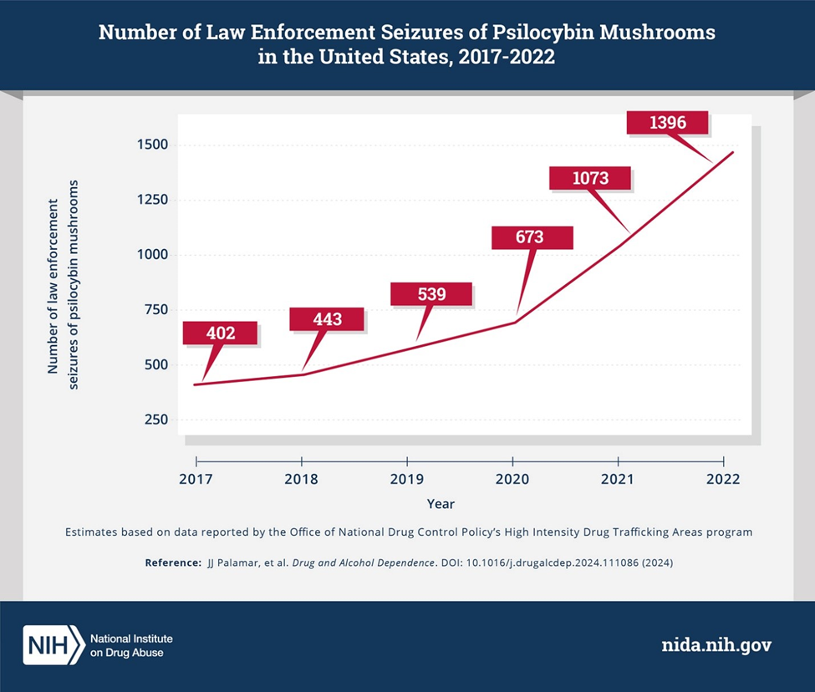
Emerging Threat: Psychedelic Mushroom

Slide 15
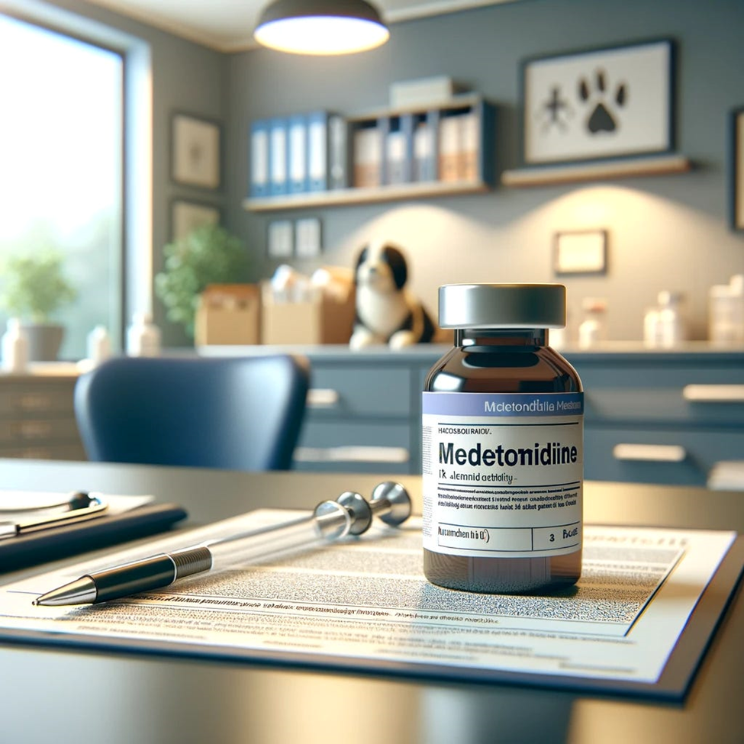
Emerging Threats: Medetomidine

Slide 16
Emerging Threats: Cocaethylene

Slide 17
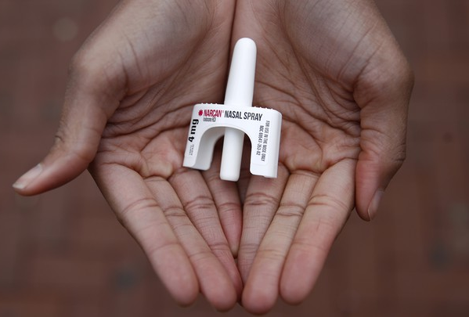
Laura Viafora Ray - JFRD

Slide 18
Overdose Data Surveillance & Trends in Jacksonville

Slide 19
Jacksonville Fire & Rescue Department Overdose Data
Data Source
Jacksonville Fire & Rescue Department, City of Jacksonville, Florida
Captain Michael Bernard - Office of Information Services (with additional analysis and chart/graph development by Laura Viafora Ray, MPH, CPH, Program Coordinator - Opioid Abatement)
Definitions
Dispatched as Overdose = a 9-1-1 call in which the caller stated that the victim was suffering from a known or suspected overdose
Naloxone Administered = the count of naloxone administered, which may include repeat doses to same patient
Opioid-Related Overdose (known or suspected) = the following conditions existed: naloxone administered and nature of call at scene is “ingestion/poisoning/OD,” OR naloxone administered and clinical impression is “opioid-related,” OR overdose reported with the following substances: “Fentanyl, Carfentanil or Heroin,” OR overdose reported with naloxone administration, OR treatment protocol = “Overdose-Narcotic/Opioid”
This query was updated in October 2023; ‘New Query’ is identical to ‘Old Query’ plus treatment protocol = “Overdose-Narcotic/Opioid”
Bystander Narcan Use Prior to Arrival of JFRD = the following conditions existed: “Suspected Drug Overdose” = Yes AND “Opioid Antagonists Administered (PTA JFRD) = Nasal Naloxone/Narcan, OR narrative search for key terms “nasal” and “Narcan” and “naloxone” with a review of the narrative to ensure the incident applies to the intended definition and removal of duplicates so the same incident is not counted twice
Additional Notes
A 911 call received as overdose and/or naloxone administration does not necessarily confirm an overdose, opioid use, or opioid misuse
Each of the definitions and events listed above are independent of the other and are not mutually exclusive
Notes:
Notes:
The query for “Opioid-Related Overdose was amended in October of 2023 to also include incidents in which the protocol chosen was “Overdose-Narcotic/Opioid” and this slide reflects the updated definition that corresponds to the updated query. The query had been previously amended in April 2021.
“Naloxone Doses Administered”:
-On a DENs call several months ago, we were discussing the measures "Number of Opioid-Related Overdoses" and "Naloxone Doses Given" over time and as a ratio of calls to doses to see if that could be any indication of the potency of street drugs in a given time frame. I had an opportunity to discuss this with Mark in detail, so I wanted to share some takeaways from that conversation:
-JFRD's protocol for dosage of naloxone has changed multiple times over the years, and it depends on patient factors. For example, a patient experiencing cardiac arrest will be given 2 mg dose of naloxone at a minimum, compared to a range of 0.4 mg to 1.0 mg for a patient not experiencing cardiac arrest.
-Two doses of nasal Narcan will always equal 8 mg, because each plunger contains 4 mg, but two doses of IV naloxone given by JFRD will vary depending on the protocol at the time of the overdose incident and patient factors. In other words, there is not a standard "dose" of naloxone for the purposes of that data point.
-The EMT/firefighter's goal when giving a patient naloxone is for the patient to begin breathing, not necessarily regain consciousness. This is considered compassionate care because giving too high of a dose of naloxone will cause the patient to experience worse withdrawal symptoms. When a community member is giving Narcan, their goal is for the person to wake up, even if this means giving a much higher dose.
-The bad news is that due to these factors, these data points cannot be used to make any assessment about potency of street drugs. The good news is at least we have more clarification about this data and its limitations, so we won't make erroneous conclusions.

Slide 20
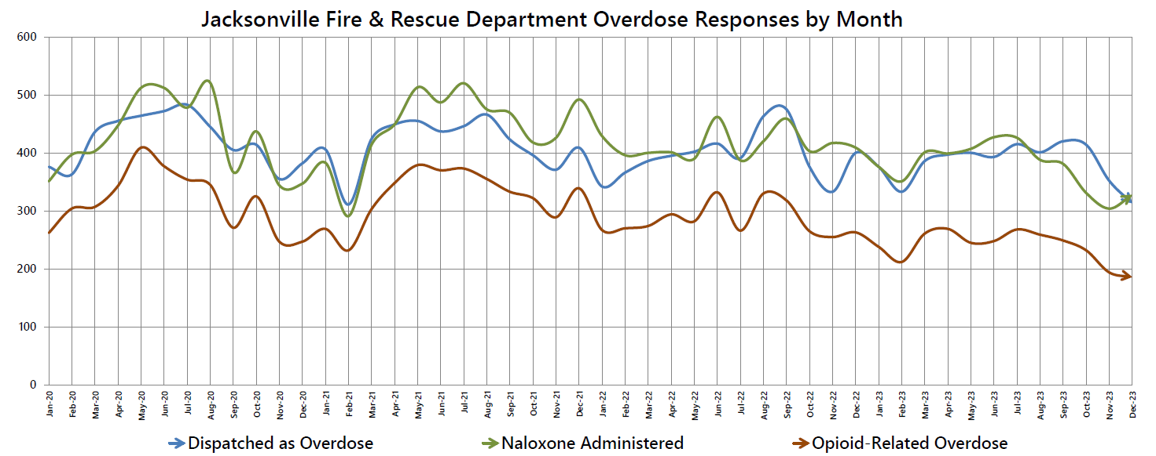

Slide 21
# of Suspected Opioid-Related (O-R) Overdose (OD) Patients By Year
 | 2019-2020 | 2020-2021 | 2021-2022 | 2022-2023 | 2023-2024 (Jan)
% Change | +24% | +3% | -13% | -16% | -29%
Notes:
-Updated through January 2024
-In addition to being down 29% in January 2024 compared to January 2023, we are also down 10% in January 2024 compared to last month (December 2023)

Slide 22
Suspected Opioid-Related (O-R) Overdose (OD) Patients by Incident Zip Code January 2024
Zip Code (Health Zone) | Count | % of O-R OD | Trend (Compared to January 2023)
32218 (Outer Rim) | 18 | 11% | 6% Increase
32254 (Urban Core) | 15 | 9% | 21% Decrease
32244 (Southwest) | 10 | 6% | 41% Decrease
32210 (Southwest) | 10 | 6% | 69% Decrease
32209 (Urban Core) | 10 | 6% | 23% Decrease
32216 (Arlington) | 9 | 5% | 10% Decrease
32211 (Arlington) | 9 | 5% | 80% Increase
32256 (Southeast) | 8 | 5% | 50% Decrease
32246 (Arlington) | 8 | 5% | 20% Decrease
32233 (Beaches) | 7 | 4% | 250% Increase
32205 (Southwest) | 7 | 4% | 40% Increase
TOTAL (Top 11) | 111 | 65%
TOTAL (Other 20 Zips) | 59 | 35%
TOTAL (All 31 Zips) | 170 | 100%
Notes:
-Updated through January 2024

Slide 23
Suspected Opioid-Related (O-R) Overdose (OD) Patients by Incident Zip Code January 2024
Top 10 Zip Codes | Count | Population Size | Rate per 1,000 pop.
32254 (Urban Core) | 15 | 14,545 | 1.03
32202 (Urban Core) | 3 | 6,544 | 0.46
32234 (Outer Rim) | 3 | 7,514 | 0.40
32204 (Urban Core) | 3 | 8,673 | 0.35
32233 (Beaches) | 7 | 23,980 | 0.29
32209 (Urban Core) | 10 | 36,656 | 0.27
32218 (Outer Rim) | 18 | 67,040 | 0.27
32211 (Arlington) | 9 | 34,168 | 0.26
32205 (Southwest) | 7 | 29,605 | 0.24
32216 (Arlington) | 9 | 42,847 | 0.21
32219 (Outer Rim) | 3 | 14,474 | 0.21
TOTAL (Top 11) | 87
TOTAL (Other 20 Zips) | 83
TOTAL (All 31 Zips) | 170
Zip codes highlighted in orange are in the top 11 for Count and Rate
Notes:
-Updated through January 2024
-Zip codes highlighted in orange = both in the top 11 for count (due to their being a tie for tenth) and the top 11 for rate per 1,000 (due to their being a tie for tenth)
-Population size data source: Decennial Census (2020)

Slide 24
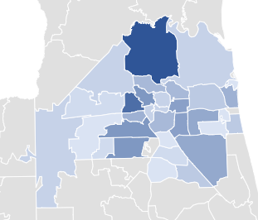
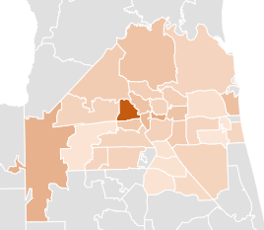
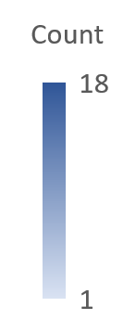
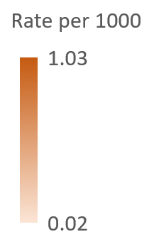
Opioid-Related Overdoses by Count and Rate
January 2024

Slide 25
% of Suspected Opioid-Related (O-R) Overdose (OD) Patients
Race/Year | 2014 | 2015 | 2016 | 2017 | 2018 | 2019 | 2020 | 2021 | 2022 | 2023 | 2024 (Jan)
Black or African American | 8% | 8% | 10% | 9% | 10% | 12% | 14% | 18% | 21% | 23% | 21%
Hispanic or Latino | 2% | 2% | 2% | 3% | 4% | 3% | 4% | 3% | 5% | 6% | 4%
Other/ Unknown | 2% | 3% | 2% | 4% | 4% | 3% | 3% | 2% | 2% | 2% | 4%
White | 88% | 87% | 86% | 84% | 82% | 82% | 79% | 77% | 72% | 69% | 71%
% of Suspected Opioid-Related (O-R) Overdose (OD) Patients
Gender/Year | 2014 | 2015 | 2016 | 2017 | 2018 | 2019 | 2020 | 2021 | 2022 | 2023 | 2024 (Jan)
Male | 53% | 55% | 64% | 62% | 61% | 63% | 66% | 67% | 65% | 66% | 61%
Female | 47% | 45% | 36% | 38% | 39% | 37% | 34% | 33% | 35% | 34% | 39%
Old Query | New Query
Notes:
-Updated through January 2024

Slide 26
% of Suspected Opioid-Related (O-R) Overdose (OD) Patients
Age Range | 2014 | 2015 | 2016 | 2017 | 2018 | 2019 | 2020 | 2021 | 2022 | 2023 | 2024 (Jan)
19 or younger | 6% | 2% | 2% | 2% | 2% | 2% | 1% | 2% | 2% | 2% | 5%
20-29 | 26% | 30% | 30% | 26% | 26% | 21% | 21% | 15% | 15% | 14% | 15%
30-39 | 23% | 27% | 33% | 36% | 37% | 36% | 35% | 36% | 32% | 32% | 26%
40-49 | 18% | 17% | 17% | 18% | 17% | 22% | 21% | 23% | 23% | 24% | 25%
50-59 | 17% | 15% | 12% | 12% | 11% | 12% | 13% | 14% | 15% | 15% | 18%
60-69 | 6% | 6% | 5% | 5% | 5% | 6% | 7% | 8% | 9% | 10% | 5%
70 or older | 3% | 2% | 1% | 1% | 2% | 2% | 2% | 2% | 3% | 3% | 6%
Some years add up to 99% or 101% due to rounding
Old Query | New Query
Notes:
-Updated through December 2023

Slide 27
Bystander Narcan Use Prior to Arrival (PTA) of JFRD
 | 2019-2020 | 2020-2021 | 2021-2022 | 2022-2023 | 2023-2024 (Jan)
% Change in Opioid-Related OD Calls | +24% | +3% | -13% | -16% | -29%
% Change in Use of NARCAN PTA by Bystanders | +59% | +79% | +5% | +23% | -3%
Notes:
Notes:
-Narcan nasal spray was first FDA approved in November 2015, but the first report of Narcan use PTA JFRD was not until 2017.

Slide 28
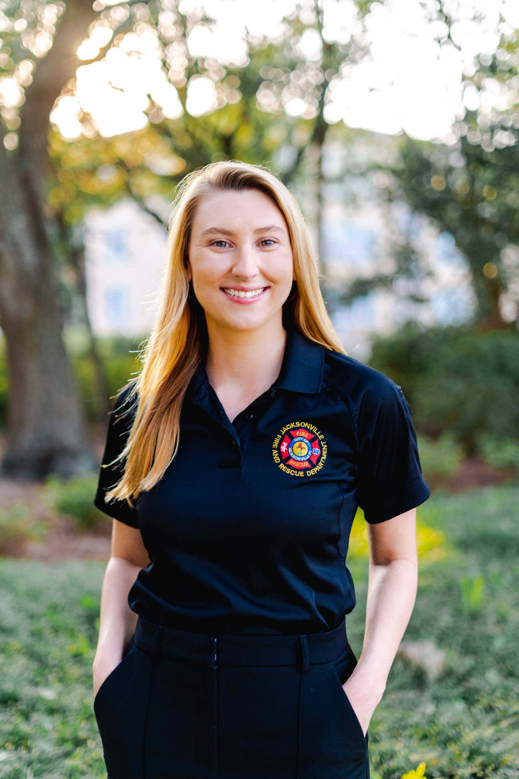
Contact Me
Laura Viafora Ray, MPH, CPH
Program Coordinator - Opioid Abatement
Office: (904) 255-7730
Cell: (904) 575-0495
Email: lvray@coj.net
Connect on LinkedIn

Slide 29
COJ Opioid Abatement Program Update

Slide 30
FY 2023-2024 Cycle
Funded Category | Programs Funded | Total Amount Awarded | % Distribution Across Awarded Amounts | Total Amount Budgeted | % Distribution Across Budgeted Amounts
Prevention | 10 | $2,276,563.40 | 34.8% | $2,459,683.76 | 34%
Treatment | 6 | $2,283,683.39 | 34.9% | $2,387,340.12 | 33%
Recovery Support | 8 | $1,982,003.36 | 30.3% | $2,387,340.12 | 33%
TOTAL | 24 | $6,542,250.15 |  | $7,234,364.00

Slide 31
COJ Opioid Abatement Program Update
FY 23-24 OSPG Awards
Currently in the contract execution stage
FY 23-24 OSPG Applications
Tentative Mandatory Application Workshops to be held in April
Tentative application cycle: May 1 - May 31
Want to stay updated?
Email opioidabatement@coj.net to request to be added to the listserv

Slide 32
Opioid Abatement Program Staff

Slide 33
Kelsey Spangle
Department of Health
Duval

Slide 34
Florida Department of Health
OD2A Surveillance
February 28, 2024

Slide 35
Presenter
Kelsey Spangle, MS, MPH, CPH
Epidemiologist
Florida Department of Health in Duval County

Slide 36
Emergency Department Visits by Drug Type Duval County, January - December 2023

Slide 37
Contact Information
Kelsey Spangle, MS, MPH, CPH
Epidemiologist
Kelsey.Spangle@FLhealth.gov
904-253-1859

Slide 38
Morgan Pinchin
Community Paramedicine Program
Clay County

Slide 39
Clay County Fire Rescue Overdose Data
Updated February 2024

Slide 40
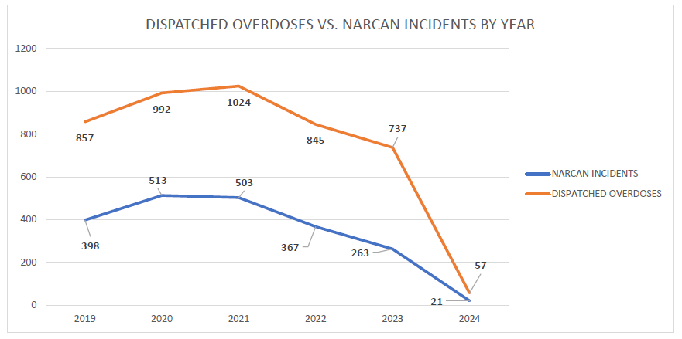

Slide 41
Monthly Incidents by Zip Code

Slide 42
Incidents with Narcan Administrations by Zip Code

Slide 44
Other Related Data
314 incidents with Narcan administration
15% decrease from 2022
Top Zip Code- 32068
100 patients, 31%
83% white, 11% black, 6% other
Male- 61%, female- 39%
18% between the ages of 35-44
17% 25-34
32% 65+
9% increase
72 % residence, 9% nursing home, 4% roadway, 4% public area
13 self reported overdose reversals

Slide 45
January 2024
57 dispatched incidents for possible overdose
19 incidents with Narcan administration
57% in 32068
6 reported bystander overdose reversals

Slide 46
Narcan Distribution Data FY2
51 kits distributed
Year 2 goal of 500
23 total presentation
244 individuals trained
81% of year 2 goal
Average pre-test scores 64.77%
Average post-test scores 93.21% (Increase of 28.44 points)
Feel confident after training 93.72%
Increase in confidence by 79.92%

Slide 47
Contact Us
Morgan Pinchin
Administrative Assistant, Community Paramedicine Program
Office: (904)529-4417
Cell: (904)338-4584
Email: Morgan.Pinchin@claycountygov.com
Paramedicine Office
(904)529-4109
Community.paramedicine@claycountygov.com

Slide 48
DEN Projects
Settlement Funds

Slide 50
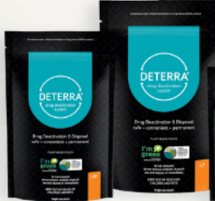
Messaging
With CEUs
Community
Resources

Slide 51
Powering Healthy Communities

Slide 52
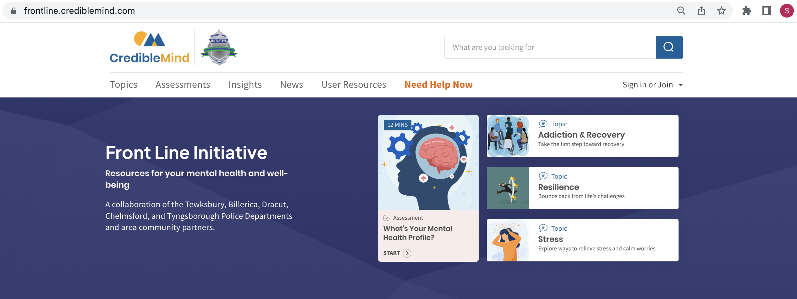
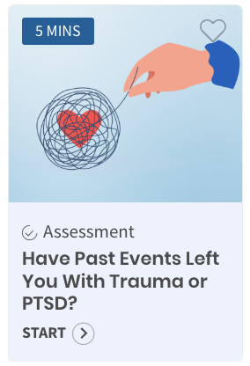

Slide 53
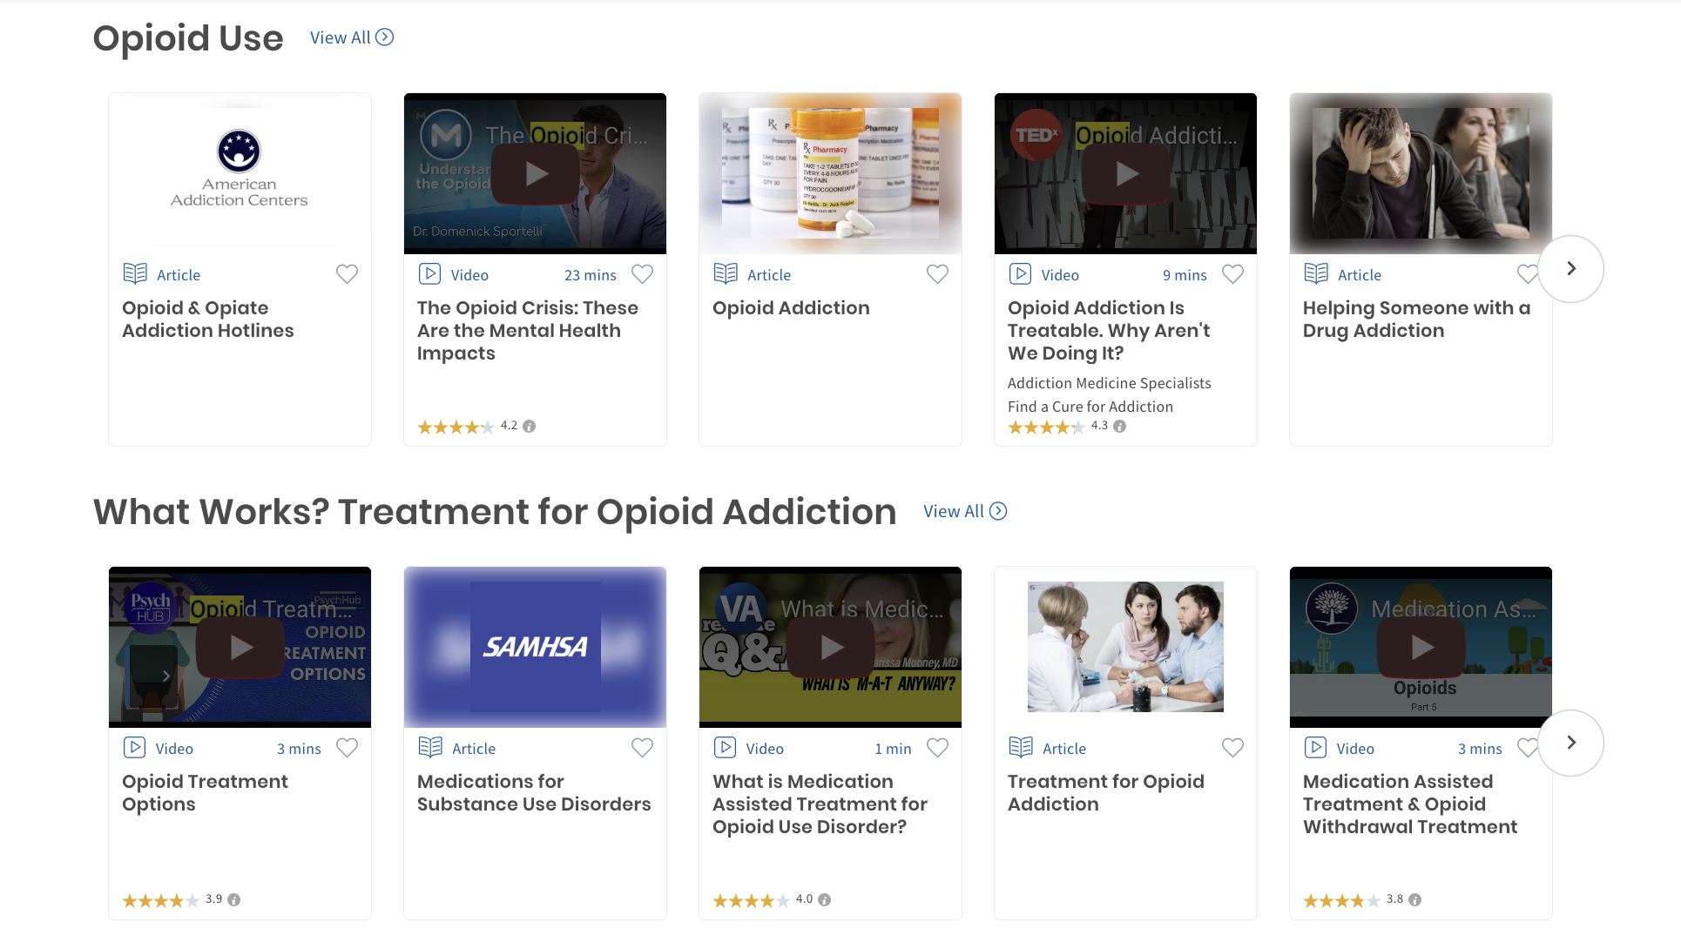

Slide 54
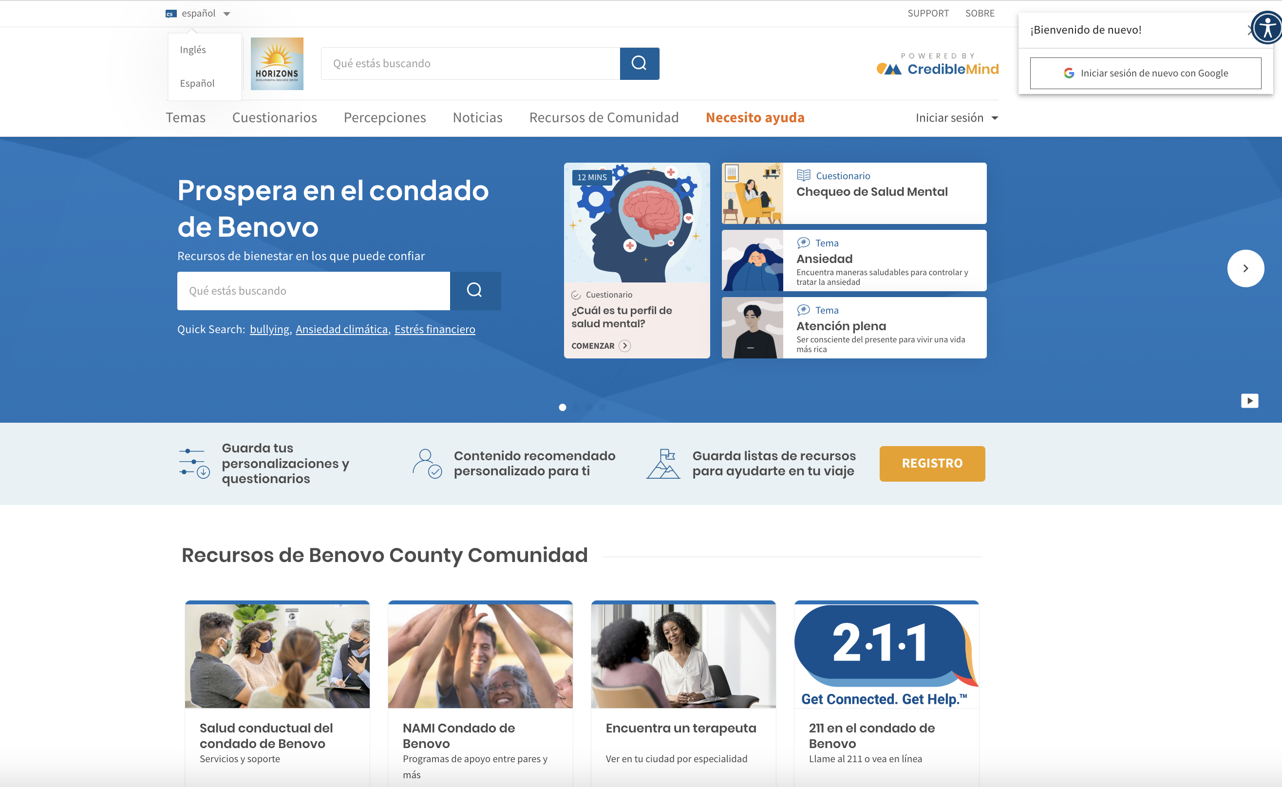
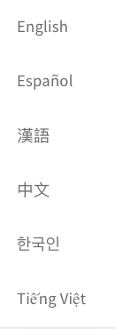

Slide 55
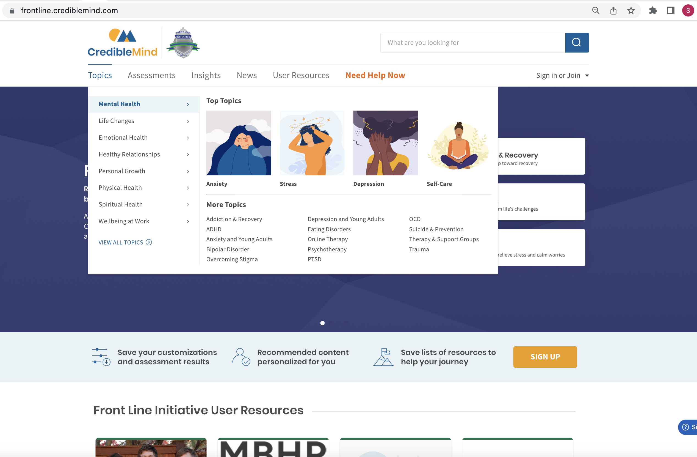
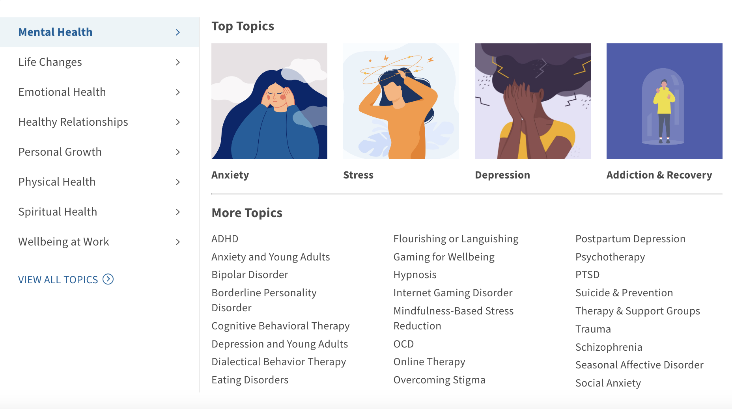

Slide 58
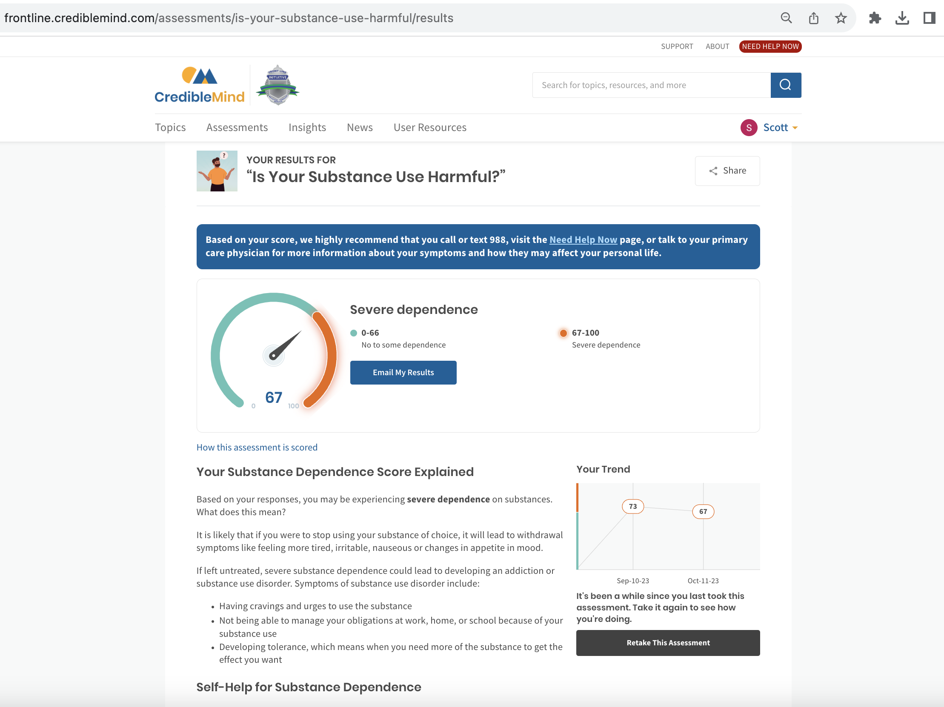

Slide 59
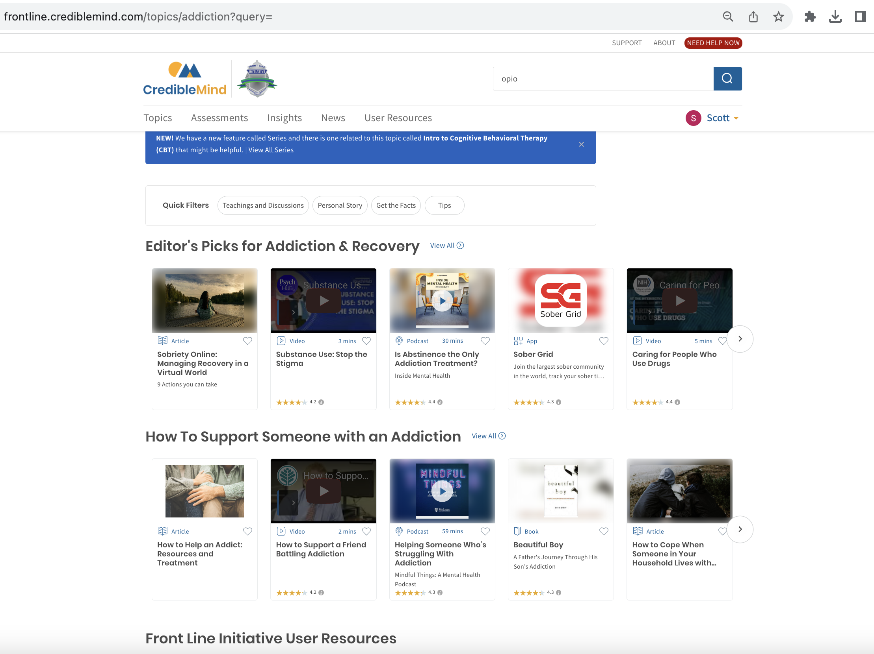

Slide 60
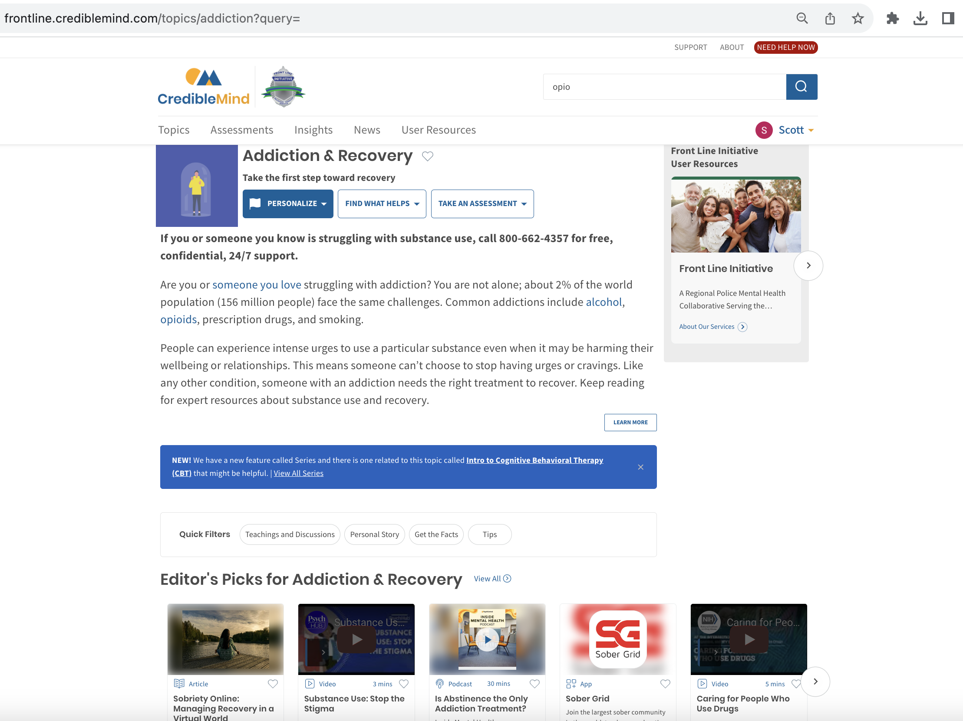

Slide 61
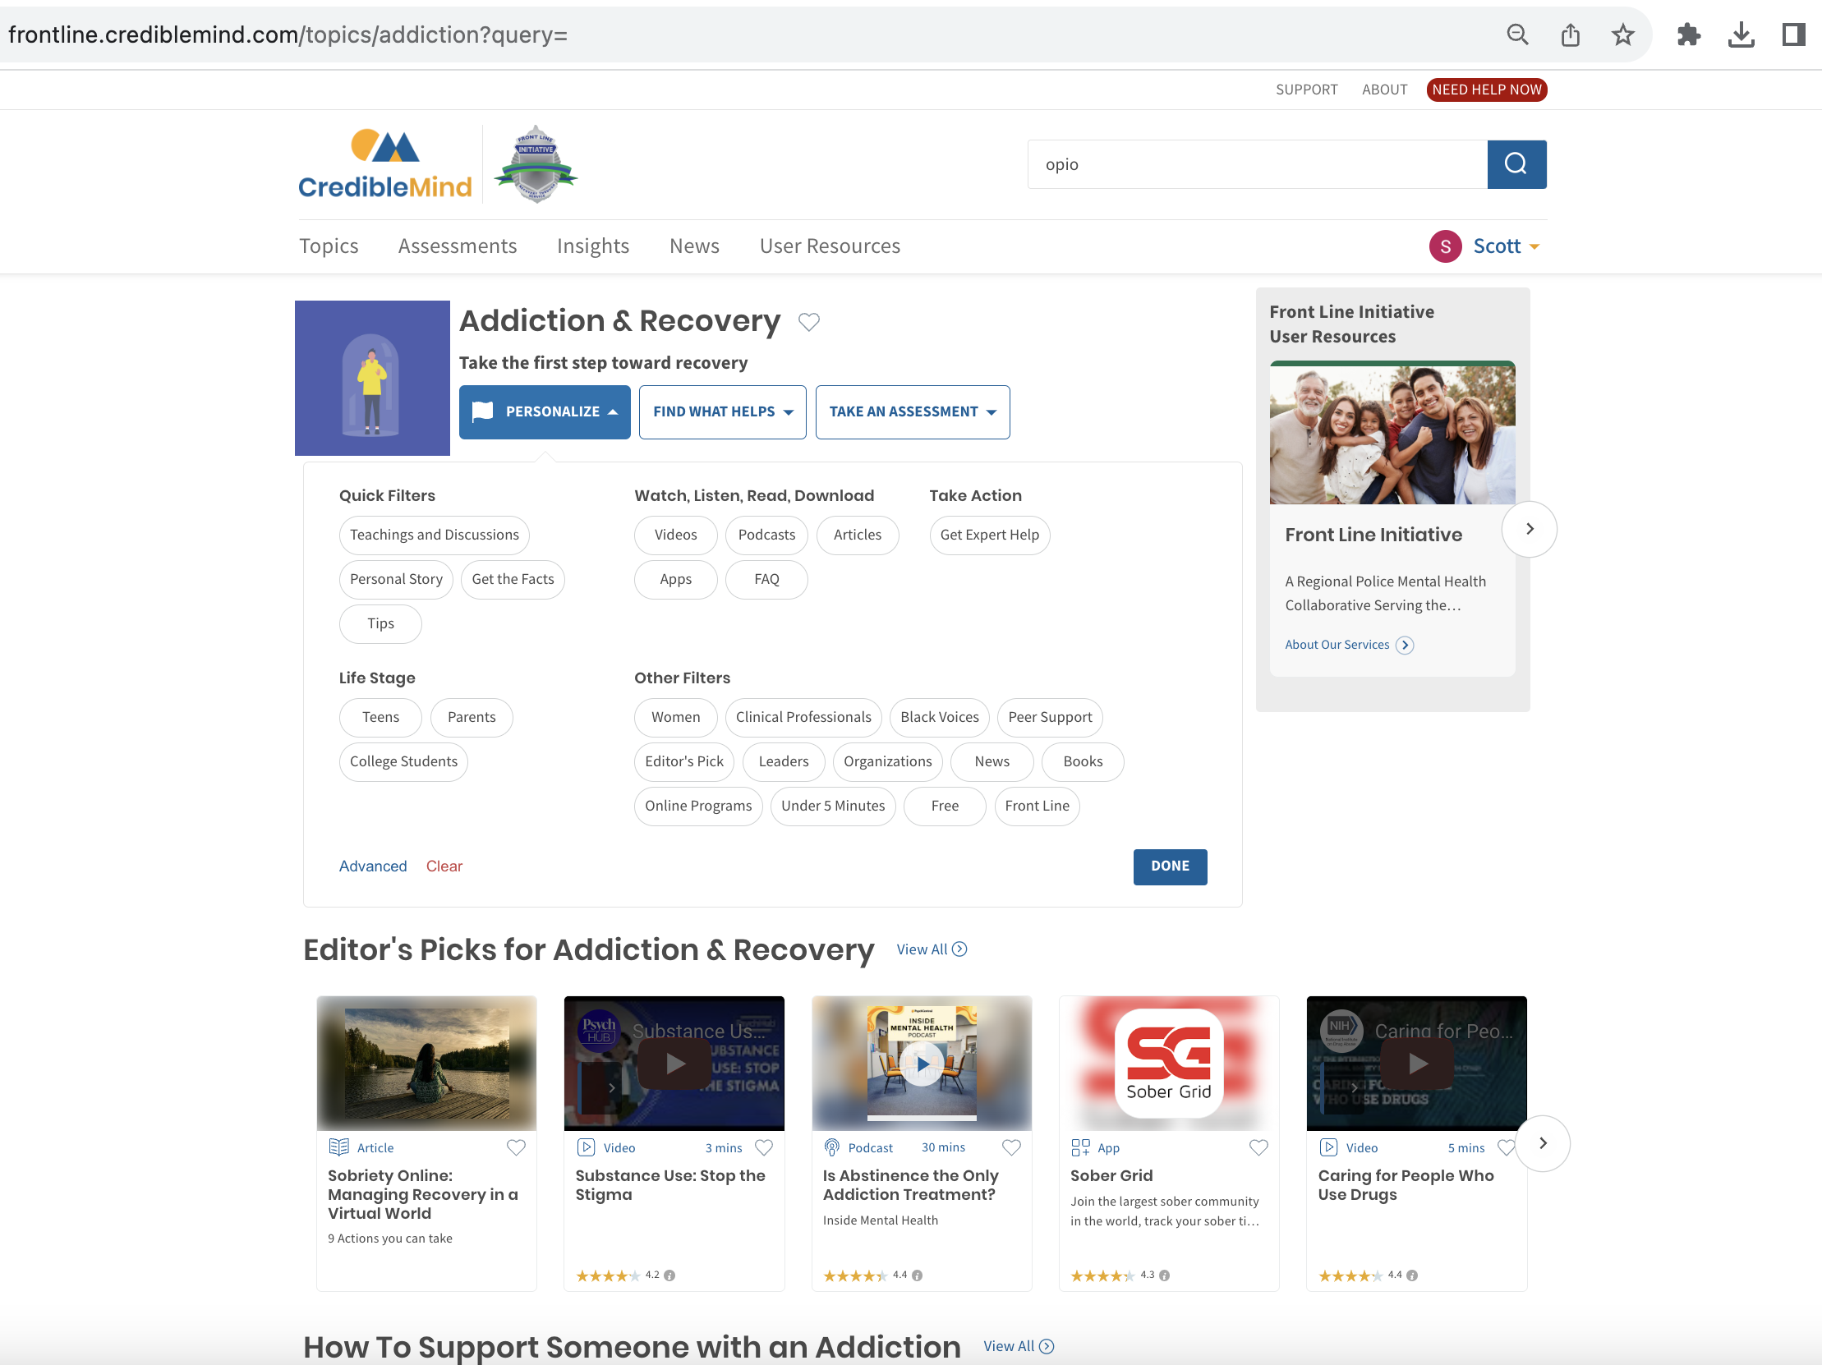

Slide 62
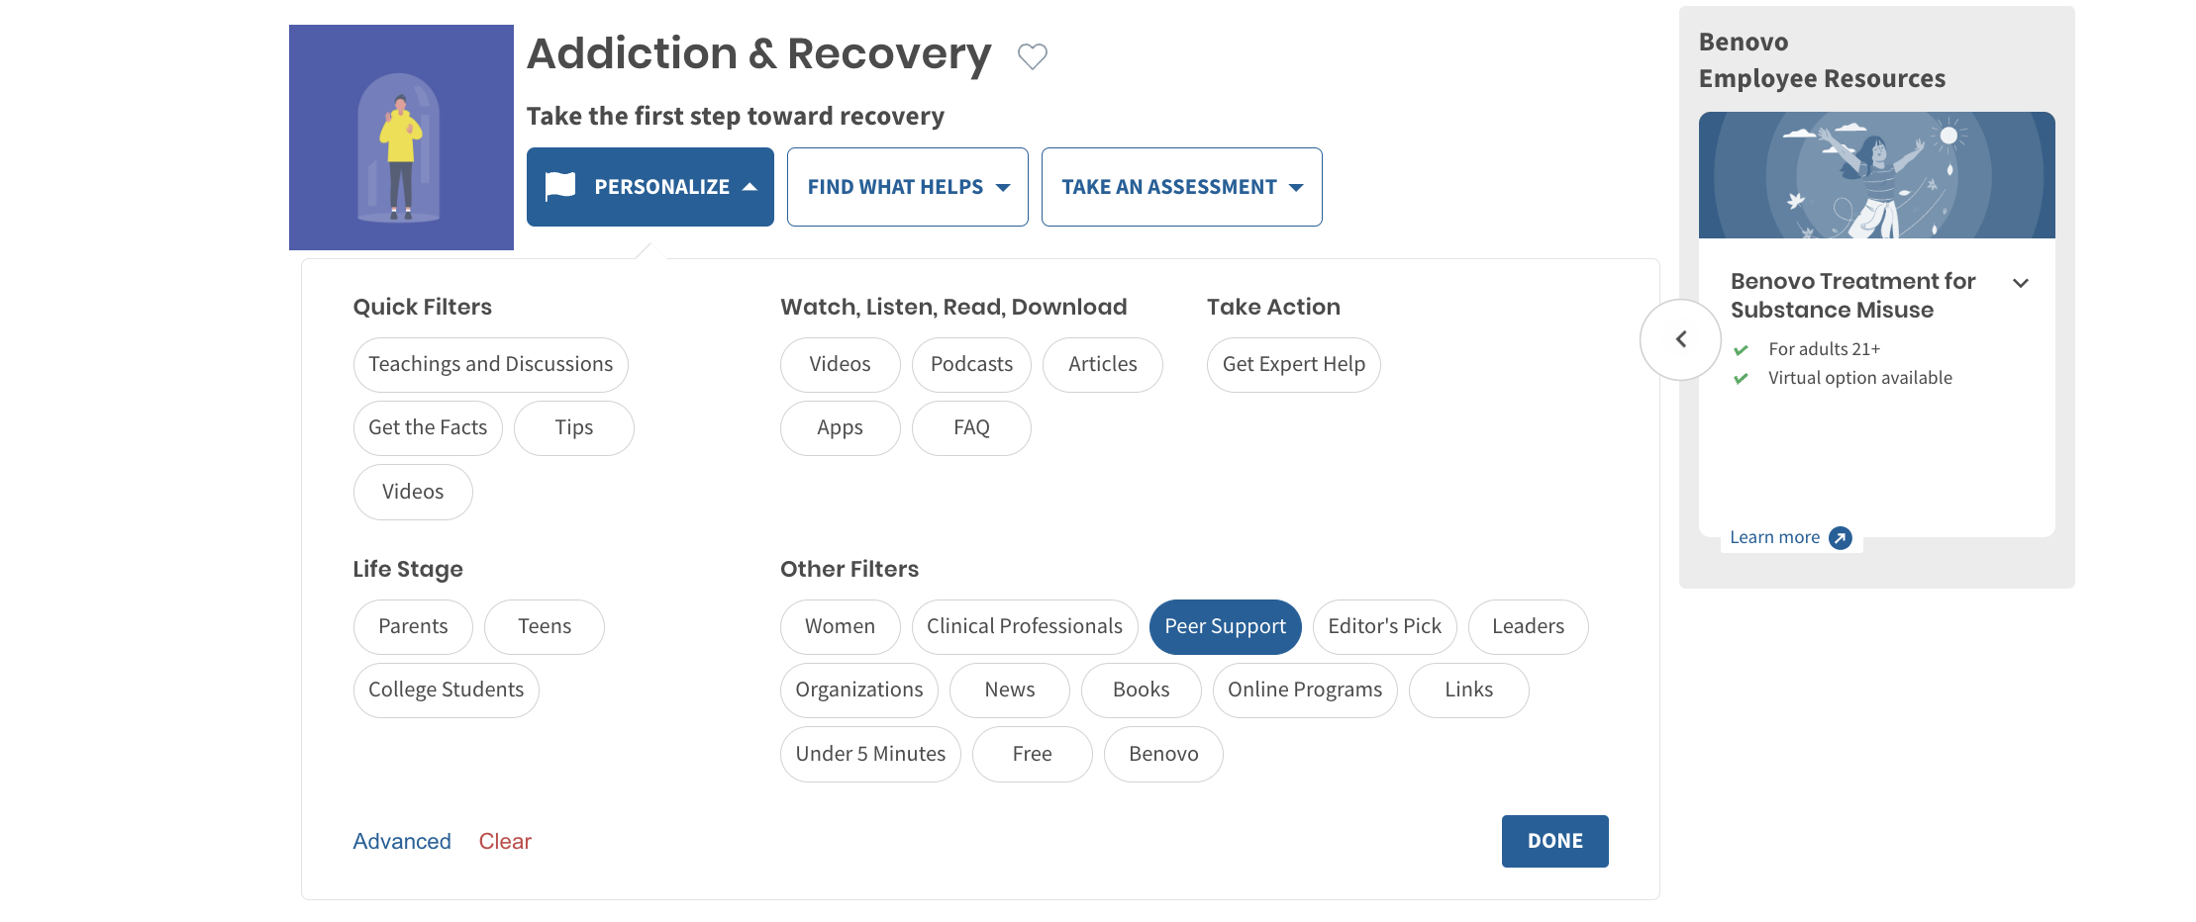

Slide 63
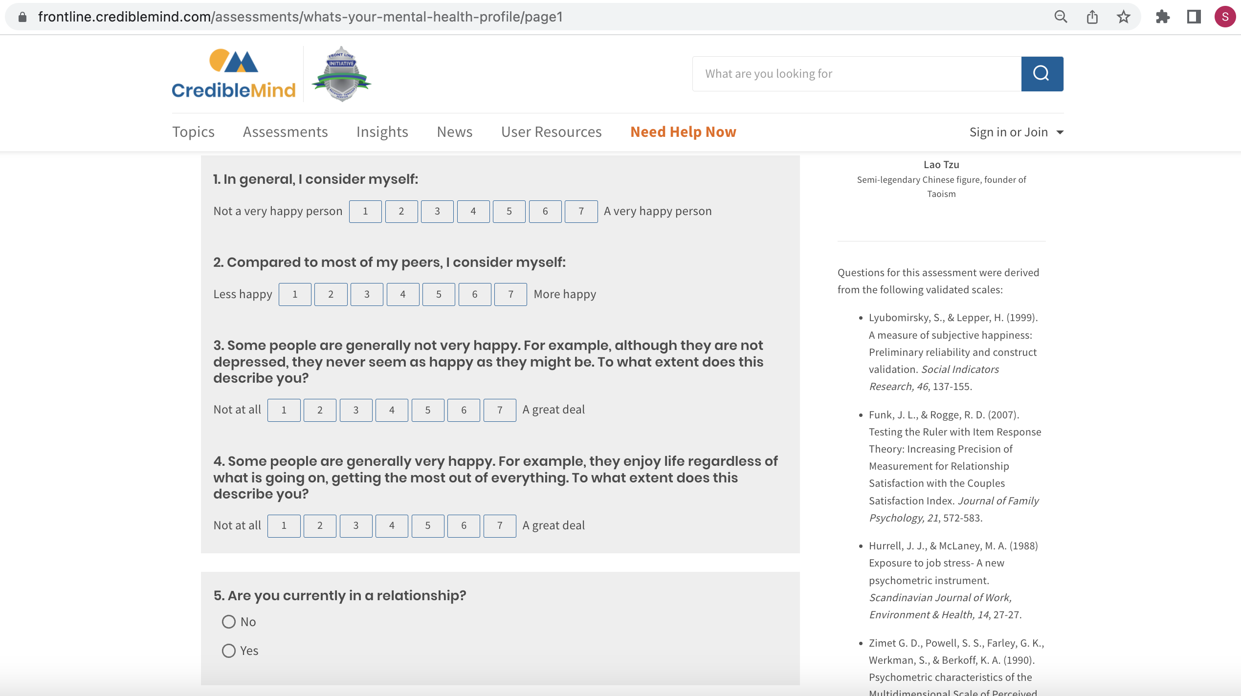

Slide 64
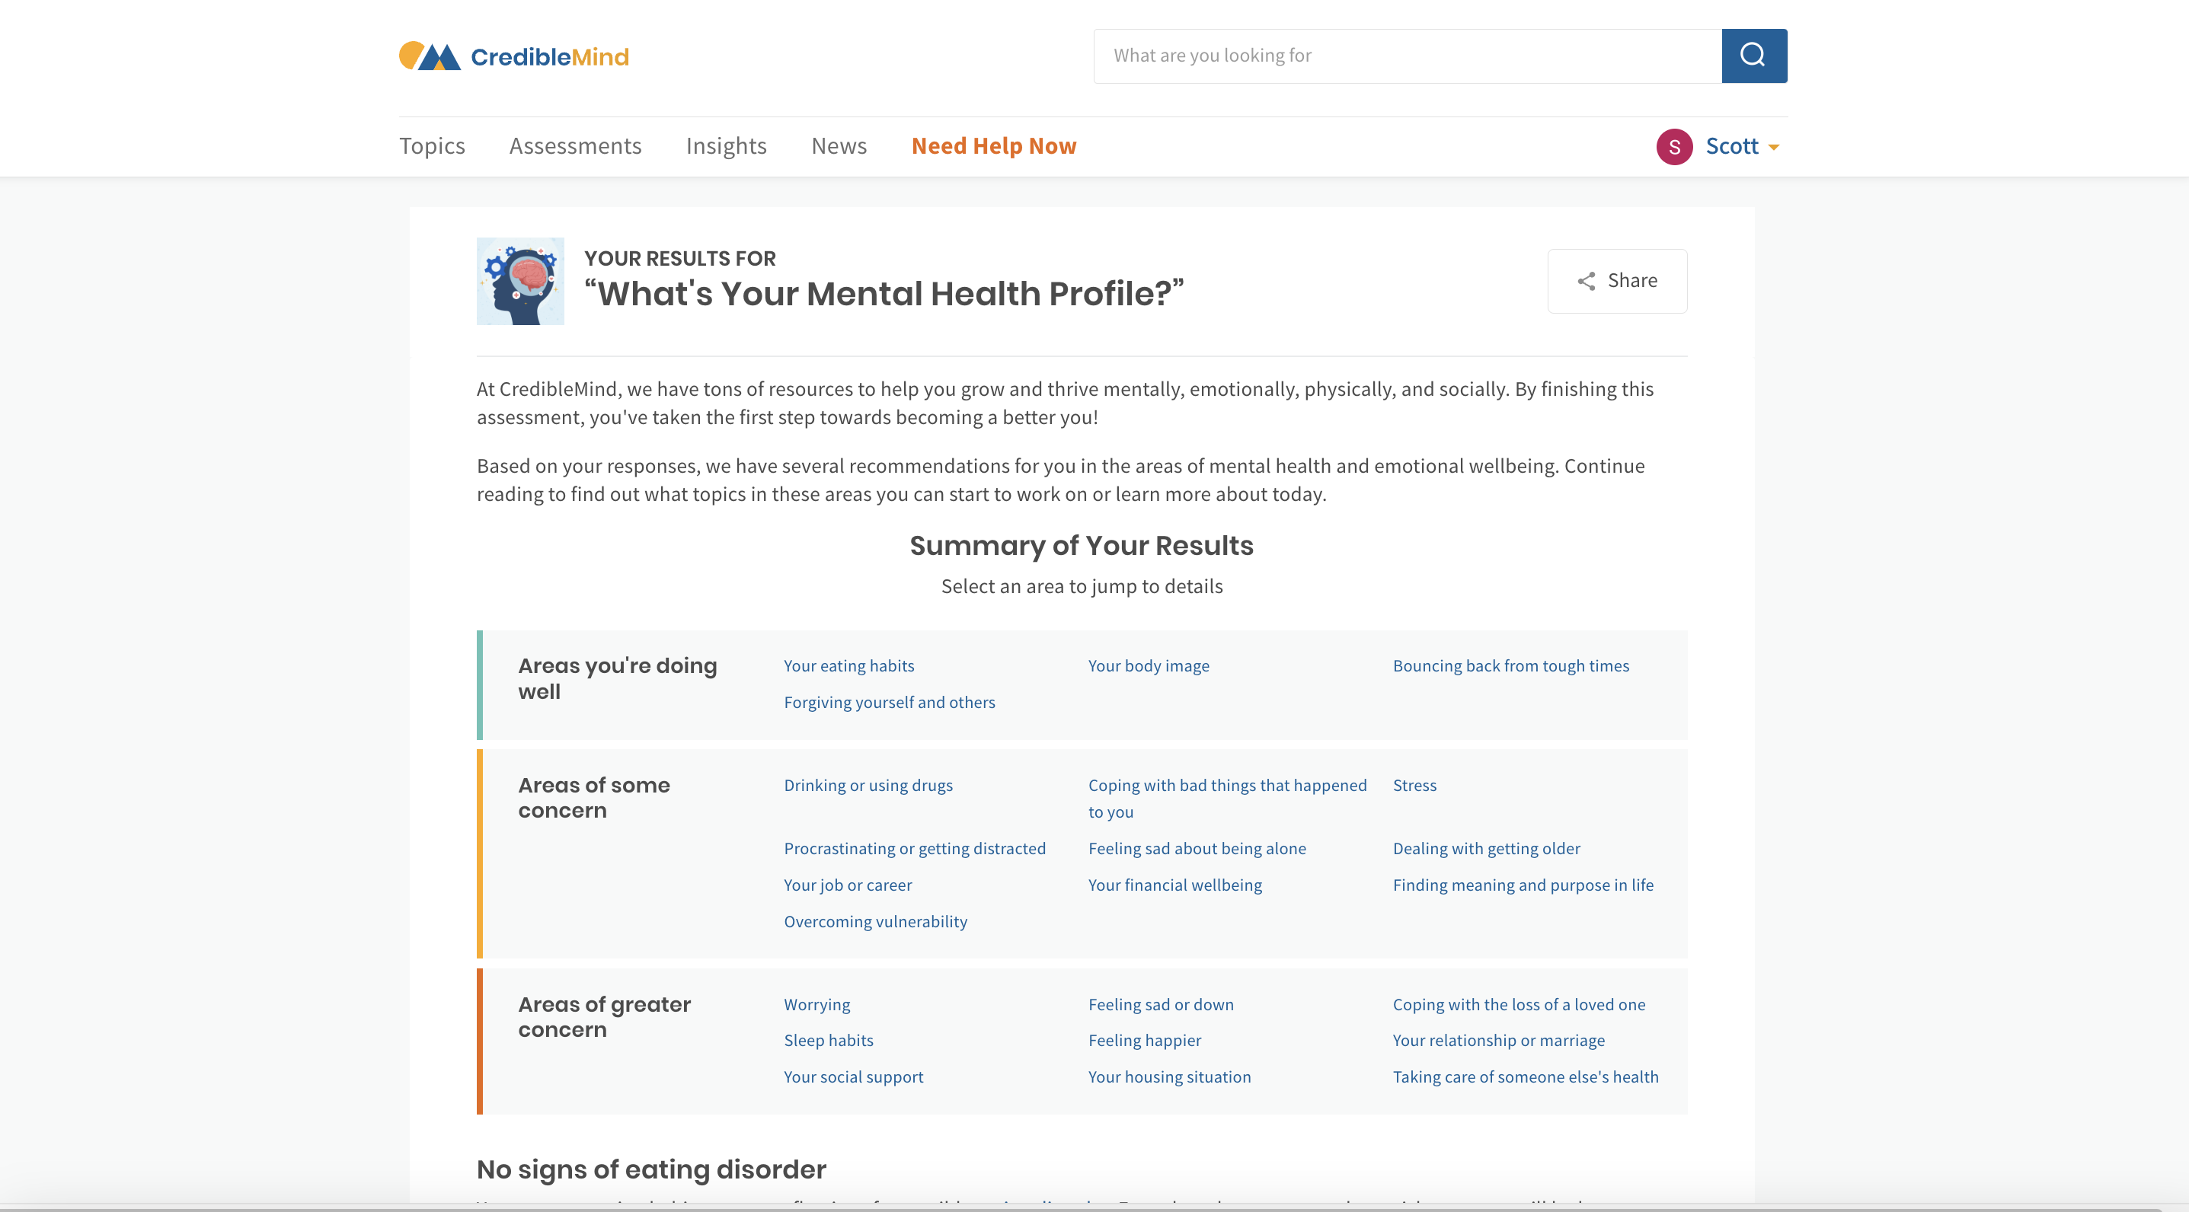

Slide 65
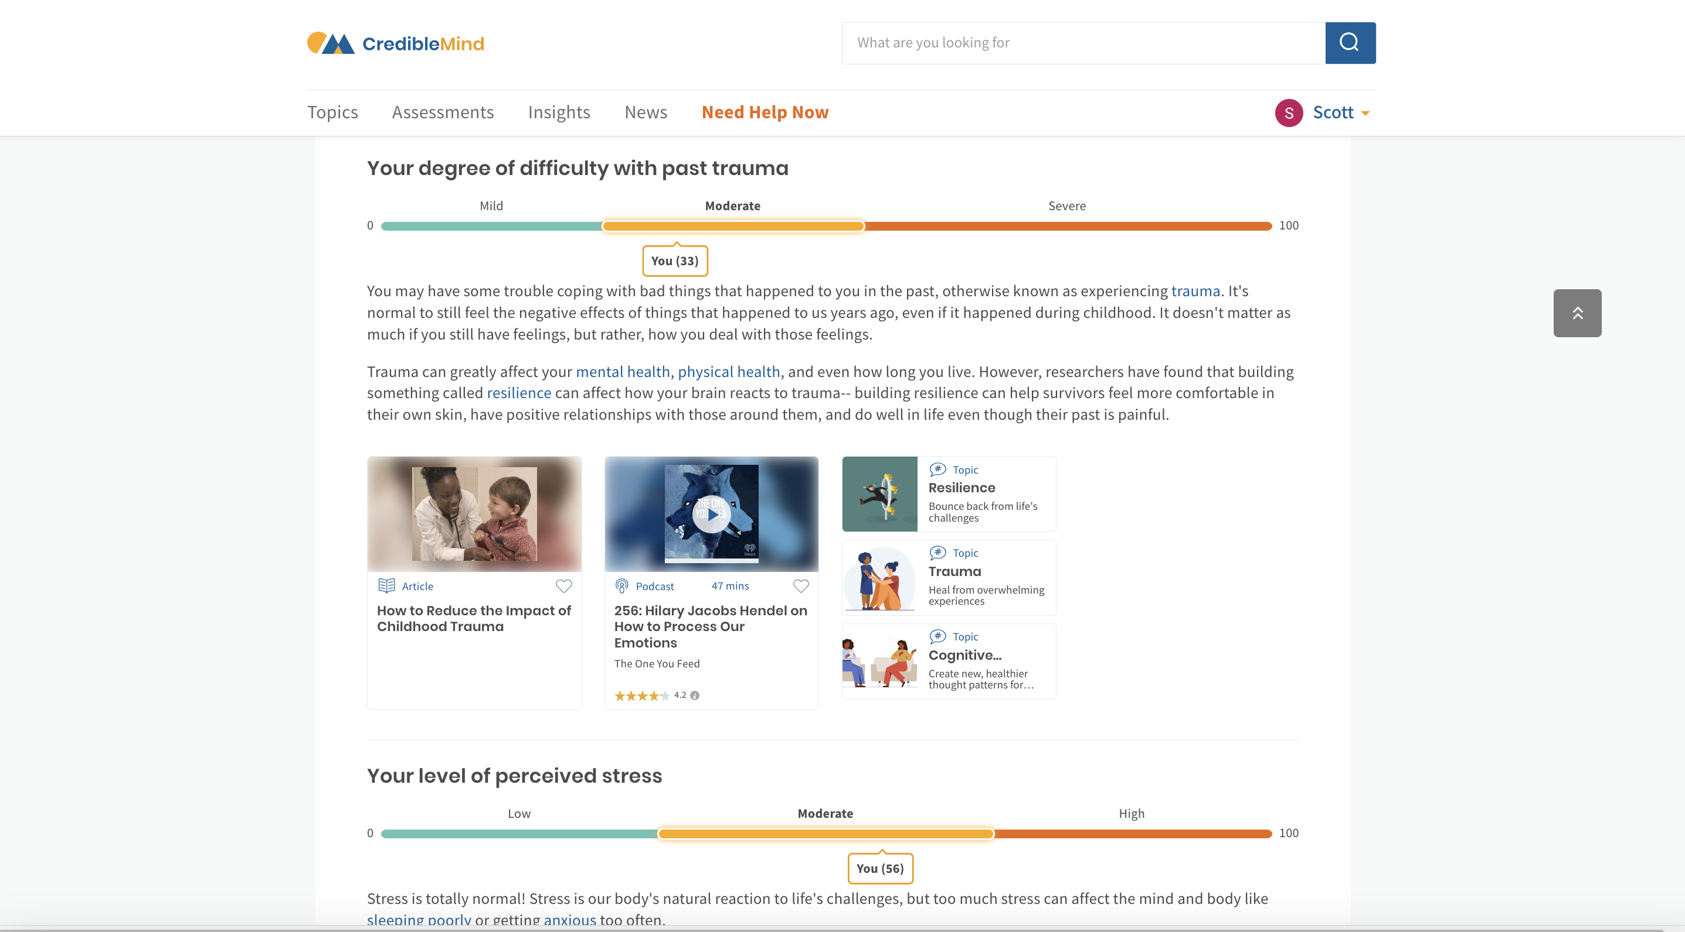

Slide 66
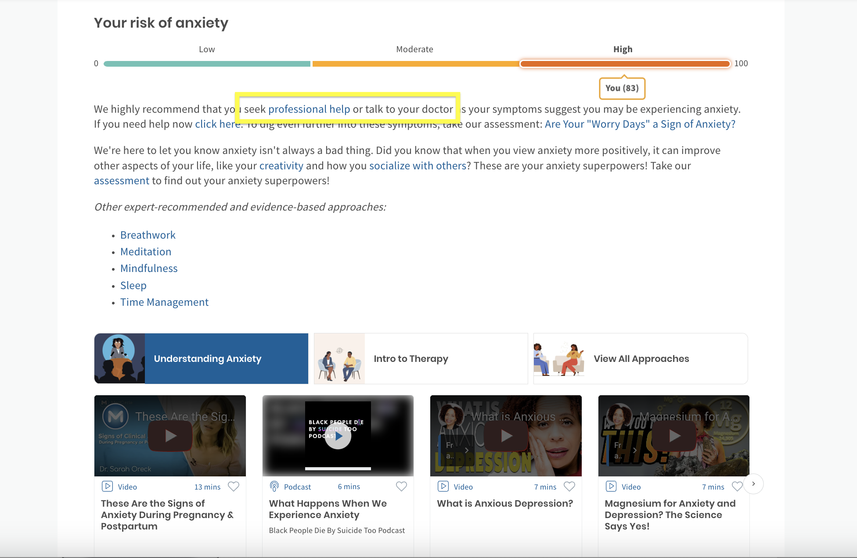

Slide 67
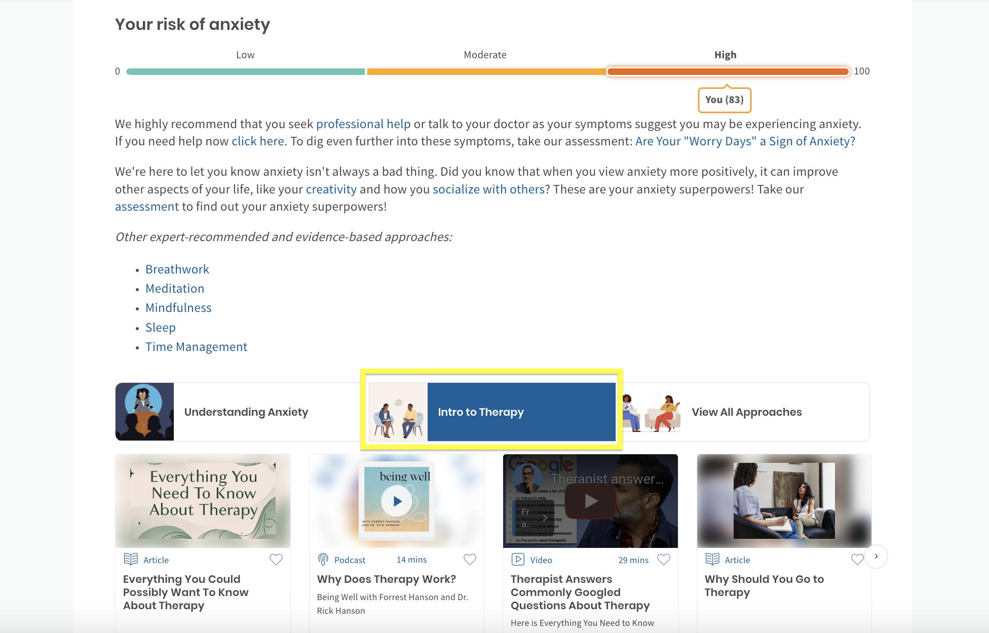

Slide 68
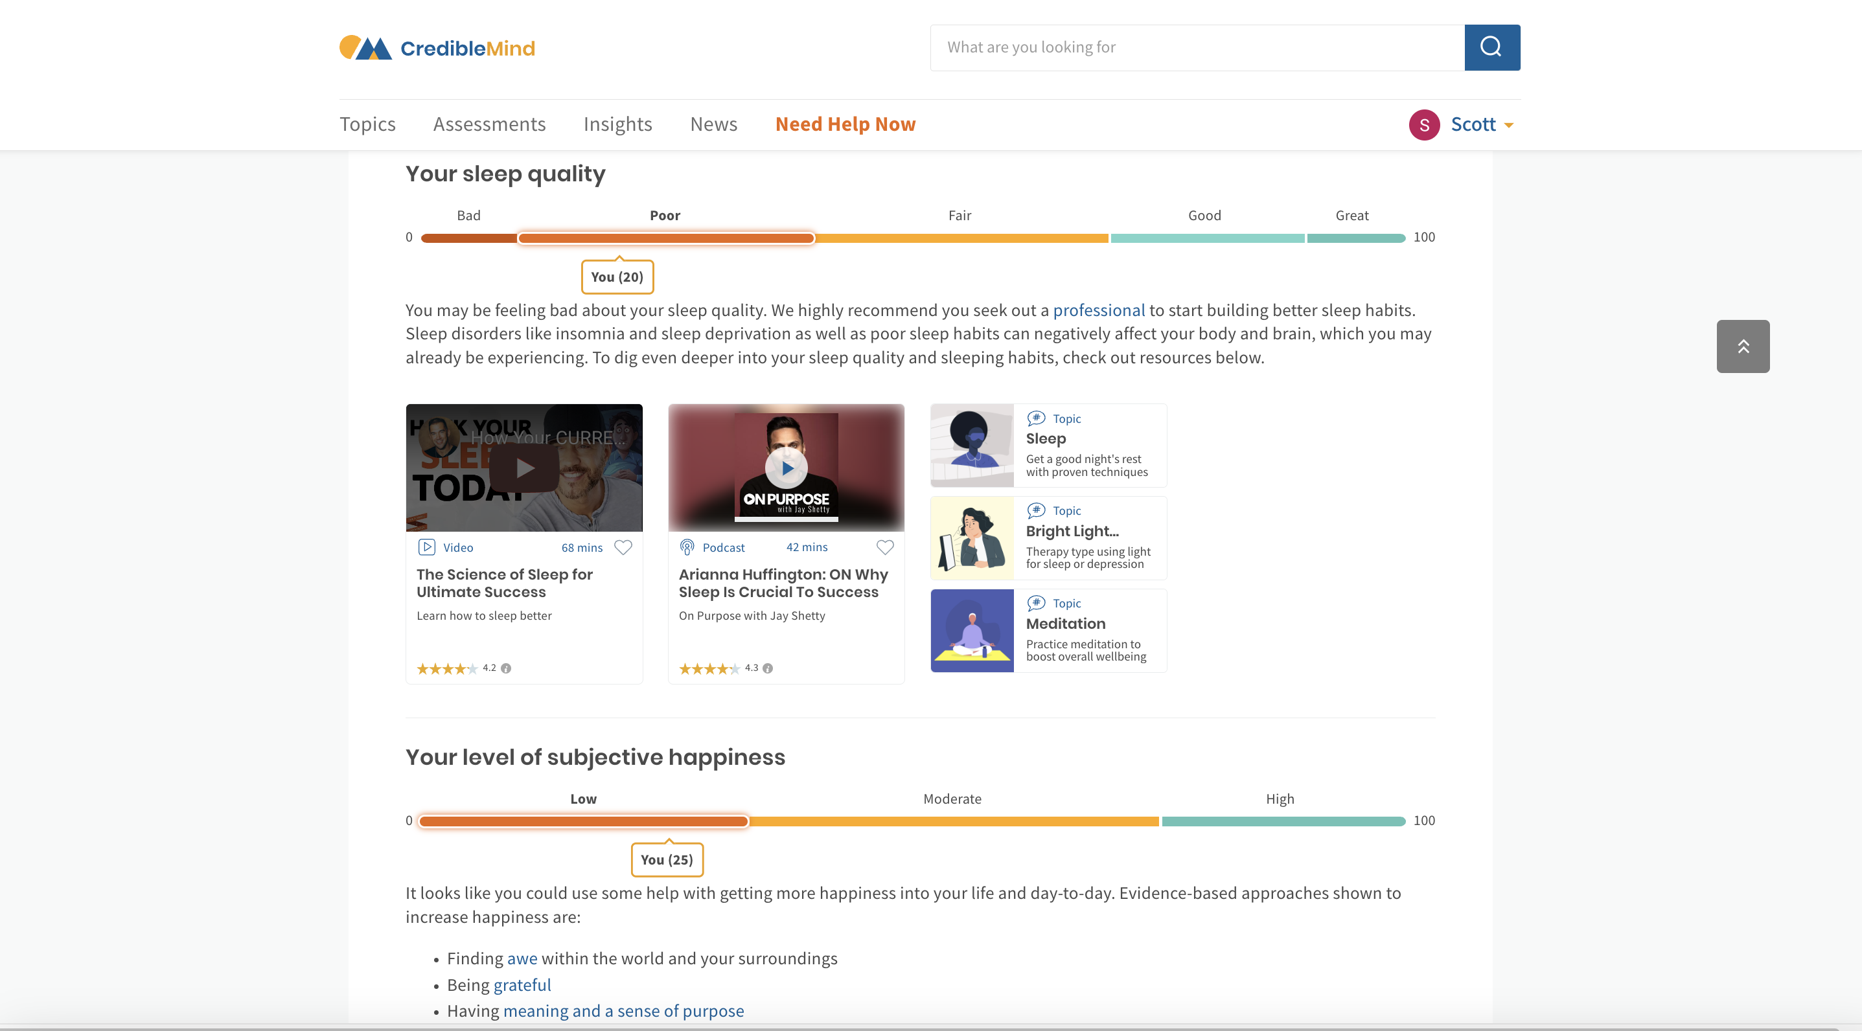

Slide 69
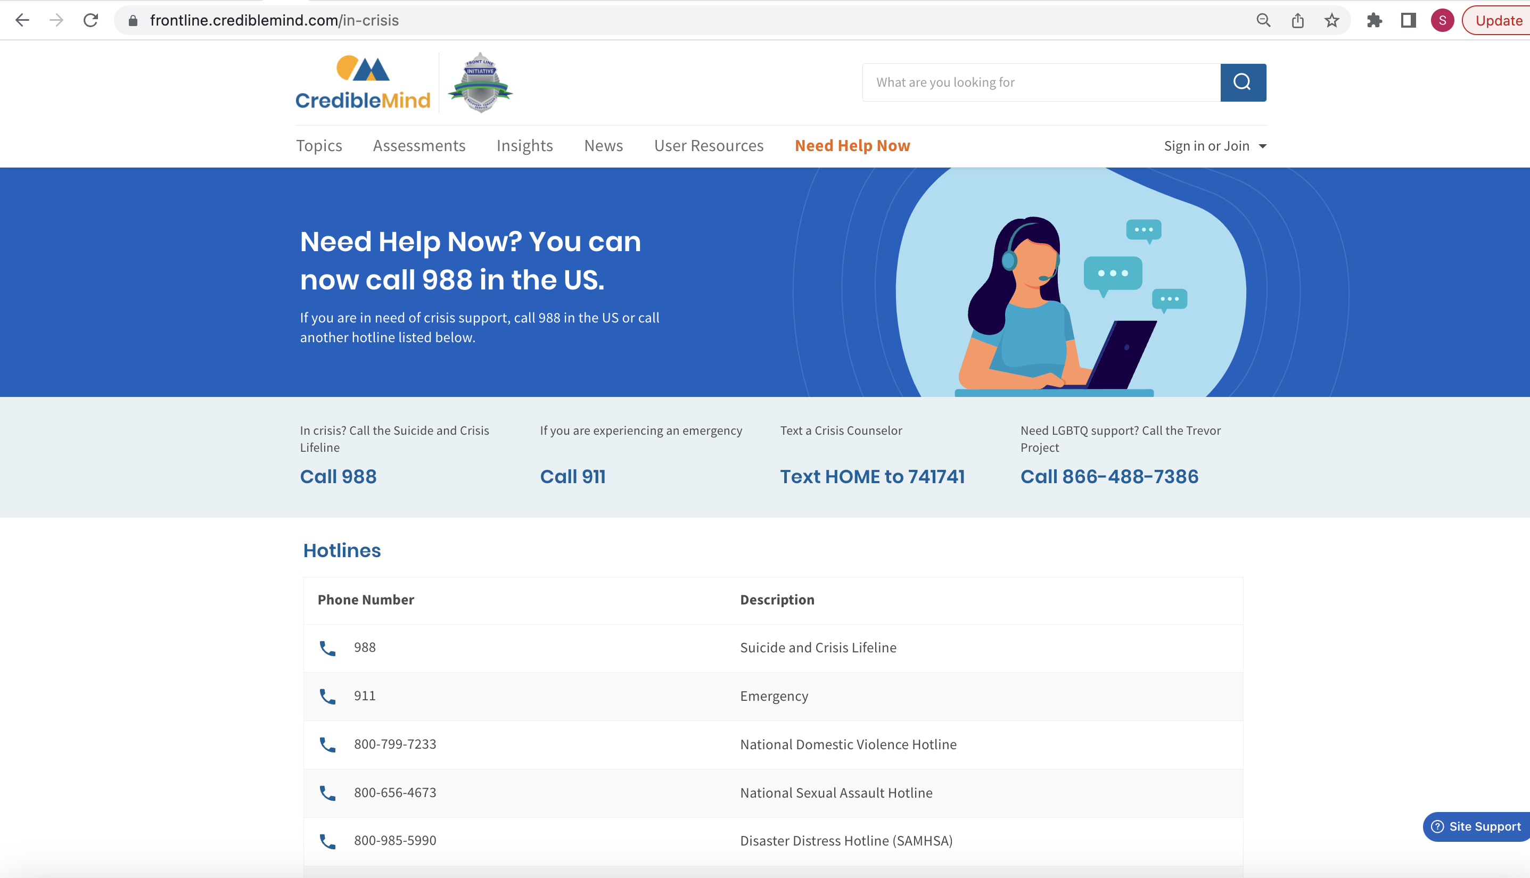

Slide 71
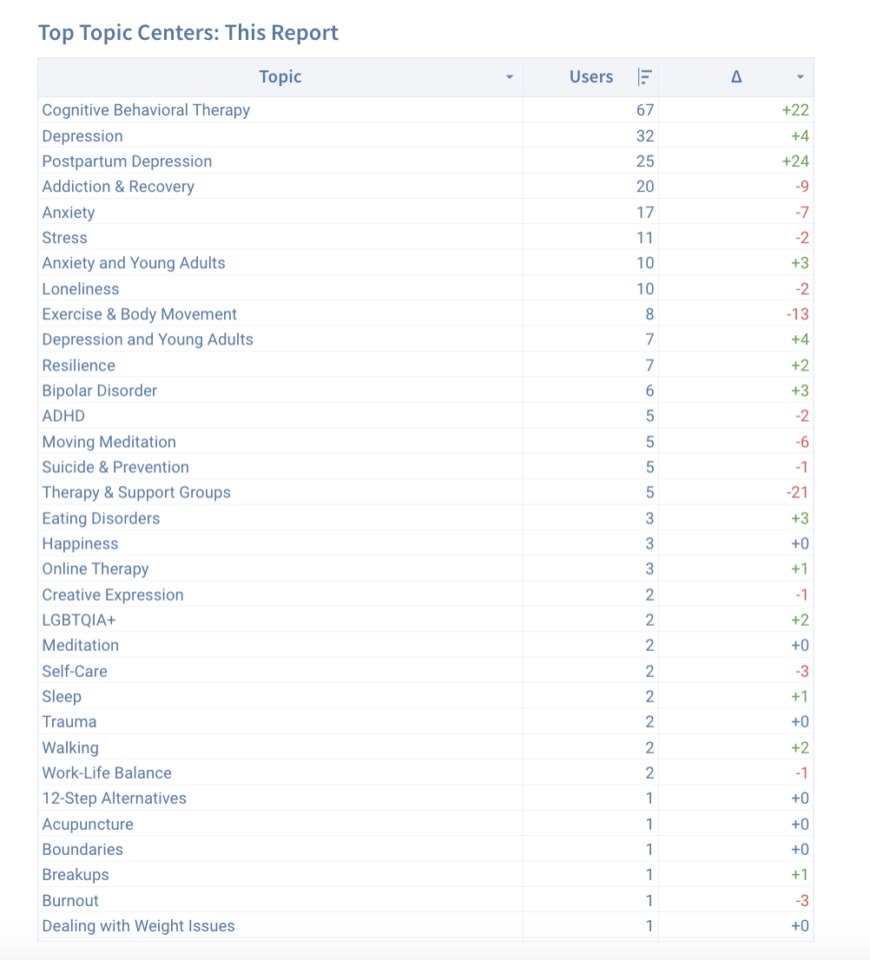
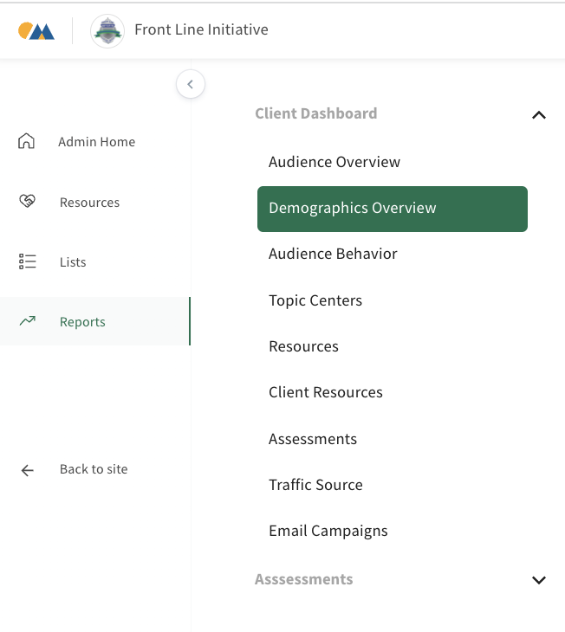

Slide 72
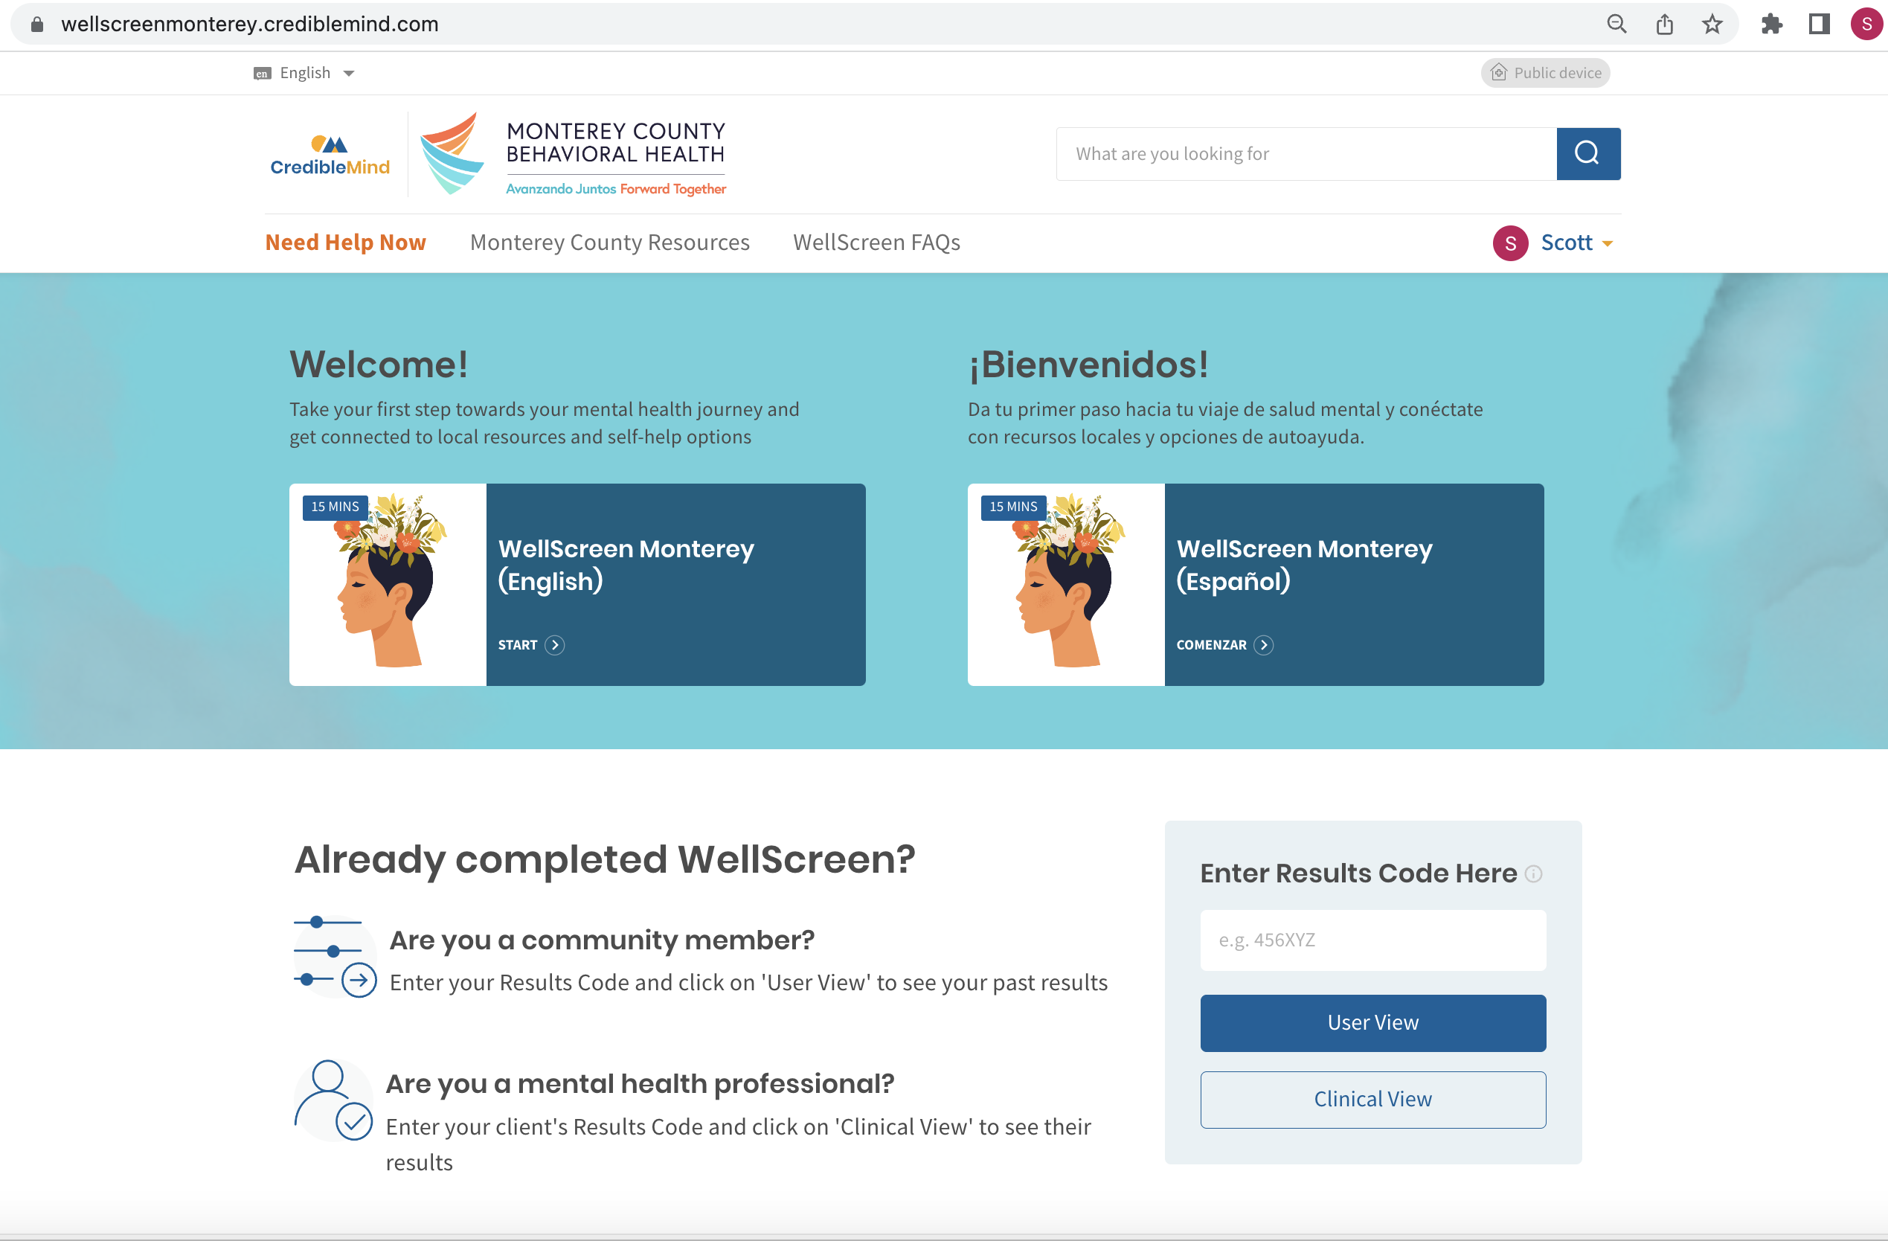

Slide 73
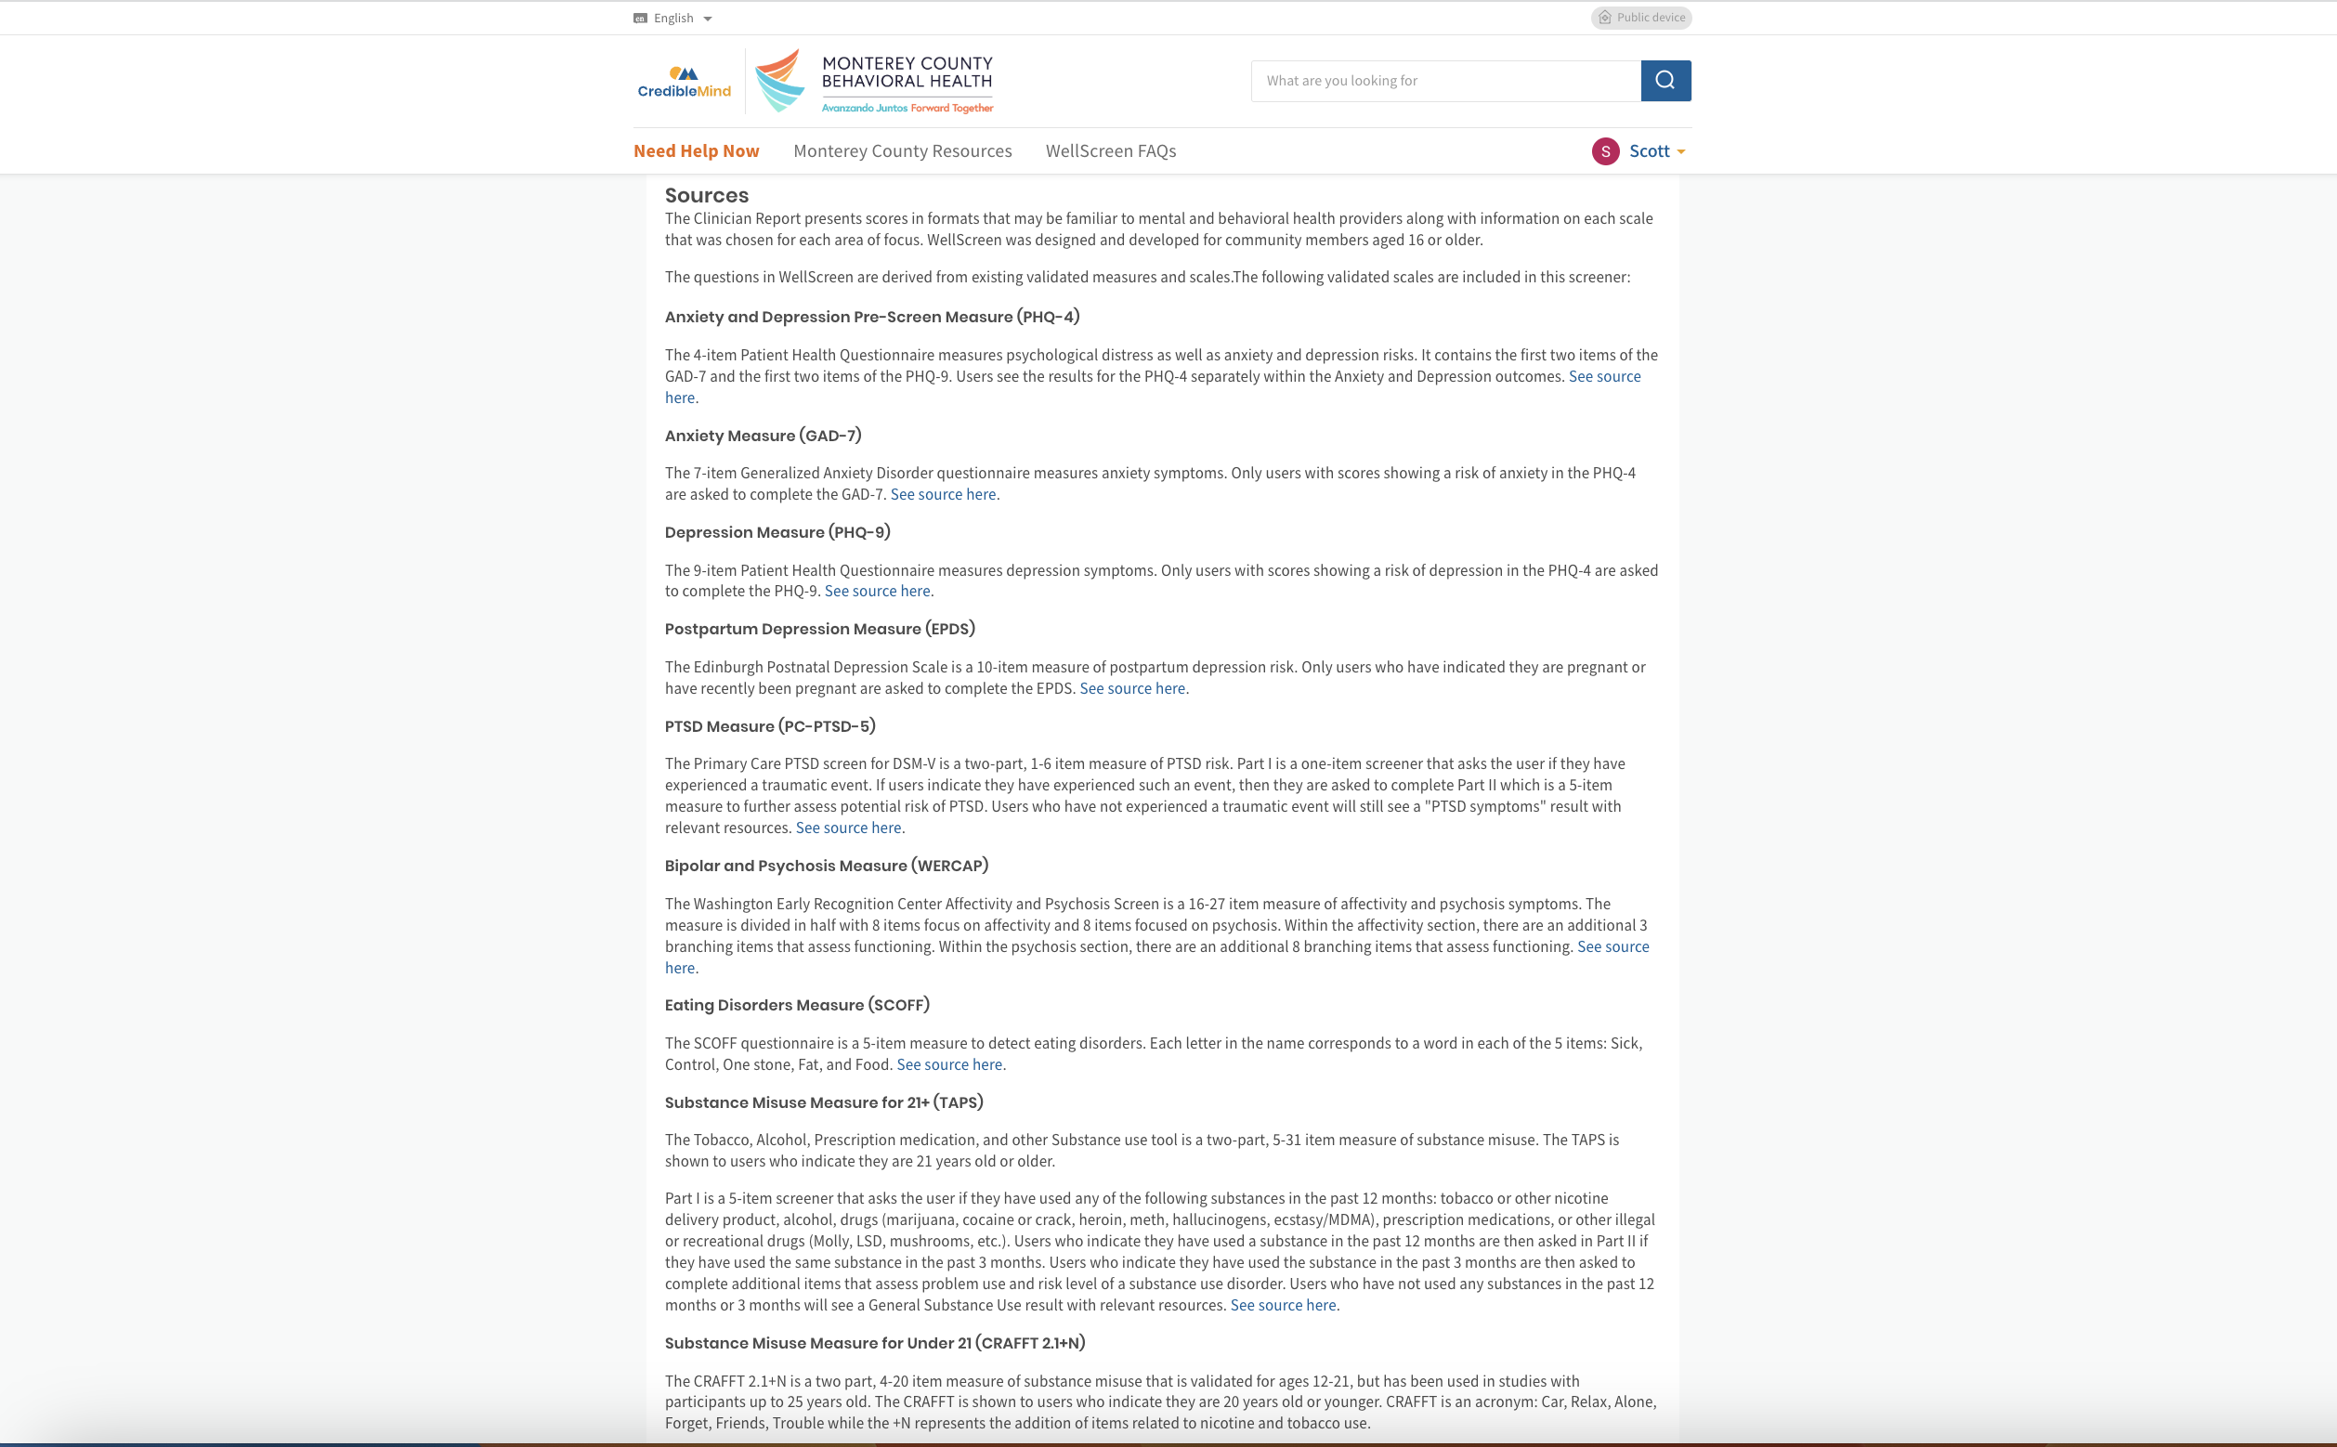

Slide 74
Phases of Psychosis
Functioning
Course of Psychosis
McGlashan 2001

Slide 75
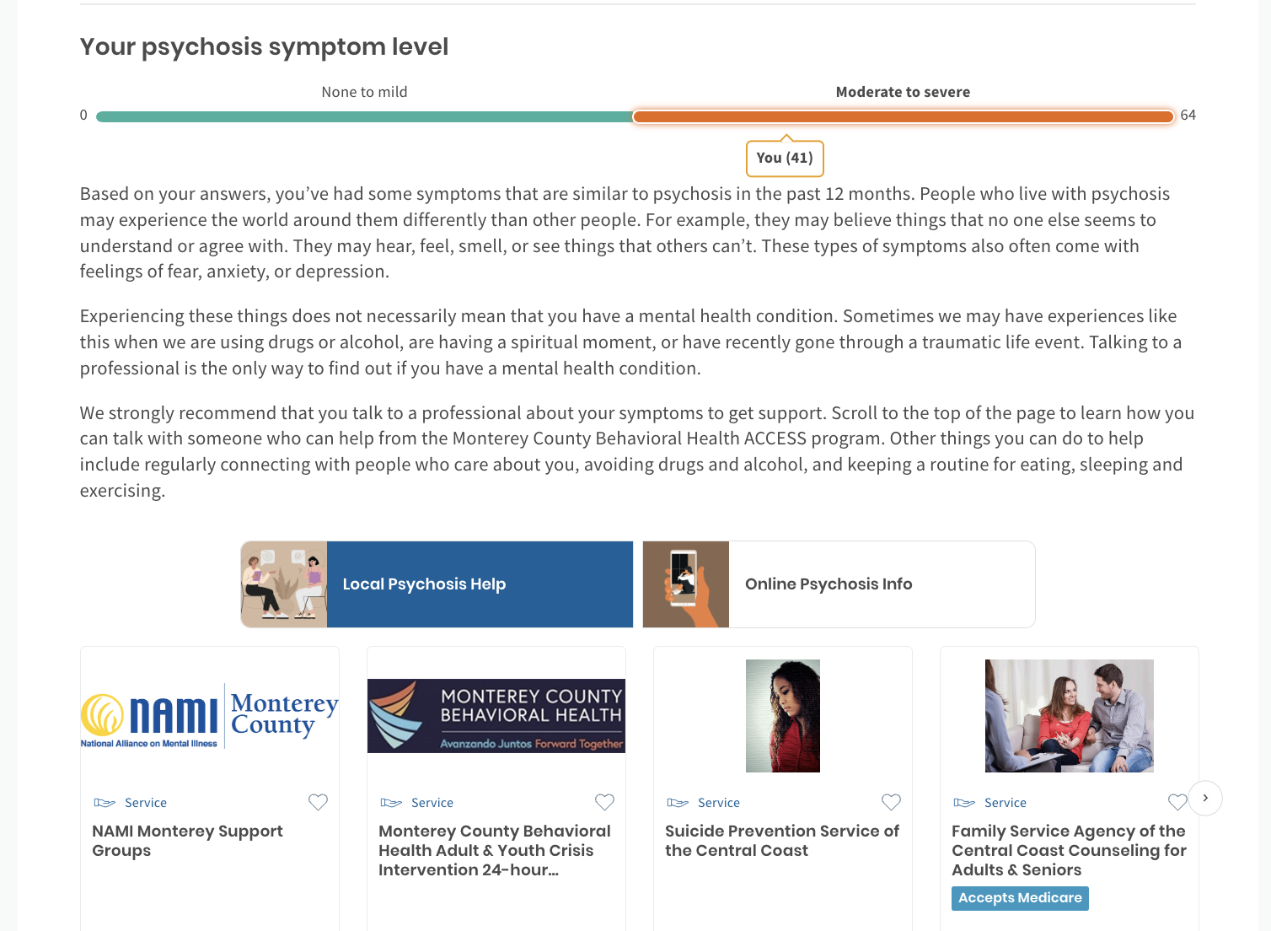
(33)

Slide 76
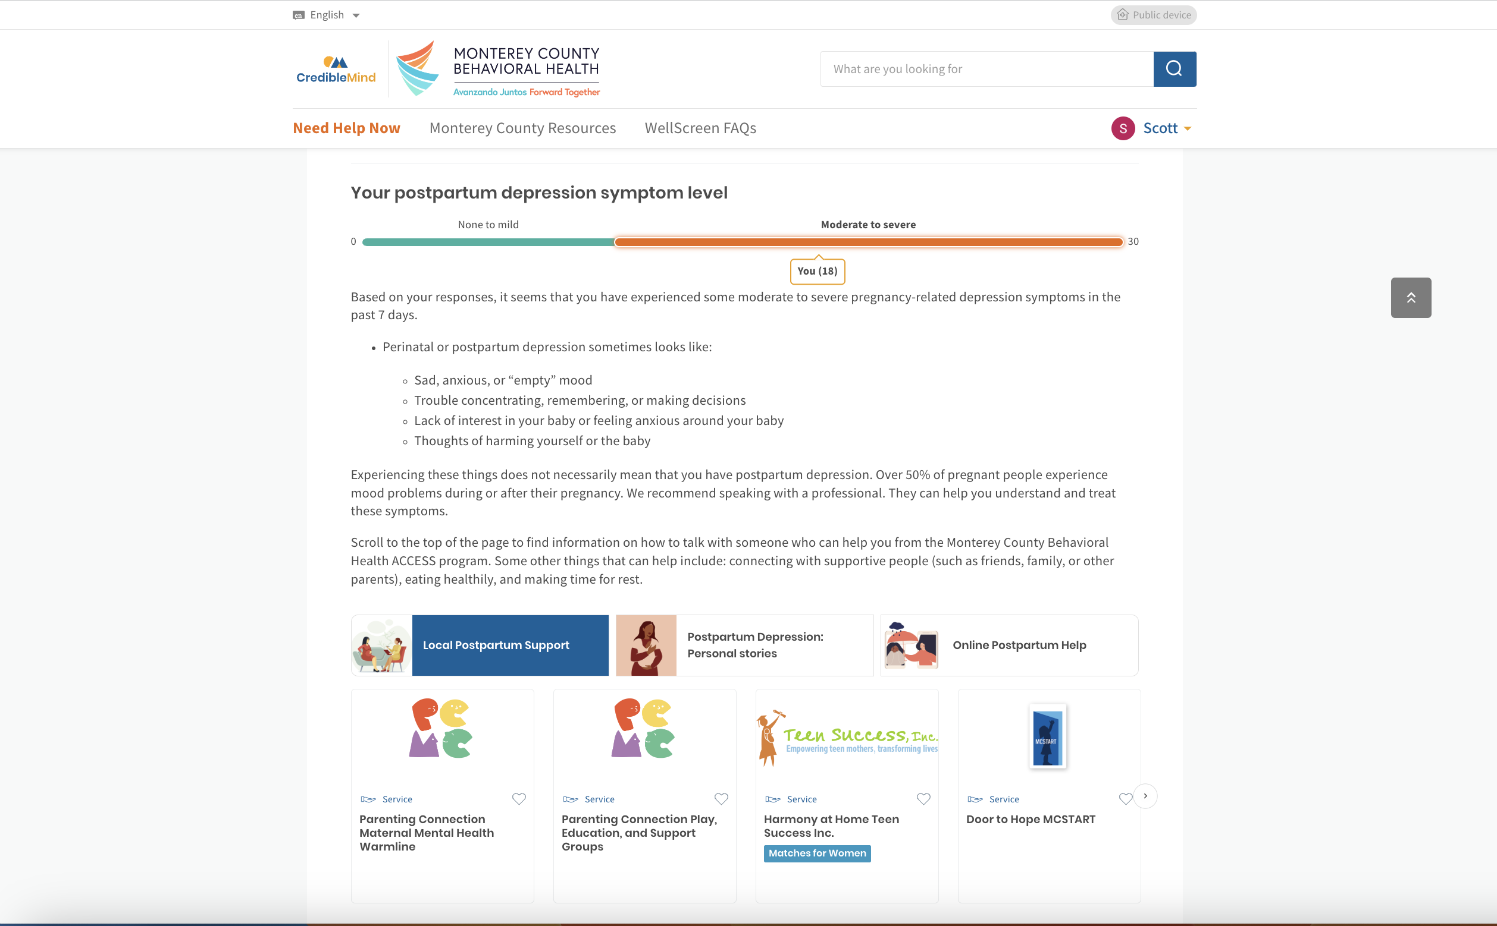

Slide 77
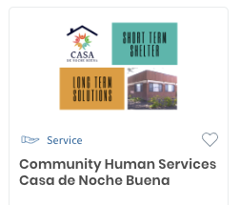

Slide 78
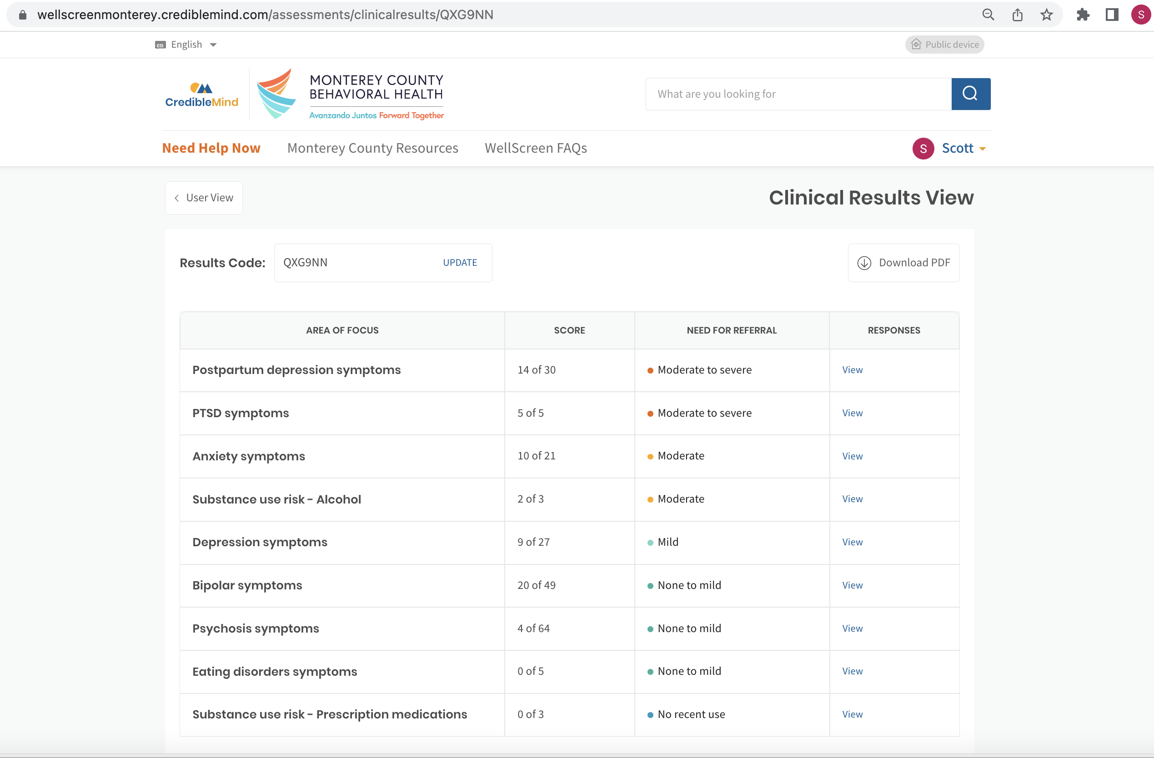

Slide 79
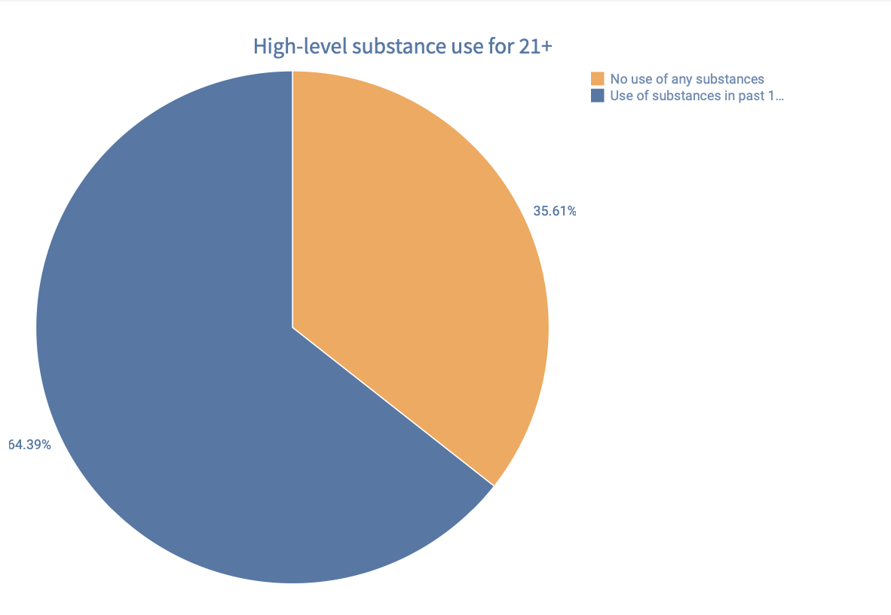

Slide 80
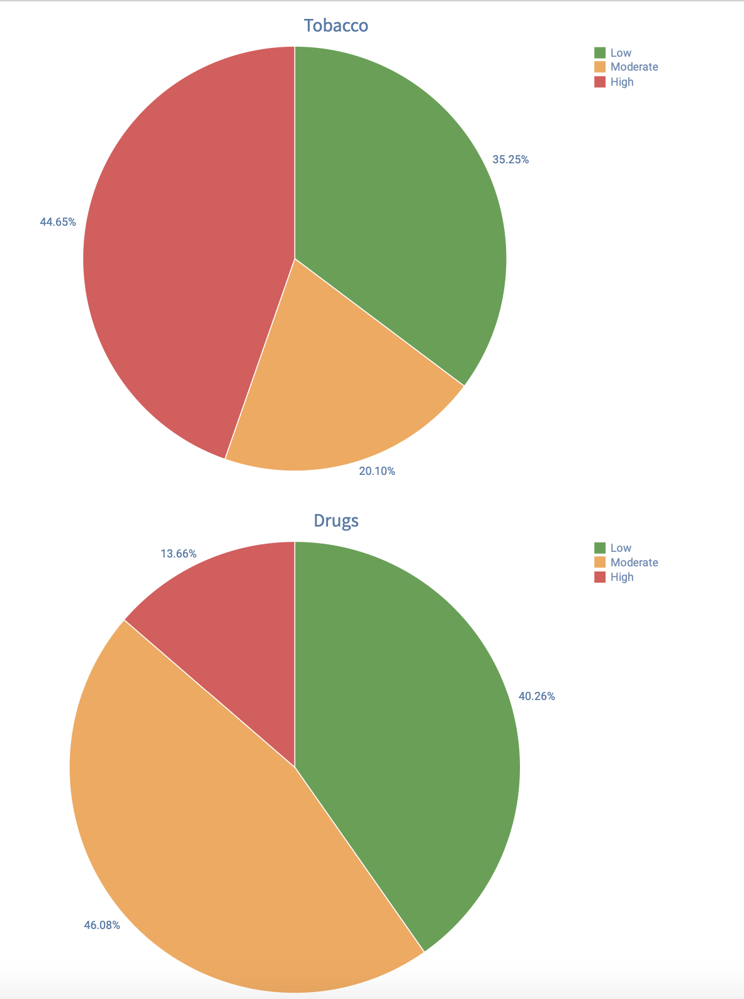
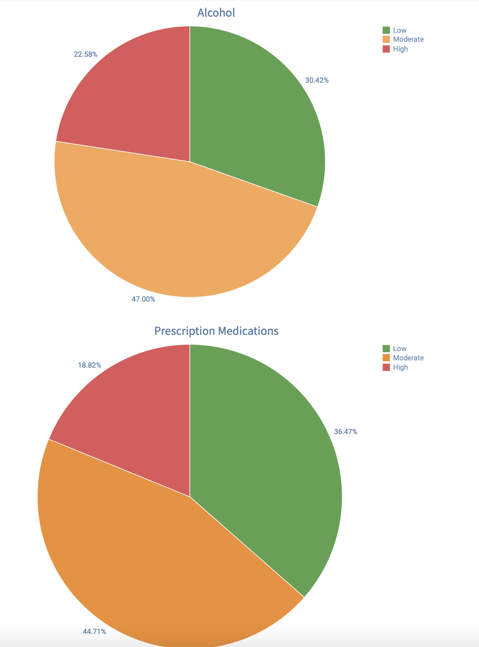

Slide 81
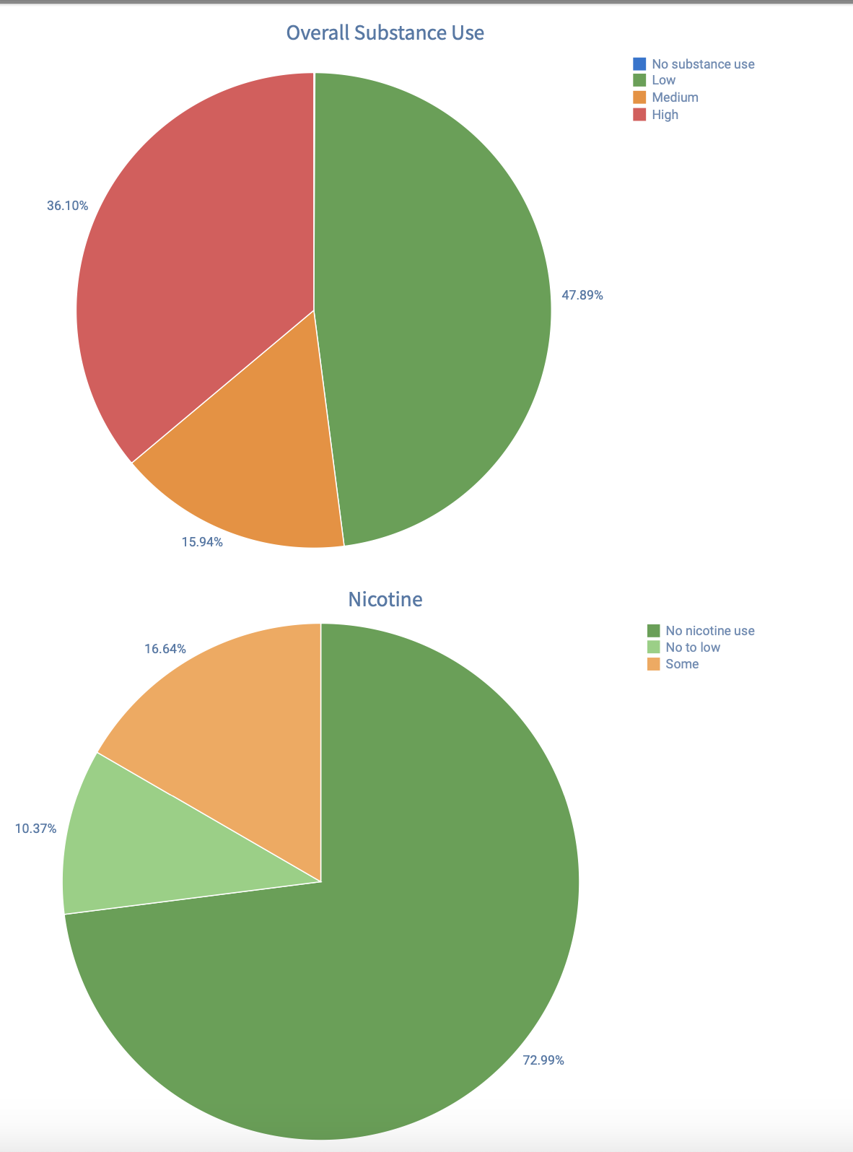

Slide 82
Contact Information
Kelsey Spangle, MS, MPH, CPH
Epidemiologist
Kelsey.Spangle@FLhealth.gov
904-253-1859

Slide 83
Sober Living & Recovery Supports
Data
Subcommittees

Slide 84
Thank You
84
Kathleen Roberts
KRoberts@ccafl.org
Deborah Babin
DBabin@nfhitda.org

