Slide 1

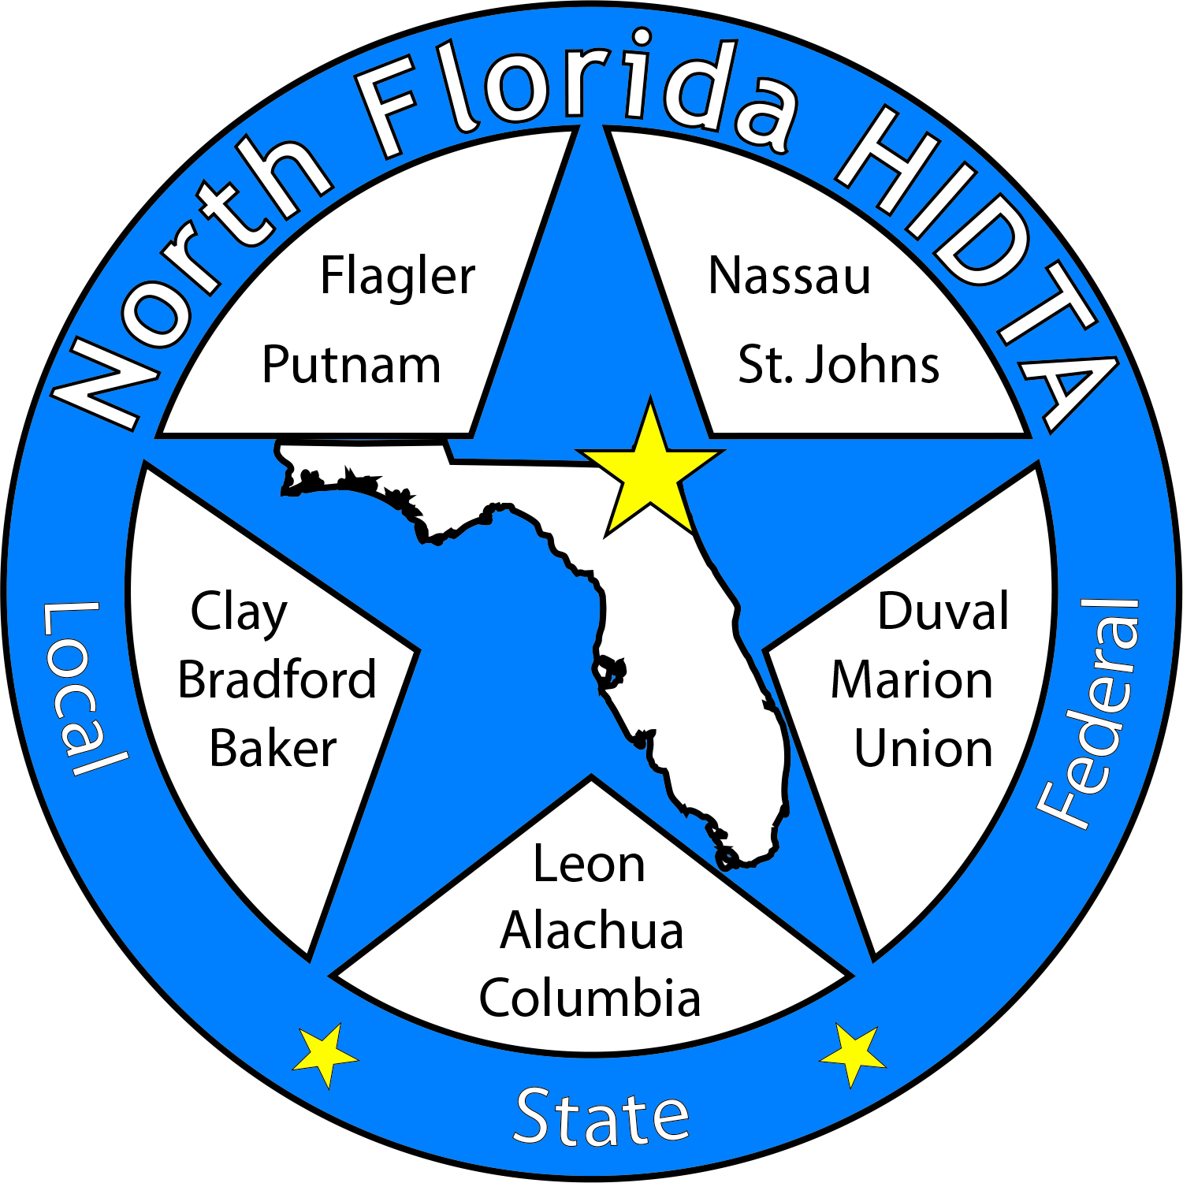
Duval DEN
April 26, 2023

Slide 2
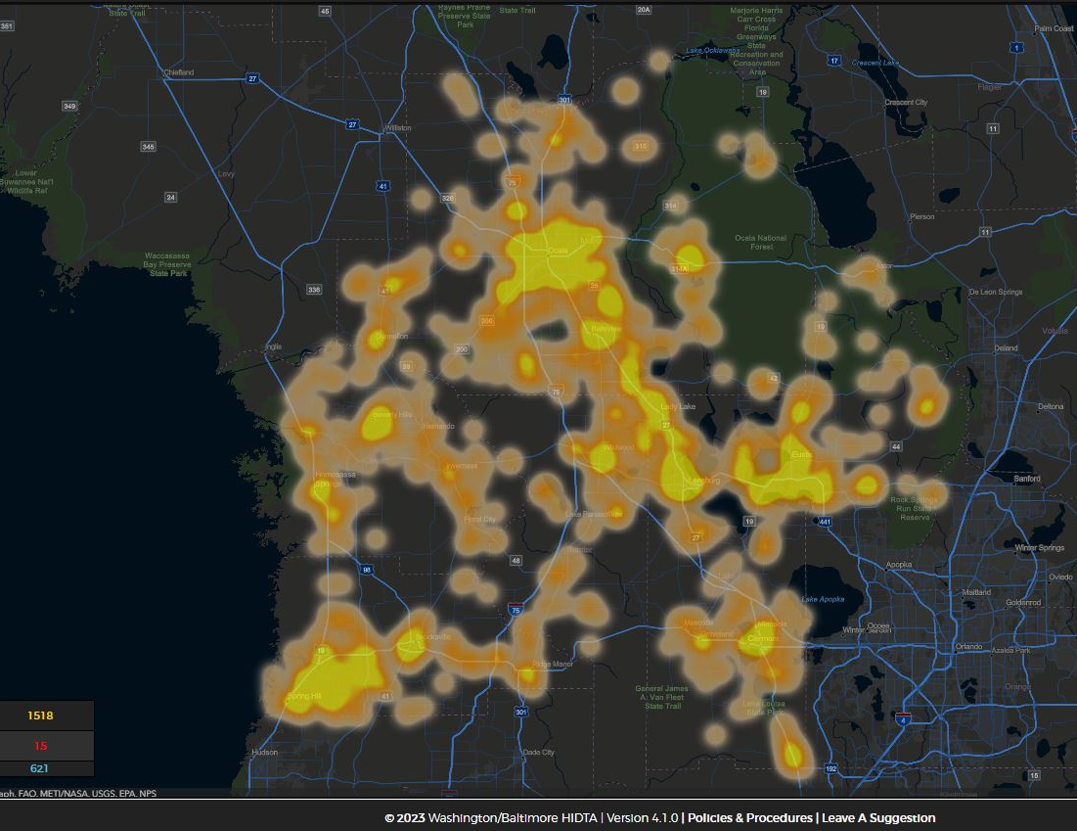
Today’s Focus
Welcome & Introductions
Data & Information Shares
Subcommittees
Open Discussion

Slide 3

DATA & INFORMATION SHARES

Slide 4
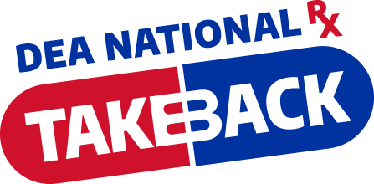
DEA Take Back Day – Spring 2023
 | Pounds Collected | Locations
Duval | 1609 lbs | 5
Nassau | 173 lbs | 3
St Johns | 134.6 lbs | 3
Putnam | 43.5 lbs | 2

Slide 5
National Prevention Week – May 7-13
Tues@2pm Shares across the region
National Fentanyl Awareness Day – May 9th
Youth Voice – Video initiative
Any shares please email Kimberly Boykin kboykin@ccafl.org

Slide 6
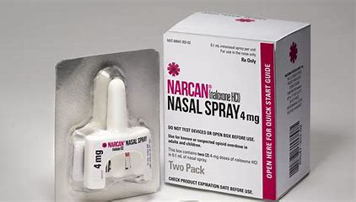
Naloxone – OTC & Additional Info

Slide 7
Questions? See Contact Info Below:
Rob Jacobson
Director of Community Health Services
FL, GA, PR
Emergent
Cell: 813-297-2538
Email: jacobsonr@ebsi.com
Jennifer Williams
Statewide Overdose Prevention Coordinator
Substance Abuse and Mental Health (SAMH)
Department of Children and Families (DCF)
Headquarters (HQ) Tallahassee
Cell: 850-481-2954
Email: Jennifer.williams1@myflfamilies.com

Slide 8
In the News – Harm to Children/Youth
 | Total Articles | Occurring at School | Occurring at Home | Resulting in ER Visit
Articles citing youth overdose or suspected overdose | 15 | 9 | 5 | 13
 | Fentanyl | THC, Delta 8, CBD | Alcohol | Unknown
Suspected Substance | 6 | THC: 6 Delta 8: 1 CBD:1 | 1
 | Elementary Age | Middle School | High School | College
Age/Grade mentioned | 19m,20m, 1,2,3yrs. 4 elementary |  | 13,14,15yrs | 1

Slide 9
In the News – Harm to Children/Youth
Month | County/City
December 2022 | Dade/Miami
January 2023 | Broward/Deerfield beach
March 2023 | Palm Beach/Wellington, Duval/Jacksonville, Clay/Orange Park, Lee/Cape Coral, Seminole/Maitland,
April 2023 | Hernando/Brooksville, Putnam/Interlachen

Slide 10
Percent of youth who reported
Adverse Childhood Experiences (ACEs), 2022
 | Florida | LSF | Duval | Clay | Nassau | Marion | Volusia
Emotional abuse | 17.1% | 17.9% | 17.5% | 19.5% | 16.9% | 18.3% | 18.8%
Physical abuse | 10.7% | 11.4% | 11.8% | 11.9% | 7.5% | 10.6% | 11.5%
Sexual abuse | 6.6% | 7.6% | 6.8% | 5.3% | 9.5% | 9.6% | 7.2%
Parents separated or divorced | 39.4% | 41.9% | 42.4% | 41.1% | 40.2% | 46.1% | 48.6%
Physical abuse in household | 8.5% | 8.9% | 6.5% | 11.5% | 8.6% | 10.2% | 11%
Substance abuse in household | 24.9% | 28.7% | 20.6% | 32.6% | 31.1% | 34.8% | 31.2%
Mental illness in household | 32.9% | 36.4% | 27.1% | 45.5% | 42.2% | 39.9% | 42.5%
Incarcerated household member | 23.3% | 26.4% | 22% | 29.1% | 29.3% | 32.2% | 32.6%
Emotional neglect | 31.2% | 32.2% | 29.3% | 36.7% | 32.7% | 33.1% | 32.6%
Physical neglect | 6.7% | 7.3% | 5.2% | 6.4% | 4.7% | 6.7% | 8.8%

Slide 11
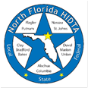
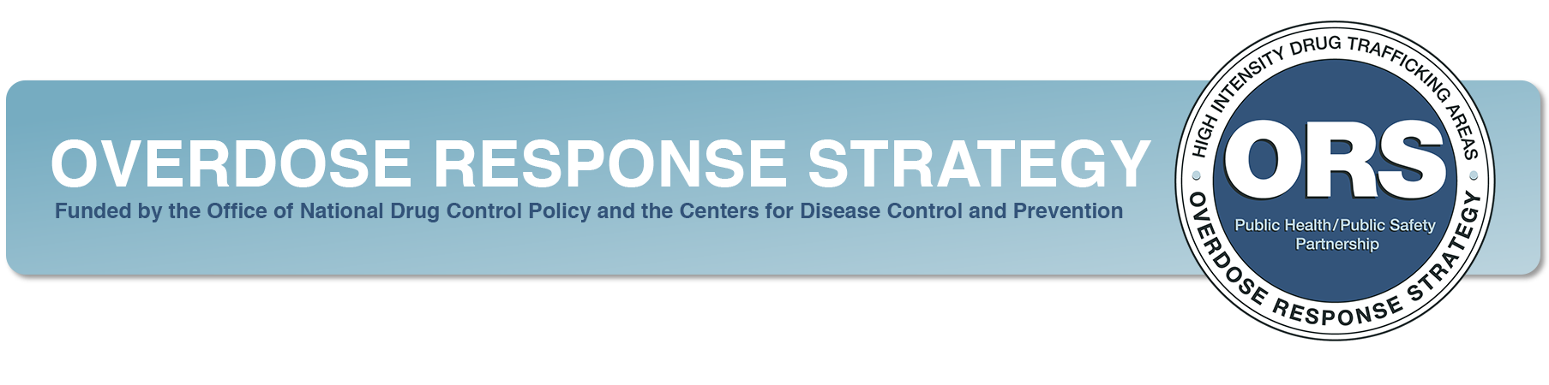
Deborah Babin
&
Scott Delano

Slide 12
The Overdose Response Strategy
Drug Epidemiology Network

Slide 13
IN THE NEWS…

Slide 14
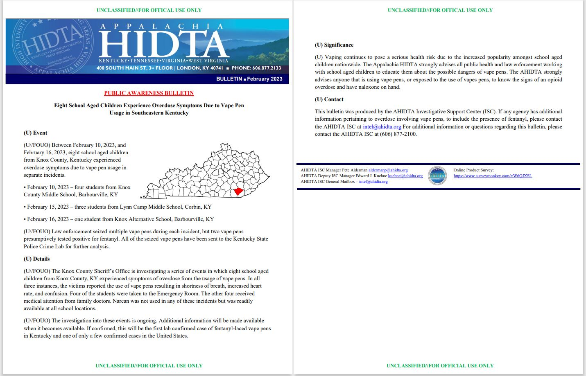

Slide 15
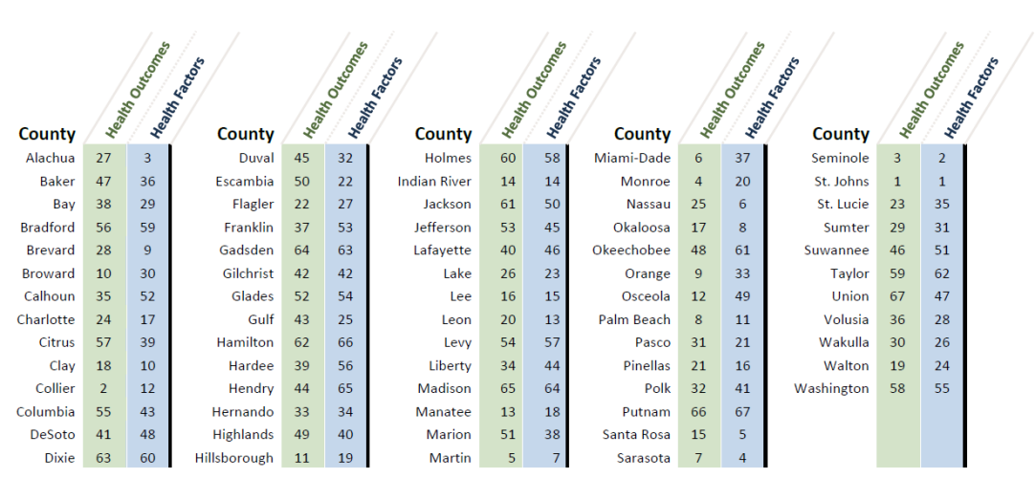
2022 County Health Rankings
46
30
21

Slide 16
2023 County Health Ranking Indicator Examples
 | Duval | Clay | Nassau | Marion | Volusia | Florida
Excessive Drinking (BRFSS, 2020) | 19% | 18% | 20% | 18% | 20% | 17%
Alcohol Impaired Driving Deaths (Fatality Analysis Reporting System) | 27% | 27% | 30% | 29% | 22% | 22%
Smoking (BRFSS, 2020) | 19% | 20% | 18% | 21% | 20% | 16%
Teen Births Rate per 1,000 15-19 yr females National Center for Health Statistics | 26 | 16 | 21 | 30 | 20 | 18
Child Poverty American Community Survey | 21% | 12% | 14% | 21% | 19% | 17
https://www.countyhealthrankings.org/

Slide 17

Recovery Ecosystem Index Score
3

Slide 18
Economic Indicators
 | Duval | Clay | Nassau | Marion | Volusia | Florida | US
Median Household Income American Community Survey (2016-2020) | $56,769 | $68,657 | $72,998 | $46,587 | $52,407 | $57,703 | $64,994
Labor Force Participation Rate American Community Survey (2016-2020) | 83.4% | 82.1% | 81.7% | 74.0% | 78.9% | 81.3% | 82.1%
Poverty Rate American Community Survey (2016-2020) | 14.5% | 9.5% | 9.8% | 15.5% | 13.2% | 13.3% | 12.8%
Recovery Ecosystem Index Map (norc.org)
https://rei.norc.org/

Slide 19
Infrastructure & Social
 | Duval | Clay | Nassau | Marion | Volusia | Florida | US
One or More Vehicles American Community Survey (2016-2020) | 92.4% | 96.5% | 97.2% | 95.2% | 94.3% | 93.9% | 91.5%
Broadband Access American Community Survey (2016-2020) | 86.1% | 92.2% | 90.4% | 83.9% | 82.6% | 85.4% | 85.2%
Social Associations per 10k County Business Patterns | 8.6 | 7 | 9.7 | 6.9 | 7.5 | 6.7 | 8.7
Severe Housing Cost Burden County Health Rankings | 15% | 10.2% | 10.6% | 12.8% | 15.5% | 16.9% | 13.0%
Recovery Ecosystem Index Map (norc.org)
https://rei.norc.org/

Slide 20
Continuum of SUD Support
 | Duval | Clay | Nassau | Marion | Volusia | Florida | US
Recovery Residences per 100k SAMHSA N-SSATS | .4 | 0 | 0 | 1.1 | .5 | 0.9 | 1
Average Distance to Nearest SSP (miles) SAMHSA N-SSATS | 287.6 | 294.4 | 266.6 | 257.4 | 228.7 | N/A | N/A
NA or SMART Meetings per 100k | 4.8 | 3.7 | 7 | 14.7 | 12.1 | 7.5 | 8.1
Is there a Drug-Free Communities Coalition? | Yes | Yes | No | Yes | No | 25.4% | 15.6%
Is there a Drug Court? | Yes | Yes | Yes | Yes | Yes | 61.2% | 48.2%
Recovery Ecosystem Index Map (norc.org)
https://rei.norc.org/

Slide 21
Substance Use Treatment
 | Duval | Clay | Nassau | Marion | Volusia | Florida | US
Substance Use Treatment Facilities per 100k | 2.3 | 1.9 | 1.2 | 3.3 | 3.5 | 2.8 | 4.3
Buprenorphine Providers per 100k | 18.2 | 13.5 | 11.7 | 10.3 | 17.4 | 11.6 | 15.2
Average Distance to Nearest MAT Provider (miles) | 4.8 | 9 | 10.8 | 6 | 10.1 | N/A | N/A
Mental Health Providers per 100k | 232 | 114.7 | 134.1 | 107.7 | 158.8 | 187.6 | 284.4
Recovery Ecosystem Index Map (norc.org)
https://rei.norc.org/

Slide 22
Age Adjusted Drug Overdose Mortality Rate
-CDC WONDER
2011 – 2015
Vs
2016 - 2020

Slide 23
Age Adjusted Drug Overdose Mortality Rate
-CDC WONDER
2011 – 2015
Vs
2016 - 2020

Slide 24
Age Adjusted Drug Overdose Mortality Rate
2016 - 2020
 | Duval | Clay | Nassau | Marion | Volusia | Florida | US
All Drugs | 63.1 | 47.3 | 50.2 | 69.6 | 58.2 | 38.8 | 32.5
Opioids | 53.5 | 40.5 | 42.8 | 45.7 | 47.8 | 27.4 | 23.4

Slide 25
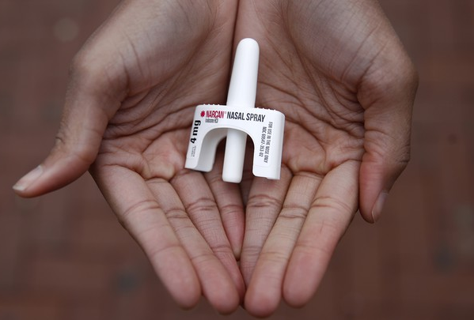

Laura Viafora Ray - JFRD

Slide 26

Overdose Data Surveillance & Trends in Jacksonville

Slide 27

Jacksonville Fire & Rescue Department Overdose Data
Data Source
  Jacksonville Fire & Rescue Department, City of Jacksonville, Florida
  Mark E. Rowley, BSN, RN, EMT-P, CAPO, Lieutenant - Rescue 62-B Shift and Captain Michael Bernard - Office of Information Services (with additional analysis and chart/graph development by Laura Viafora Ray, MPH, CPH, Project Director - The Safe and Healthy Neighborhoods Project)
Definition
  Dispatched as Overdose = a 911 call in which the caller stated that the victim was suffering from a known or suspected overdose
  Naloxone Administered = the count of naloxone administered, which may include repeat doses to same patient
  Suspected Opioid-Related Overdose = the following type of incidents: naloxone administered and nature of call at scene is "ingestion/poisoning/OD,” OR naloxone administered and clinical impression is "opioid-related,” OR overdose reported with the following substances: "Fentanyl, Carfentanil or Heroin,” OR overdose reported with naloxone administration
Additional Notes
  A 911 call received as overdose and/or naloxone administration does not necessarily confirm an overdose, opioid use, or opioid misuse
Notes:
The query for “Opioid-Related Overdose” was amended in April 2021 and this slide reflects the updated definition that corresponds to the updated query.
Notes on the measure “Naloxone Doses Administered”:
-On a DENs call several months ago, we were discussing the measures "Number of Opioid-Related Overdoses" and "Naloxone Doses Given" over time and as a ratio of calls to doses to see if that could be any indication of the potency of street drugs in a given time frame. I had an opportunity to discuss this with Mark in detail, so I wanted to share some takeaways from that conversation:
-JFRD's protocol for dosage of naloxone has changed multiple times over the years, and it depends on patient factors. For example, a patient experiencing cardiac arrest will be given 2 mg dose of naloxone at a minimum, compared to a range of 0.4 mg to 1.0 mg for a patient not experiencing cardiac arrest.
-Two doses of nasal Narcan will always equal 8 mg, because each plunger contains 4 mg, but two doses of IV naloxone given by JFRD will vary depending on the protocol at the time of the overdose incident and patient factors. In other words, there is not a standard "dose" of naloxone for the purposes of that data point.
-The EMT/firefighter's goal when giving a patient naloxone is for the patient to begin breathing, not necessarily regain consciousness. This is considered compassionate care because giving too high of a dose of naloxone will cause the patient to experience worse withdrawal symptoms. When a community member is giving Narcan, their goal is for the person to wake up, even if this means giving a much higher dose.
-The bad news is that due to these factors, these data points cannot be used to make any assessment about potency of street drugs. The good news is at least we have more clarification about this data and its limitations, so we won't make erroneous conclusions.

Slide 32
Q1 2023 Snapshot
647 opioid-related overdose patients
  12% decrease compared to Q1 2022
  7% decrease compared to last quarter (Q4 2022)
Top zip code - 32210
  62 patients (10%)
64% male; 36% female
73% white; 20% black; 7% other
32% between ages 30-39
54% residence; 17% roadway; 11% business or hotel; 18% other

Slide 33
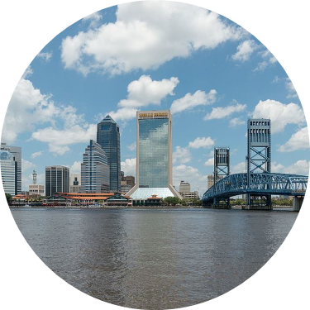
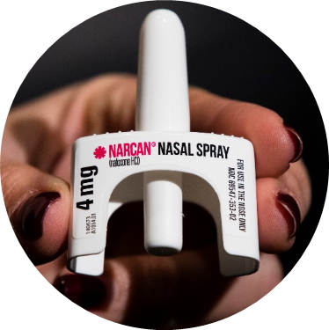
COMMUNITY-BASED NARCAN DISTRIBUTION
SEPTEMBER 2019 - APRIL 2023

Slide 34
NARCAN KIT DISTRIBUTION - SEPT. 2019 to APR. 2023
Treatment Center Partners | # of Kits
Ace Medical, Beaches Recovery/Tides Edge, CleanSlate, Gateway (multiple depts. plus Sulzbacher Center OP), Greenfield Center, Lakeview/Stepping Stone, River Region, and Sophros Recovery | 4,088
Community-Based Partners | # of Kits
Critical Awareness Security Academy, Dept. of Children & Families, Drug Free Duval, Healthy Start/ROSE Project, Inspire to Rise, JASMYN, JFRD (outreach), Overflow Health Alliance, Panama Pharmacy, Partnership for Children’s Health Jax (Mental Health First Aid trainings), and multiple street outreach partners | 9,516
TOTAL | 13,604

Slide 35

Lives Saved & Narcan Use by Laypersons
Reported use of the Narcan provided under this project is encouraged, but not required.
Thus far, ninety-two (92) individuals have voluntarily followed up to report use of their Narcan to save a person who may have otherwise died from an overdose.
Although there is no way to know for sure, we suspect that the actual number of Narcan kits used is much greater.

Slide 36
Bystander Narcan Use Prior to Arrival (PTA) of JFRD
 | 2018-2019 | 2019-2020 | 2020-2021 | 2021-2022 | 2022-2023*
% Change in Opioid-Related OD Calls | +68% | +24% | +1% | -14% | -12%
% Change in Use of NARCAN PTA by Bystanders | +191% | +59% | +79% | +5% | +74%
*January-March only
Notes:
Notes:
-Narcan nasal spray was first FDA approved in November 2015, but the first report of Narcan use PTA was not until 2017.

Slide 37
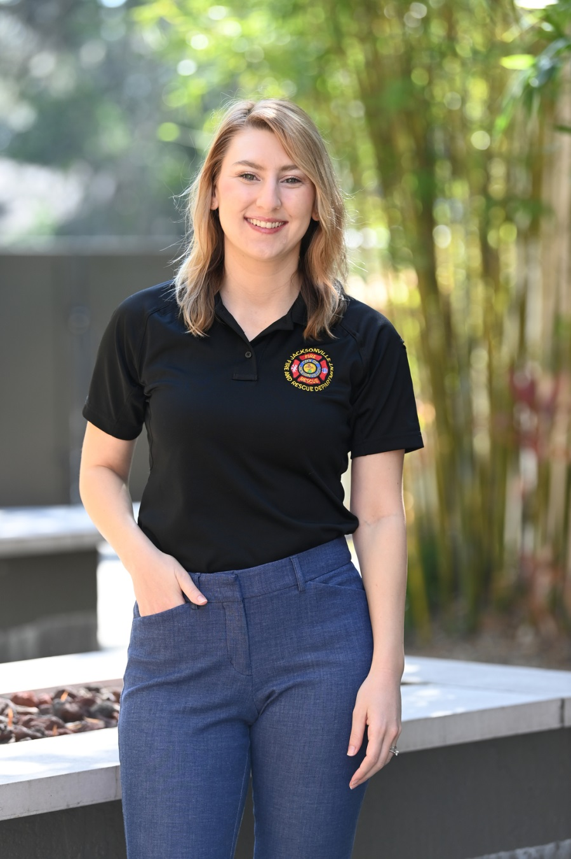
Contact Me
Laura Viafora Ray, MPH, CPH
Project Director
Office: (904) 255-7730
Cell: (904) 710-8454
Email: lvray@coj.net
Connect on LinkedIn

Slide 38


Slide 39
Sober Living & Recovery Supports
Data
Subcommittees

Slide 40

Thank You
40
Kathleen Roberts
KRoberts@ccafl.org
Deborah Babin
DBabin@nfhitda.org

