Slide 1

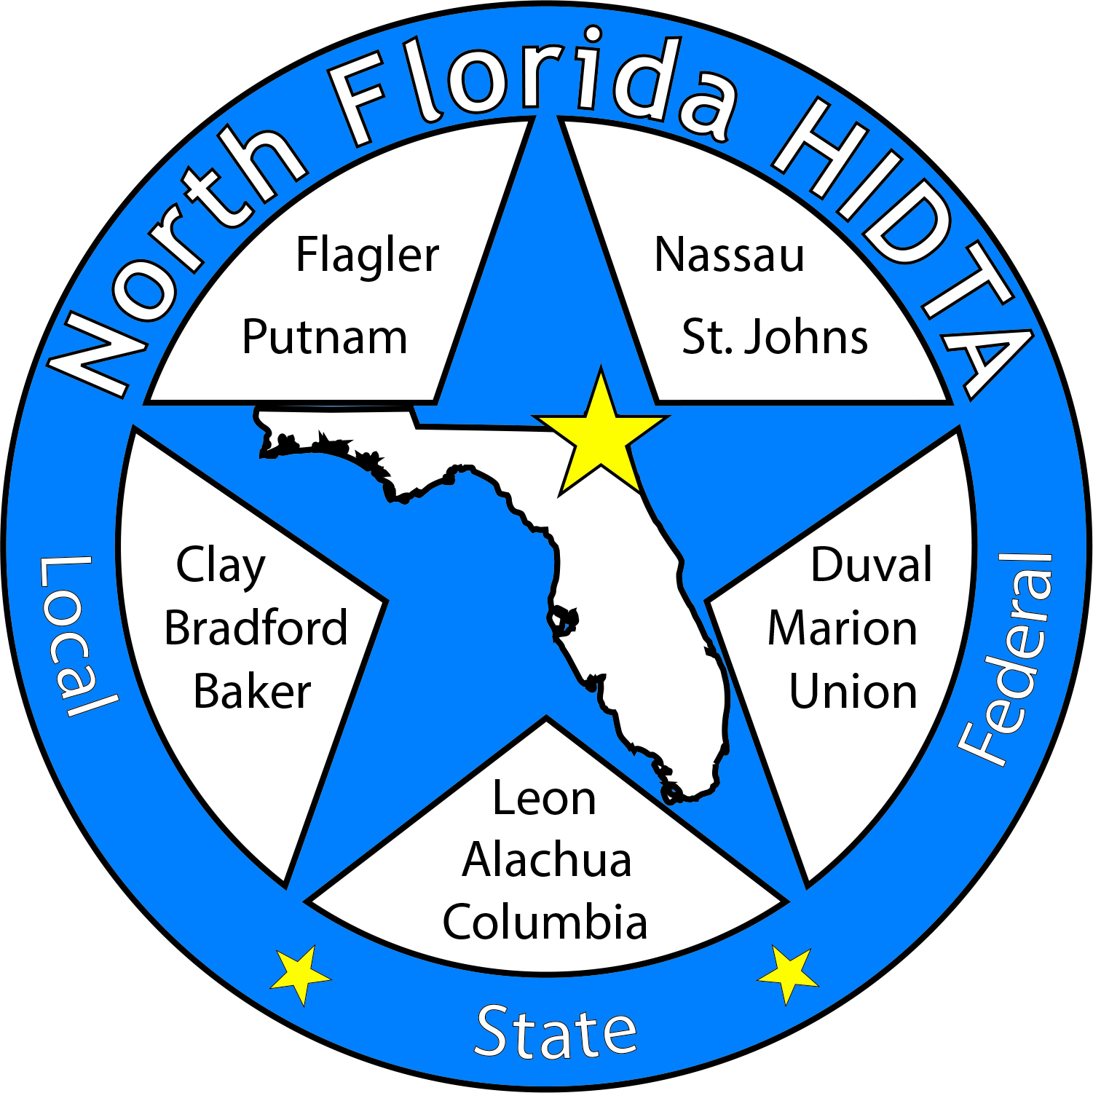
Duval DEN
May 24, 2023

Slide 2
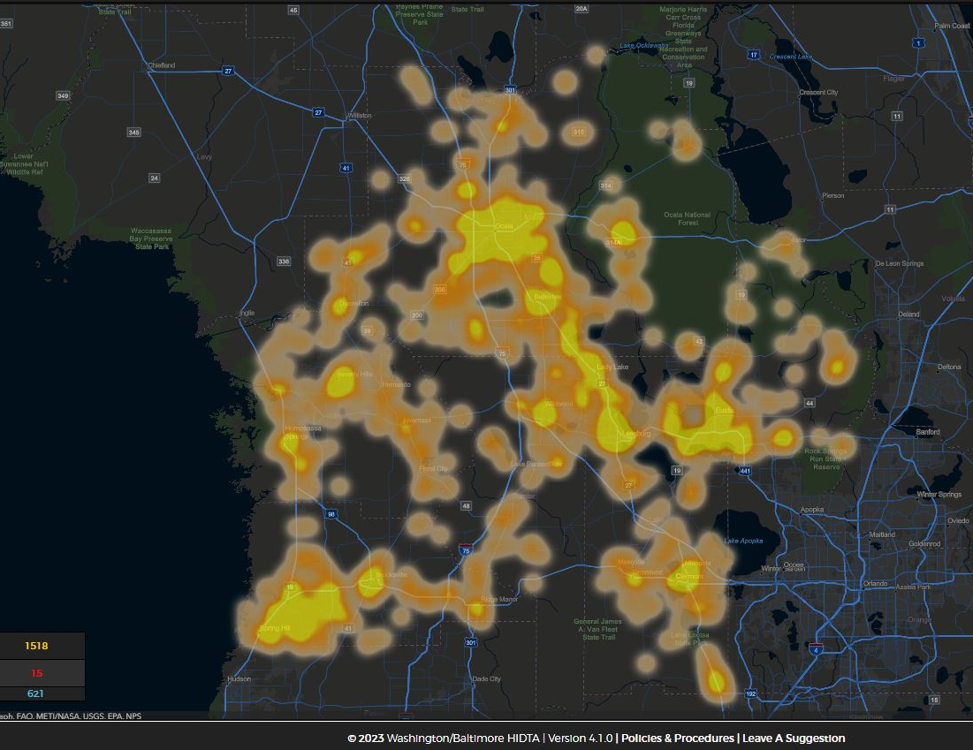
Today’s Focus
Welcome & Introductions
Data & Information Shares
Subcommittees
Open Discussion

Slide 3

Expanding Membership – Circuit 4 Partners

Slide 4

DATA & INFORMATION SHARES

Slide 5
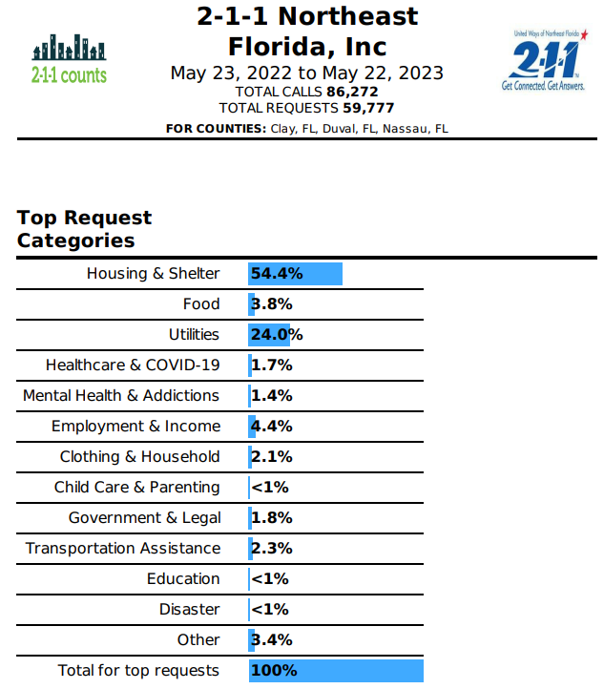
Most Requested Services

Slide 6
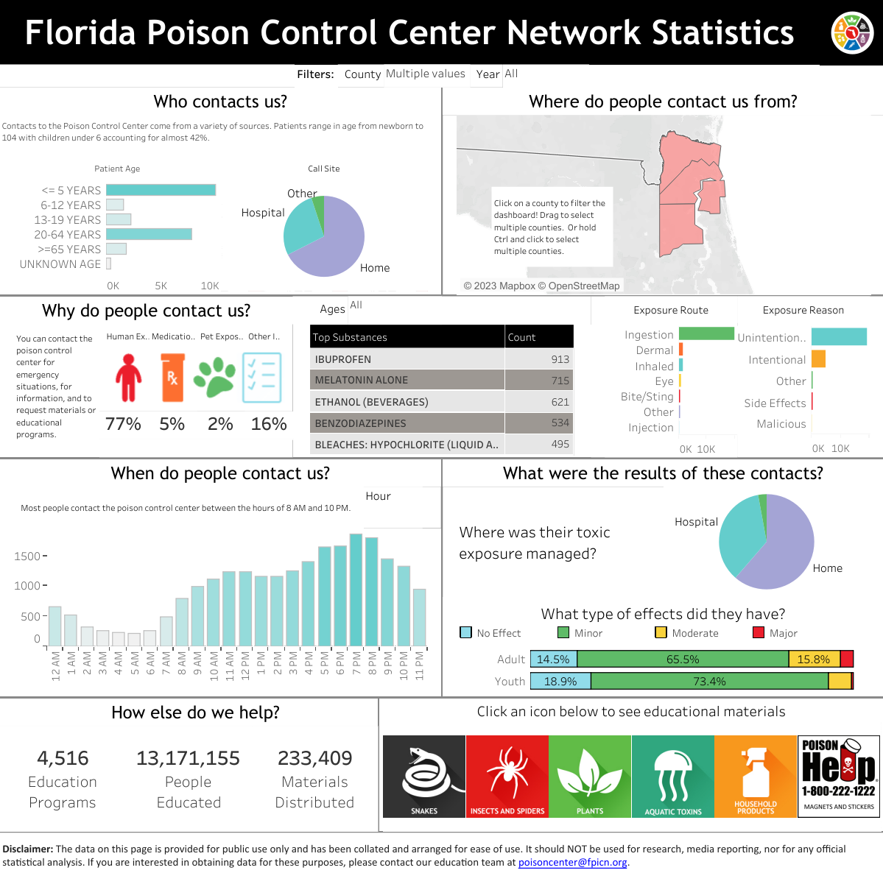

Slide 8
 | Fatal Overdoses EMSTARS 2021 | EMS Overdose Responses EMSTARS 2022 | Naloxone Administration EMSTARS 2022 | Annual Drug Arrests FDLE 2020 | Rx Dispensed FL DOH 2022 | NAS AHCA 2020
Florida | 8,093 | 105,490 | 51,752 | 68,564 | 11,633,408 | 1,121
Clay | 81 | 720 | 450 | 876 | 150,396 | 23
Duval | 596 | 5,321 | 3,824 | 5,210 | 702,068 | 107
Nassau | 19 | 401 | 325 | 510 | 74,100 | 8
Substance Use Dashboard: Overview | CHARTS (flhealthcharts.gov)

Slide 9
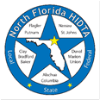

Deborah Babin
&
Scott Delano

Slide 10
The Overdose Response Strategy
Drug Epidemiology Network

Slide 11
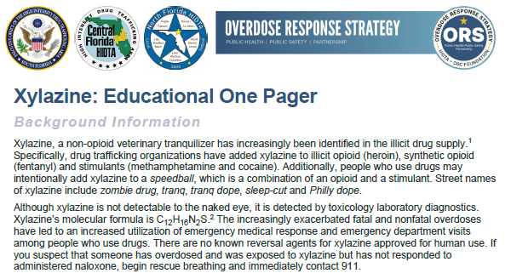

Slide 12


Slide 13


Slide 14
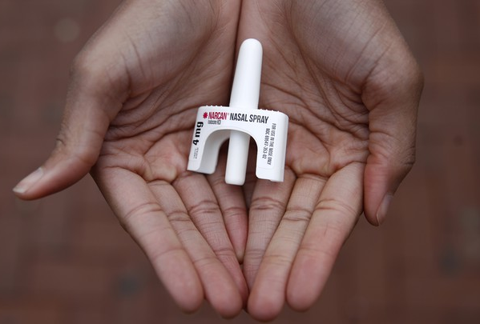

Laura Viafora Ray - JFRD

Slide 15

Overdose Data Surveillance & Trends in Jacksonville

Slide 16

Jacksonville Fire & Rescue Department Overdose Data
Data Source
  Jacksonville Fire & Rescue Department, City of Jacksonville, Florida
  Mark E. Rowley, BSN, RN, EMT-P, CAPO, Lieutenant - Rescue 62-B Shift and Captain Michael Bernard - Office of Information Services (with additional analysis and chart/graph development by Laura Viafora Ray, MPH, CPH, Project Director - The Safe and Healthy Neighborhoods Project)
Definitions
  Dispatched as Overdose = a 911 call in which the caller stated that the victim was suffering from a known or suspected overdose
  Naloxone Administered = the count of naloxone administered, which may include repeat doses to same patient
  Opioid-Related Overdose (known or suspected) = the following type of incidents: naloxone administered and nature of call at scene is "ingestion/poisoning/OD,” OR naloxone administered and clinical impression is "opioid-related,” OR overdose reported with the following substances: "Fentanyl, Carfentanil or Heroin,” OR overdose reported with naloxone administration
  Bystander Narcan Use Prior to Arrival of JFRD = the following type of incidents: “Suspected Drug Overdose” = Yes AND “Opioid Antagonists Administered (PTA JFRD) = Nasal Naloxone/Narcan OR narrative search for key terms “nasal” and “Narcan” and “naloxone” with a review of the narrative to ensure the incident applies to the intended definition and removal of duplicates so the same incident is not counted twice
Additional Notes
  A 911 call received as overdose and/or naloxone administration does not necessarily confirm an overdose, opioid use, or opioid misuse
Notes:
Notes:
The query for “Opioid-Related Overdose” was amended in April 2021 and this slide reflects the updated definition that corresponds to the updated query.
“Naloxone Doses Administered”:
-On a DENs call several months ago, we were discussing the measures "Number of Opioid-Related Overdoses" and "Naloxone Doses Given" over time and as a ratio of calls to doses to see if that could be any indication of the potency of street drugs in a given time frame. I had an opportunity to discuss this with Mark in detail, so I wanted to share some takeaways from that conversation:
-JFRD's protocol for dosage of naloxone has changed multiple times over the years, and it depends on patient factors. For example, a patient experiencing cardiac arrest will be given 2 mg dose of naloxone at a minimum, compared to a range of 0.4 mg to 1.0 mg for a patient not experiencing cardiac arrest.
-Two doses of nasal Narcan will always equal 8 mg, because each plunger contains 4 mg, but two doses of IV naloxone given by JFRD will vary depending on the protocol at the time of the overdose incident and patient factors. In other words, there is not a standard "dose" of naloxone for the purposes of that data point.
-The EMT/firefighter's goal when giving a patient naloxone is for the patient to begin breathing, not necessarily regain consciousness. This is considered compassionate care because giving too high of a dose of naloxone will cause the patient to experience worse withdrawal symptoms. When a community member is giving Narcan, their goal is for the person to wake up, even if this means giving a much higher dose.
-The bad news is that due to these factors, these data points cannot be used to make any assessment about potency of street drugs. The good news is at least we have more clarification about this data and its limitations, so we won't make erroneous conclusions.

Slide 17
# of Suspected Opioid-Related (O-R) Overdose (OD) Patients
Month/Year | 2014 | 2015 | 2016 | 2017 | 2018 | 2019 | 2020 | 2021 | 2022 | 2023
Jan | 15 | 16 | 39 | 170 | 115 | 259 | 238 | 248 | 251 | 216
Feb | 16 | 33 | 91 | 200 | 143 | 195 | 282 | 203 | 239 | 198
Mar | 13 | 17 | 118 | 164 | 235 | 244 | 276 | 276 | 242 | 233
Apr | 29 | 28 | 106 | 145 | 170 | 207 | 319 | 303 | 259 | 234
May | 23 | 16 | 97 | 136 | 230 | 227 | 369 | 342 | 240
Jun | 27 | 18 | 72 | 224 | 187 | 225 | 351 | 330 | 291
Jul | 23 | 27 | 99 | 179 | 205 | 213 | 321 | 328 | 238
Aug | 29 | 36 | 124 | 210 | 139 | 219 | 323 | 316 | 280
Sep | 29 | 56 | 140 | 151 | 165 | 248 | 247 | 305 | 281
Oct | 21 | 47 | 209 | 183 | 184 | 250 | 298 | 293 | 241
Nov | 18 | 34 | 229 | 205 | 152 | 243 | 220 | 265 | 221
Dec | 23 | 44 | 189 | 180 | 196 | 262 | 223 | 309 | 230
TOTAL | 266 | 372 | 1,513 | 2,147 | 2,121 | 2,792 | 3,467 | 3,518 | 3,013 | 881
% Change |  | +40% | +307% | +42% | -1% | +32% | +24% | +1% | -14% | -11%

Slide 18
Suspected Opioid-Related (O-R) Overdose (OD) Patients by Incident Zip Code Jan 2023 - Apr 2023
Zip Code | Count | % of O-R OD | Trend (Compared to Jan 2022 - Apr 2022)
32210 (Southwest) | 78 | 9% | 27% decrease
32244 (Southwest) | 61 | 7% | 9% decrease
32218 (Outer Rim) | 58 | 7% | 29% decrease
32209 (Urban Core) | 51 | 6% | 16% increase
32246 (Arlington) | 49 | 6% | 8% decrease
32254 (Urban Core) | 46 | 5% | 8% decrease
32256 (Southeast) | 44 | 5% | 47% increase
32207 (Arlington) | 44 | 5% | 4% decrease
32208 (Urban Core) | 42 | 5% | 11% increase
32205 (Southwest) | 38 | 4% | 3% increase
TOTAL (Top 10) | 511 | 58%
TOTAL (Other 24 Zips) | 370 | 42%
TOTAL (All 34 Zips) | 881 | 100%

Slide 19
Suspected Opioid-Related (O-R) Overdose (OD) Patients by Incident Zip Code Q1: Jan 2023 - Apr 2023
Top 10 Zip Codes | Count | Population Size | Rate per 1,000
32202 (Urban Core) | 35 | 6,965 | 5.03
32254 (Urban Core) | 46 | 13,572 | 3.39
32206 (Urban Core) | 32 | 16,118 | 1.99
32220 (Outer Rim) | 22 | 12,703 | 1.73
32219 (Outer Rim) | 19 | 12,760 | 1.49
32204 (Urban Core) | 11 | 7,507 | 1.47
32209 (Urban Core) | 51 | 35,919 | 1.42
32208 (Urban Core) | 42 | 30,648 | 1.37
32205 (Southwest) | 38 | 30,349 | 1.25
32210 (Southwest) | 78 | 62,457 | 1.25
TOTAL (Top 10) | 374
TOTAL (Other 24 Zips) | 507
TOTAL (All 34 Zips) | 881
Notes:
Notes:
Zip codes highlighted in orange - both in the top 10 for count and the top 10 for rate per 1,000.

Slide 20
Key Takeaways Zip Code Trends
YTD 2023
The Urban Core (Health Zone 1)
  Three of the six zip codes (32209, 32254, and 32208) rank in the top 10 for Opioid-Related Overdose Calls by count
  All six zip codes (32202, 32254, 32206, 32204, 32209, and 32208) rank in the top 8 for Opioid-Related Overdose Calls by rate per 1,000 pop.
  Four of the six zip codes (32202, 32206, 32208, and 32209) have seen increases in count (comparing Jan 22-Apr 22 and Jan 23-Apr 23)
Zip Code 32256 (Southeast/Health Zone 3)
  Ranks #7 by count and #16 by rate
  In 2022, it ranked #12 by count and #20 by rate
  47% increase (comparing Jan 22-Apr 22 and Jan 23-Apr 23)
Notes:
Notes:
Since 2018, a Health Zone 3 zip code has only been in the top 10 once before - in 2019 when 32256 ranked #8.

Slide 21
% of Suspected Opioid-Related (O-R) Overdose (OD) Patients
Race/Year | 2014 | 2015 | 2016 | 2017 | 2018 | 2019 | 2020 | 2021 | 2022 | 2023 (Jan-Apr)
Black or African American | 8% | 8% | 10% | 9% | 10% | 11% | 14% | 17% | 20% | 21%
Hispanic or Latino | 2% | 2% | 2% | 3% | 4% | 3% | 3% | 3% | 5% | 5%
Other/ Unknown | 2% | 3% | 2% | 4% | 4% | 4% | 4% | 4% | 2% | 1%
White | 88% | 87% | 86% | 84% | 82% | 82% | 79% | 76% | 73% | 73%
% of Suspected Opioid-Related (O-R) Overdose (OD) Patients
Gender/Year | 2014 | 2015 | 2016 | 2017 | 2018 | 2019 | 2020 | 2021 | 2022 | 2023 (Jan-Apr)
Male | 53% | 55% | 64% | 62% | 61% | 64% | 66% | 68% | 66% | 65%
Female | 47% | 45% | 36% | 38% | 39% | 36% | 34% | 32% | 34% | 35%

Slide 22
% of Suspected Opioid-Related (O-R) Overdose (OD) Patients
Age Range | 2014 | 2015 | 2016 | 2017 | 2018 | 2019 | 2020 | 2021 | 2022 | 2023 (Jan-Apr)
19 or younger | 6% | 2% | 2% | 2% | 2% | 1% | 1% | 1% | 2% | 2%
20-29 | 26% | 30% | 30% | 26% | 26% | 22% | 20% | 15% | 14% | 14%
30-39 | 23% | 27% | 33% | 36% | 37% | 36% | 35% | 36% | 33% | 32%
40-49 | 18% | 17% | 17% | 18% | 17% | 22% | 21% | 23% | 24% | 24%
50-59 | 17% | 15% | 12% | 12% | 11% | 12% | 13% | 14% | 15% | 15%
60-69 | 6% | 6% | 5% | 5% | 5% | 6% | 7% | 8% | 9% | 10%
70 or older | 3% | 2% | 1% | 1% | 2% | 2% | 2% | 2% | 3% | 3%
Some years add up to 99% or 101% due to rounding

Slide 23
Jan-Apr 2023 Snapshot
881 opioid-related overdose patients
  11% decrease compared to Jan-Apr 2022
  9% decrease compared to Sept-Dec 2022
Top zip code - 32210
  78 patients (9%)
65% male; 35% female
73% white; 21% black/AA; 6% other
32% between ages 30-39
53% residence; 17% roadway; 11% business or hotel; 19% other

Slide 24
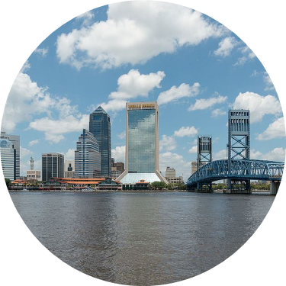
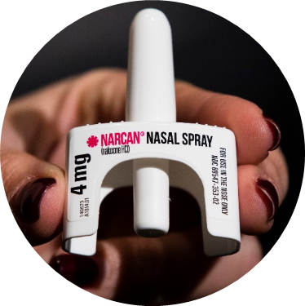
COMMUNITY-BASED NARCAN DISTRIBUTION
SEPTEMBER 2019 - MAY 2023

Slide 25

Project Activities at a Glance
14,115 Narcan kits distributed
358 unique trainings reaching over 6,250 community members
Notes:
Notes:
Average training size is 17.

Slide 26
NARCAN KIT DISTRIBUTION - SEPTEMBER 2019 to MAY 2023
Treatment Center Partners (current or former) | # of Kits
Ace Medical, Beaches Recovery/Tides Edge, CleanSlate, Gateway (multiple depts. plus Sulzbacher Center OP), Greenfield Center, Lakeview/Stepping Stone, River Region, and Sophros Recovery | 4,171
Community-Based Partners (current or former) | # of Kits
Critical Awareness Security Academy, Dept. of Children & Families, Drug Free Duval, Healthy Start/ROSE Project, Inspire to Rise, JASMYN, JFRD (training/outreach), Overflow Health Alliance, Panama Pharmacy, Partnership for Children’s Health Jax (Mental Health First Aid trainings), and multiple street outreach partners | 9,944
TOTAL | 14,115

Slide 27

Lives Saved & Narcan Use by Laypersons
Reported use of the Narcan provided under this project is encouraged, but not required.
Thus far, one hundred (100) individuals have voluntarily followed up to report use of their Narcan to save a person who may have otherwise died from an overdose.
Although there is no way to know for sure, we suspect that the actual number of Narcan kits used is much greater.
Notes:
Received eight additional reports since the April DENs meeting.

Slide 28
Bystander Narcan Use Prior to Arrival (PTA) of JFRD
 | 2018-2019 | 2019-2020 | 2020-2021 | 2021-2022 | 2022-2023*
% Change in Opioid-Related OD Calls | +32% | +24% | +1% | -14% | -11%
% Change in Use of NARCAN PTA by Bystanders | +191% | +59% | +79% | +5% | +70%
*January-April only
Notes:
Notes:
-Narcan nasal spray was first FDA approved in November 2015, but the first report of Narcan use PTA JFRD was not until 2017.

Slide 29
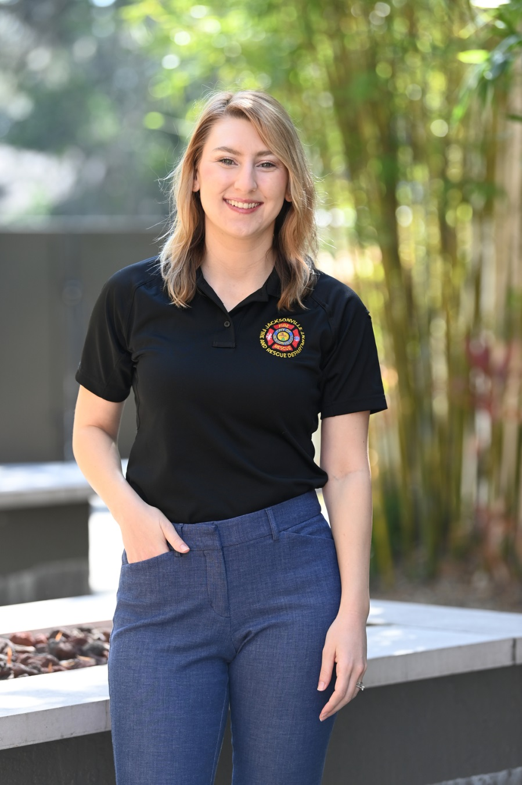
Contact Me
Laura Viafora Ray, MPH, CPH
Project Director
Office: (904) 255-7730
Cell: (904) 710-8454
Email: lvray@coj.net
Connect on LinkedIn

Slide 30
Duval Department of Health

Slide 31

Florida Department of Health
OD2A Surveillance
LaTerica Thomas, MPH, CPH
Epidemiologist

Slide 32
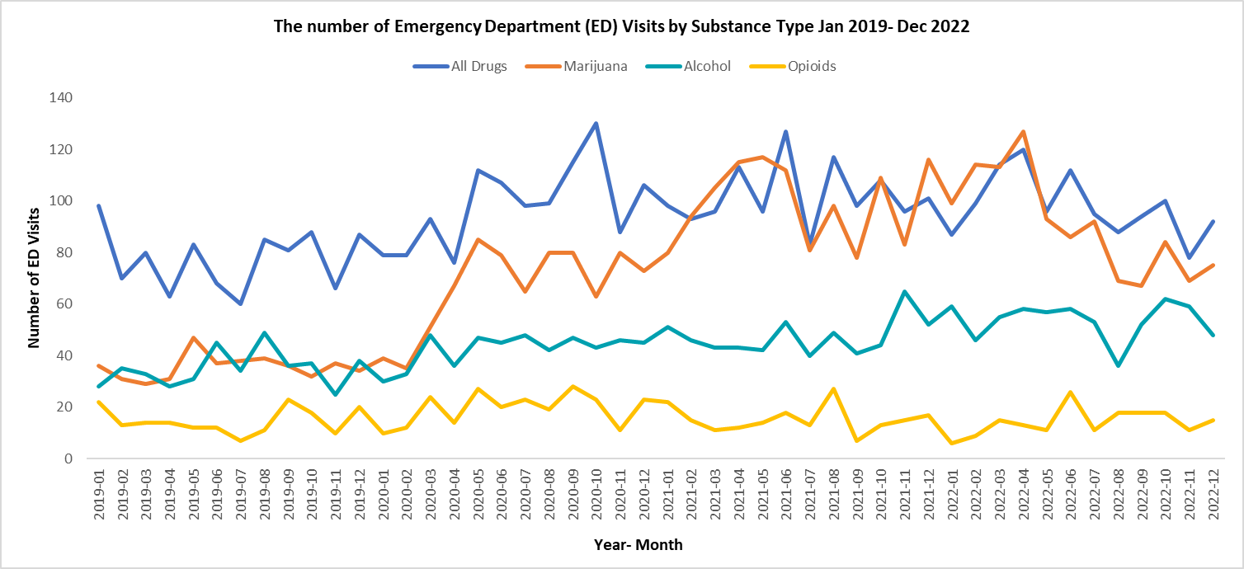
Youth Substance Use-Related ED Visits in Duval County

Slide 33
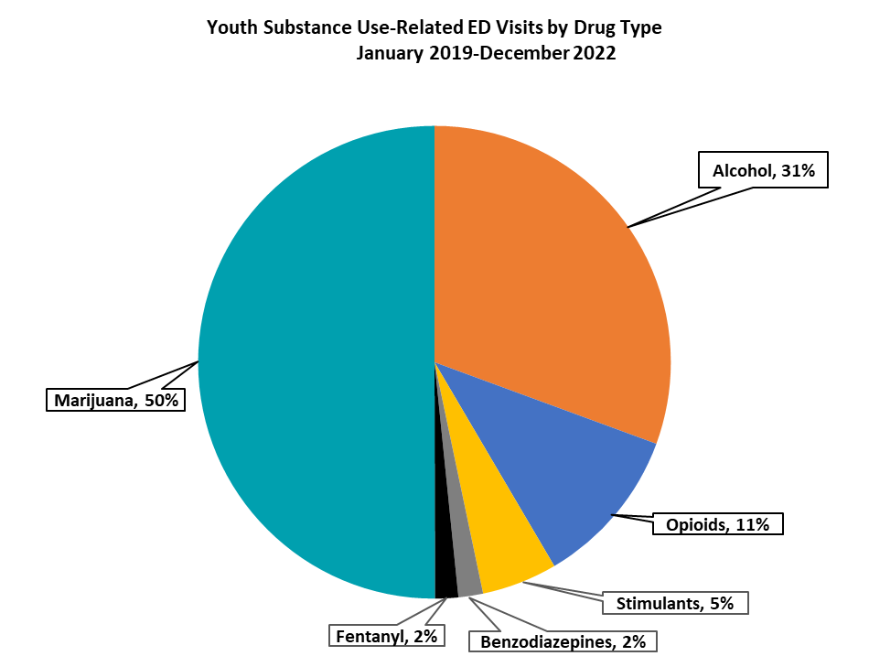
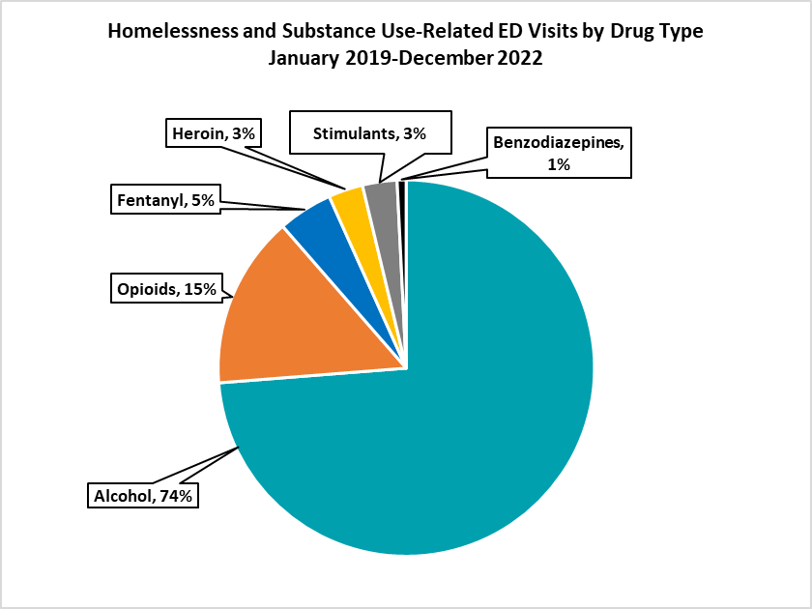

Youth Substance Use-Related ED Visits in Duval County

Slide 34
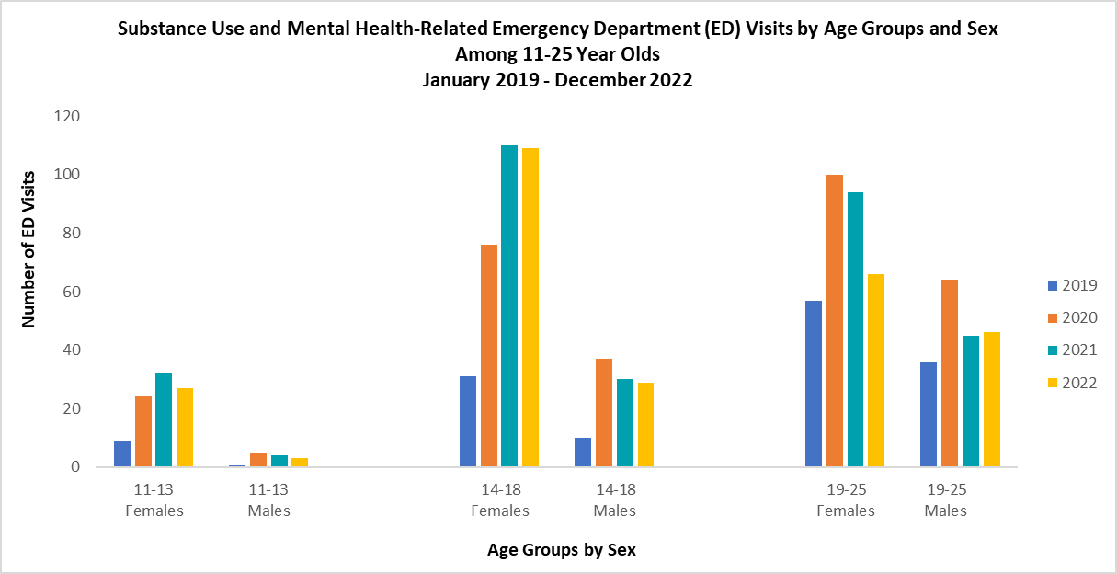
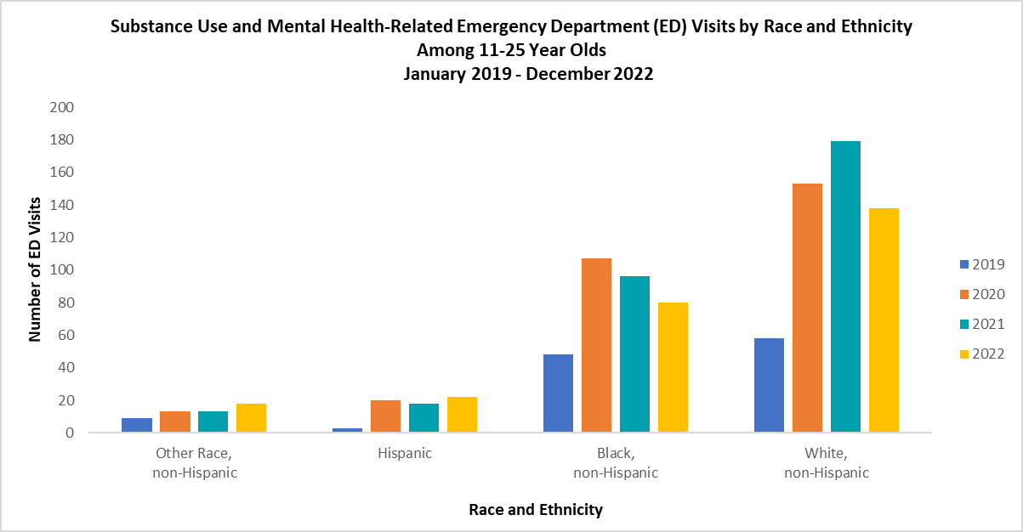
Youth Substance Use and Mental Health-Related ED Visits in Duval County
Disproportionate burden in Age Groups, January – December; 2019 - 2022
Zip Codes: 32209, 32210, 32216, 32218, 32225 & 32244
Age Group: 14-18
Race/Ethnicity/Gender: White, non-Hispanic Females

Slide 35
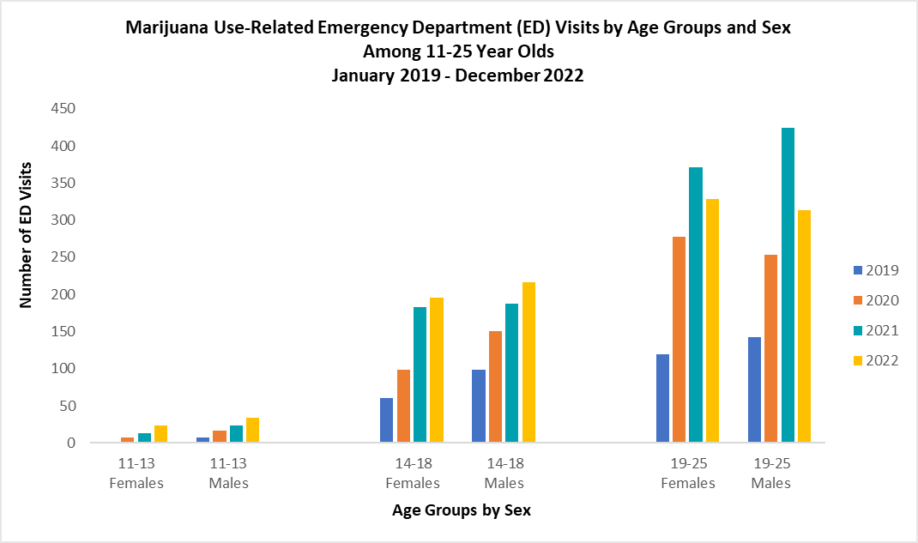
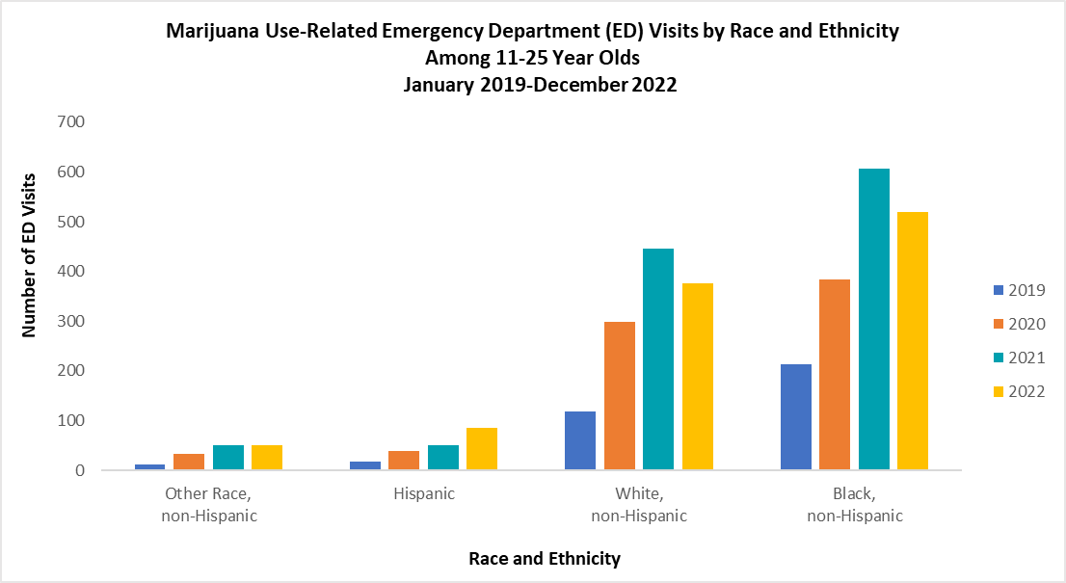
Youth Marijuana Use-Related ED Visits in Duval County
Disproportionate burden in Age Groups, January – December; 2019 - 2022
Zip Codes: 32209, 32210, & 32218
Age Group: 19-25
Race/Ethnicity/Gender: Black, non-Hispanic Males

Slide 36
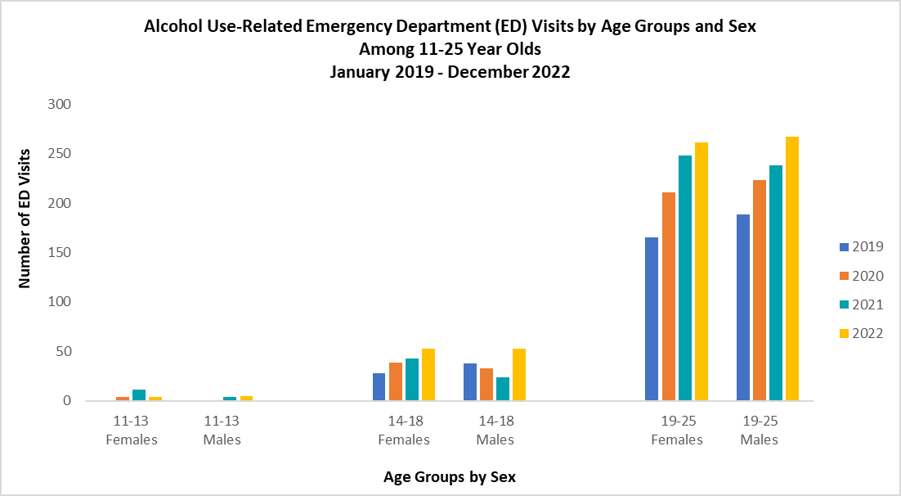
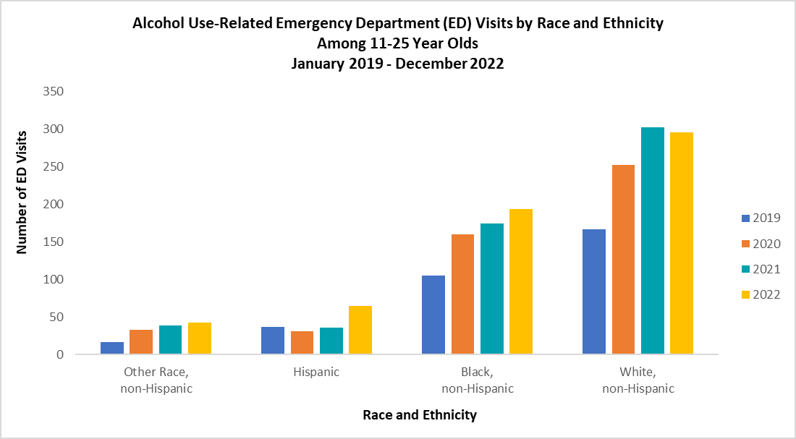
Youth Alcohol Use-Related ED Visits in Duval County
Disproportionate burden in Age Groups, January – December; 2019 - 2022
Zip Codes: 32210, 32216 & 32218
Age Group: 19-25
Race/Ethnicity/Gender: White, non-Hispanic Males

Slide 37
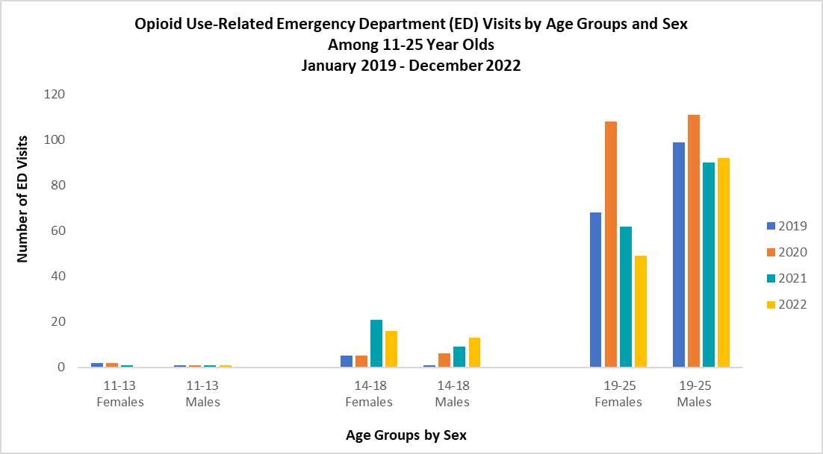
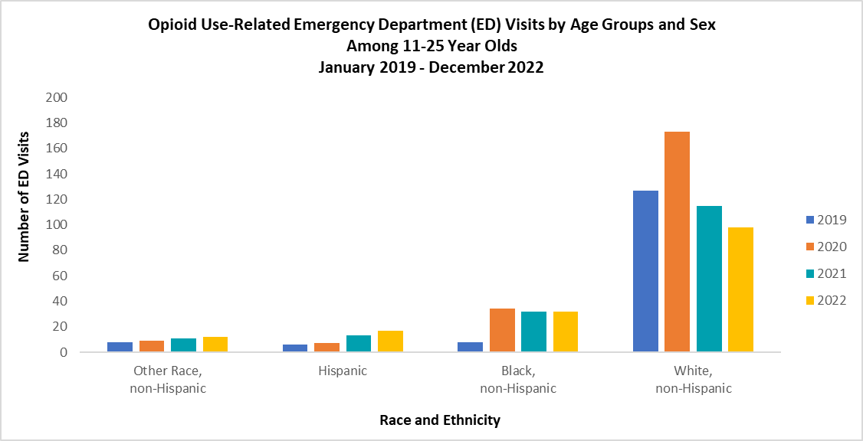
Youth Opioid Use-Related ED Visits in Duval County
Disproportionate burden in Age Groups, January – December; 2019 – 2022
Zip Codes: 32210, 32218, 32220, & 32225
Age Group: 19-25
Race/Ethnicity/Gender: White, non-Hispanic Males

Slide 38



Learn More
 | LaTerica Thomas, MPH, CPH Epidemiologist CDC Foundation LaTerica.Thomas@flhealth.gov 904-253-1407 José I. Peña Bravo, PhD OPS Biological Scientist IV Florida Department of Health Jose.PenaBravo@flhealth.gov 904-253-1859

Slide 39


Slide 40
Sober Living & Recovery Supports
Data
Subcommittees

Slide 41

Thank You
41
Kathleen Roberts
KRoberts@ccafl.org
Deborah Babin
DBabin@nfhitda.org

