Slide 1

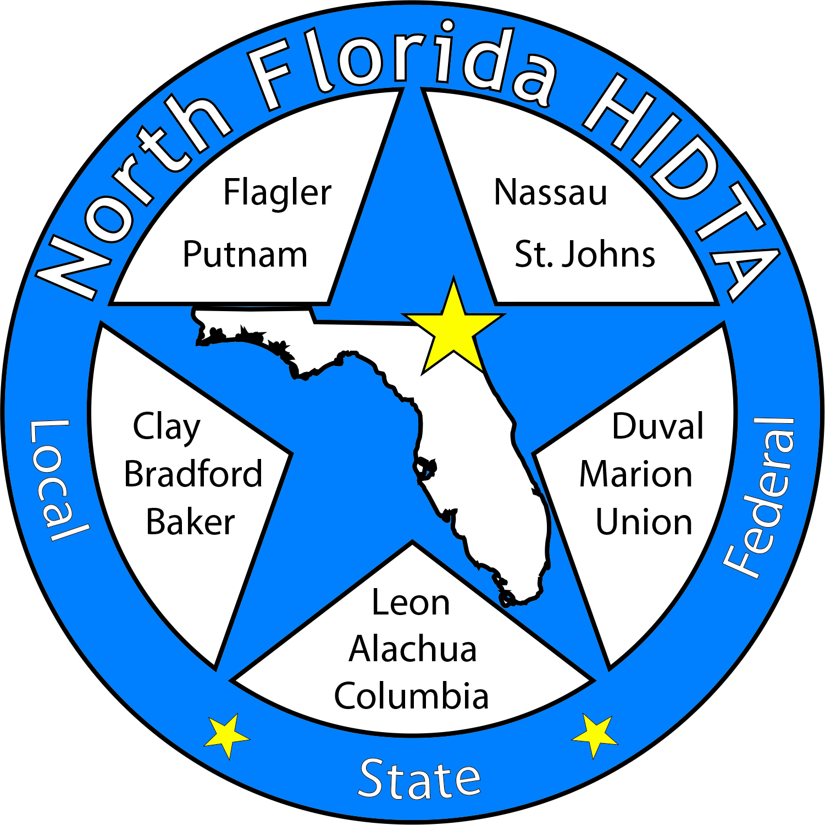
Duval DEN
May 24, 2023

Slide 2
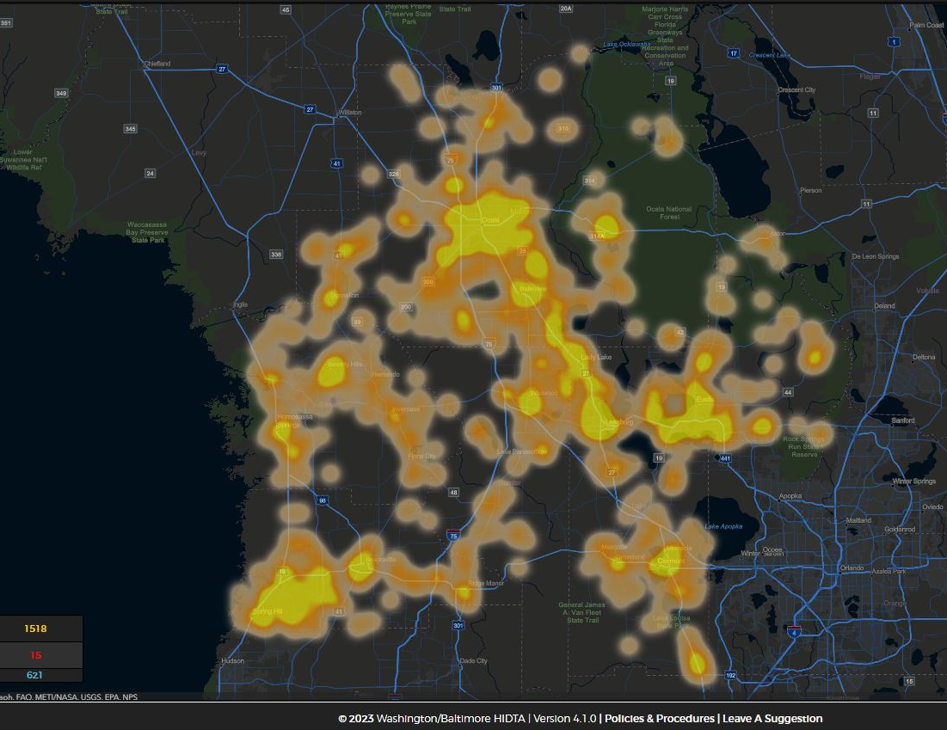
Today’s Focus
Welcome & Introductions
Data & Information Shares
Subcommittees
Open Discussion

Slide 3

Expanding Membership – Circuit 4 Partners

Slide 4

DEN Meetings
July – No DEN Meeting
August 23 – In Person
September 28 – Regional DEN
October 25 – Virtual
November 29 – In Person

Slide 5

DATA & INFORMATION SHARES

Slide 6
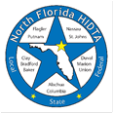

Deborah Babin
&
Scott Delano

Slide 7
The Overdose Response Strategy
Drug Epidemiology Network

Slide 8
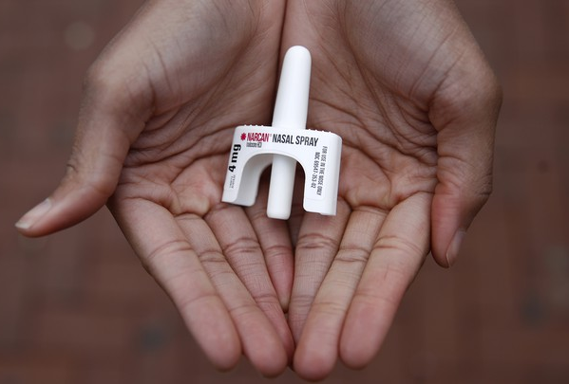

Laura Viafora Ray - JFRD

Slide 9
Opioid Abatement Update
Notes:
-Madelaine will provide a brief update on the opioid abatement process
-Laura will update the group on her new title/role (still providing Narcan kits to partners, still providing data updates to DENs)

Slide 10

Overdose Data Surveillance & Trends in Jacksonville

Slide 11

Jacksonville Fire & Rescue Department Overdose Data
Data Source
  Jacksonville Fire & Rescue Department, City of Jacksonville, Florida
  Mark E. Rowley, BSN, RN, EMT-P, CAPO, Lieutenant - Rescue 62-B Shift and Captain Michael Bernard - Office of Information Services (with additional analysis and chart/graph development by Laura Viafora Ray, MPH, CPH, Program Coordinator - Opioid Abatement)
Definitions
  Dispatched as Overdose = a 911 call in which the caller stated that the victim was suffering from a known or suspected overdose
  Naloxone Administered = the count of naloxone administered, which may include repeat doses to same patient
  Opioid-Related Overdose (known or suspected) = the following type of incidents: naloxone administered and nature of call at scene is "ingestion/poisoning/OD,” OR naloxone administered and clinical impression is "opioid-related,” OR overdose reported with the following substances: "Fentanyl, Carfentanil or Heroin,” OR overdose reported with naloxone administration
  Bystander Narcan Use Prior to Arrival of JFRD = the following type of incidents: “Suspected Drug Overdose” = Yes AND “Opioid Antagonists Administered (PTA JFRD) = Nasal Naloxone/Narcan OR narrative search for key terms “nasal” and “Narcan” and “naloxone” with a review of the narrative to ensure the incident applies to the intended definition and removal of duplicates so the same incident is not counted twice
Additional Notes
  A 911 call received as overdose and/or naloxone administration does not necessarily confirm an overdose, opioid use, or opioid misuse
Notes:
Notes:
The query for “Opioid-Related Overdose” was amended in April 2021 and this slide reflects the updated definition that corresponds to the updated query.
“Naloxone Doses Administered”:
-On a DENs call several months ago, we were discussing the measures "Number of Opioid-Related Overdoses" and "Naloxone Doses Given" over time and as a ratio of calls to doses to see if that could be any indication of the potency of street drugs in a given time frame. I had an opportunity to discuss this with Mark in detail, so I wanted to share some takeaways from that conversation:
-JFRD's protocol for dosage of naloxone has changed multiple times over the years, and it depends on patient factors. For example, a patient experiencing cardiac arrest will be given 2 mg dose of naloxone at a minimum, compared to a range of 0.4 mg to 1.0 mg for a patient not experiencing cardiac arrest.
-Two doses of nasal Narcan will always equal 8 mg, because each plunger contains 4 mg, but two doses of IV naloxone given by JFRD will vary depending on the protocol at the time of the overdose incident and patient factors. In other words, there is not a standard "dose" of naloxone for the purposes of that data point.
-The EMT/firefighter's goal when giving a patient naloxone is for the patient to begin breathing, not necessarily regain consciousness. This is considered compassionate care because giving too high of a dose of naloxone will cause the patient to experience worse withdrawal symptoms. When a community member is giving Narcan, their goal is for the person to wake up, even if this means giving a much higher dose.
-The bad news is that due to these factors, these data points cannot be used to make any assessment about potency of street drugs. The good news is at least we have more clarification about this data and its limitations, so we won't make erroneous conclusions.

Slide 12
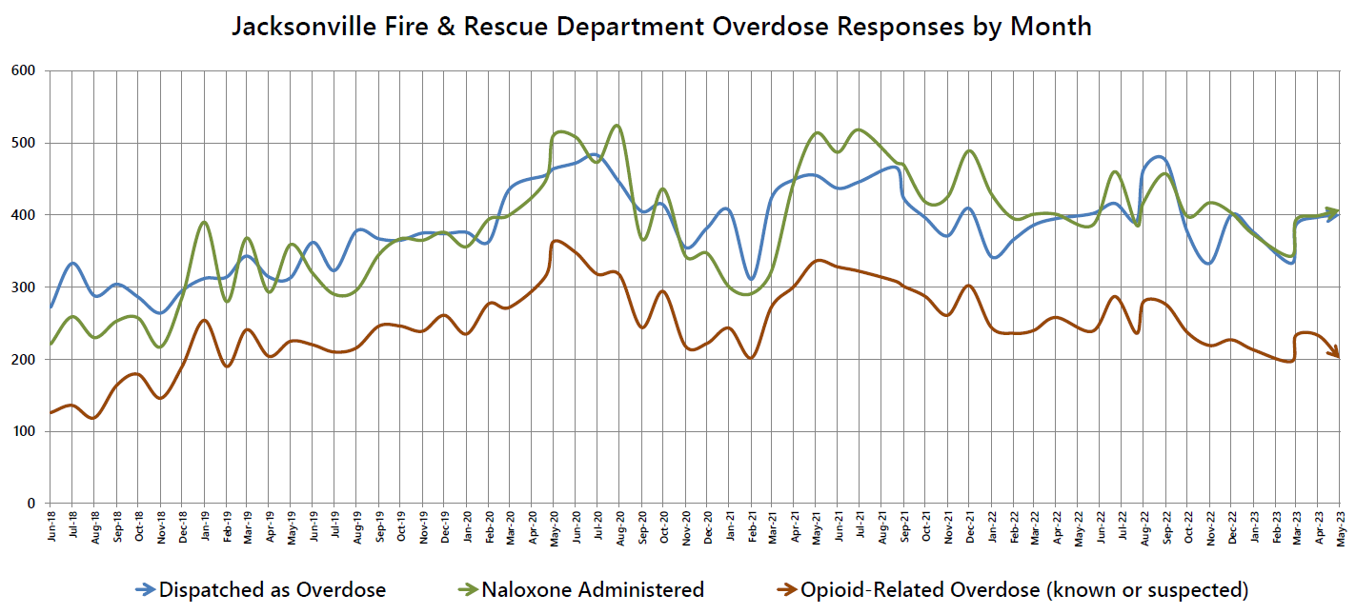

Slide 13
# of Suspected Opioid-Related (O-R) Overdose (OD) Patients
Month/Year | 2014 | 2015 | 2016 | 2017 | 2018 | 2019 | 2020 | 2021 | 2022 | 2023
Jan | 15 | 16 | 39 | 170 | 115 | 259 | 238 | 248 | 251 | 216
Feb | 16 | 33 | 91 | 200 | 143 | 195 | 282 | 203 | 239 | 198
Mar | 13 | 17 | 118 | 164 | 235 | 244 | 276 | 276 | 242 | 233
Apr | 29 | 28 | 106 | 145 | 170 | 207 | 319 | 303 | 259 | 234
May | 23 | 16 | 97 | 136 | 230 | 227 | 369 | 342 | 240 | 205
Jun | 27 | 18 | 72 | 224 | 187 | 225 | 351 | 330 | 291
Jul | 23 | 27 | 99 | 179 | 205 | 213 | 321 | 328 | 238
Aug | 29 | 36 | 124 | 210 | 139 | 219 | 323 | 316 | 280
Sep | 29 | 56 | 140 | 151 | 165 | 248 | 247 | 305 | 281
Oct | 21 | 47 | 209 | 183 | 184 | 250 | 298 | 293 | 241
Nov | 18 | 34 | 229 | 205 | 152 | 243 | 220 | 265 | 221
Dec | 23 | 44 | 189 | 180 | 196 | 262 | 223 | 309 | 230
TOTAL | 266 | 372 | 1,513 | 2,147 | 2,121 | 2,792 | 3,467 | 3,518 | 3,013 | 1,086
% Change |  | +40% | +307% | +42% | -1% | +32% | +24% | +1% | -14% | -12%

Slide 14
Suspected Opioid-Related (O-R) Overdose (OD) Patients by Incident Zip Code YTD: Jan 2023 - May 2023
Zip Code | Count | % of O-R OD | Trend (Compared to Jan 2022 - May 2022)
32210 (Southwest) | 96 | 9% | 25% Decrease
32218 (Outer Rim) | 78 | 7% | 28% Decrease
32244 (Southwest) | 73 | 7% | 14% Decrease
32209 (Urban Core) | 62 | 6% | 9% Increase
32254 (Urban Core) | 58 | 5% | 9% Decrease
32207 (Arlington) | 58 | 5% | 9% Increase
32246 (Arlington) | 56 | 5% | 7% Decrease
32205 (Southwest) | 54 | 5% | 20% Increase
32208 (Urban Core) | 50 | 5% | 4% Decrease
32256 (Southeast) | 49 | 5% | 14% Increase
TOTAL (Top 10) | 634 | 58%
TOTAL (Other 24 Zips) | 452 | 42%
TOTAL (All 34 Zips) | 1,086 | 100%

Slide 15
Suspected Opioid-Related (O-R) Overdose (OD) Patients by Incident Zip Code YTD: Jan 2023 - May 2023
Top 10 Zip Codes | Count | Population Size | Rate per 1,000
32202 (Urban Core) | 39 | 6,544 | 5.96
32254 (Urban Core) | 58 | 14,545 | 3.99
32206 (Urban Core) | 37 | 18,283 | 2.02
32220 (Outer Rim) | 25 | 13,037 | 1.92
32204 (Urban Core) | 16 | 8,673 | 1.84
32205 (Southwest) | 54 | 29,605 | 1.82
32209 (Urban Core) | 62 | 36,656 | 1.69
32207 (Arlington) | 58 | 36,207 | 1.60
32208 (Urban Core) | 50 | 33,286 | 1.50
32219 (Outer Rim) | 21 | 14,474 | 1.45
TOTAL (Top 10) | 420
TOTAL (Other 24 Zips) | 666
TOTAL (All 34 Zips) | 1,086
Notes:
Notes:
Zip codes highlighted in orange - both in the top 10 for count and the top 10 for rate per 1,000.
Population size data source: Decennial Census (2020)

Slide 16
% of Suspected Opioid-Related (O-R) Overdose (OD) Patients
Race/Year | 2014 | 2015 | 2016 | 2017 | 2018 | 2019 | 2020 | 2021 | 2022 | 2023 (Jan-May)
Black or African American | 8% | 8% | 10% | 9% | 10% | 11% | 14% | 17% | 20% | 20%
Hispanic or Latino | 2% | 2% | 2% | 3% | 4% | 3% | 3% | 3% | 5% | 5%
Other/ Unknown | 2% | 3% | 2% | 4% | 4% | 4% | 4% | 4% | 2% | 2%
White | 88% | 87% | 86% | 84% | 82% | 82% | 79% | 76% | 73% | 73%
% of Suspected Opioid-Related (O-R) Overdose (OD) Patients
Gender/Year | 2014 | 2015 | 2016 | 2017 | 2018 | 2019 | 2020 | 2021 | 2022 | 2023 (Jan-May)
Male | 53% | 55% | 64% | 62% | 61% | 64% | 66% | 68% | 66% | 65%
Female | 47% | 45% | 36% | 38% | 39% | 36% | 34% | 32% | 34% | 35%

Slide 17
% of Suspected Opioid-Related (O-R) Overdose (OD) Patients
Age Range | 2014 | 2015 | 2016 | 2017 | 2018 | 2019 | 2020 | 2021 | 2022 | 2023 (Jan-May)
19 or younger | 6% | 2% | 2% | 2% | 2% | 1% | 1% | 1% | 2% | 2%
20-29 | 26% | 30% | 30% | 26% | 26% | 22% | 20% | 15% | 14% | 14%
30-39 | 23% | 27% | 33% | 36% | 37% | 36% | 35% | 36% | 33% | 33%
40-49 | 18% | 17% | 17% | 18% | 17% | 22% | 21% | 23% | 24% | 24%
50-59 | 17% | 15% | 12% | 12% | 11% | 12% | 13% | 14% | 15% | 15%
60-69 | 6% | 6% | 5% | 5% | 5% | 6% | 7% | 8% | 9% | 9%
70 or older | 3% | 2% | 1% | 1% | 2% | 2% | 2% | 2% | 3% | 3%
Some years add up to 99% or 101% due to rounding

Slide 18
January - May 2023 Snapshot
1,086 opioid-related overdose patients
  12% decrease compared to Jan-May 2022
  13% decrease compared to Aug-Dec 2022
Top zip code - 32210
  96 patients (9%)
65% male; 35% female
73% white; 20% black/AA; 7% other
33% between ages 30-39
53% residence; 18% roadway; 11% business or hotel; 18% other

Slide 19

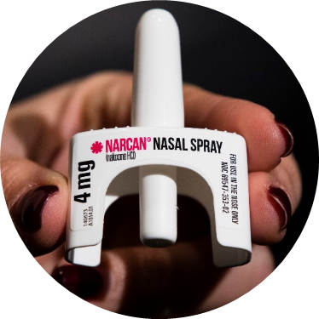
COMMUNITY-BASED NARCAN DISTRIBUTION
SEPTEMBER 2019 - JUNE 2023

Slide 20

Project Activities at a Glance
14,598 Narcan kits distributed
365 unique trainings reaching over 6,600 community members
Notes:
Notes:
Average training size is 17.

Slide 21

Lives Saved & Narcan Use by Laypersons
Reported use of the Narcan provided under this project is encouraged, but not required.
Thus far, one hundred two (102) individuals have voluntarily followed up to report use of their Narcan to save a person who may have otherwise died from an overdose.
Although there is no way to know for sure, we suspect that the actual number of Narcan kits used is much greater.
Notes:
Received two additional reports since the May DENs meeting.

Slide 22
Bystander Narcan Use Prior to Arrival (PTA) of JFRD
 | 2018-2019 | 2019-2020 | 2020-2021 | 2021-2022 | 2022-2023*
% Change in Opioid-Related OD Calls | +32% | +24% | +1% | -14% | -12%
% Change in Use of NARCAN PTA by Bystanders | +191% | +59% | +79% | +5% | +65%
*January-May only
Notes:
Notes:
-Narcan nasal spray was first FDA approved in November 2015, but the first report of Narcan use PTA JFRD was not until 2017.

Slide 23

Contact Me
Laura Viafora Ray, MPH, CPH
Program Coordinator - Opioid Abatement
Office: (904) 255-7730
Cell: (904) 710-8454
Email: lvray@coj.net
Connect on LinkedIn

Slide 24
Duval Department of Health

Slide 25
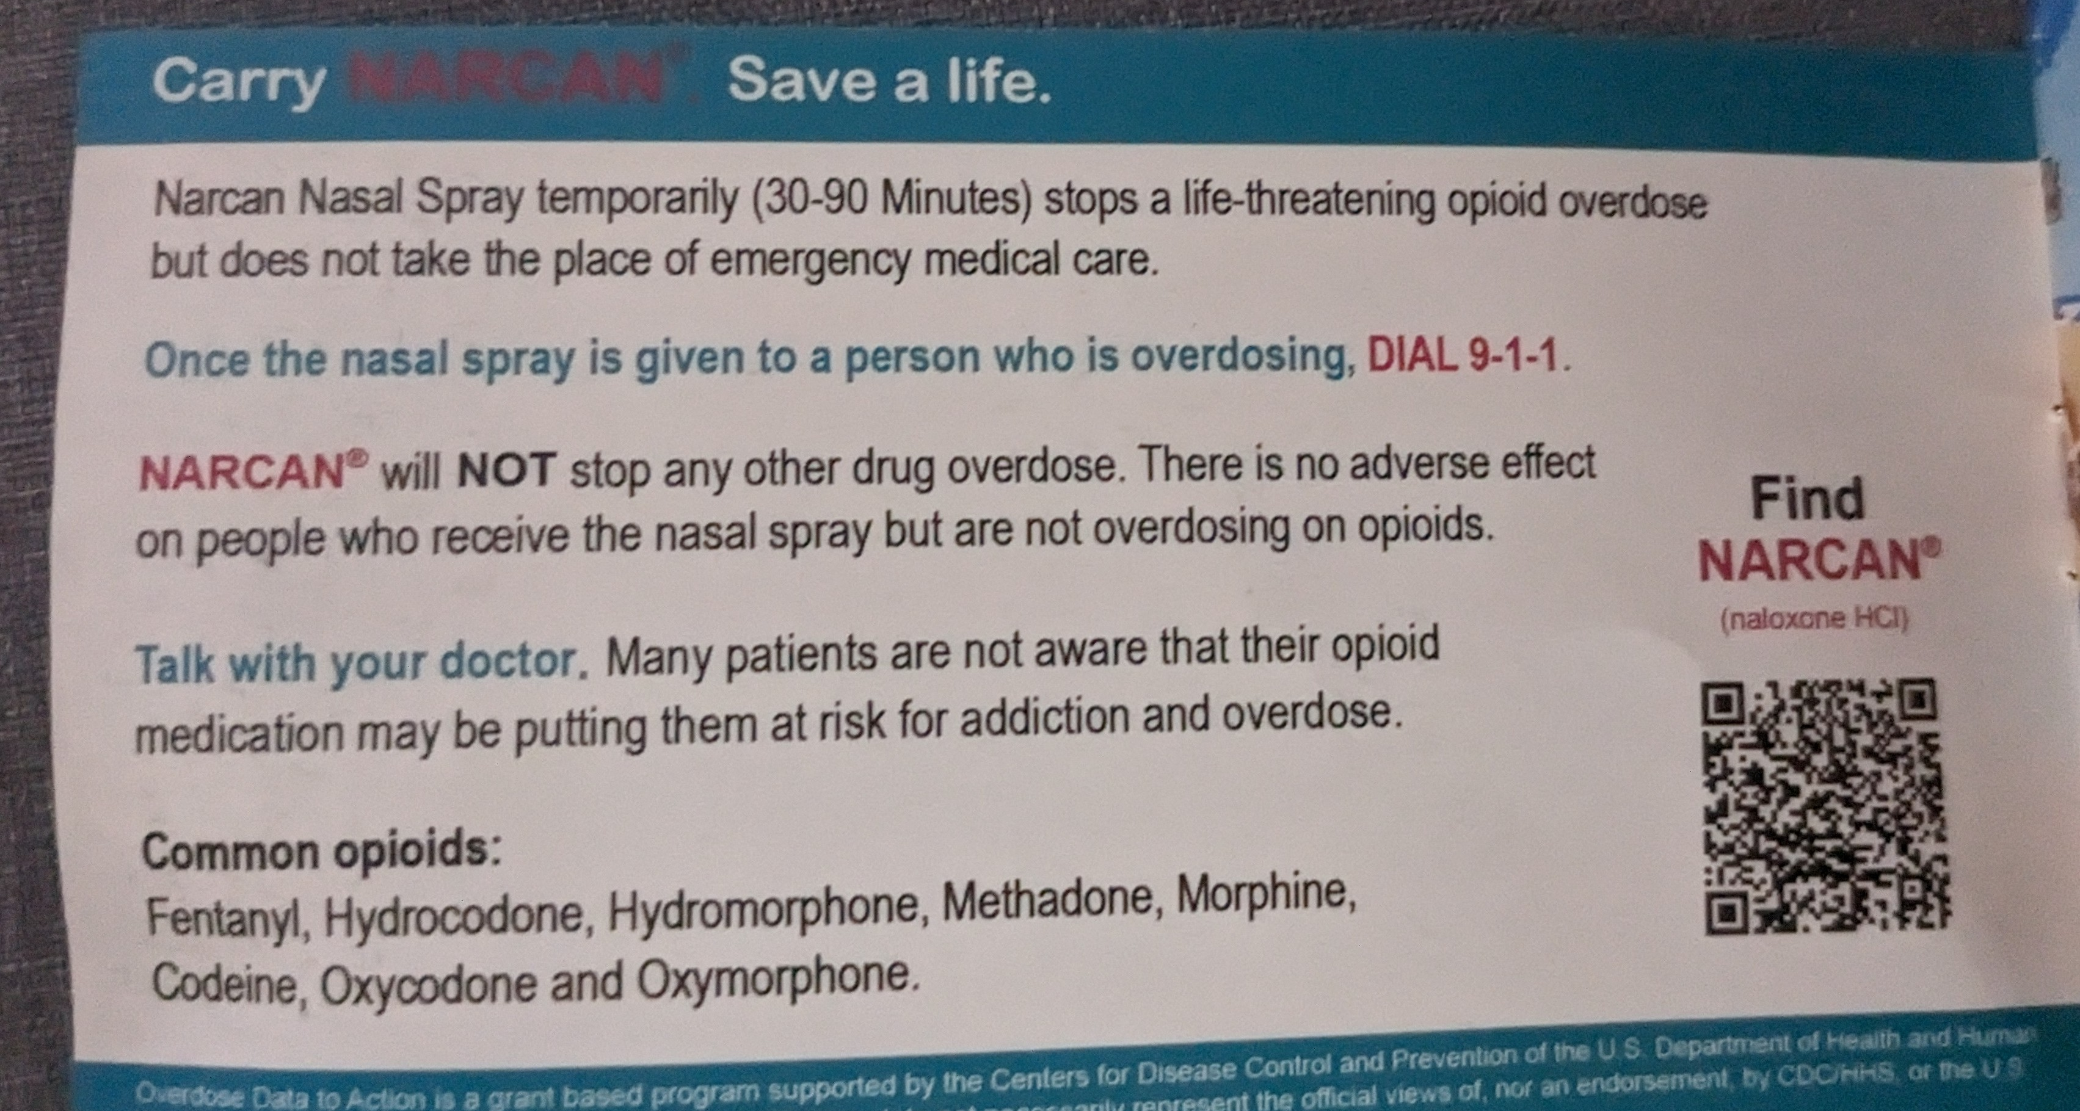
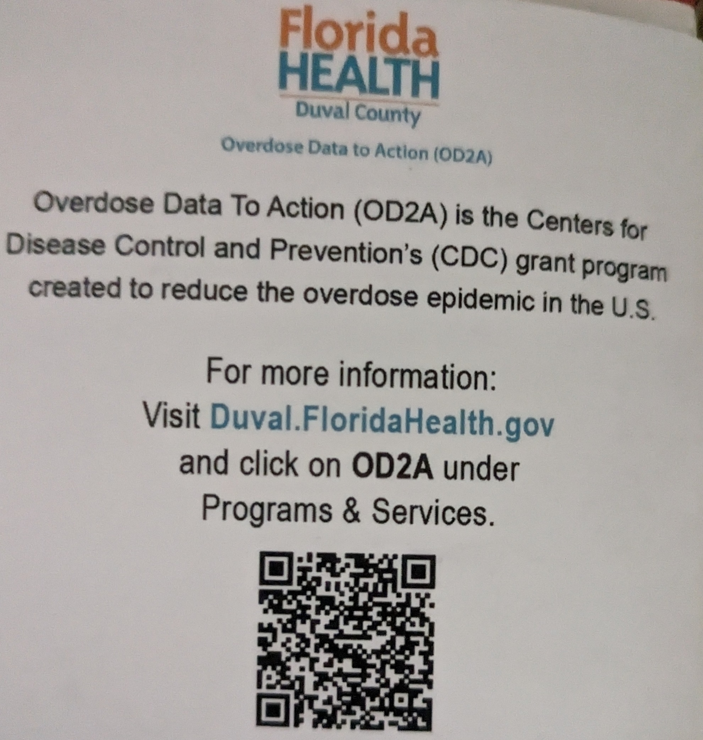
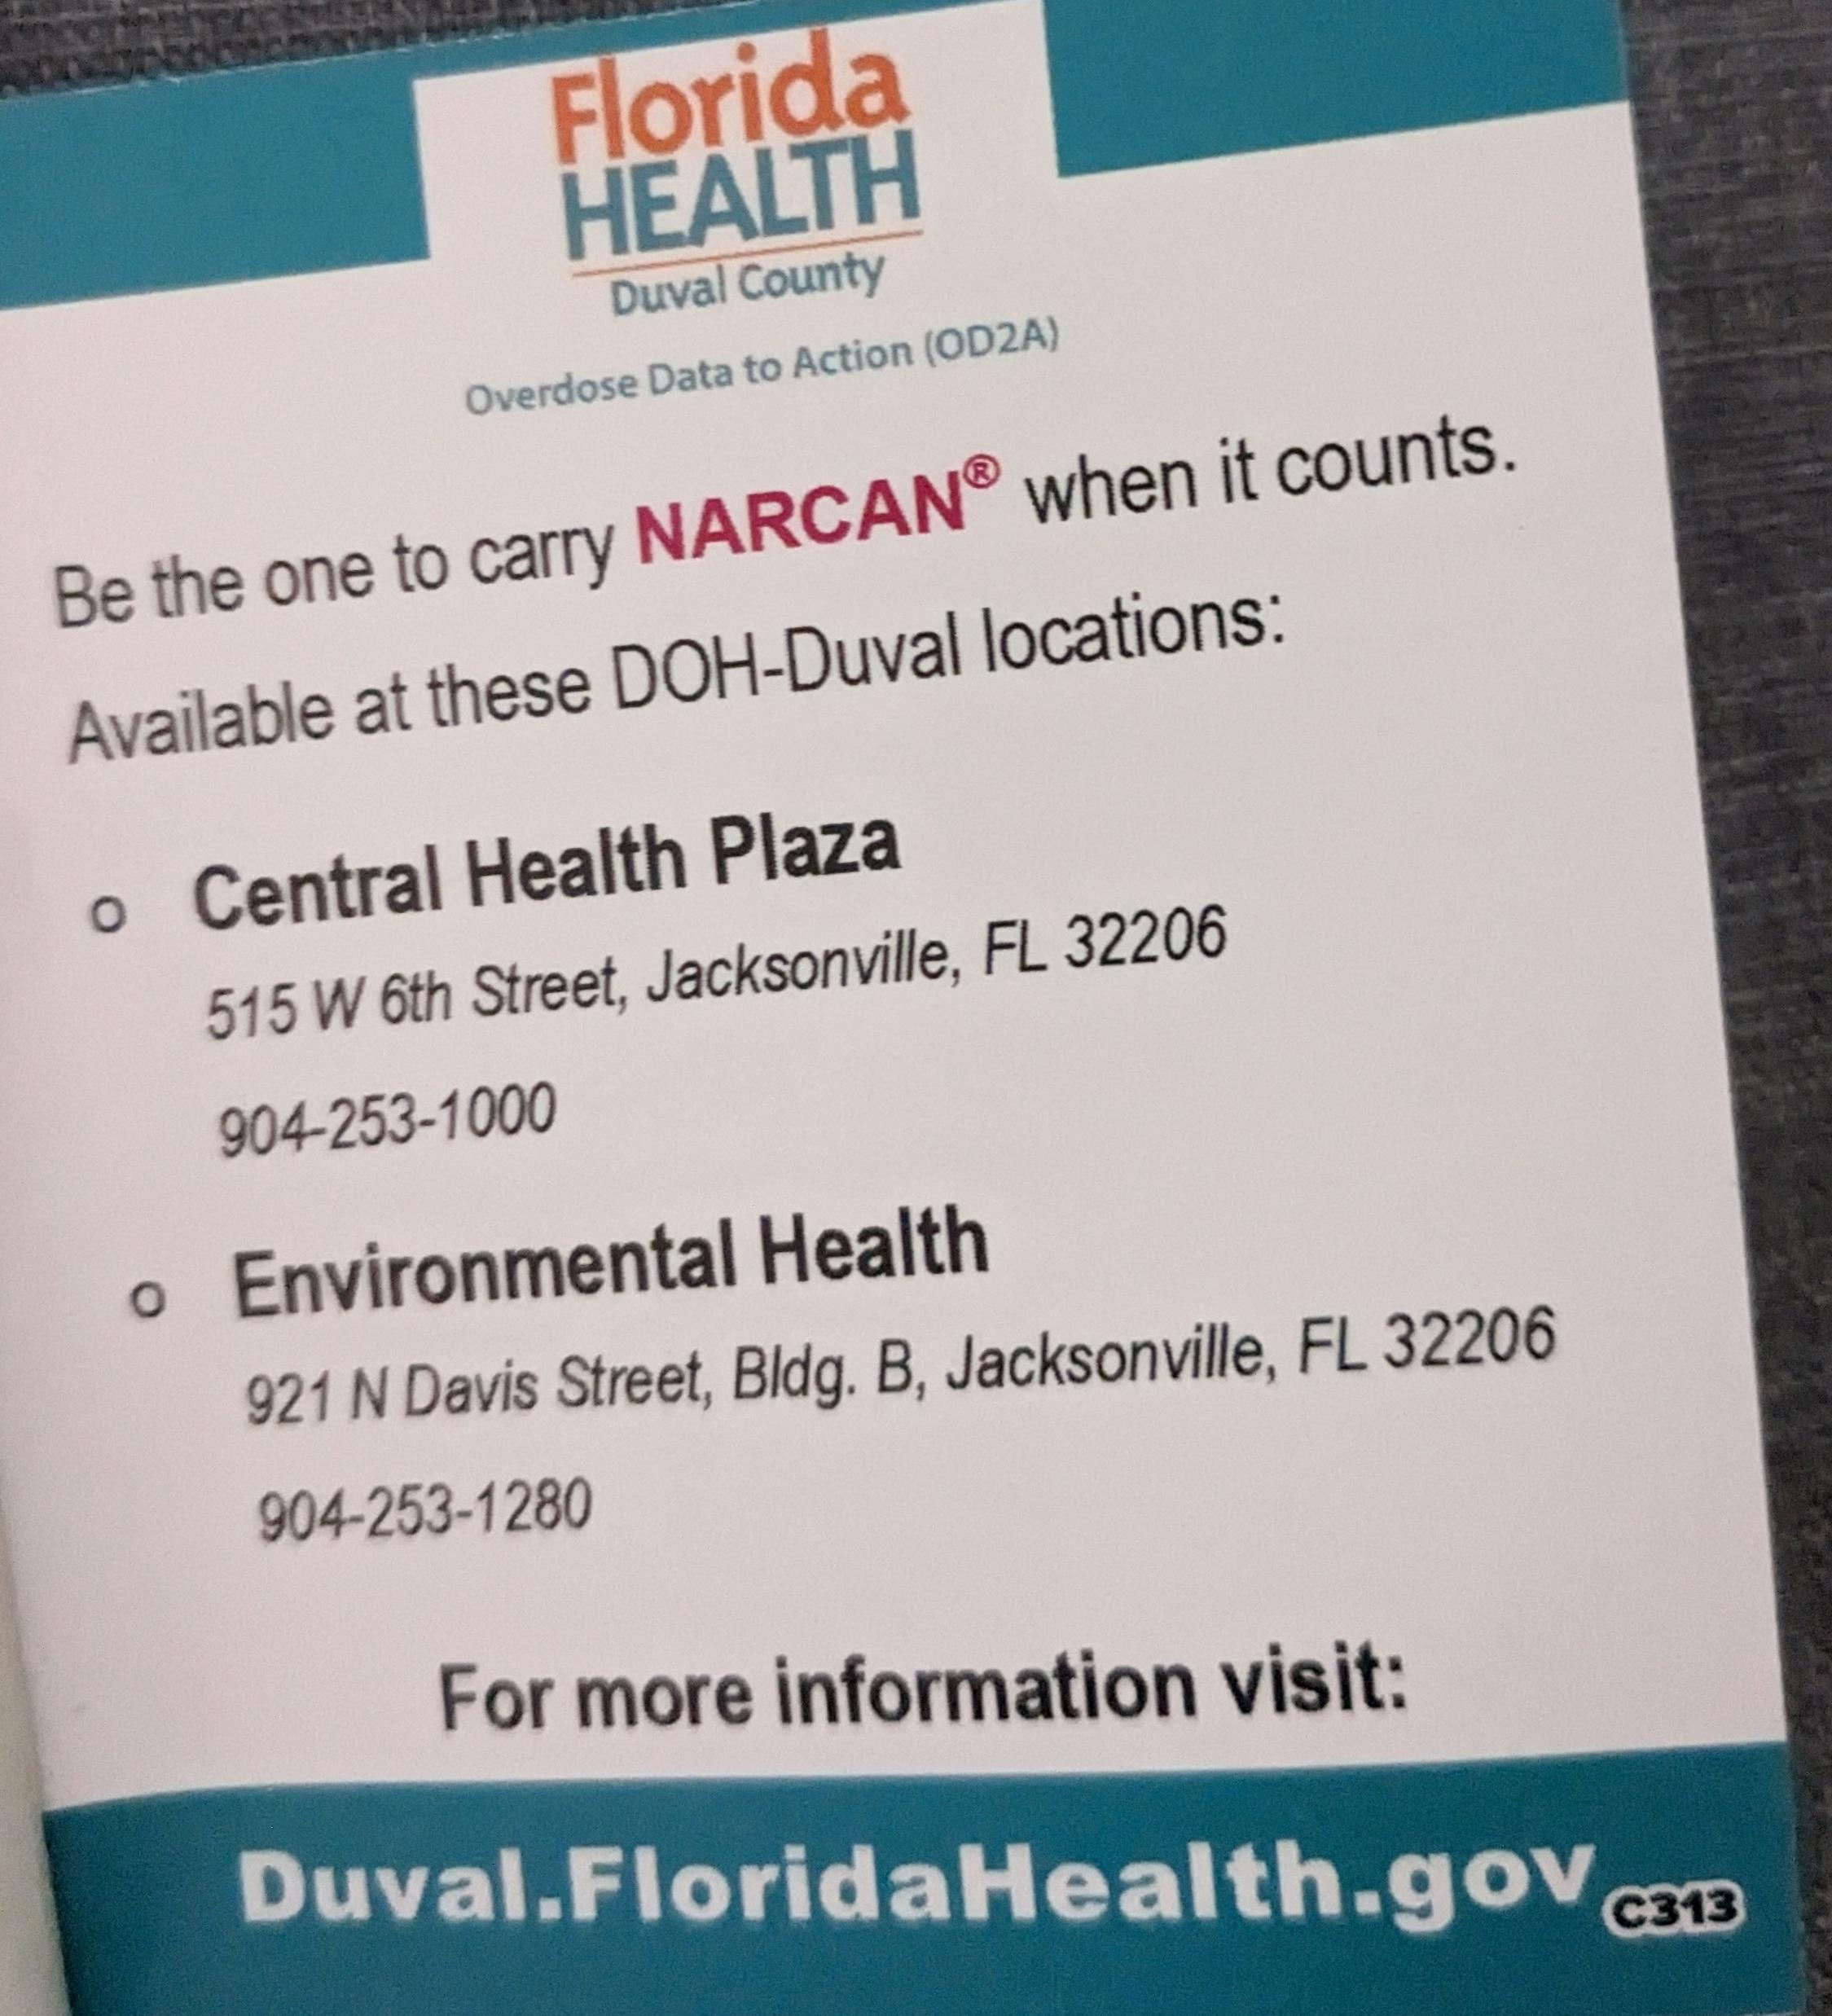


Slide 26

Florida Department of Health
OD2A Surveillance
LaTerica Thomas, MPH, CPH
Epidemiologist

Slide 27
Florida Department of Health
OD2A Surveillance
LaTerica Thomas, MPH, CPH
Epidemiologist
José I. Peña Bravo, PhD
Epidemiologist

Slide 28
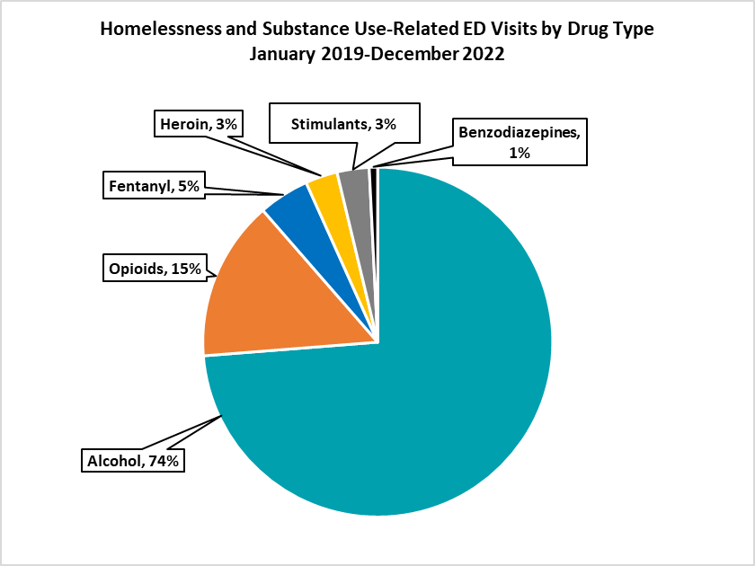
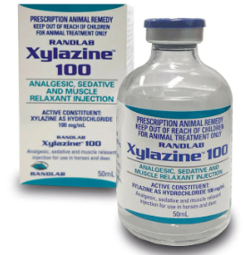
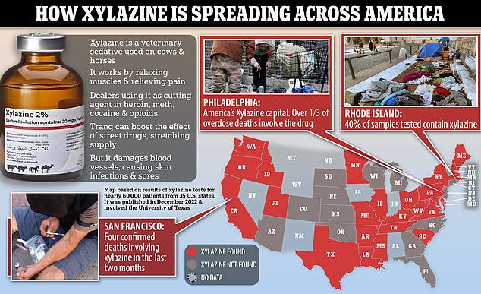
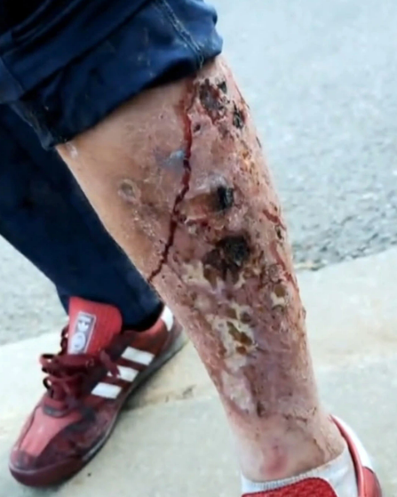
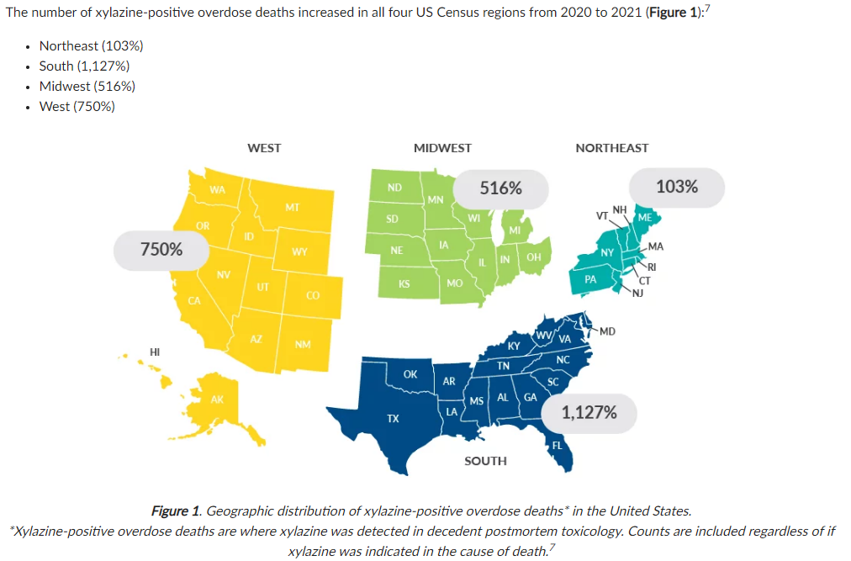
Xylazine Information
Xylazine (1972, FDA) is a non-opioid sedative or tranquilizer that is intended to be used for horses, cows, sheep, etc.
Xylazine and fentanyl mixtures are referred to as “Tranq”, “Tranq Dope”, “Philly Dope” or “Zombie Drug”
99% of Xylazine fatalities had fentanyl present, White House declared “Tranq” an Emerging Threat in April 2023
From 2020-2021, the South had the largest increase in nationwide Xylazine-related fatalities at 1,127%
Naloxone (Narcan) should be given in response to ANY suspected drug overdose to reverse any possible opioid effects

Slide 29
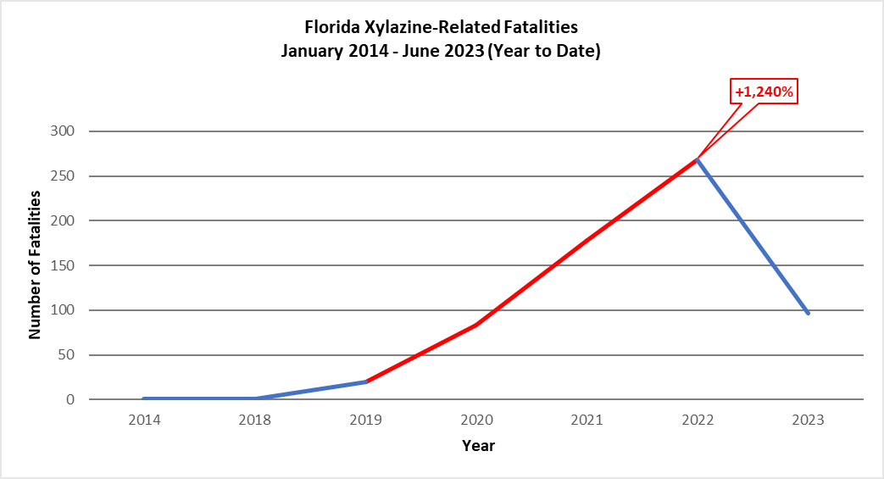
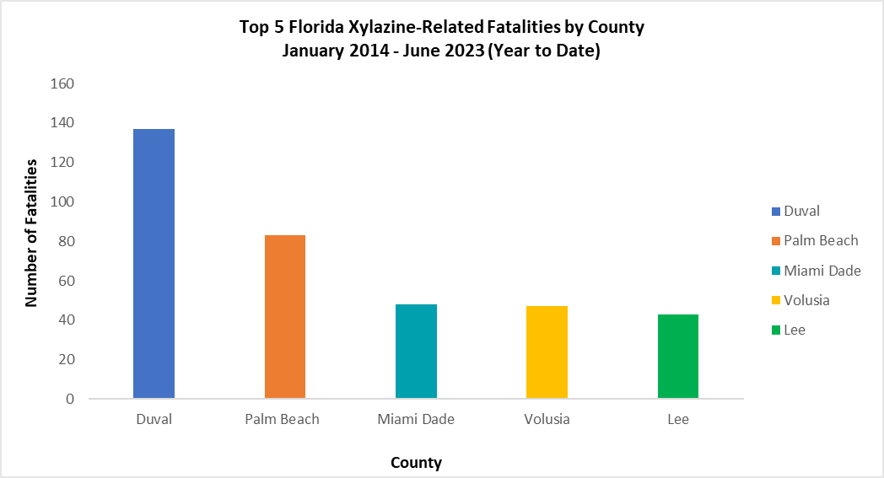
Xylazine Fatalities in Florida

Slide 30
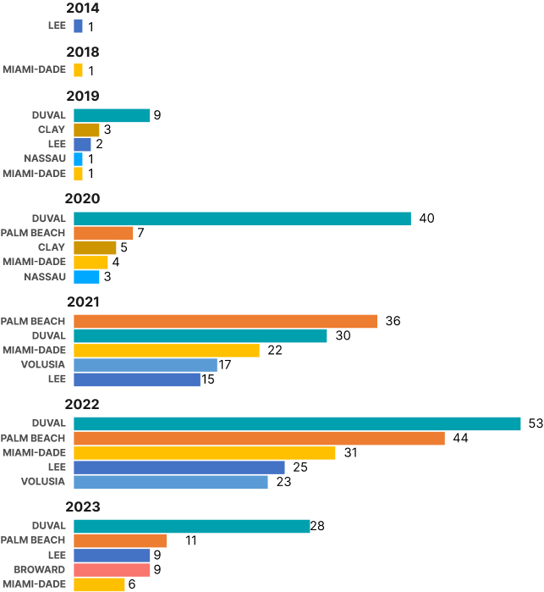
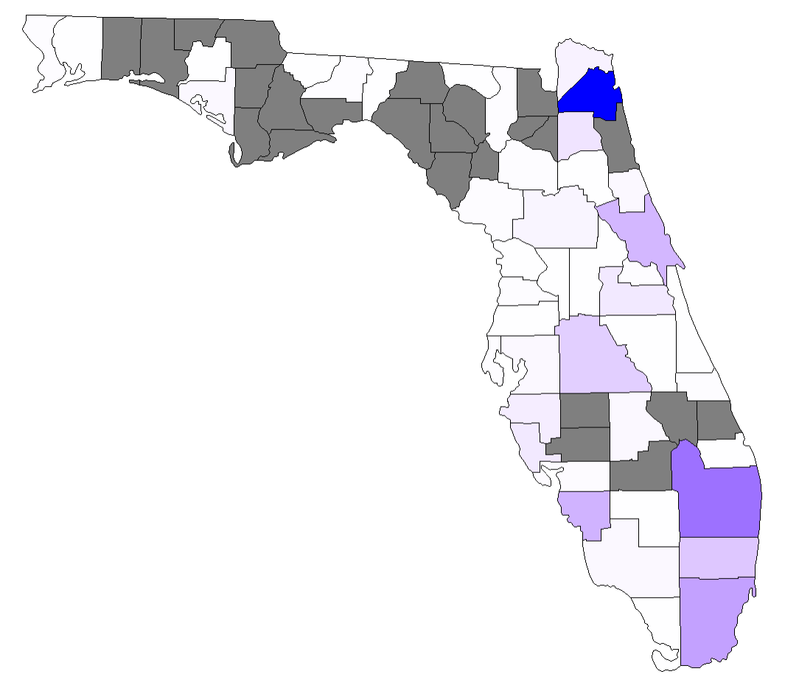

Xylazine Fatalities in Florida
Xylazine-Related Fatalities in Florida Counties
From 2014 – 2023 (YTD)
Duval: 160
Volusia: 49
160
120
80
40
Palm Beach: 98
Lee: 52
0
No Data
Miami-Dade: 65

Slide 31
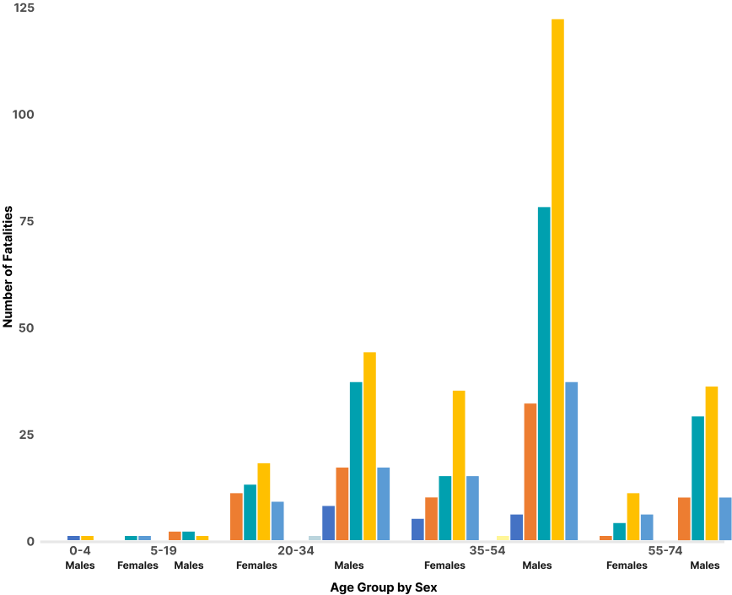
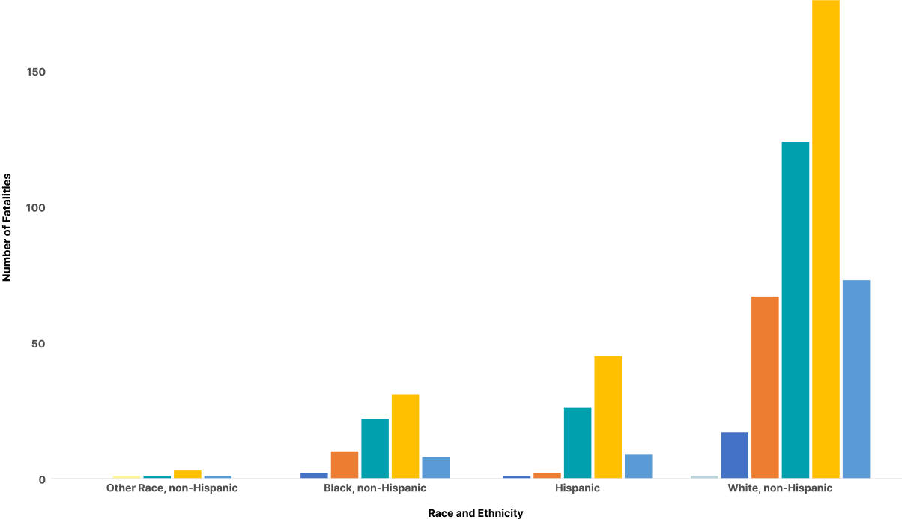
Xylazine Fatalities in Florida
Disproportionate Burden (ranked; top 3):
Age Group by Sex
Race and Ethnicity
1
485
1
276
2
124
3
85
2
3
73
83
(YTD)

Slide 32
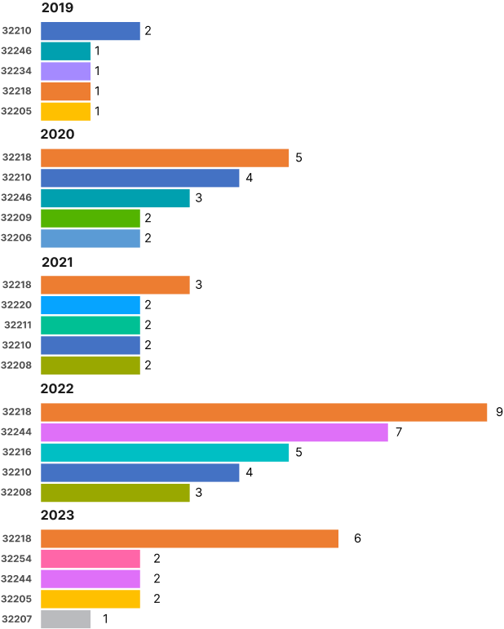
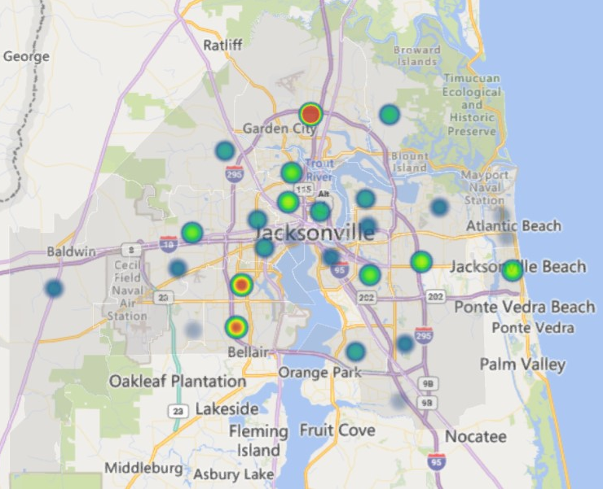
Xylazine Fatalities in Duval County
Xylazine-Related Fatalities in Duval County
From 2019 – 2023 (YTD)
Number of Fatalities
24
(1) 32218: 24
(5) 32208: 6
(4) 32209: 7
(5) 32220: 6
(4) 32246: 7
(4) 32250: 7
(2) 32210: 13
(5) 32216: 6
1
(3) 32244: 12

Slide 33
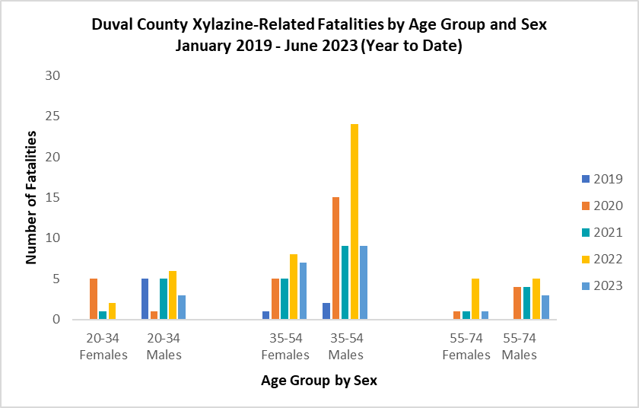
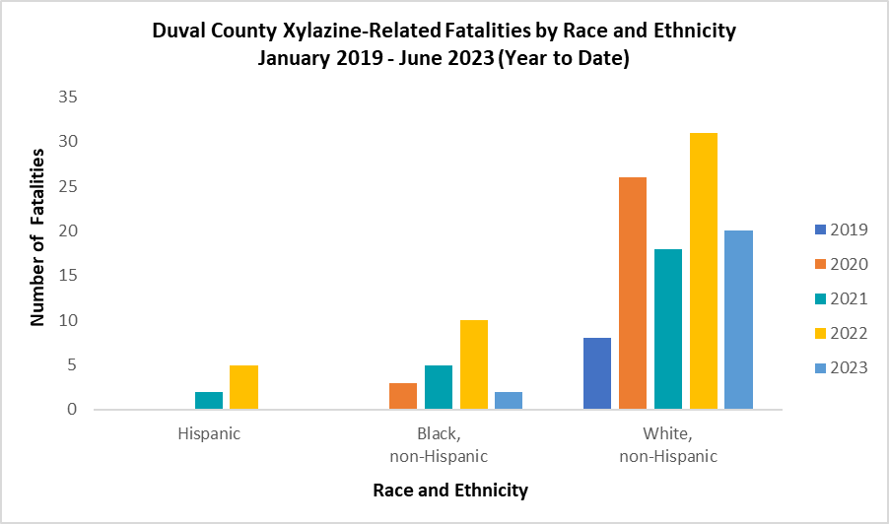
Xylazine Fatalities in Duval County
Disproportionate burden in Age Groups, January 2019 – June 2023
Zip Code: 32210, 32218 & 32244
Age Group: 35-54
Race/Ethnicity/Gender: White, non-Hispanic Males

Slide 34



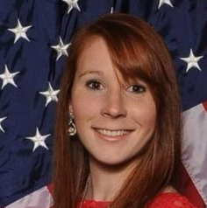
Learn More
 | LaTerica Thomas, MPH, CPH Epidemiologist CDC Foundation LaTerica.Thomas@flhealth.gov 904-253-1407 José I. Peña Bravo, PhD Epidemiologist Florida Department of Health Jose.PenaBravo@flhealth.gov 904-253-2449 Kelsey Spangle, MS, MPH, CPH Epidemiology Fellow Florida Department of Health Kelsey.Spangle@flhealth.gov 904-253-1859

Slide 35
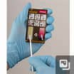
Bobby Betros
C: 858-405-6374
Connect with SwabTek!

Slide 36
Sober Living & Recovery Supports
Data
Subcommittees

Slide 37

Thank You
37
Kathleen Roberts
KRoberts@ccafl.org
Deborah Babin
DBabin@nfhitda.org

