Slide 1
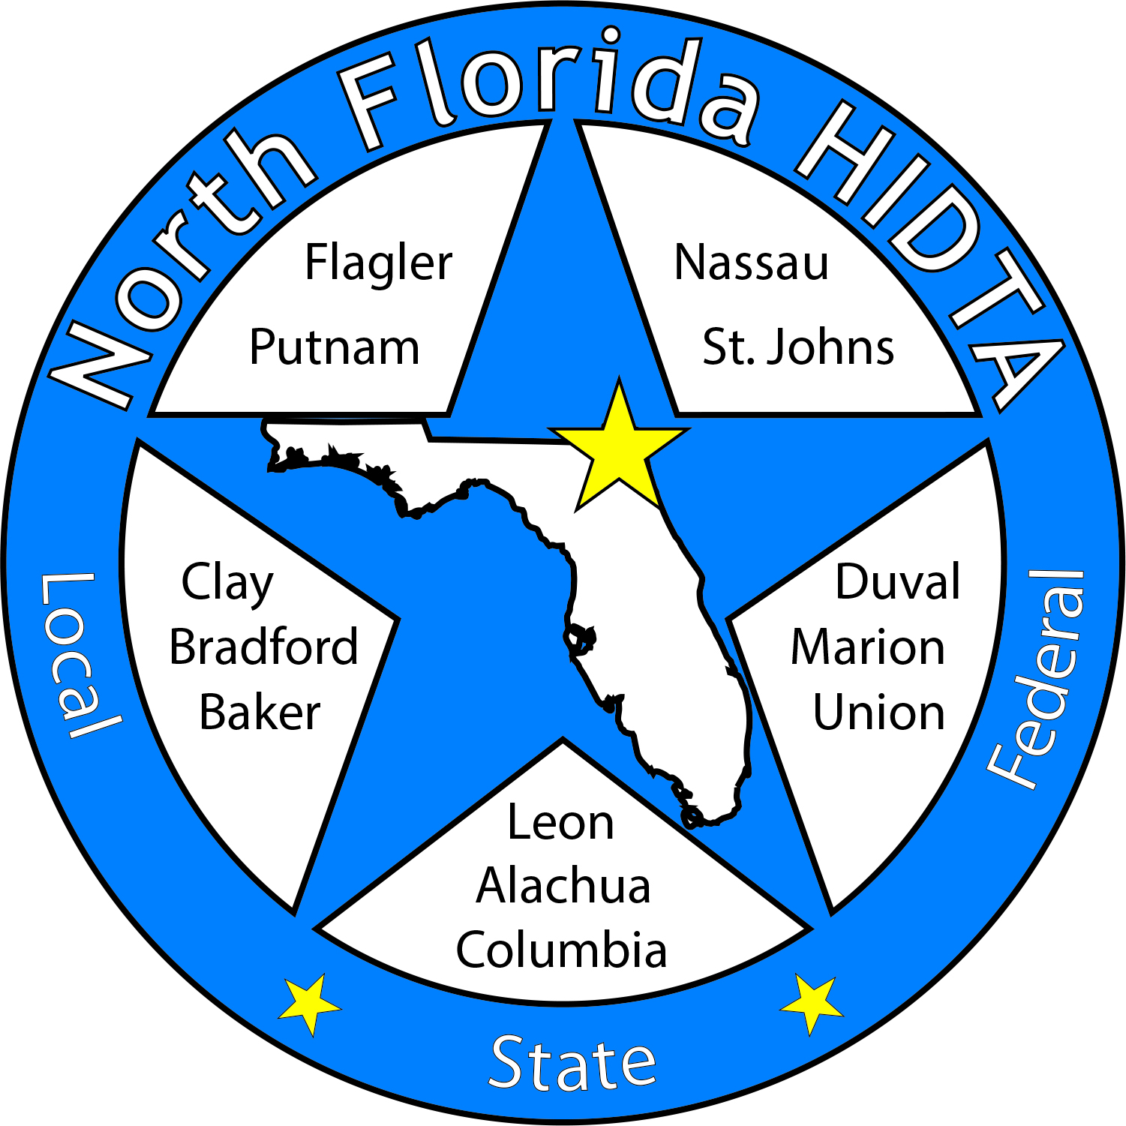
Duval DEN
August 23, 2023

Slide 2
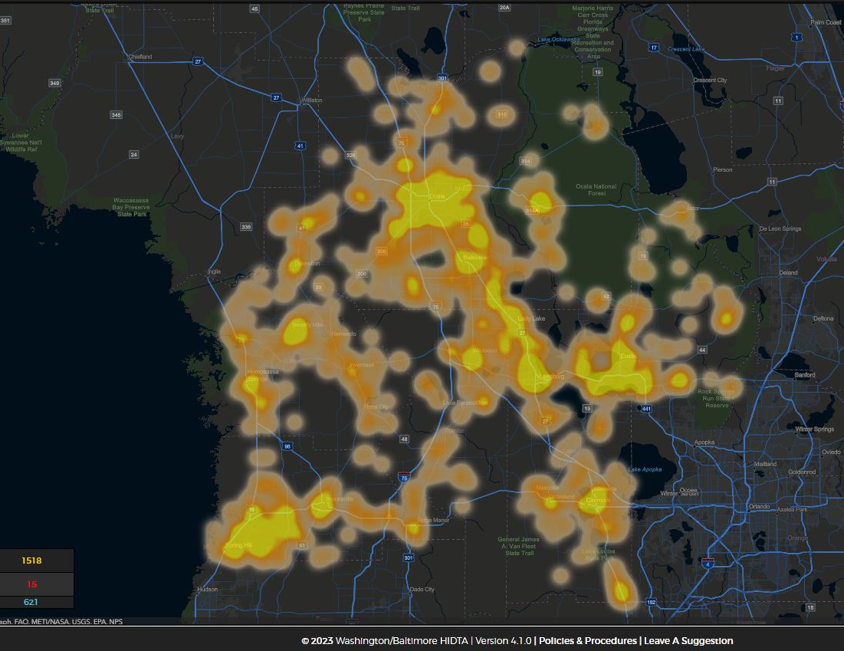
Today’s Focus
Welcome & Introductions
Data & Information Shares
Subcommittees
Open Discussion

Slide 3
Expanding Membership – Circuit 4 Partners

Slide 4
DEN Meetings
August 23 – In Person
September 28 – Regional DEN
October 25 – Virtual
November 29 – In Person
December – NO MEETING

Slide 5
DATA & INFORMATION SHARES

Slide 6
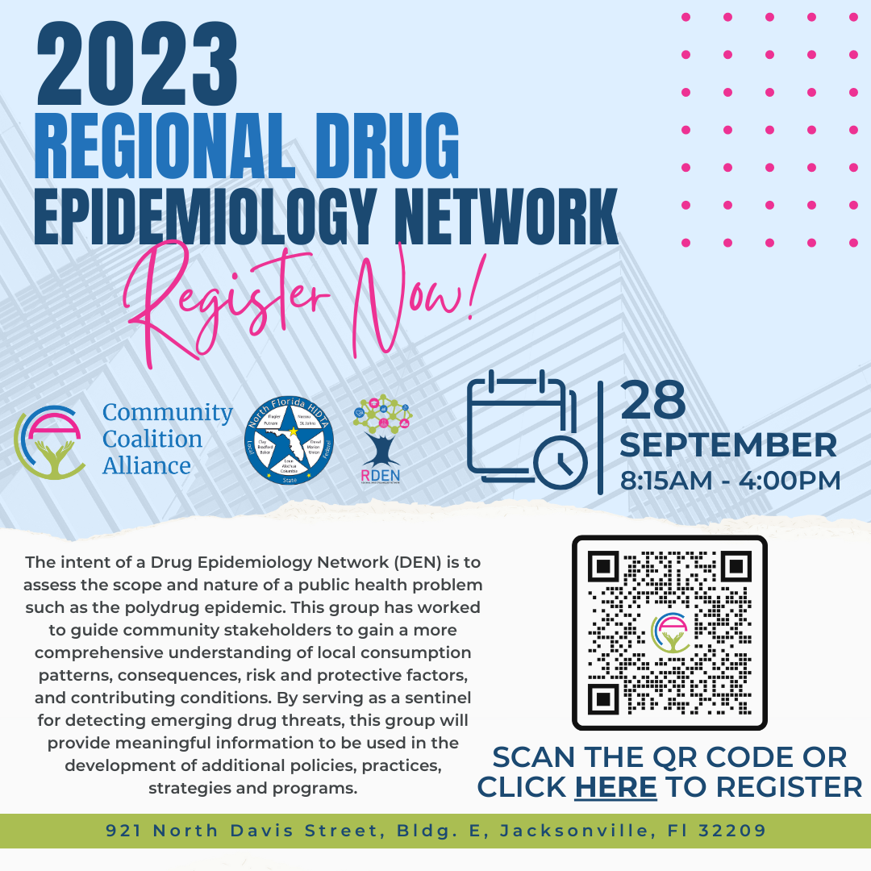

Slide 7
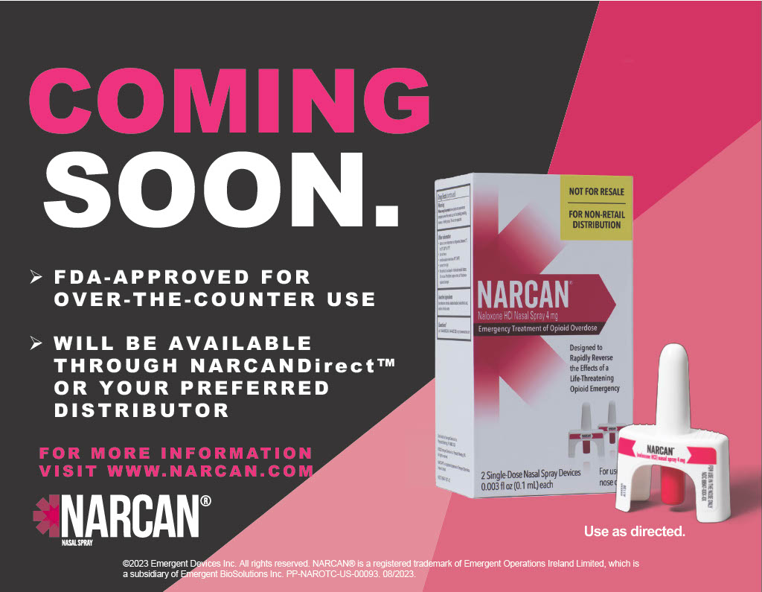

Slide 8
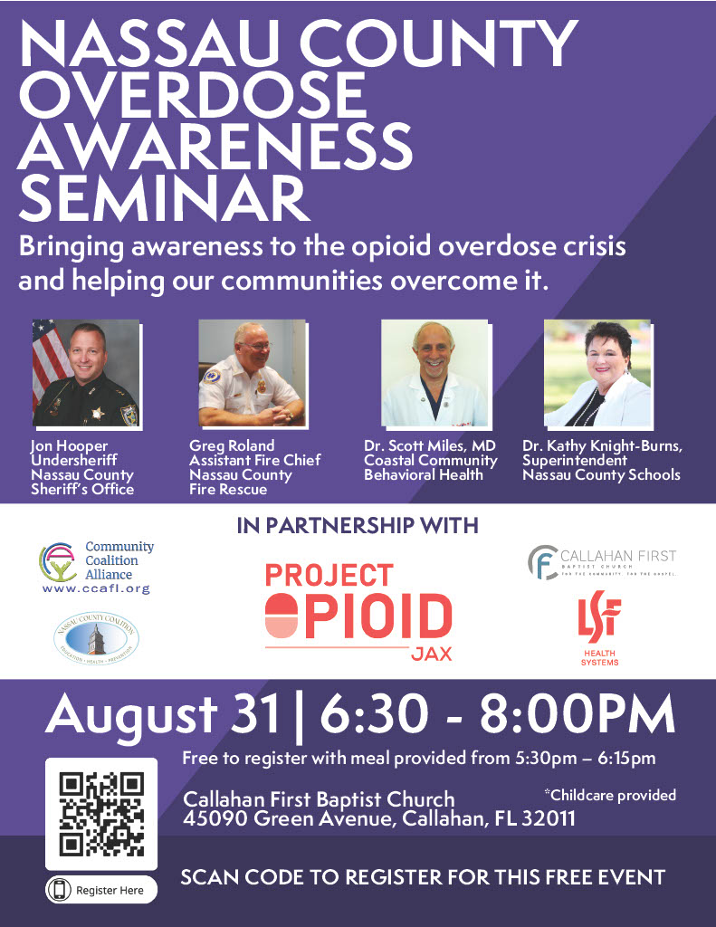

Slide 9
Top Requested Services
Clay
Duval
Nassau

Slide 10
Top Housing/Shelter
Clay
Duval
Nassau

Slide 11
Medical Examiner – 2022 Interim Report
 | Cause | Present
Fentanyl | 236 | 39
Cocaine | 127 | 34
Alprazolam | 20 | 31
Methamphetamine | 104 | 44
Xylazine | 32 | 22
615 deaths

Slide 12
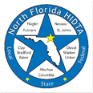
Deborah Babin & Scott Delano

Slide 13
Special
Thank You

Slide 14
Substance Trend Alerts
Illicit drug manufacturers intentionally combining pesticides with synthetic cannabinoids
Prodrugs

Slide 15
The Overdose Response Strategy
Drug Epidemiology Network

Slide 16
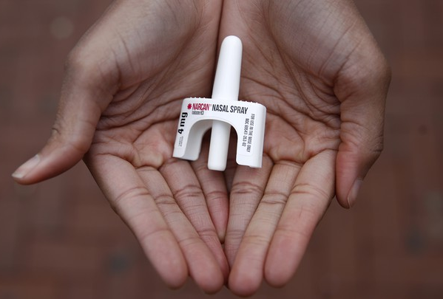
Laura Viafora Ray - JFRD

Slide 17
Overdose Data Surveillance & Trends in Jacksonville

Slide 18
Jacksonville Fire & Rescue Department Overdose Data
Data Source
Jacksonville Fire & Rescue Department, City of Jacksonville, Florida
Mark E. Rowley, BSN, RN, EMT-P, CAPO, Lieutenant - Rescue 62-B Shift and Captain Michael Bernard - Office of Information Services (with additional analysis and chart/graph development by Laura Viafora Ray, MPH, CPH, Program Coordinator - Opioid Abatement)
Definitions
Dispatched as Overdose = a 911 call in which the caller stated that the victim was suffering from a known or suspected overdose
Naloxone Administered = the count of naloxone administered, which may include repeat doses to same patient
Opioid-Related Overdose (known or suspected) = the following type of incidents: naloxone administered and nature of call at scene is "ingestion/poisoning/OD,” OR naloxone administered and clinical impression is "opioid-related,” OR overdose reported with the following substances: "Fentanyl, Carfentanil or Heroin,” OR overdose reported with naloxone administration
Bystander Narcan Use Prior to Arrival of JFRD = the following type of incidents: “Suspected Drug Overdose” = Yes AND “Opioid Antagonists Administered (PTA JFRD) = Nasal Naloxone/Narcan OR narrative search for key terms “nasal” and “Narcan” and “naloxone” with a review of the narrative to ensure the incident applies to the intended definition and removal of duplicates so the same incident is not counted twice
Additional Notes
A 911 call received as overdose and/or naloxone administration does not necessarily confirm an overdose, opioid use, or opioid misuse
Notes:
Notes:
The query for “Opioid-Related Overdose” was amended in April 2021 and this slide reflects the updated definition that corresponds to the updated query.
“Naloxone Doses Administered”:
-On a DENs call several months ago, we were discussing the measures "Number of Opioid-Related Overdoses" and "Naloxone Doses Given" over time and as a ratio of calls to doses to see if that could be any indication of the potency of street drugs in a given time frame. I had an opportunity to discuss this with Mark in detail, so I wanted to share some takeaways from that conversation:
-JFRD's protocol for dosage of naloxone has changed multiple times over the years, and it depends on patient factors. For example, a patient experiencing cardiac arrest will be given 2 mg dose of naloxone at a minimum, compared to a range of 0.4 mg to 1.0 mg for a patient not experiencing cardiac arrest.
-Two doses of nasal Narcan will always equal 8 mg, because each plunger contains 4 mg, but two doses of IV naloxone given by JFRD will vary depending on the protocol at the time of the overdose incident and patient factors. In other words, there is not a standard "dose" of naloxone for the purposes of that data point.
-The EMT/firefighter's goal when giving a patient naloxone is for the patient to begin breathing, not necessarily regain consciousness. This is considered compassionate care because giving too high of a dose of naloxone will cause the patient to experience worse withdrawal symptoms. When a community member is giving Narcan, their goal is for the person to wake up, even if this means giving a much higher dose.
-The bad news is that due to these factors, these data points cannot be used to make any assessment about potency of street drugs. The good news is at least we have more clarification about this data and its limitations, so we won't make erroneous conclusions.

Slide 19
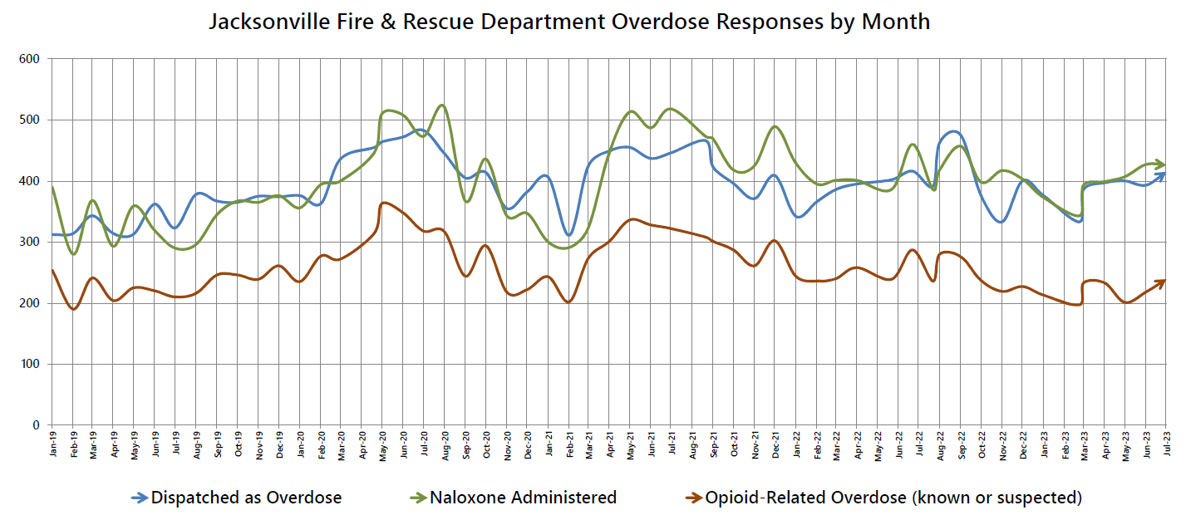

Slide 20
# of Suspected Opioid-Related (O-R) Overdose (OD) Patients
Month/Year | 2014 | 2015 | 2016 | 2017 | 2018 | 2019 | 2020 | 2021 | 2022 | 2023
Jan | 15 | 16 | 39 | 170 | 115 | 259 | 238 | 248 | 251 | 216
Feb | 16 | 33 | 91 | 200 | 143 | 195 | 282 | 203 | 239 | 198
Mar | 13 | 17 | 118 | 164 | 235 | 244 | 276 | 276 | 242 | 233
Apr | 29 | 28 | 106 | 145 | 170 | 207 | 319 | 303 | 259 | 234
May | 23 | 16 | 97 | 136 | 230 | 227 | 369 | 342 | 240 | 205
Jun | 27 | 18 | 72 | 224 | 187 | 225 | 351 | 330 | 291 | 221
Jul | 23 | 27 | 99 | 179 | 205 | 213 | 321 | 328 | 238 | 243
Aug | 29 | 36 | 124 | 210 | 139 | 219 | 323 | 316 | 280
Sep | 29 | 56 | 140 | 151 | 165 | 248 | 247 | 305 | 281
Oct | 21 | 47 | 209 | 183 | 184 | 250 | 298 | 293 | 241
Nov | 18 | 34 | 229 | 205 | 152 | 243 | 220 | 265 | 221
Dec | 23 | 44 | 189 | 180 | 196 | 262 | 223 | 309 | 230
TOTAL | 266 | 372 | 1,513 | 2,147 | 2,121 | 2,792 | 3,467 | 3,518 | 3,013 | 1,550
% Change |  | +40% | +307% | +42% | -1% | +32% | +24% | +1% | -14% | -12%
Notes:
-Updated through July 2023

Slide 21
Suspected Opioid-Related (O-R) Overdose (OD) Patients by Incident Zip Code January 2023 - July 2023
Zip Code | Count | % of O-R OD | Trend (Compared to Jan-Jul 2022)
32210 (Southwest) | 131 | 8% | 27% Decrease
32218 (Outer Rim) | 113 | 7% | 32% Decrease
32244 (Southwest) | 92 | 6% | 27% Decrease
32254 (Urban Core) | 88 | 6% | 18% Decrease
32207 (Arlington) | 86 | 6% | 12% Increase
32208 (Urban Core) | 81 | 5% | 7% Increase
32205 (Southwest) | 78 | 5% | 30% Increase
32216 (Arlington) | 77 | 5% | 4% Increase
32209 (Urban Core) | 76 | 5% | 10% Decrease
32211 (Arlington) | 73 | 5% | 14% Decrease
32256 (Southeast) | 73 | 5% | 35% Increase
TOTAL (Top 11) | 968 | 62%
TOTAL (Other 23 Zips) | 582 | 38%
TOTAL (All 34 Zips) | 1,550 | 100%
Notes:
-Updated through July 2023

Slide 22
Suspected Opioid-Related (O-R) Overdose (OD) Patients by Incident Zip Code January 2023 - July 2023
Top 10 Zip Codes | Count | Population Size | Rate per 1,000
32202 (Urban Core) | 54 | 6,544 | 8.25
32254 (Urban Core) | 88 | 14,545 | 6.05
32204 (Urban Core) | 30 | 8,673 | 3.46
32205 (Southwest) | 78 | 29,605 | 2.63
32206 (Urban Core) | 47 | 18,283 | 2.57
32220 (Outer Rim) | 33 | 13,037 | 2.53
32208 (Urban Core) | 81 | 33,286 | 2.43
32207 (Arlington) | 86 | 36,207 | 2.38
32211 (Arlington) | 73 | 34,168 | 2.14
32209 (Urban Core) | 76 | 36,656 | 2.07
32219 (Outer Rim) | 30 | 14,474 | 2.07
TOTAL (Top 11) | 676
TOTAL (Other 23 Zips) | 874
TOTAL (All 34 Zips) | 1,550
Zip codes highlighted in orange appear on both lists: Top 11 for Count and Rate
Notes:
-Updated through July 2023
-Zip codes highlighted in orange = both in the top 11 for count and the top 11 for rate per 1,000
-Population size data source: Decennial Census (2020)

Slide 23
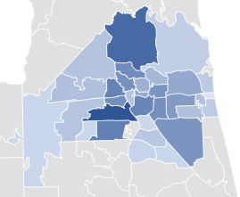
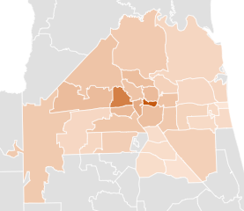
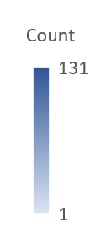
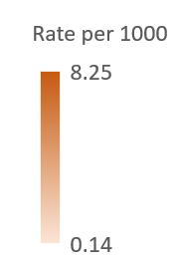
Opioid-Related Overdoses by Count and Rate
January 2023 - July 2023
Notes:
-The zip code in darkest blue in the Southwest portion of the map is 32210. The zip code in darkest blue in the Northern portion of the map is 32218.
-The zip code in darkest orange in the center of the map is 32202, and the zip code west of that that is also dark orange is 32254.

Slide 24
% of Suspected Opioid-Related (O-R) Overdose (OD) Patients
Race/Year | 2014 | 2015 | 2016 | 2017 | 2018 | 2019 | 2020 | 2021 | 2022 | 2023 (Jan-July)
Black or African American | 8% | 8% | 10% | 9% | 10% | 11% | 14% | 17% | 20% | 21%
Hispanic or Latino | 2% | 2% | 2% | 3% | 4% | 3% | 3% | 3% | 5% | 5%
Other/ Unknown | 2% | 3% | 2% | 4% | 4% | 4% | 4% | 4% | 2% | 2%
White | 88% | 87% | 86% | 84% | 82% | 82% | 79% | 76% | 73% | 72%
% of Suspected Opioid-Related (O-R) Overdose (OD) Patients
Gender/Year | 2014 | 2015 | 2016 | 2017 | 2018 | 2019 | 2020 | 2021 | 2022 | 2023 (Jan-July)
Male | 53% | 55% | 64% | 62% | 61% | 64% | 66% | 68% | 66% | 66%
Female | 47% | 45% | 36% | 38% | 39% | 36% | 34% | 32% | 34% | 34%
Notes:
-Updated through July 2023

Slide 25
% of Suspected Opioid-Related (O-R) Overdose (OD) Patients
Age Range | 2014 | 2015 | 2016 | 2017 | 2018 | 2019 | 2020 | 2021 | 2022 | 2023 (Jan-July)
19 or younger | 6% | 2% | 2% | 2% | 2% | 1% | 1% | 1% | 2% | 2%
20-29 | 26% | 30% | 30% | 26% | 26% | 22% | 20% | 15% | 14% | 15%
30-39 | 23% | 27% | 33% | 36% | 37% | 36% | 35% | 36% | 33% | 31%
40-49 | 18% | 17% | 17% | 18% | 17% | 22% | 21% | 23% | 24% | 25%
50-59 | 17% | 15% | 12% | 12% | 11% | 12% | 13% | 14% | 15% | 15%
60-69 | 6% | 6% | 5% | 5% | 5% | 6% | 7% | 8% | 9% | 10%
70 or older | 3% | 2% | 1% | 1% | 2% | 2% | 2% | 2% | 3% | 3%
Some years add up to 99% or 101% due to rounding
Notes:
-Updated through July 2023

Slide 26
July 2023 Snapshot
243 opioid-related overdose patients across 239 opioid-related incidents
2% increase compared to July 2022
10% increase compared to June 2023
Top zip code - 32218
21 patients (9%)
65% male; 35% female
69% white; 24% black/AA; 7% other
28% between ages 40-49
48% residence; 17% roadway; 14% business or hotel; 21% other

Slide 27
Data Deep Dive: Overdose Incident Location - Roadways
Year | % of Opioid-Related ODs in Roadway
2014 | 4%
2015 | 8%
2016 | 11%
2017 | 13%
2018 | 13%
2019 | 13%
2020 | 17%
2021 | 19%
2022 | 19%
2023 (Jan-Jul) | 18%
In 73% of opioid-related overdoses occurring in a roadway between January and July 2023, the OD victim was male, compared to opioid-related overdoses occurring in this time period across all incident locations where 66% of OD victims were male.
Notes:
-Roadway: overdose victim may have been found on the side of a road, under an overpass, on a highway/off ramp, sidewalk, parking lot. Some addresses in the report specifically mention a ramp or overpass. It does NOT mean the overdose victim was driving or even the passenger in a car. The high percentage is likely a reflection of our worsening affordable housing crisis and the intersection between being unhoused and being at higher risk of experiencing overdose. This is further reflected in the demographic breakdown - of the 279 roadway incidents, 73% were male overdose victims, which mirrors national data (US Department of Housing and Urban Development, 2022 Annual Homeless Assessment Report to Congress) that shows that males have higher rates of being unsheltered, compared to females.

Slide 28
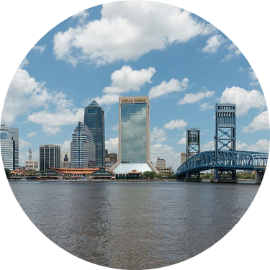
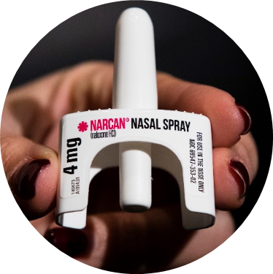
COMMUNITY-BASED NARCAN DISTRIBUTION
SEPTEMBER 2019 - AUGUST 2023

Slide 29
Project Activities at a Glance
14,857 Narcan kits distributed; 81% in high-need zip codes
379 unique trainings reaching over 6,900 community members
Notes:
-For distributions and trainings from September 2019 to July 2023
-Average training size is 18

Slide 30
Lives Saved & Narcan Use by Laypersons
Reported use of the Narcan provided under this project is encouraged, but not required.
Thus far, one hundred two (102) individuals have voluntarily followed up to report use of their Narcan to save a person who may have otherwise died from an overdose.
Although there is no way to know for sure, we suspect that the actual number of Narcan kits used is much greater.

Slide 31
Bystander Narcan Use Prior to Arrival (PTA) of JFRD
 | 2018-2019 | 2019-2020 | 2020-2021 | 2021-2022 | 2022-2023*
% Change in Opioid-Related OD Calls | +32% | +24% | +1% | -14% | -12%
% Change in Use of NARCAN PTA by Bystanders | +191% | +59% | +79% | +5% | +55%
*Jan-Jul only
Notes:
Notes:
-Narcan nasal spray was first FDA approved in November 2015, but the first report of Narcan use PTA was not until 2017. The Safe and Healthy Neighborhoods Project began Narcan distribution in September 2019.

Slide 32
Additional Data & Research Highlights

Slide 33
Pharmacy Availability of Buprenorphine for Opioid Use Disorder Treatment in the US
Study Methods
Retrospective analysis of pharmacy calls made between 1/1/2022 and 12/31/2022
5,283 unique pharmacies were called on behalf of 3,779 patients across 42 states
Clinical support staff of a telehealth program contacted a patient’s preferred pharmacy and utilized a standardized script to determine if at least one formulation of buprenorphine was available
Study Results
58% of pharmacies (3,058 of 5,283) reported stock of at least one formulation of buprenorphine/naloxone
Overall, a greater percentage of chain pharmacies reported stock compared to independent pharmacies (62% and 45%, respectively)
Stock varied greatly between states, with Florida having the lowest percentage of pharmacies reporting stock (37%) and Washington having the highest (84%)

Slide 34
Pharmacy Availability of Buprenorphine for Opioid Use Disorder Treatment in the US
Availability of Buprenorphine at Retail Pharmacies in Florida vs. Overall
 | Florida | Overall
CVS | 38% | 60%
Publix | 26% | 31%
Walgreens | 51% | 70%
Walmart | 37% | 58%
Other | 34% | 48%

Slide 35
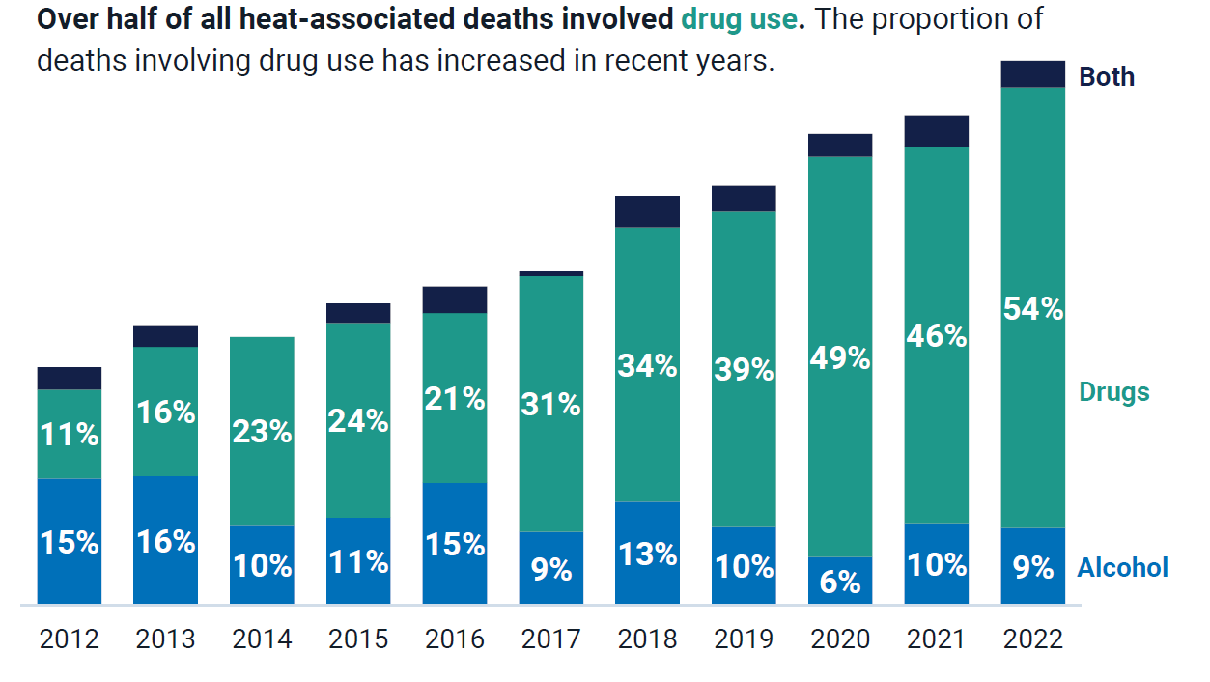
Maricopa County Department of Public Health 2022 Heat Deaths Report

Slide 36
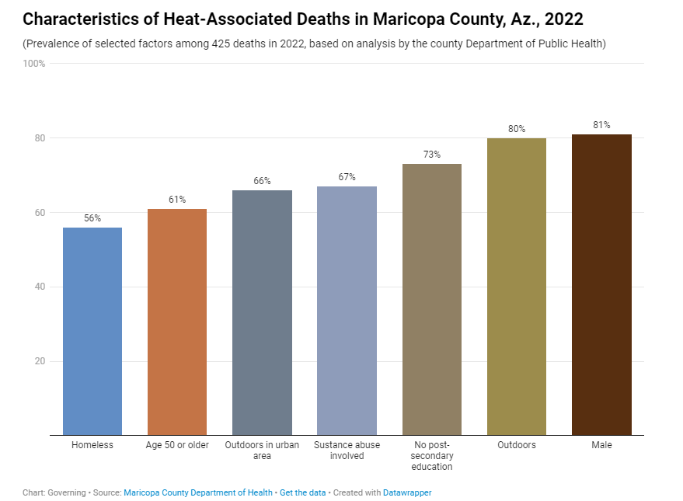
Maricopa County Department of Public Health 2022 Heat Deaths Report

Slide 37
Maricopa County Department of Public Health 2022 Heat Deaths Report
Maricopa County identified 283 deaths involving substance use, representing over two-thirds of all heat-associated deaths recorded in 2022
81% of these deaths involved drug use alone, 14% involved alcohol only, and 5% involved both drugs and alcohol
Methamphetamine was involved in 93% of heat-associated deaths involving drug use, and fentanyl was involved in 44% of heat-associated deaths involving drug use
53% of all heat-associated deaths involved methamphetamine
54% of heat-associated deaths in 2022 involving substance use were among individuals experiencing homelessness

Slide 38
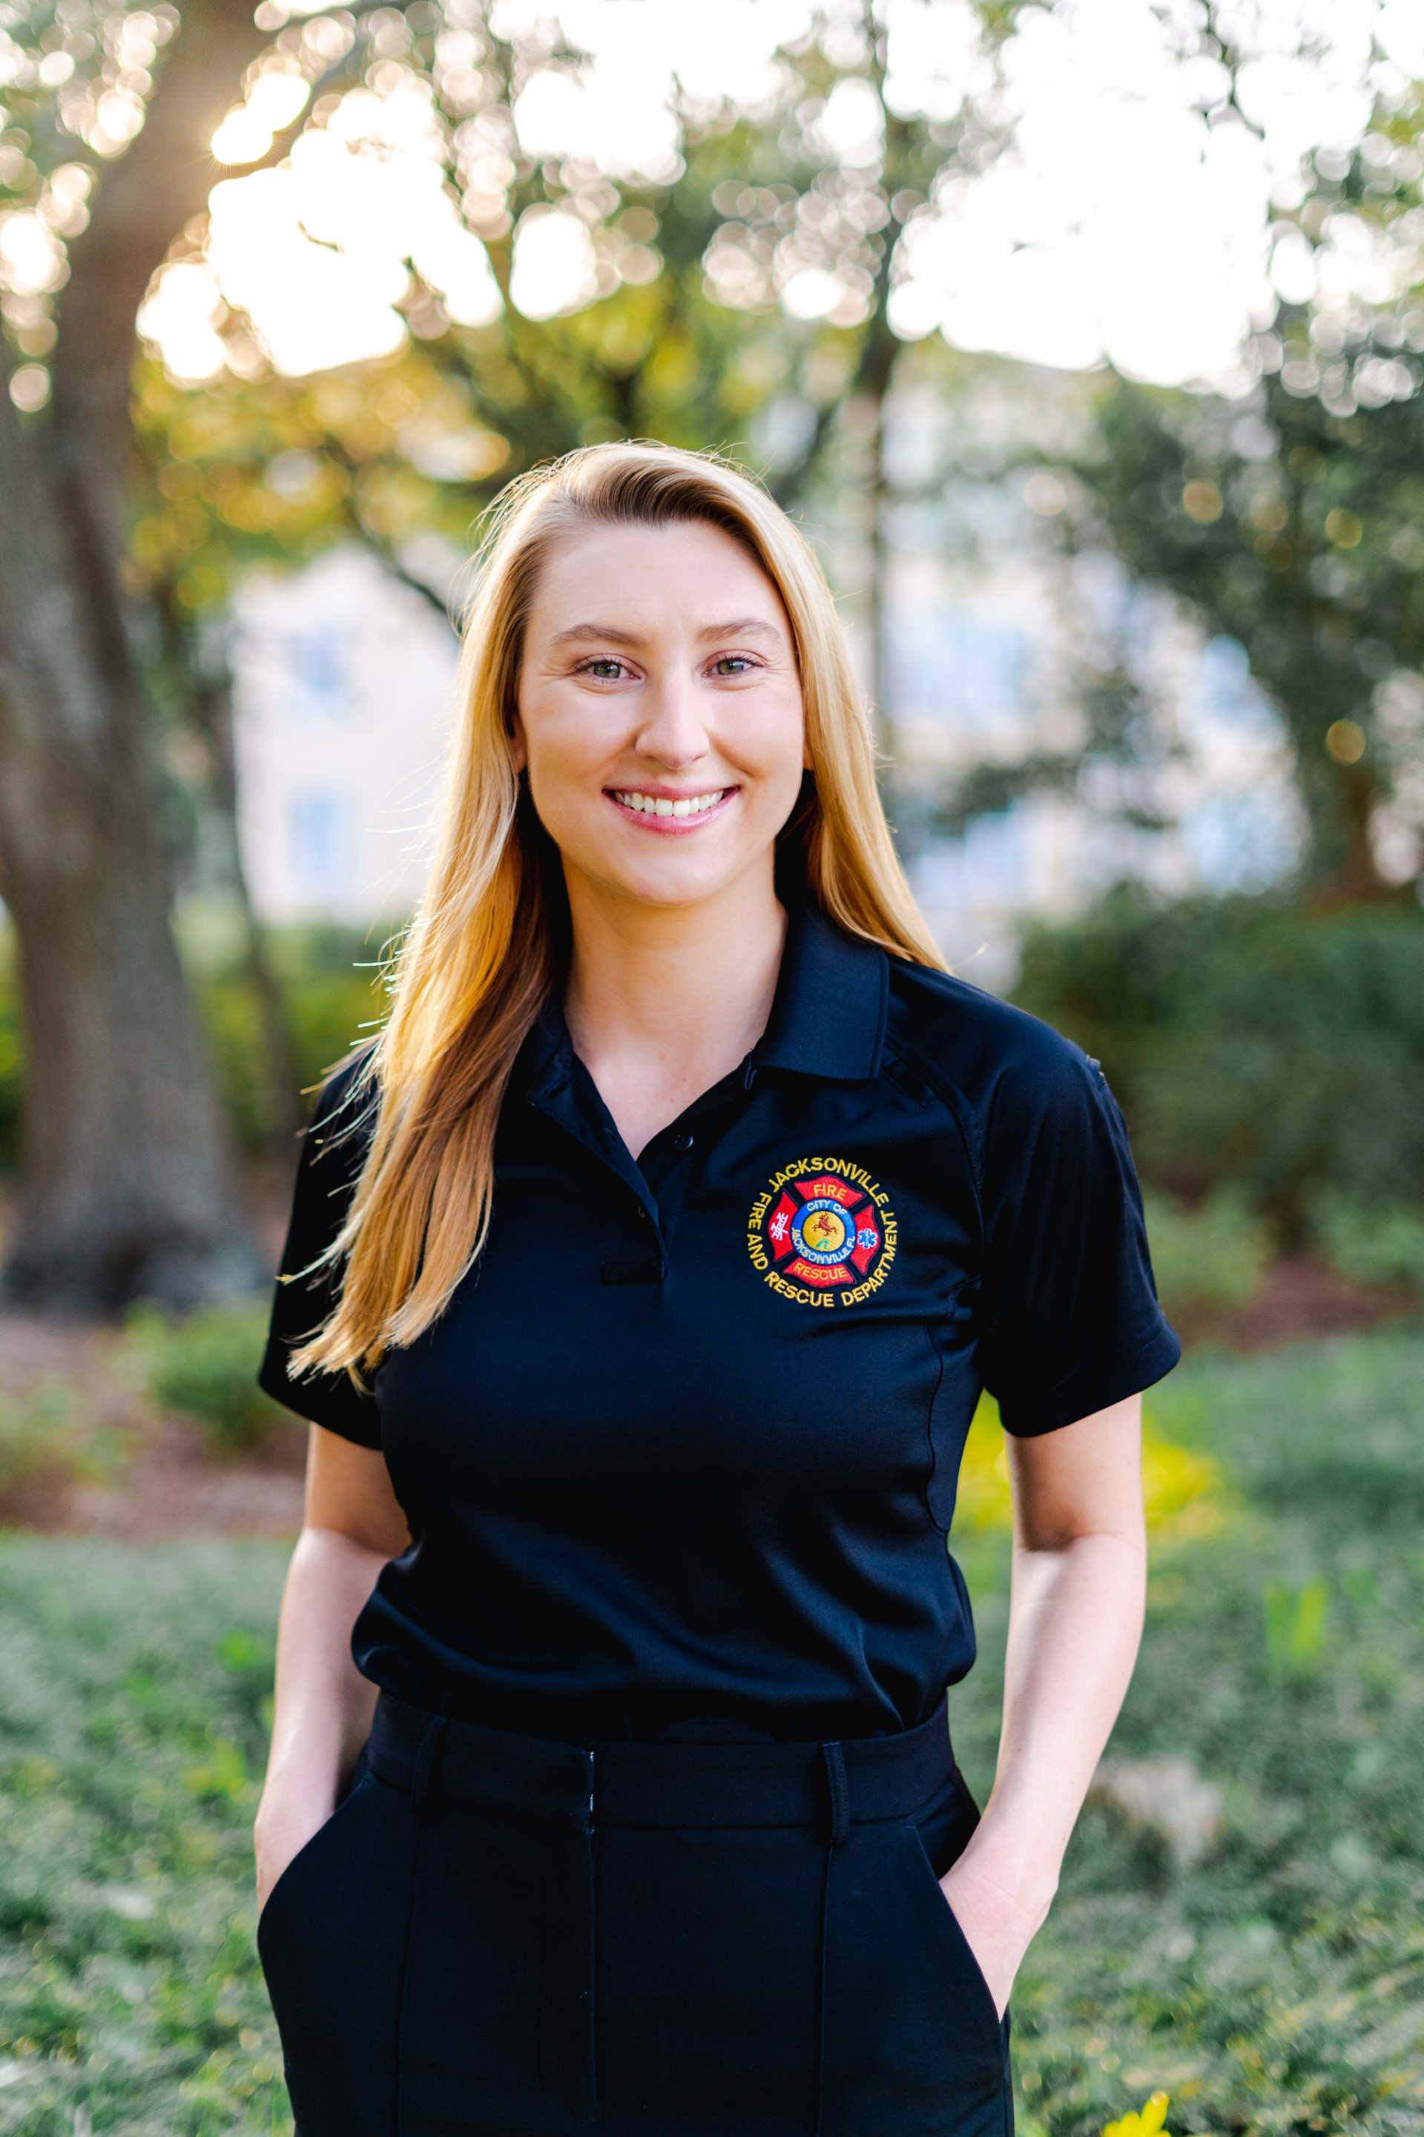
Contact Me
Laura Viafora Ray, MPH, CPH
Program Coordinator - Opioid Abatement
Office: (904) 255-7730
Cell: (904) 575-0495
Email: lvray@coj.net
Connect on LinkedIn

Slide 39
Opioid Abatement Update
Notes:
-Madelaine will provide a brief update on the opioid abatement process
-Laura will update the group on her new title/role (still providing Narcan kits to partners, still providing data updates to DENs)

Slide 40
Opioid Abatement Program
Jacksonville Fire & Rescue department

Slide 41
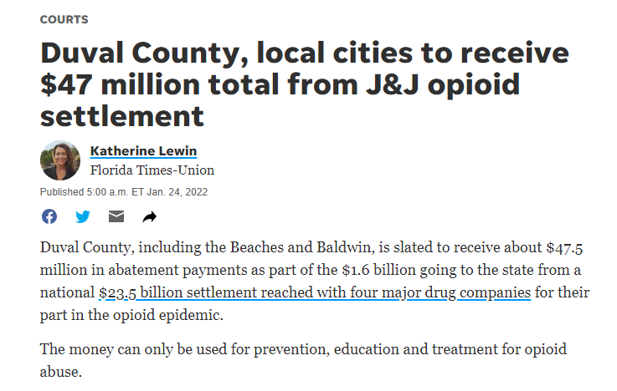
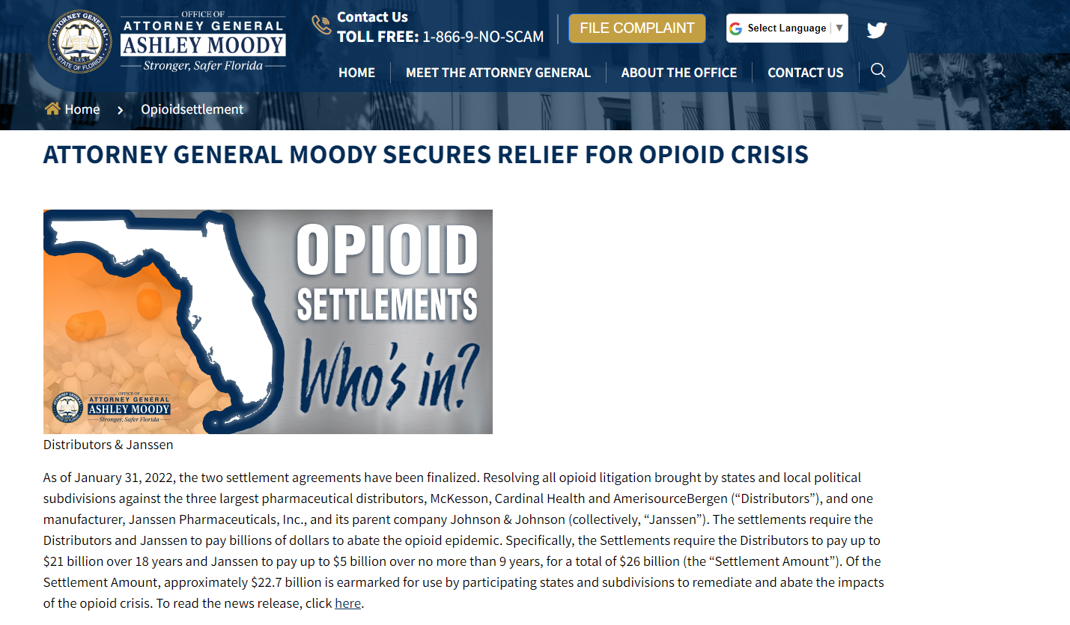
Background
Settlement funds from various civil lawsuits
First announced in early 2022
Schedule B: Authorized Uses
Opioid and Substance Use Disorder (OSUD) Grants Committee

Slide 42
Opioid and Substance Use Disorder (OSUD) Grants Committee
Passed by Jacksonville City Council June 2023
Ordinance 2023-0350-E
7 members
In process of confirming appointed members
Notes:
7 members: The committee consists of two peer specialists, two healthcare professionals, two mental health professionals, and the health administrator of the DOH, Duval County

Slide 43
OSUD Grants Committee
Eligibility
Overview of process
Schedule B
Timeline
Notes:
Eligibility: must be in existence for 3 years, must be located in Duval County, the program must serve the residents of Duval County.
There are also a number of eligibility documents required including financial disclosures. If you’re aware of the City’s Public Service Grants program, a lot of this application will be familiar to you.
Once you determine you’re eligible to apply, you can submit an application which includes sections about the agency’s board and previous work, the proposed program’s goals, budget, etc.
Schedule B is a settlement document that outlines the sort of things that this funding can go to in the realms of prevention, treatment, and recovery support of those with OUD and co-occurring substance use and mental health conditions. The key to remember for this money is that the programming must involve OUD. It can address co-occurring substance use and mental health issues; but OUD must be the focus of the program.
Again, we are in the process of appointing the committee members now and hope to open the application in the coming months.

Slide 44
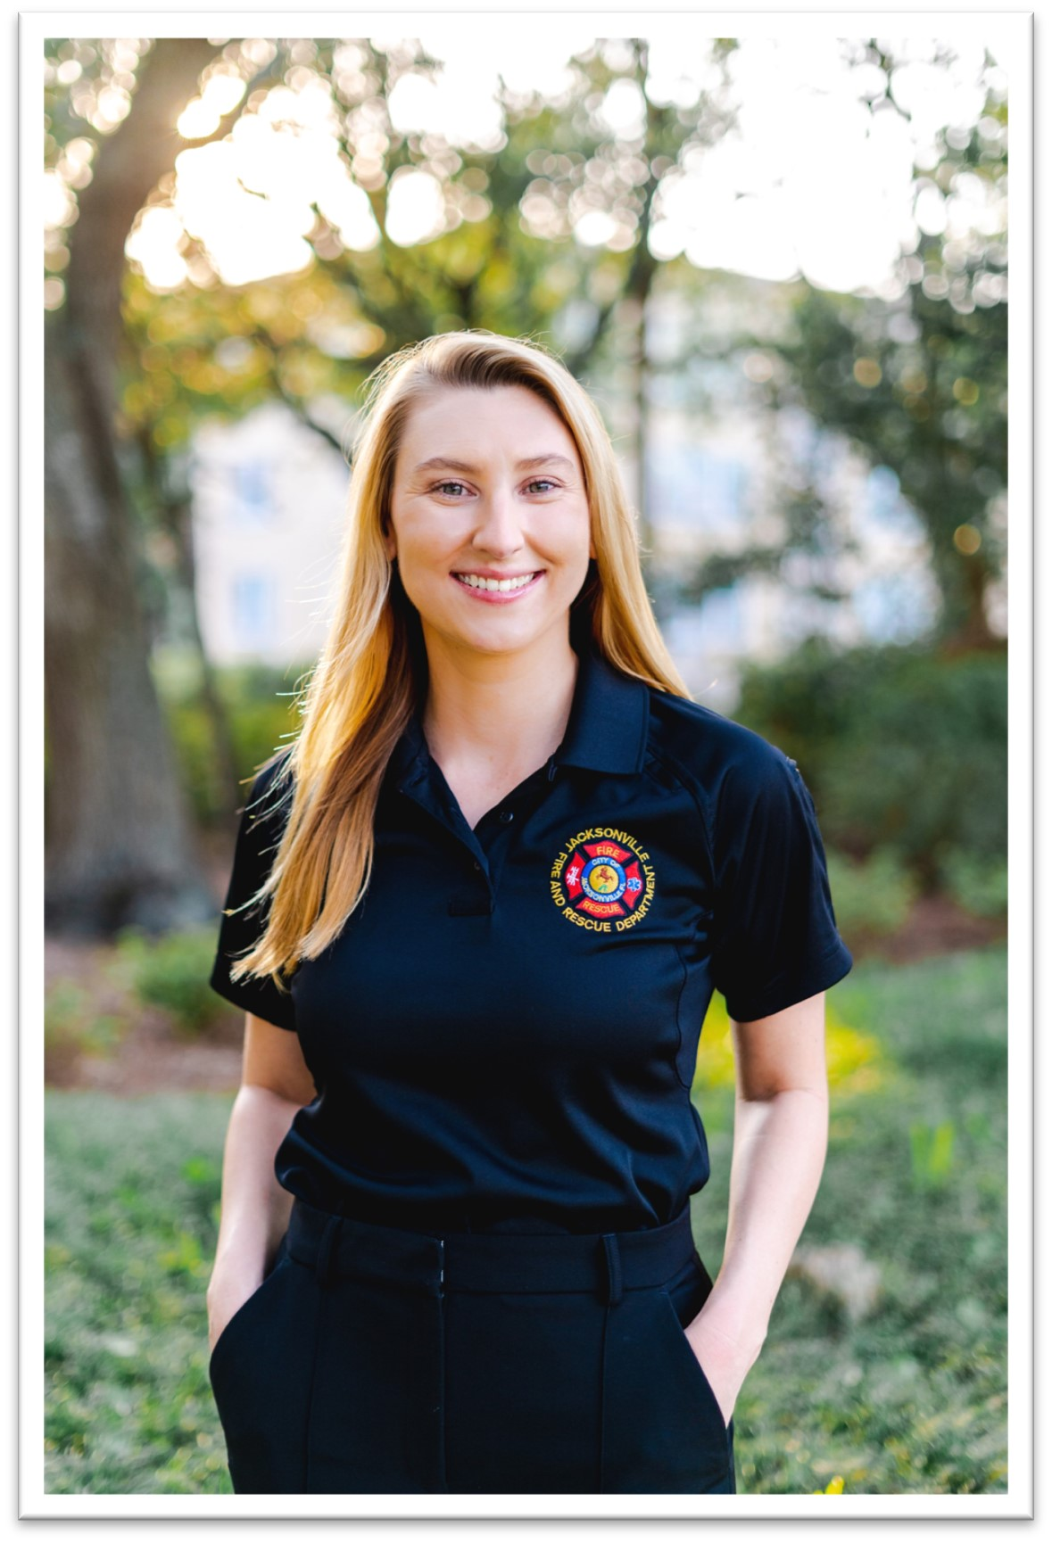
Opioid Abatement Team
Madelaine Zarou
mazarou@coj.net | (904) 255-3312
Laura Viafora Ray
lvray@coj.net| (904) 255-7730
Notes:
We are happy to answer any questions about the process.
We have a distro list for those who are interested in receiving updates; feel free to put your email addresses in the chat box below or contact us directly to be added to the list.

Slide 45
Duval RCO

Slide 46
Data Challenges

Slide 47
Sober Living & Recovery Supports
Data
Subcommittees

Slide 48
Thank You
48
Kathleen Roberts
KRoberts@ccafl.org
Deborah Babin
DBabin@nfhitda.org

