Slide 1
Major General John D. Haas
The Adjutant General of Florida

Slide 2
The FLYCA Mission
To empower youth through leadership to become successful, productive citizens by leading, training, and mentoring them through a highly disciplined and motivational environment, free from outside distractions.

Slide 3
Program History
The Florida Youth ChalleNGe Academy (FLYCA) began in 2001 to change the lives of Florida’s youth in need of leadership. It is a Cooperative Agreement program with:
The Department of Defense / National Guard Bureau
The State of Florida through:
FL Department of Military Affairs
FL Department of Juvenile Justice
FL Department of Children & Families

Slide 4
Program History
The Youth ChalleNGe program is a national program with
40 Programs in 29 States & PR
FLYCA is the only program of its kind in Florida

Slide 5
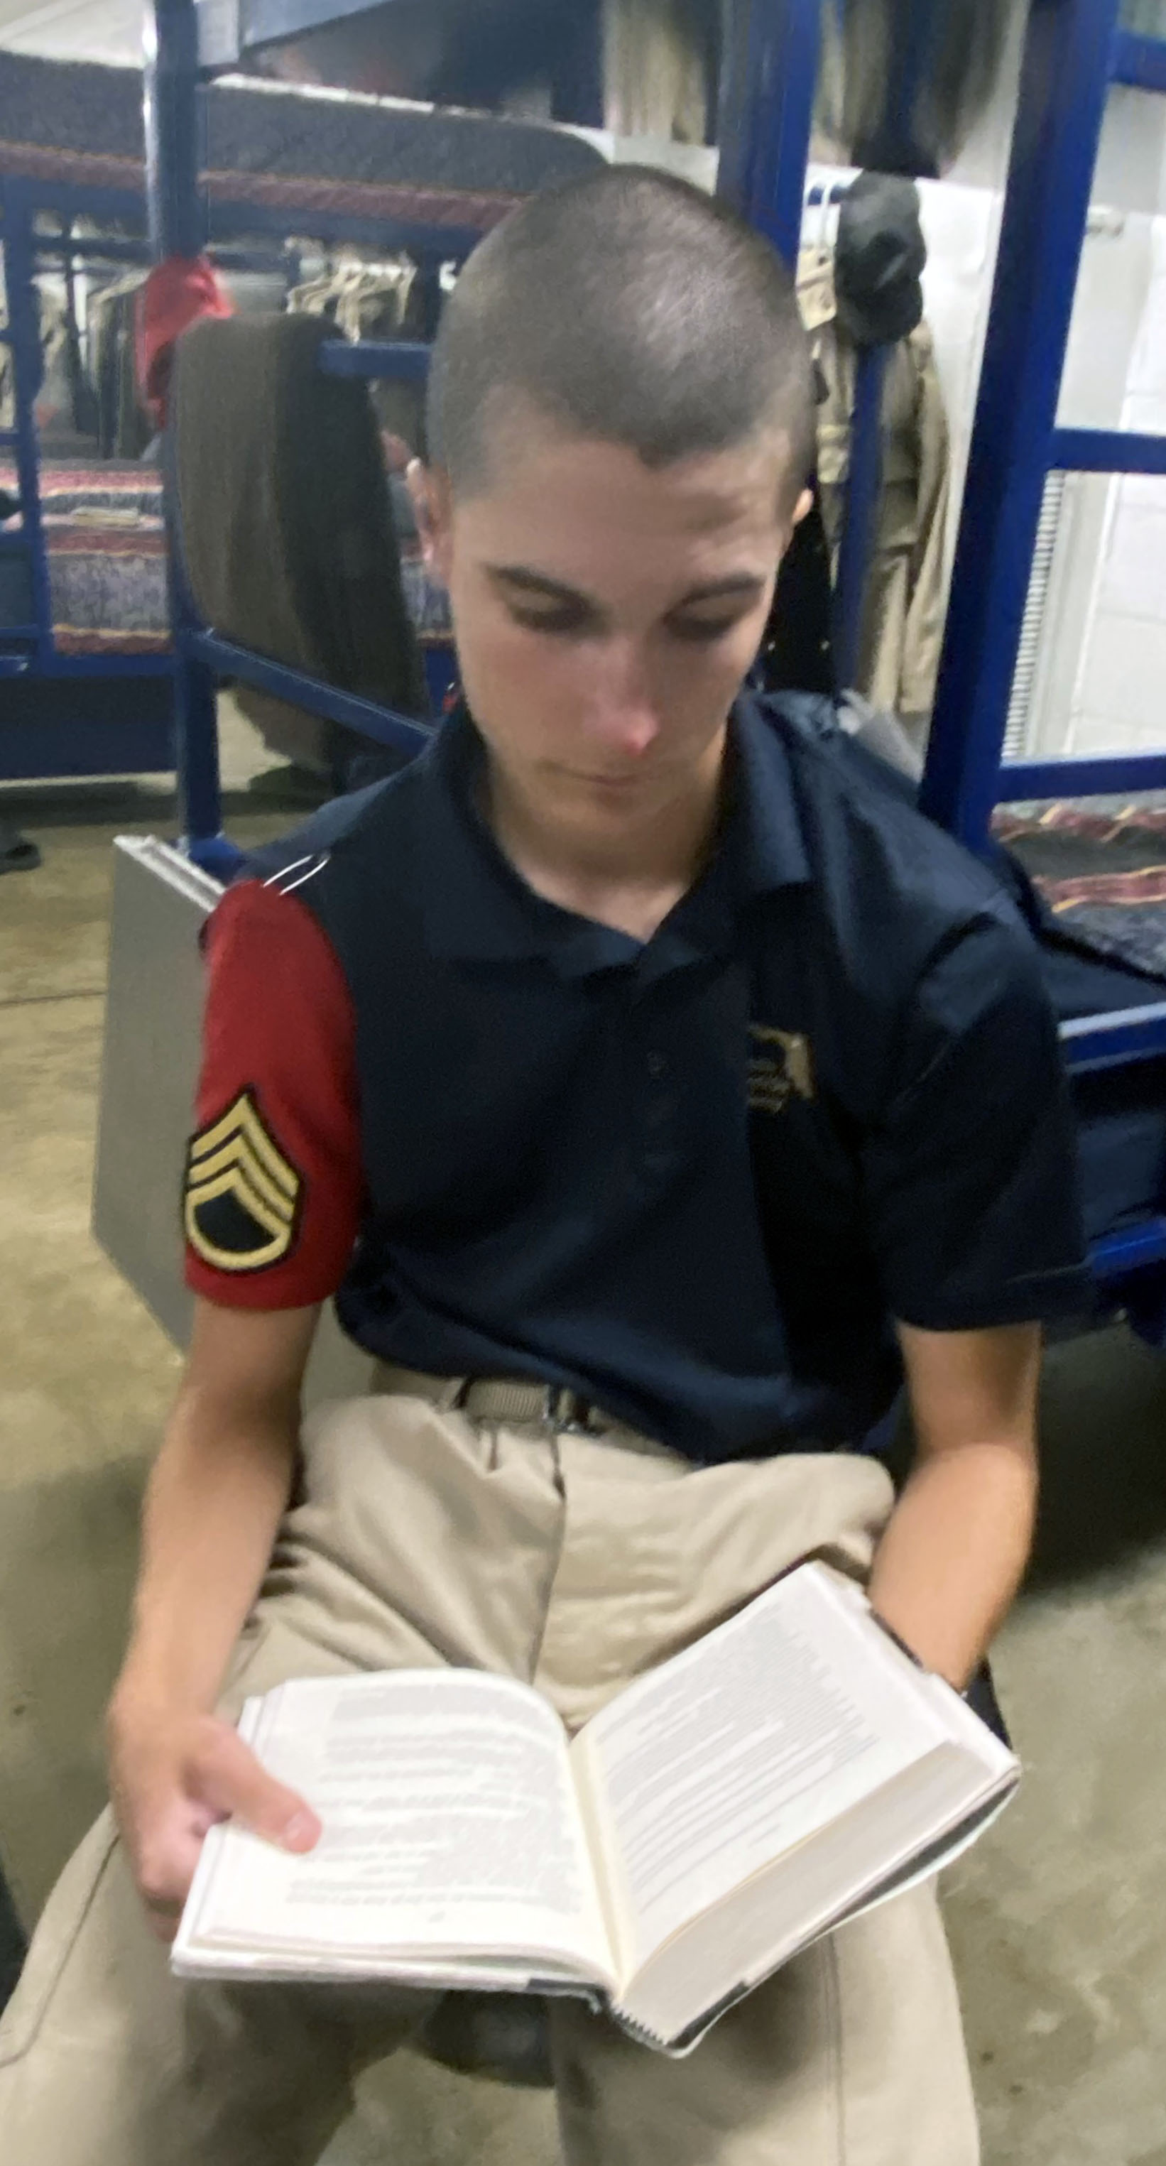
Course Structure
Total program length is 17 ½ months
5 ½ month Residential Phase
Acclimation (two weeks)
ChalleNGe (five months)
12 month Post-Residential Phase
(Two classes annually -- July & January)

Slide 6
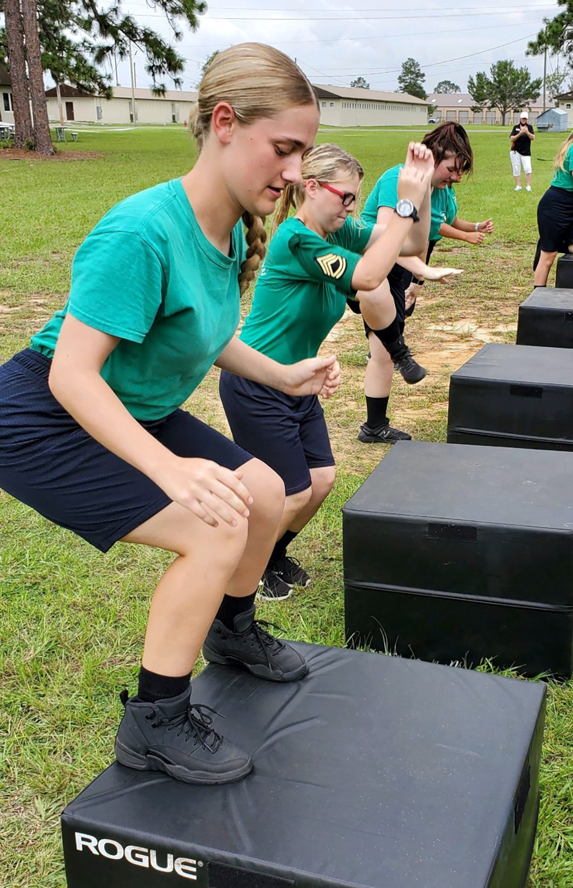
Admission Criteria
Males and females, 16 - 18 years old
Can turn 19 years old 2nd day of Residential Phase
High school dropout/expellee, or withdrawal from school
A citizen or legal resident of United States & Florida
Cannot be court ordered to attend
Not charged, under indictment, or awaiting sentencing
No adult charges
Free of illegal drugs
Physically & mentally able to complete the program
Be a volunteer

Slide 7
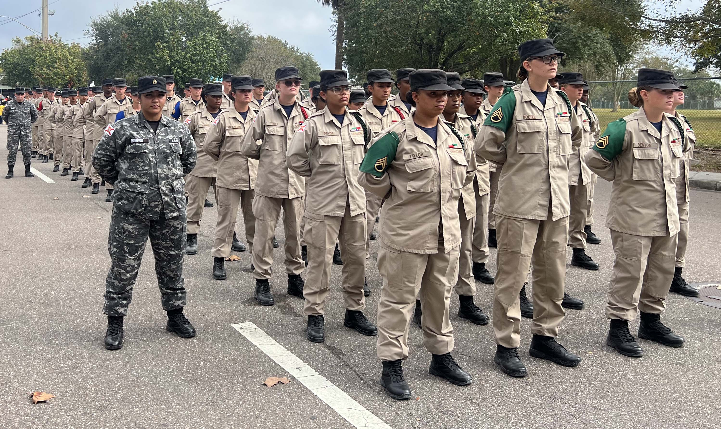
Eight Core Components
Academic Excellence
Health and Hygiene
Physical Fitness
Service to Community
Life Skills
Job Skills
Responsible Citizenship
Leadership / Followership

Slide 8
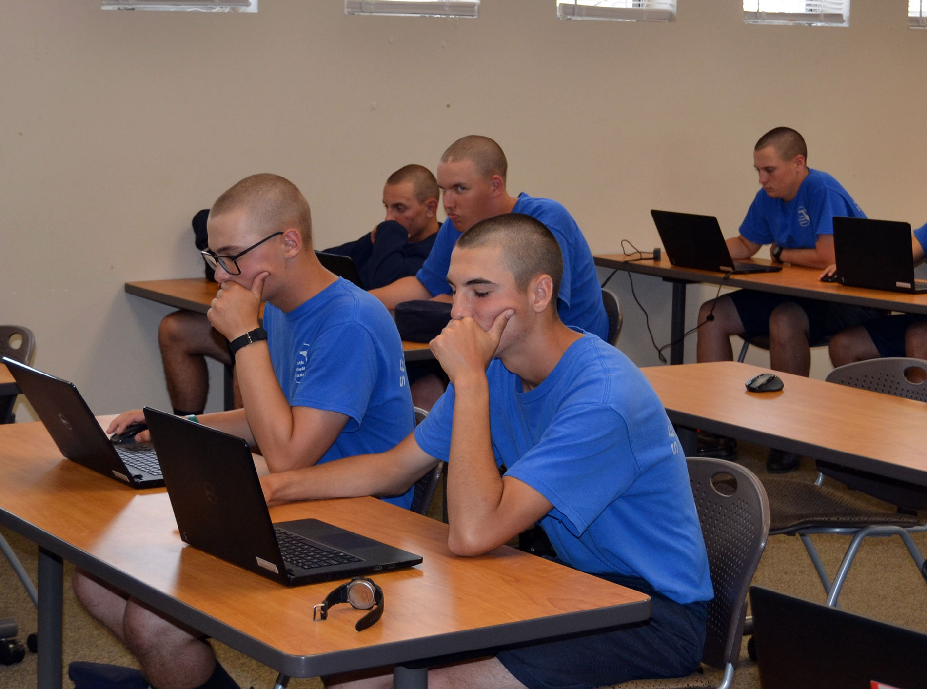
Academic/Vocational Programs
ACADEMIC EXCELLENCE CORE:
Track 1 (High School Credit Recovery)
Track 2 (ABE/GED)
GED+ Supplemental Instruction
College Dual Enrollment – 3 college credits
Available to select track 1 cadets – counts as a ½ high school credit
JOB SKILLS CORE:
Horticulture / Agriculture
Microsoft Office Certification Course
TESTING/CERTIFICATION & Support:
Maintain Pearson Vue accredited testing center which supports all required testing.

Slide 9
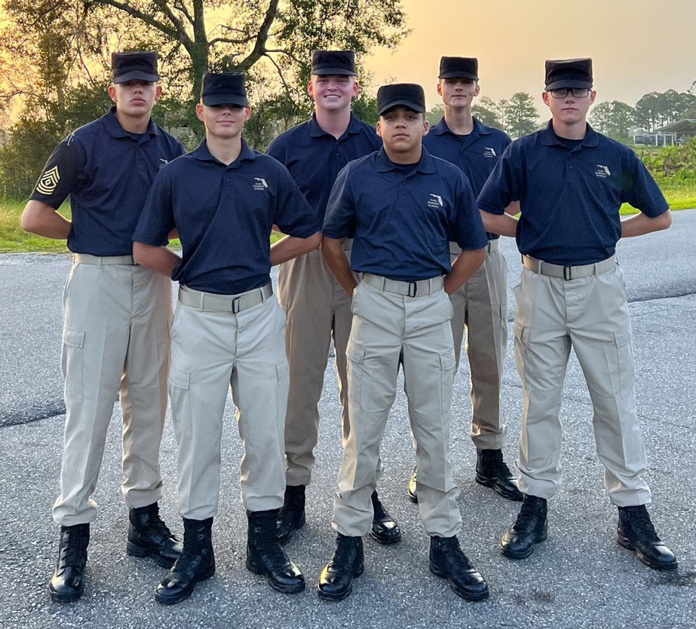
Graduation Statistics
FLYCA Enrollment & Graduation Total Service Hours Given:
434,973
Total Enrolled: 7,234 Total Service Dollar Contribution: Graduates: 6,068 $8,686,988.70
GED’s Earned: 3,509
Average Educational Growth in 5 ½ Months
Cadets educationally gain approximately 1 ½ grade
levels in Mathematics and
Reading Comprehension.

Slide 10
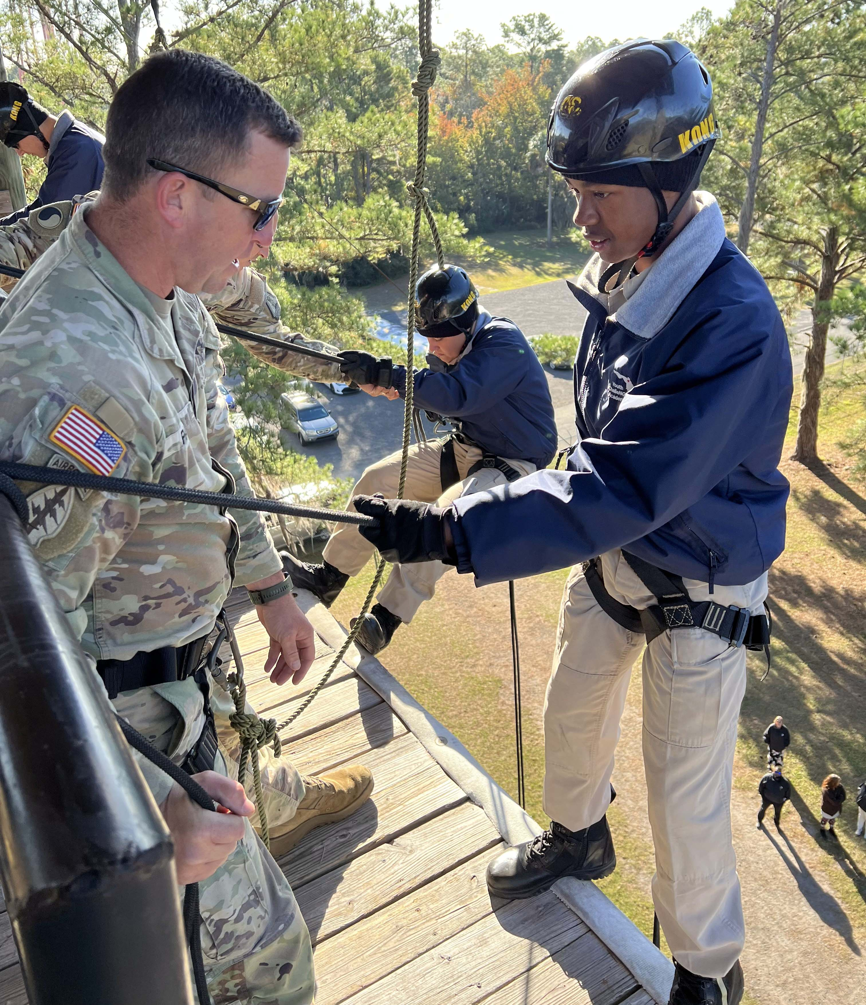
Cadets Served Throughout Florida
FLYCA has served cadets from
63
of Florida’s 67 counties
(as of Class #45 which graduated in December 2023)
The only counties that FLYCA hasn’t
yet served are:
Hardee | Holmes | Lafayette | Liberty

Slide 11
Questions & Comments
?

