Slide 1
FLORIDA YOUTH SUBSTANCE ABUSE SURVEY
Presented by: BERT ROTHENBACH, PhD
March 28, 2024
Rothenbach Research and Consulting, LLC

Slide 2
Survey Questionnaires
Questionnaire development
Data analysis and reporting
FYS
Florida
Youth Survey
FYSAS
Florida Youth
Substance Abuse Survey
DCF
MS and HS
Even years
Odd years
FYTS
Florida Youth
Tobacco Survey
DOH
MS and HS
Even years
Odd years
Florida’s Student Health Behavior Survey System
Project management
Sample design
Data collection tools
County coordinators
School recruitment
Logistical and tech support
Data processing
FSYS
Florida Specific
Youth Survey
DOE
HS only
Odd years
2

Slide 3
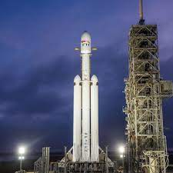
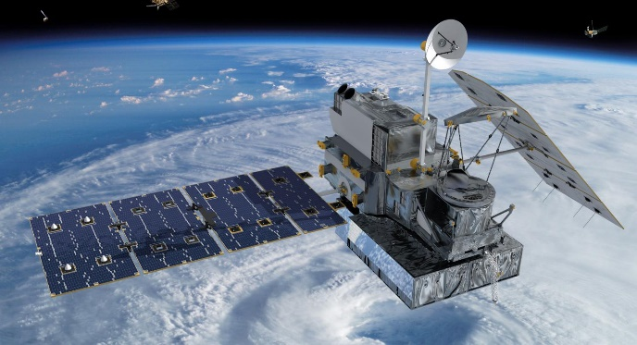
FYS
FYSAS
FYTS
FSYS
3

Slide 4
Background and Methods
The Florida Youth Survey (FYS) is a multi-survey data collection project: Three questionnaires in odd years, two in even years:
Florida Youth Substance Abuse Survey (FYSAS)
Florida Youth Tobacco Survey (FYTS)
Florida Specific Youth Survey (FSYS)
Odd years are “state-level” samples. Not every county is selected to participate. Final samples usually include 8,000-10,000 respondents.
Even years are “county-level” samples. Every county gets its own sample. Final samples usually include 50,000-60,000 respondents.
About 2/3 administered online and 1/3 with booklets.
Survey contractor, ICF, works with DCF, DOH, and DOE to plan and coordinate survey administration.
4

Slide 5
FYSAS Key Finding #1
From 2002 to 2023, substance use among Florida MS and HS students has declined dramatically:
While this remarkable improvement in youth health behavior is understood by many in the prevention community ...
Most Americans, including those working in public policy, believe youth substance abuse has increased.
FYSAS data provide confirmation and quantification of this trend.
5

Slide 6
Past-30-Day Prevalence
High School | 2002 to 2023
6

Slide 7
Alcohol
Past-30-Day Prevalence by Grade Cohort
7

Slide 8
Binge Drinking
Prevalence by Grade Cohort
8

Slide 9
Blacking Out from Drinking
Lifetime Prevalence Among High School Students
On how many occasions (if any) in your lifetime have you woken up after a night of drinking alcoholic beverages and not been able to remember the things that you did or places that you went?
9

Slide 10
Cigarettes
Past-30-Day Prevalence by Grade Cohort
10

Slide 11
Any Vaping
Past-30-Day Prevalence
Middle School
High School
11

Slide 12
Nicotine Vaping
Past-30-Day Prevalence
Middle School
High School
12

Slide 13
Marijuana Vaping
Past-30-Day Prevalence
Middle School
High School
13

Slide 14
Vaping and Cigarette Use
Past-30-Day Prevalence, Middle School and High School
14

Slide 15
Vaping Nicotine and Vaping Marijuana
Past-30-Day Prevalence
Vaping Nicotine
Vaping Marijuana
51.3% of current nicotine vapers are vaping marijuana.
66.1% of current marijuana vapers are vaping nicotine.
15

Slide 16
Vaping Nicotine and Smoking Cigarettes
Past-30-Day Prevalence
Vaping Nicotine
Smoking Cigarettes
7.1% of current nicotine vapers also smoke cigarettes.
47.5% of current smokers also vape nicotine.
16

Slide 17
Marijuana
Past-30-Day Prevalence by Grade Cohort
17

Slide 18
Alcohol and Driving Trends
Past-30-Day Prevalence Among High School Students
Riding with a Drinking Driver
Driving after Drinking
18

Slide 19
Marijuana and Driving Trends
Past-30-Day Prevalence Among High School Students
Riding with a
Marijuana-Using Driver
Driving after
Using Marijuana
19

Slide 20
Florida vs National Results
Monitoring the Future (MTF):
National school-based substance use survey, conducted in the spring every year
Schools and selected and recruited, classrooms selected within schools
Includes grades 8, 10, and 12
National comparison for youth substance use in Florida
Data quality check
20

Slide 21
Alcohol
Past-30-Day Prevalence for 8th, 10th, and 12th Graders
21

Slide 22
Alcohol
Past-30-Day Prevalence for 8th, 10th, and 12th Graders
22

Slide 23
Binge Drinking
Prevalence for 8th, 10th, and 12th Graders
23

Slide 24
Cigarettes
Past-30-Day Prevalence for 8th, 10th and 12th Graders
24

Slide 25
Marijuana
Past-30-Day Prevalence for 8th, 10th and 12th Graders
25

Slide 26
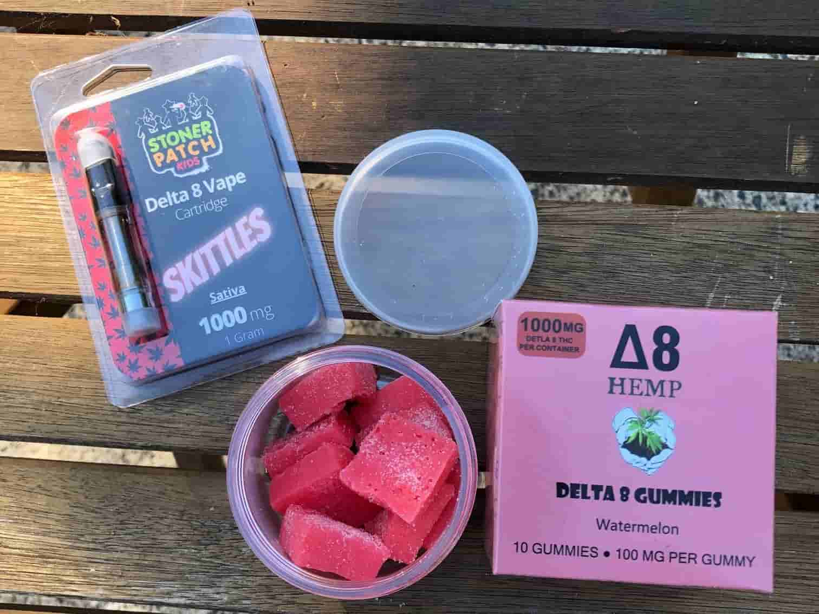
Delta-8/10 THC and Kratom
New Items Added to the 2023 High School Questionnaire
New Florida law taking effect on October 1st will limit the amount of THC in hemp-derived products.
Kratom sales to persons under age 21 made illegal in June 2023.
26

Slide 27
Delta-8/10 THC and Kratom
Lifetime Prevalence among High School Students
27

Slide 28
Delta-8/10 THC
Comparisons for 12th Grade Students
CNN Headline, March 13, 2024:
“A significant number of US 12th graders report using delta-8 products, study says, and it may be a public health concern”
MTF past-year prevalence of use among 12th graders: 11%
FYSAS lifetime prevalence of use among 12th graders: 14.2%
28

Slide 29
Marijuana and Delta-8/10 THC
Lifetime Prevalence Among High School Students
Marijuana
Delta-8/10 THC
41.2% of HS students who have tried marijuana have also tried Delta-8/10 THC products.
86.1% of HS students who have tried Delta-8/10 THC products have also tried marijuana.
29

Slide 30
Adverse Childhood Experiences
Adverse childhood experiences, commonly known as ACEs, are traumatic events experienced during childhood that have been linked to a broad range of negative health and behavior outcomes, including impaired cognitive development, high-risk behavior such as substance use, difficulty forming positive social relationships, high rates of chronic disease, and employment and financial difficulties.
30

Slide 31
How Prevalent is Childhood Trauma?
ACEs Among High School Students
31

Slide 32
Number of Adverse Childhood Experiences
High School Students
32

Slide 33
Low Trauma and High Trauma
High School Students
Low Trauma
Fewer than 4 ACEs
High Trauma
4 or More ACEs
81.6
18.4%
33

Slide 34
Which Students Report High Trauma?
Percentage Reporting 4 or More ACEs
Race and Ethnicity
Gender
Father’s Education
34

Slide 35
SES and Race/Ethnicity
Percentage Reporting 4 or More ACEs
Low SES
High SES
35
Notes:
1. MTF data show a similar pattern.
2. 2019 peak
3. Nicotine vaping declining more quickly

Slide 36
SES and Gender
Percentage Reporting 4 or More ACEs
Low SES
High SES
36

Slide 37
ACEs and Race/Ethnicity
High School Students
37

Slide 38
ACEs and Gender
High School Students
38

Slide 39
ACEs and Socioeconomic Status
High School Students
39

Slide 40
ACEs and Substance Use
Past-30-Day Prevalence by ACE Score
40

Slide 41
ACEs and Substance Use
Past-30-Day Marijuana Use Rates By ACE Responses
41

Slide 42
ACEs and Symptoms of Depression
Past-30-Day Prevalence by ACE Score
42

Slide 43
Thank you!
FYSAS reports and data tables:
myflfamilies.com/services/samh/florida-youth-substance-abuse-survey
Online data browsing tool:
flhealthcharts.gov/ChartsDashboards/rdPage.aspx?rdReport=SurveyData.Overview
Bert Rothenbach
bert@rothenbach-research.com

