Slide 1
Duval Co + Lab
Presented by Drug Free Duval Regional DEN Meeting 3/28/24 2:30 pm

Slide 2
Agenda
Co + Lab birth
Work of year 1 and 2
Identity
Goals and Objectives
Strategies
Wolfson Co + Lab birth
Where we go from here

Slide 3
Late Spring – early fall, 2021
Jessica Golden reached out with a heavy heart
Resulted in a group meeting and broad discussion with 13 youth from 9 schools, public and private
Committed to diving in deep and figure out what could be done
The founding group of Co + Labbers identified mental & behavioral health was hurting them & their friends
They connected and BELIEVED they could make an impact across schools and the broader community
The power of their belief resulted in increased knowledge, a school club, and a community-wide summit!

Slide 4
Duval Co + Lab Raising Awareness for Better Health

Slide 5
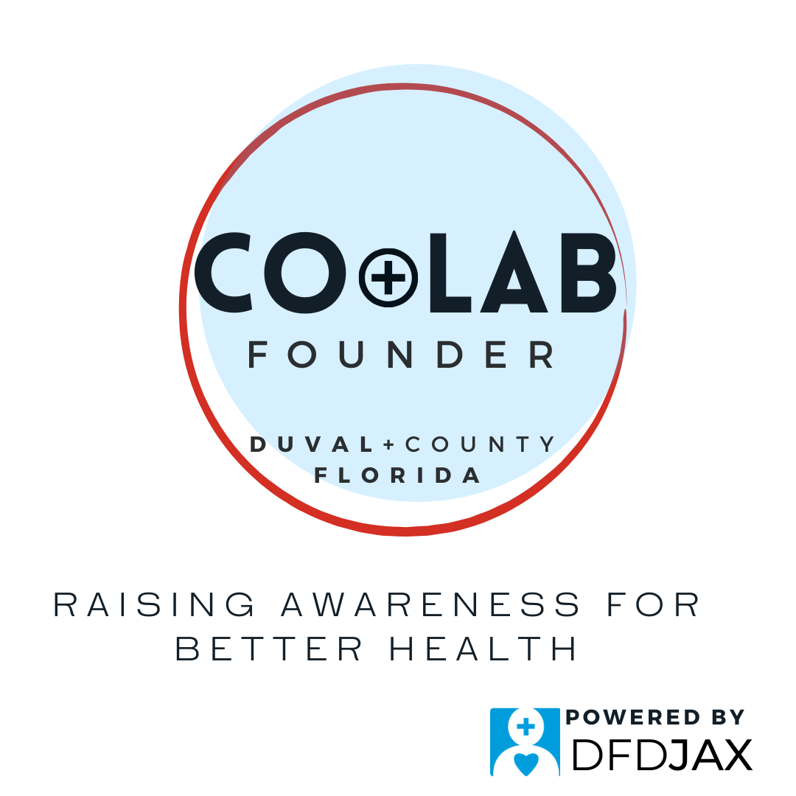
Early work…creating the identity
FOUNDERS:
Adriana Gjergi Chloe Brown Emma Tatum Grace Devine Graham Worley Jeb Allen Jessica Golden Maddie Millar Manny Montalvo Megan Barts Miles Johnson Rafael Montalvo

Slide 6
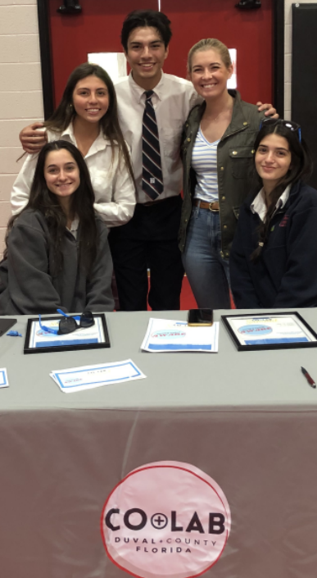
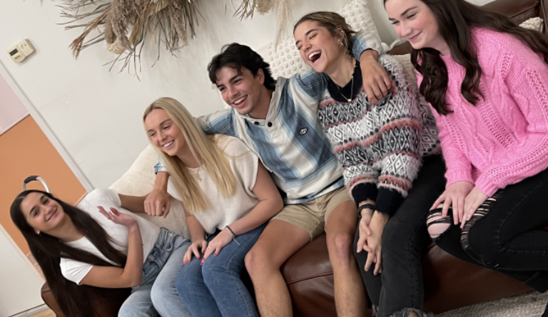
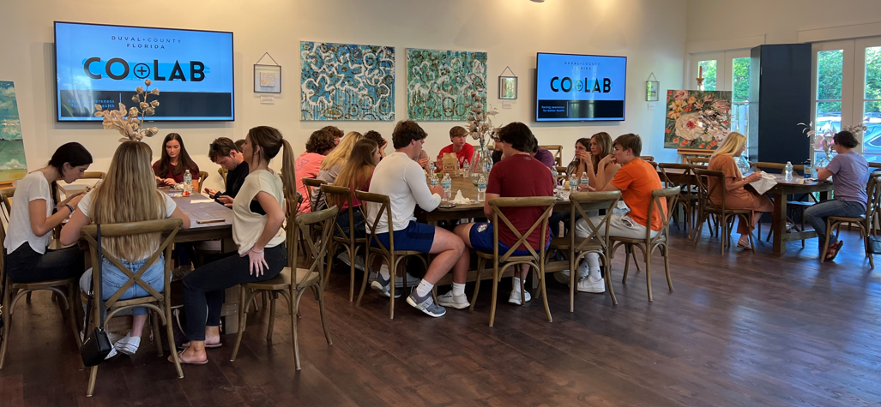
Strategizing and planning…

Slide 7
Plans into Action
Led the conversations at school health fairs
Surveys
Education: Safe Storage
Set up talks for various youth groups at schools
Founded an organization to impact their peers with the goal of better health – ALL HEALTH
Earned hundreds of volunteer hours
Participated in assembling items for a summer youth camp for a non-profit
Looked into clubs at each school with a successful club being launched at Bolles
Started some social media presence with positive messaging
Learned real information about drugs, alcohol, youth brain, preventing overdose, embracing their own natural high and encouraging that for their friends
Planned a youth summit for spring, 2022 along with peer-to-peer sessions with middle schools – because they see that as the point of highest impact

Slide 8
They demonstrated the power of embracing MINDSET change
As bold, brilliant, change-makers:
Safe Storage & Disposal
Availability & Access
Reality of potential risks of unsafe storage
Illumination of responsibility
Easy ideas for storage and disposal
Dispelling myths or urban legends
Providing tools & support materials
Safe Use & Drug Sharing
Thoughtful & Intentional
Using as directed for whom directed
Considering other substances
Shifting from benefits of sharing to risks of sharing
Healthy perception of harm

Slide 9
Summit 2022 AWARE: Laced & Lethal
Way ahead of the curve...
Counterfeit pills and fentanyl poisoning deaths
3 Perspectives were Explored:
Local mom Rebecca Sheller shared the reality of overdose and the impact to the family along with the clear message that YOUR PARENTS CARE and will help
Law Enforcement Officer Katherine Gordon discussed beyond the legal aspects of responding to an overdose…how it personally devastates the officers who respond
Coach Matthew Case talked about how he must bench a player – even if it’s the best player. He also talked about the impact on the whole team and prospects to play in the future.

Slide 10
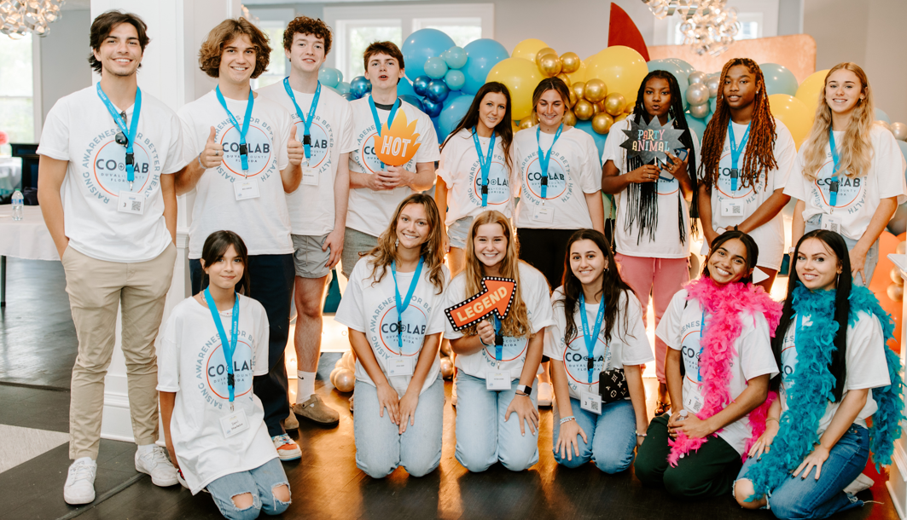
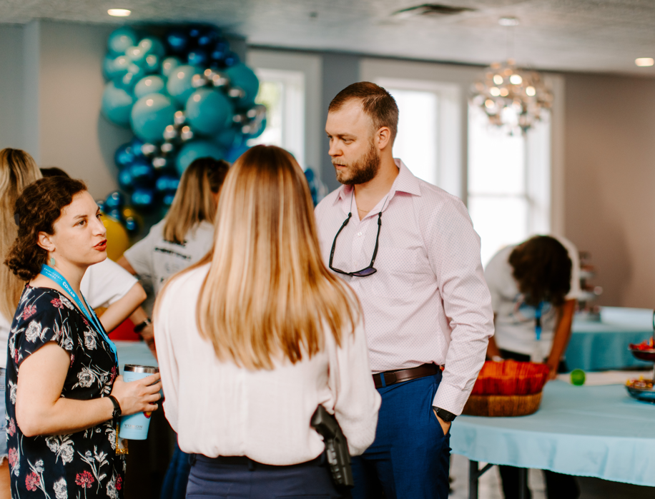
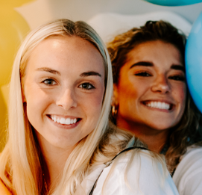
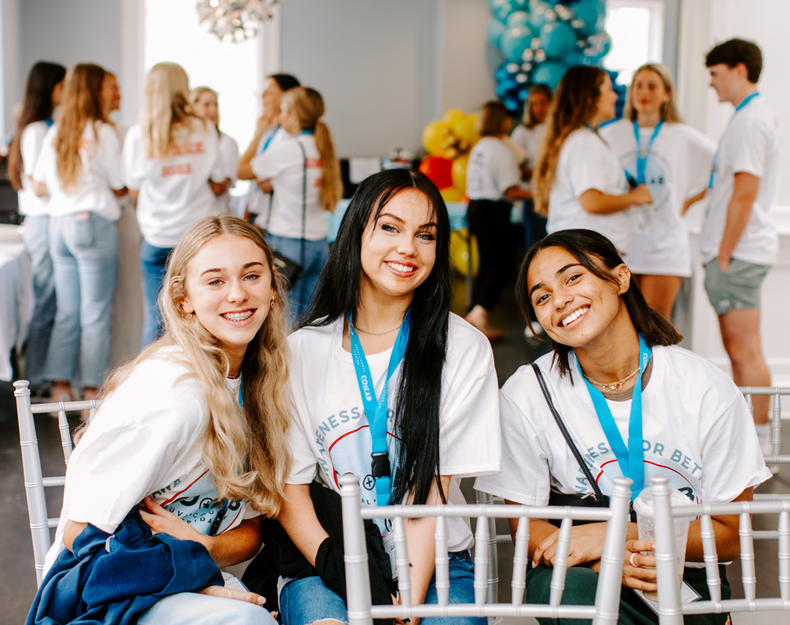
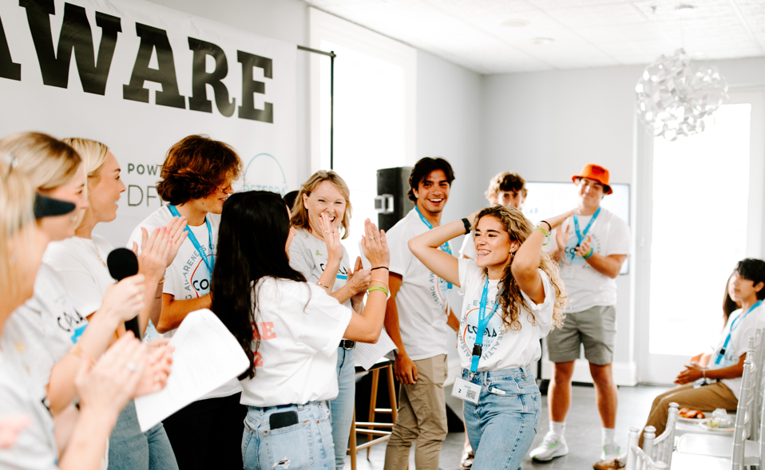
Summit 22: AWARE: Laced & Lethal

Slide 11
Year 2: Activate and Ambassadors
ADVOCACY
Social media strategy
Summit 2023

Slide 12
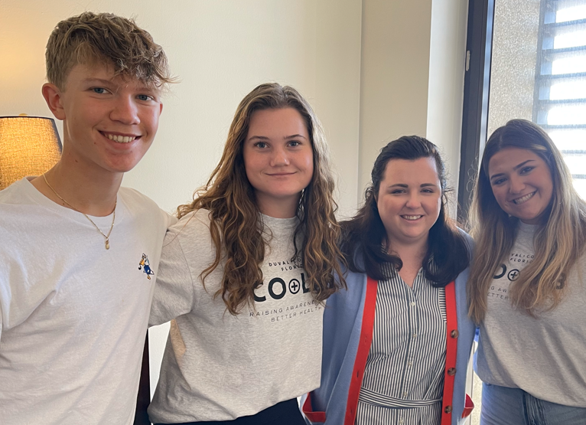
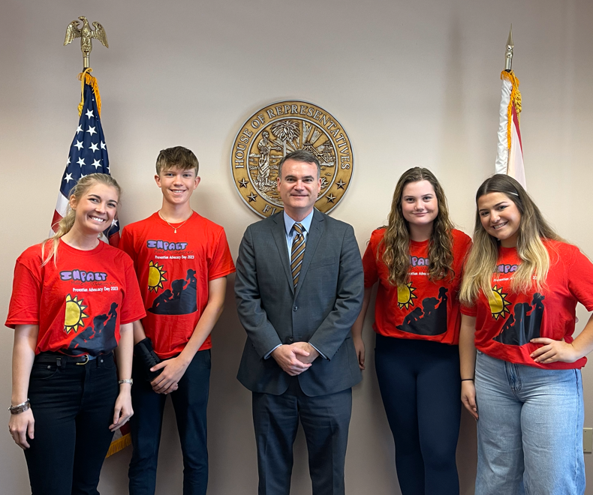
Advocacy Day ‘23
Notes:
This included weeks of preparation and action:
Advocacy training by Senator Bradley’s aide, Mary Dudley Lee and Drug Free America’s Amy Ronhasen.
Development of talking points to be used for general prevention and to address the specific risks of the hemp products and Delta 8.
A trip that started at 5:00 am from Jacksonville traveling over to Tallahassee and a day filled with meetings, talks, and encouragements for our legislators.
Passage of the Hemp Bill!

Slide 13
Social Media Strategy

Slide 14
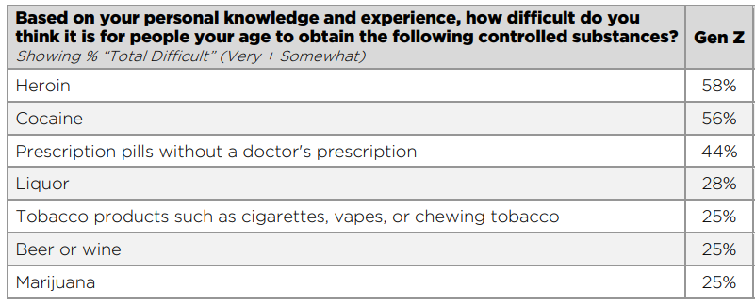
Why Social Media?
Notes:
Duval Co + Lab wanted to engage in a Social Media Project.
But why – isn’t social media just a mind-suck for our kids?
Here’s some of the rationale:
Song for Charlie, a national non-profit aimed at informing young people about the risk of fentanyl poisoning and overdose, conducted the second year of a survey. Nationwide sample of 1,500 Young Americans aged 13-24. Included n=612 Teens (ages 13-17) and n=888 Young Adults (ages 18-24). Gen Z includes all respondents ages 13-24, Teens refers to respondents ages 13-17, and Young Adults refers to respondents ages 18-24. Parental consent was required for minors between the ages of 13-17 before participation in the survey.
This survey is deep and wide, and we’ve only pulled out a couple key data around why the kids knew it was important to engage in social media
First…look at what kids ages 13-24 across the US said about the difficulty of obtaining various drugs…
Around drug use and other risk behaviors coupled with social media…youth experience:
Reduced perception of harm
Increased acceptability of use
Increased access

Slide 15
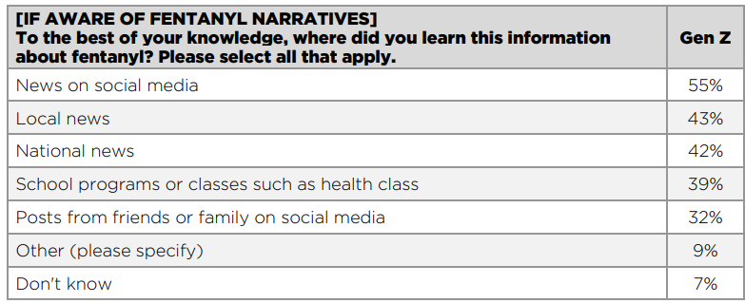
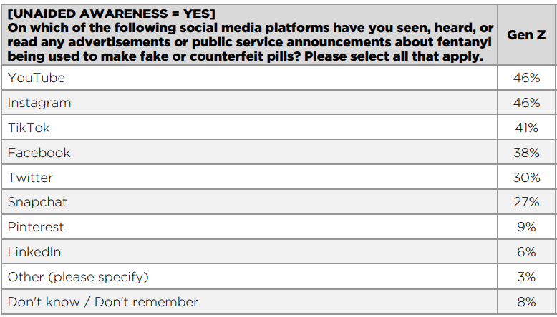
Data around social media and young people in the Us
Notes:
The survey shows the impact of social media on what our 13-24 year-olds know about an issue that can cost them their lives
And the next data shows where they have seen any advertisements OR PSAs about fentanyl in counterfeit pills

Slide 16
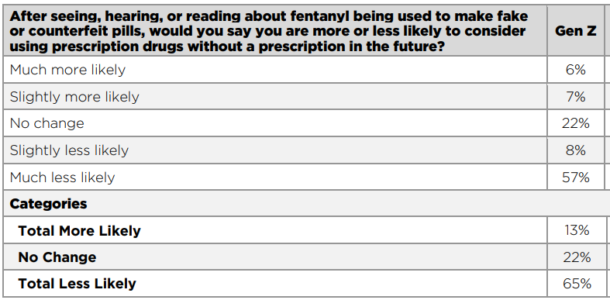
Social Media Messaging: The Impact
Notes:
Total LESS LIKELY to consider using a “prescription pill” without a prescription in the future after getting good information:
65%
We have to engage! What are the best ways? Let’s look at what the young people told us

Slide 17
How Gen Z Receives the Message Best
Notes:
64% - close to 2 or 3 people ages 13-24 – reported they could get the information BEST via social media in posts by prominent individuals and influencers.
And a close second was in advertising & PSAs on social media.

Slide 18
SUMMIT 2023
CONNECT at the roots

Slide 19
Getting to the root and Discovering solutions
Breakouts: Discover Root Causes
Academic & future pressure
Mental health challenges
Social pressure
Breakouts: Design Solutions
Report out and commit

Slide 20
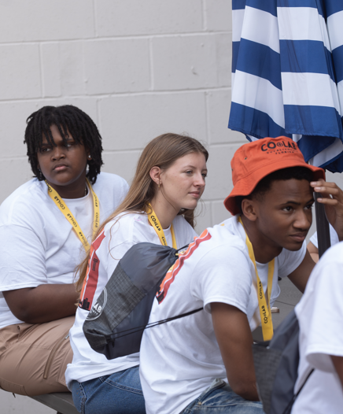
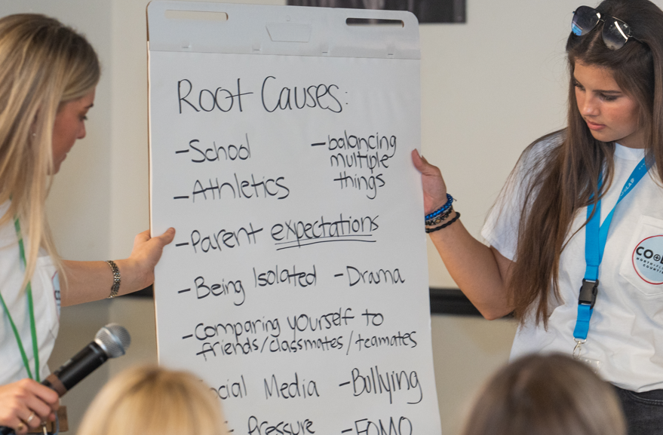
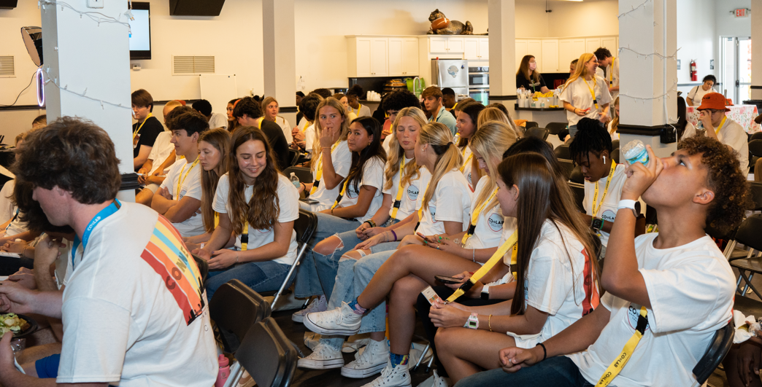
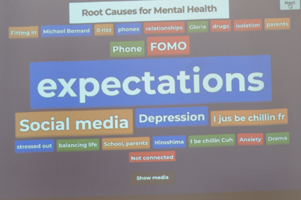
Summit 23: CONNECT at the roots

Slide 21
Year 3
Advocacy
Training & Education
Discovery Summit – fall 2024

Slide 22
And best of all…
The birth of Wolfson Co + Lab

Slide 23
Wolfson Co + Lab Leadership
Julia Leigh Allen Founder & President
Elizabeth Raine Lineberry Co-Founder & Vice President
Notes:
Julia and Raine take the podium
Why you wanted to start the club at Wolfson
What steps you had to take to get the club going
Permission from the school?
Sponsor? – was it hard to find one?
Decide on meeting dates and times

Slide 24
Getting the word out
Notes:
Julia and Raine:
Share the ways you communicated with students about the club!
Barriers in the beginning…the hurricane! (Had to move the first meeting)

Slide 25
Critical to determine…
Notes:
Julia and Raine:
First meeting happened and the classroom was full! We had standing room only.
We presented options of actions our group can take to work effectively in this critical area, including
Providing education and training to youth
Providing education and training to adults – our parents – and teachers and any others that will listen!
Participate as youth subject matter experts at either training events or on media spots
Advocate for policy and law change at the local and state level
Play a key role in any Summits the organization plans!

Slide 26
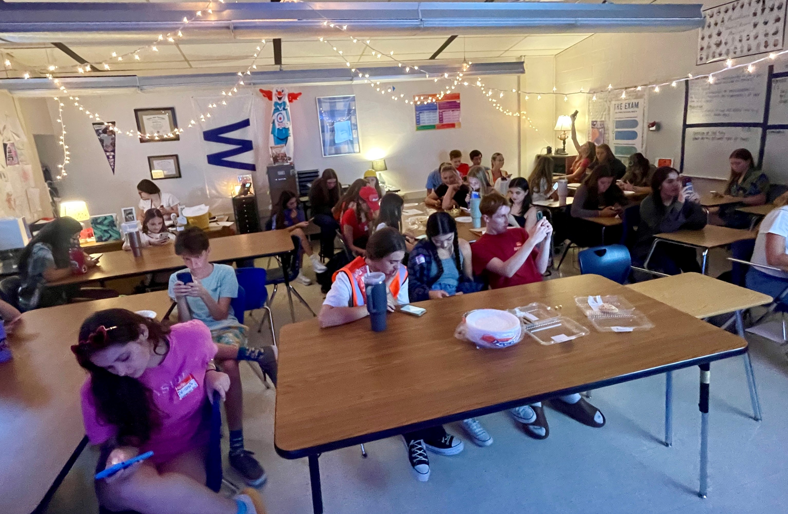
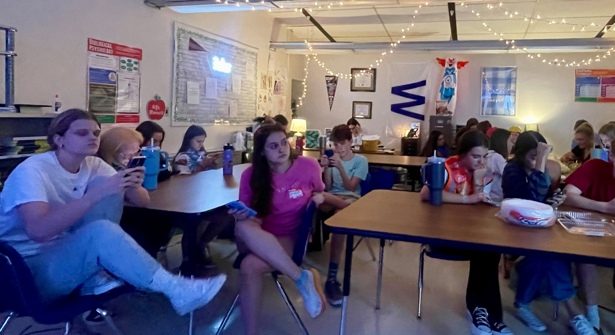
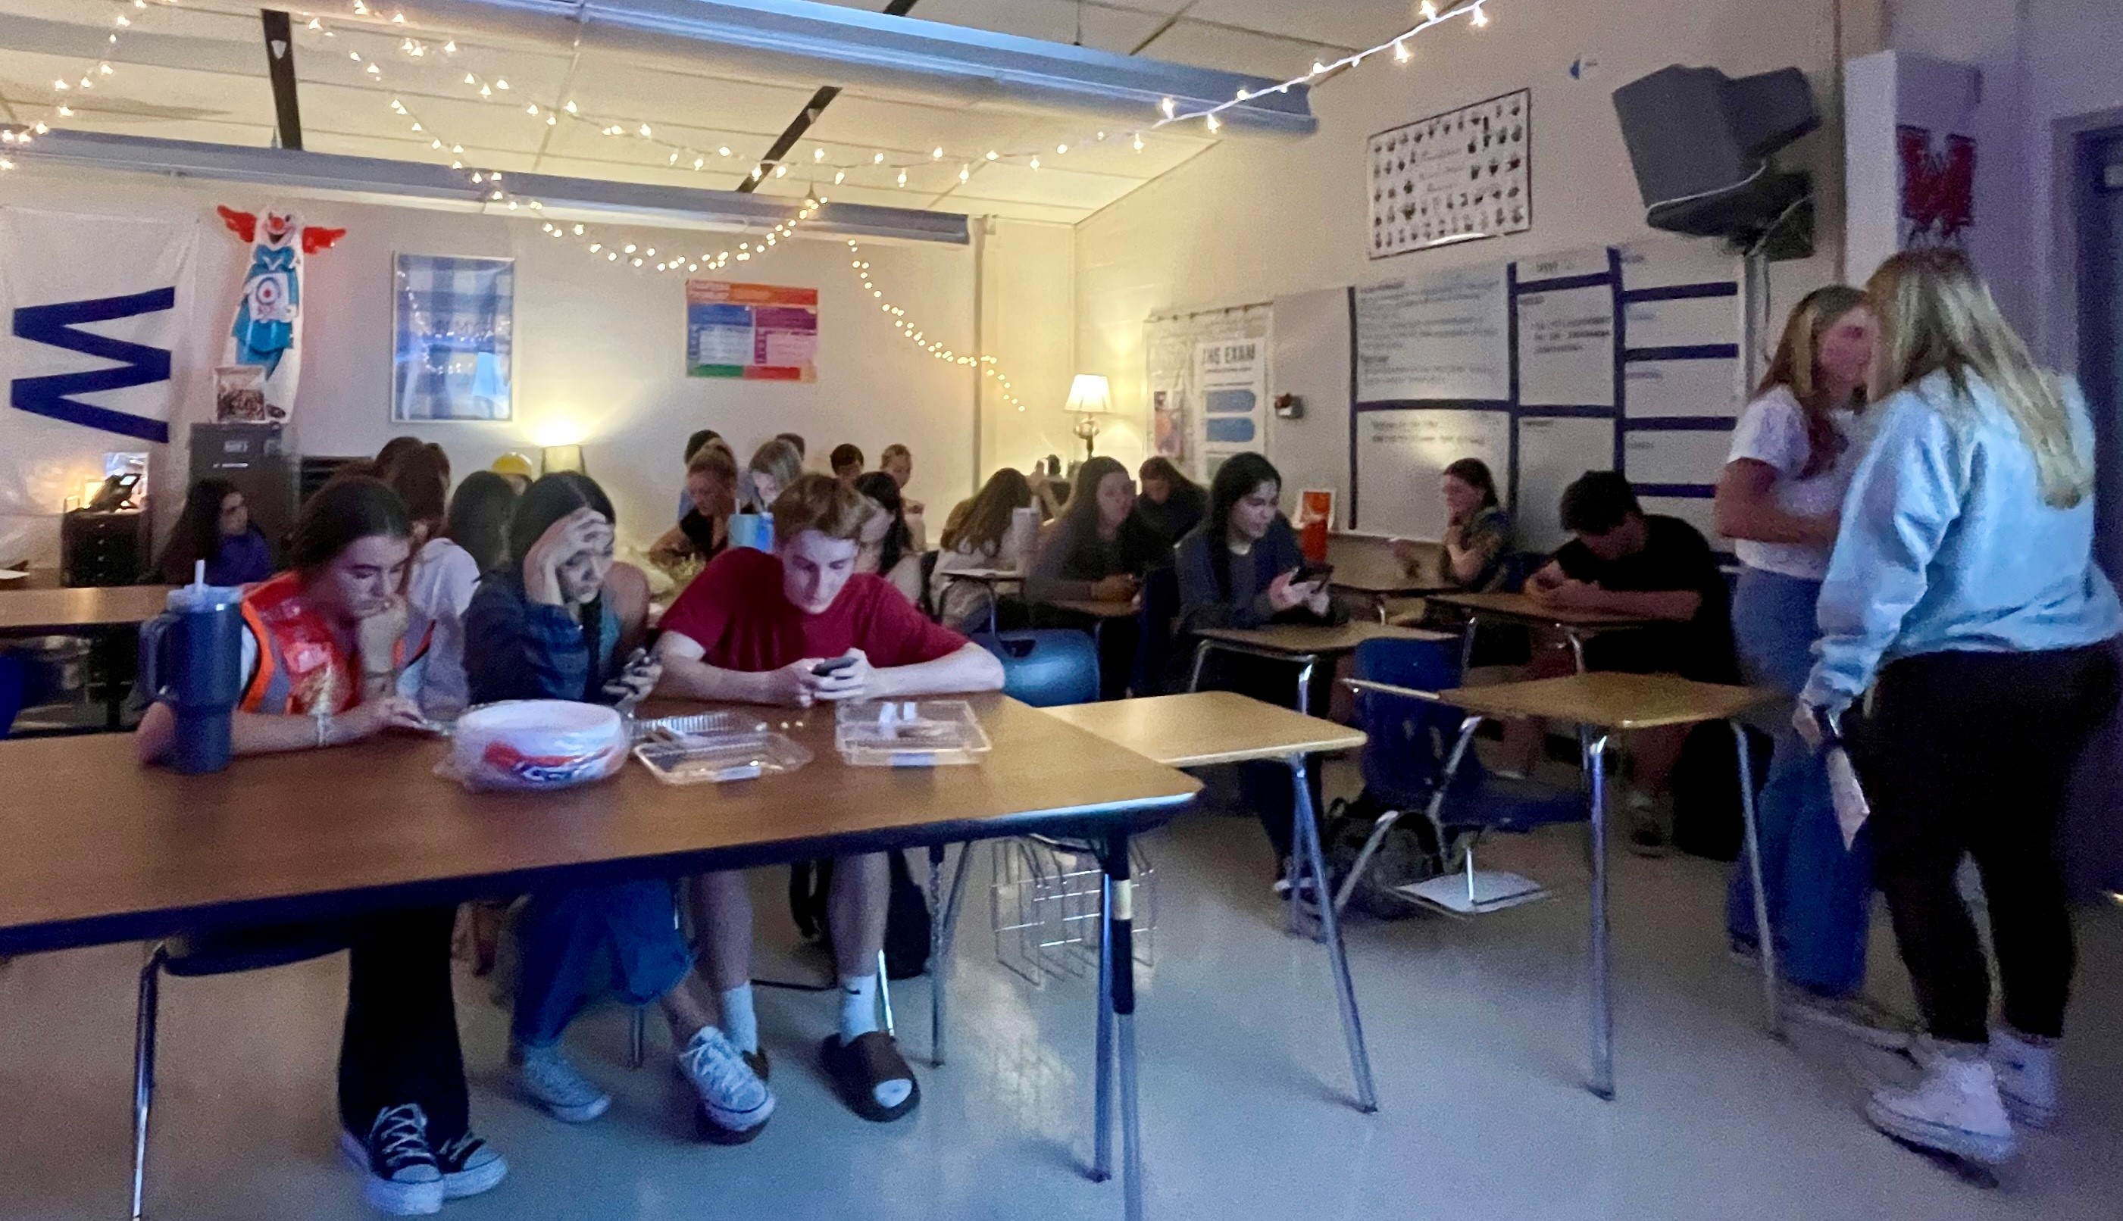
And here we go!

Slide 27
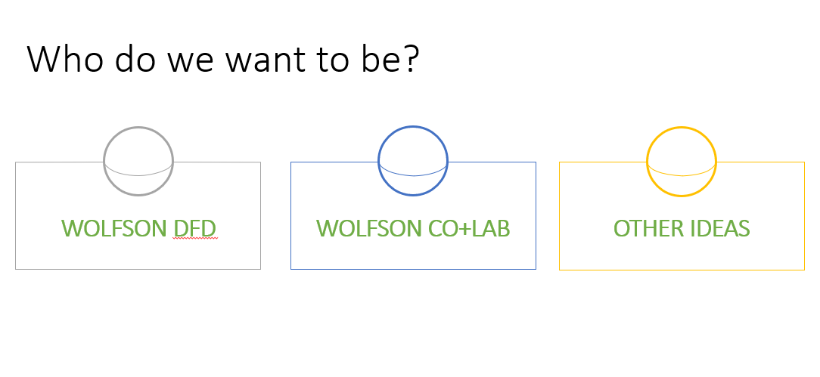
Notes:
Julia and Raine:
We knew it was important to finalize our identity as a club.
We shared ideas that we could be Wolfson DFD (concept is we are focused on freedom from substance abuse for all youth at Wolfson)
Wolfson Co Lab (concept is we are collaborating with other partners to raise awareness for better health throughout our area…and even across the US)!
Or we could come up with an alternate name!!
We decided to imbed the response to this discussion in a survey that we designed to also hone in on where we go from here. The outcomes are helping us design the club.

Slide 28
Survey responses
Notes:
Julia and Raine
The 33 people that responded to which substance they were most curious about showed us that our club members really wanted to know more about all the substances. The lowest percentages were more than 54% and the highest were 73%.
We need to bring good information about all these substances to our group.

Slide 29
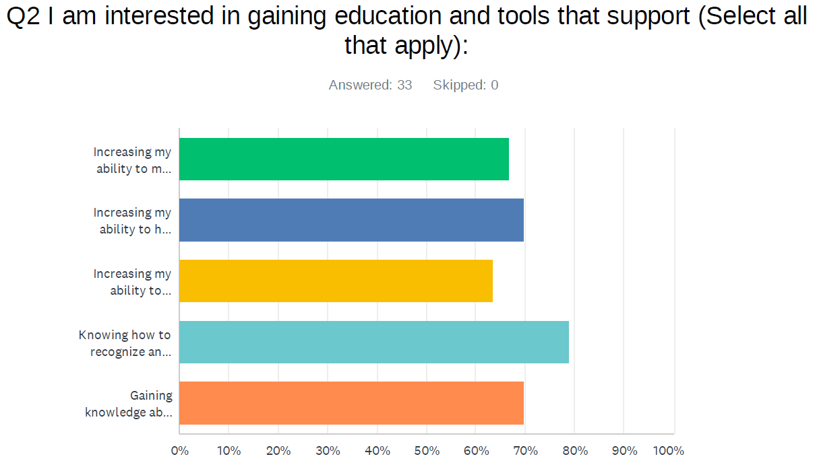
Survey responses
Notes:
Julia and Raine
We were really grateful to see the response to question 2. It says, “I am interested in gaining education and tools that support”…and these are the responses of Wolfson High School students:
Knowing how to recognize and respond to an overdose - this got the largest % with almost 79% responding to this
Increasing my ability to help someone I know struggling with substances – almost 70%
Gaining knowledge about resources for myself or someone else who is struggling with substances – almost 70%
Increasing my ability to make healthy choices – nearly 67%
Increasing my ability to create a safe environment for myself and others – almost 64%

Slide 30
Other survey outcomes
Top responses to why I or my friends use substances:
Mental Health issues
Social influence
Peer pressure
Family dysfunction
And an astounding
Of the Wolfson students responded that they believe their behavioral health choices can have an impact on their futures
Notes:
Julia and Raine:
A couple other questions have helped guide us. Given seven choices of why the respondent or a friend uses substances, the top four were:
Mental health issues
Social influence
Peer pressure
Family dysfunction
And 100% of the respondents indicate that they believe their behavioral health choices today can have an impact on their future lives.

Slide 31
The first year’s work so far…
We have done some training and education:
Natural high
Delta 8
Advocacy
Upcoming: Social media for social good
Embarked on an advocacy project, writing letters to legislators specifically to identify the hope of banning Delta 8.
IF THE GOVERNOR SIGNS THE BILL THAT PASSED, DELTA 8 WILL BE BANNED IN FLORIDA AS OF 10/1/2024!
Notes:
Julia and Raine:
It’s been a great first year and we’re only part way through.
We have provided training and education on Natural high, Delta 8, and Advocacy. We have an upcoming training to present on social media for social good.
We targeted the banning of Delta 8 in an advocacy project…and the bill passed the Senate unanimously and the House by a large majority! Hopefully the Governor will sign it soon – and if so it will go into effect on 10/1/24!

Slide 32
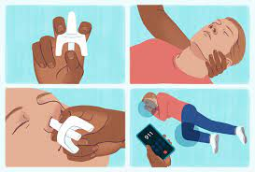
Opioid Overdose & Narcan Admin training
In response to the student’s #1 goal to get education and training, we got okayed to provide the Opioid Overdose and Narcan Administration training & give a Narcan kit to teens with parental permission!
We have a barrier
to overcome…
The kids want to be able to carry the Narcan at all times. Now we are embarking on changing DCPS policy!
Notes:
Julia and Raine:
As you may remember seeing from the survey, the students wanted MOST to learn to identify an opioid overdose and know how to respond to it. SO…we have gotten permission to provide the Opioid Overdose and Narcan Training to the students and we’re even allowed to provide the trainees with Narcan kits after they take the training.
BUT…DCPS policy does not permit the kids to carry it at school. So now, led by our efforts, DCPS is working toward changing that policy to allow students who have completed the training to carry their Narcan whenever and wherever. Drug Free Duval is also working with us on this and we’ll let you know how it goes! Sally, Susan, will you join us as we wrap up?

Slide 33
Planning for 24-25
PARENT STRATEGY:
Screening of Screenagers at 3 locations
Establish a parent group
Provide education and training and tools that address the most common reasons youth use substances
DISCOVERY SUMMIT 2024
Youth panel on mental health and substance abuse
Breakouts for parents & youth (separately)
Andy Duran of LEAD presentation on AI and social media
Breakouts for parents & youth
Notes:
Julia and Raine:
We will continue to work with our Wolfson Co + Lab members and the DFD team to craft next year’s strategies based on data and needs of our members. Some of our strategies will be with Duval Co + Lab and some will be separate.
Susan and Sally:
Rolling out clubs in additional schools with the help of Julia and Raine!
Parent Strategy
Discovery Summit

Slide 34
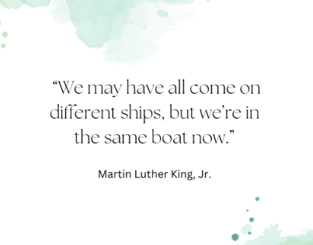
Sally Finn, sally@dfdjax.org
Susan Pitman, susan@dfdjax.org
Hannah Schaper, Hannah@dfdjax.org
Notes:
Questions for any of us?

