Slide 1
Florida’s Marijuana
Challenges of Today

Slide 2
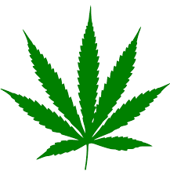
Marijuana
For over a decade, laws regulating the distribution and use of marijuana have evolved (state & federal levels)
It has a Schedule I classification (since 1970s) under the Controlled Substances Act (CSA)
Carries a high risk of misuse
Lack of accepted safety for use
It remains a federal offense

Slide 3
Medical Marijuana
June 26, 2014: Compassionate Medical Cannabis Act
Permitted those suffering from muscle spasms, cancer, epilepsy, and chronic seizures to use low-THC cannabis products recommended by qualified physicians. In
2016: Expanded the Right to Try Act
Permitted qualified doctors to prescribe full-strength marijuana to patients with terminal illnesses.
2017: Senate Bill 8A
Expanded the qualifying conditions under the Florida medical marijuana program
NOTE: Florida's medical marijuana program is administered by the state's Department of Health's Office of Medical Marijuana Use (OMMU).

Slide 4
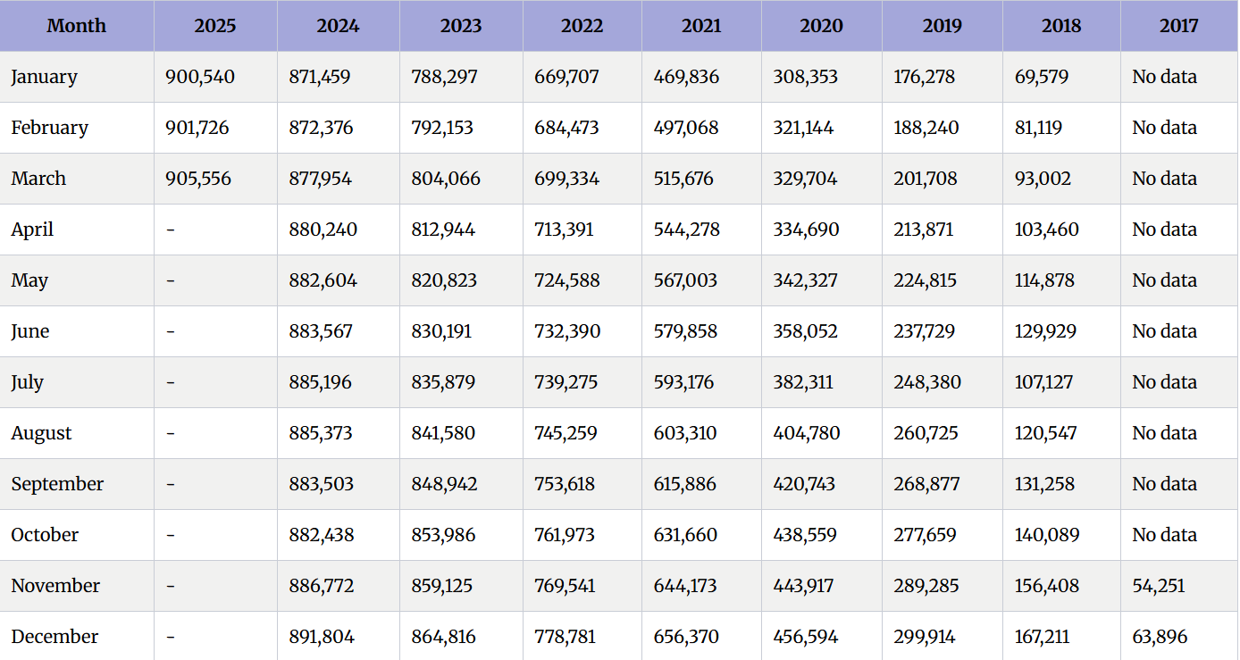
Registered With Medical Marijuana Card - Florida

Slide 5
Agricultural Improvement Act 2018 (AIA) – Farm Bill
Hemp (thc .3%) was deemed agricultural product
This legalized the sale and production of hemp
products are marketed as “legal hemp” and sold in places like gas stations, smoke shops, bodegas, and online

Slide 6
Farm Bill
Loophole: Hemp definition: “the plant Cannabis sativa L. and any part of that plant, including the seeds thereof and all derivatives, extracts, cannabinoids, isomers, acids, salts, and salts of isomers, whether growing or not, with a delta-9 tetrahydrocannabinol concentration of not more than 0.3 percent on a dry weight basis”

Slide 7
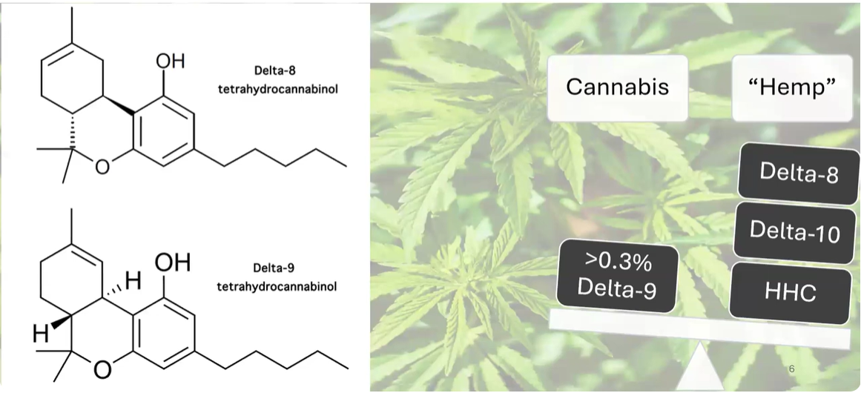

Slide 8
Hemp Vs Marijuana
 | Hemp | Marijuana
Cannabis | √ | √
THC Content | Less than .3% | > .3%
Psychoactive | No | Yes
Predominant Cannabinoid | CBD | THC
Uses | Food & Non-Food | Medical or Recreational

Slide 9
CANNABIDIOL​
CBD is short for cannabidiol, and it's one chemical compound found in the Cannabis sativa plant — in both marijuana and hemp. CBD differs from THC (tetrahydrocannabinol) because it doesn't cause the intoxicating, euphoric “high” associated with marijuana. CBD products come in oils, edibles, topical creams, capsules, and beverages.​

Slide 10
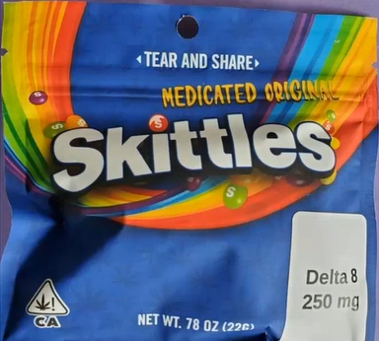
Delta 8
Synthesized from CBD/ hemp
Legal because – loophole in Farm Bill
Available at: gas stations, convenience stores, smoke shops, CBD shops, health food stores, restaurants, & online
Intoxicating effects similar to delta-9-THC (active ingredient in marijuana)
No regulatory oversight
NOTE: Most products are not pure and contain many other compounds
Other isomers: Delta 10 THC, THC-O
https://cen.acs.org/biological-chemistry/natural-products/Delta-8-THC-craze-concerns/99/i31

Slide 11
FDA Delta 8 Warning
Delta-8 THC products have not been evaluated or approved by the FDA for safe use
The FDA has received 104 adverse event reports involving delta-8 THC-containing products.
55% required intervention (e.g., evaluation by emergency medical services) or hospital admission
Adverse events included, but were not limited to: hallucinations, vomiting, tremor, anxiety, dizziness, confusion, and loss of consciousness
https://www.fda.gov/consumers/consumer-updates/5-things-know-about-delta-8-tetrahydrocannabinol-delta-8-thc

Slide 12
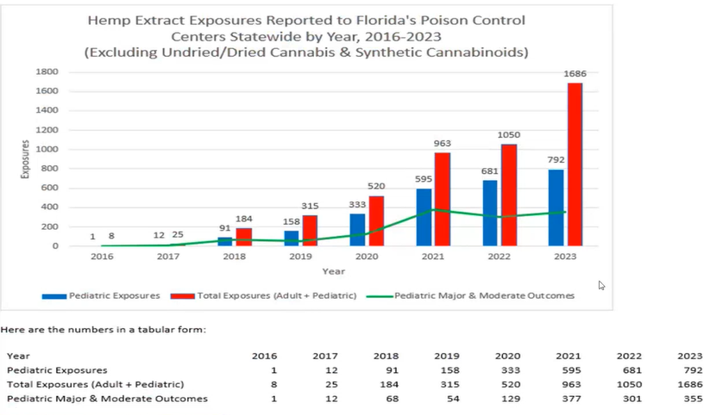

Slide 13
National Poison Control Centers
Received 2,362 exposure cases of delta-8 THC products between 1/2021 and 2/2022.
58% involved adults, 41% involved pediatric patients (< 18 years old).
40% involved unintentional exposure to delta-8 THC; 82% of these unintentional exposures affected pediatric patients.
70% required healthcare facility evaluation (8% resulted in admission to a critical care unit; 45% of patients requiring healthcare facility evaluation were pediatric patients)
One pediatric case was coded with a medical outcome of death.

Slide 14
Florida Poison Control Centers
Received 1,731 calls related to hemp extract exposures in 2022
Received 2,478 calls in 2023
43% increase.
Preliminary 2024 Poison Center data shows a significant increase from 2023.

Slide 15
What We Know…
Delta-8 THC products have not been evaluated or approved by the FDA for safe use and may be marketed in ways that put public health at risk.
Delta-8 THC has psychoactive and intoxicating effects.
Delta-8 THC products often involve use of potentially harmful chemicals.

Slide 17
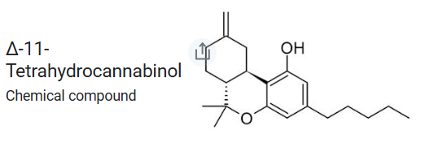
Shares same chemical formula, but has a different arrangement of atoms
Said to be a more potent & longer lasting high

Slide 18
Florida Youth Substance Abuse Survey
2024
Participation from 346 middle schools and 306 high schools.
Final sample size is 44,755 across grades 6 through 12.
75.1% administered online and 24.9% with booklets.
Regional Participation:
Middle School: 7,152
High School: 6,794

Slide 19
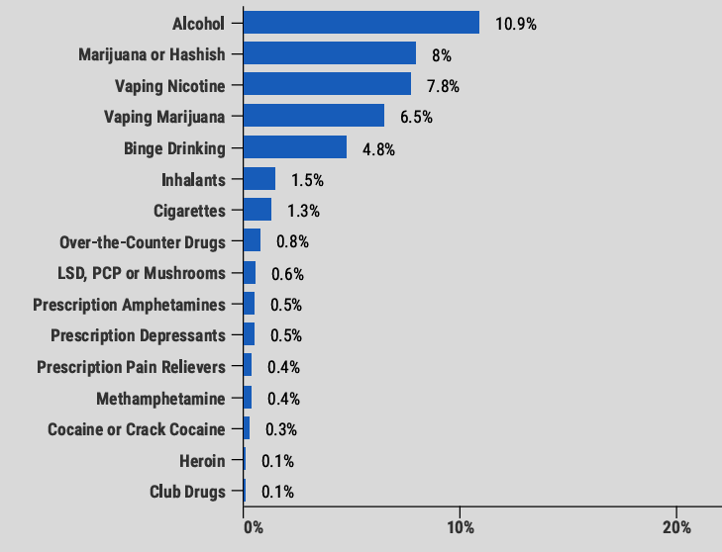
Past 30 day Use

Slide 20
Past 30 Day Use – 2024
 | Florida | Region | Dixie | Hamilton | Baker | Citrus | Putnam | Duval
Delta Lifetime | 8.7% | 10.2% | 15.2% | 10.4% | 10.7% | 15.8% | 8.4% | 7.8%
Vaping Marijuana | 5.5% | 6.5% | 14% | 5.4% | 6.8% | 9.6% | 5.4% | 5.9%
Marijuana or Hashish | 6.3% | 8% | 13.1% | 2.9% | 8% | 11% | 6% | 8.1%

Slide 21
Middle School Past 30 Day Use – 2024
 | Florida | Region | Dixie | Hamilton | Baker | Citrus | Putnam | Duval
Vaping Marijuana | 2.2% | 2.7% | 8.5% | 5.2% | 3.3% | 2.9% | 4.2% | 2.6%
Marijuana or Hashish | 2.4% | 3.3% | 7% | 5.3% | 4.4% | 3.7% | 3.9% | 3.5%

Slide 22
High School Past 30 Day Use – 2024
 | Florida | Region | Dixie | Hamilton | Baker | Citrus | Putnam | Duval
Delta Lifetime | 8.7% | 10.2% | 15.2% | 10.4% | 10.7% | 15.8% | 8.4% | 7.8%
Vaping Marijuana | 7.8% | 9.4% | 18.2% | 5.6% | 9.5% | 14.6% | 6.4% | 8.5%
Marijuana or Hashish | 9.1% | 11.6% | 17.8% | 1.1% | 10.5% | 16.5% | 7.8% | 11.8%

Slide 23
Trends – Store Sold Items of Concern

Slide 25
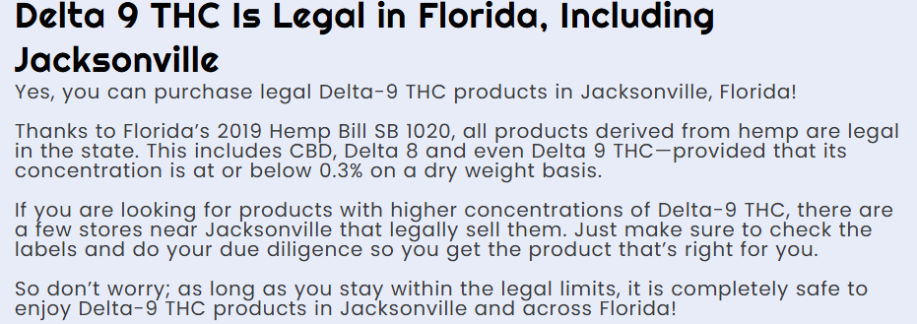

Slide 27
How is it Showing Up?
Edibles/ Candies
Vape Products/ Carts
Flower (Smokable)
Oils
Capsules
Beverages
Chips
Cereals
Inhalers

Slide 28
DELTA 8/9/10/11​
Notes:
Delta-8 THC (Δ8-THC) is a natural cannabinoid with psychotropic properties that is derived from industrial hemp as opposed to marijuana. The most commonly known cannabinoid, referred to as THC, can be broken down by molecular structure to Δ9-THC (marijuana) and Δ8-THC (hemp). ​
​
Wait a second, isn’t THC federally illegal and illegal in most states? Yeah, we get this question a lot. This question can be answered in just a few words; The 2018 Farm Bill. When this bill was signed into law in late 2018, it federally legalized all Hemp products which contain less than 0.3% Delta 9-THC (the illegal one). And with huge advances in Hemp science, scientists have figured out how to concentrate the Delta 8-THC content in Hemp while at the same time minimize the Delta 9-THC content to under the legal limit. This leaves us with a Hemp extract oil that is anywhere from 90%-98% pure Delta 8-THC, while keeping the Delta 9-THC percentage at essentially 0%. ​
Delta-8 THC is synthesized from CBD/ hemp​
Legal because of loophole in Farm Bill​
Sold in gas stations, convenience stores, smoke shops, CBD shops, health food stores, restaurants, online ​
Produces intoxicating effects similar to delta-9-THC (active ingredient in marijuana)​
No regulatory oversight​
Most hemp extracts sold as delta-8-THC are not pure and contain many other compounds​
​
Types of Delta Products:​
Edibles/ Candies​
Vape Products/ Carts​
Flower (Smokable)​
Oils​
Capsules​
Beverages​
Chips​
Cereals​
Inhalers​
​
​

Slide 29
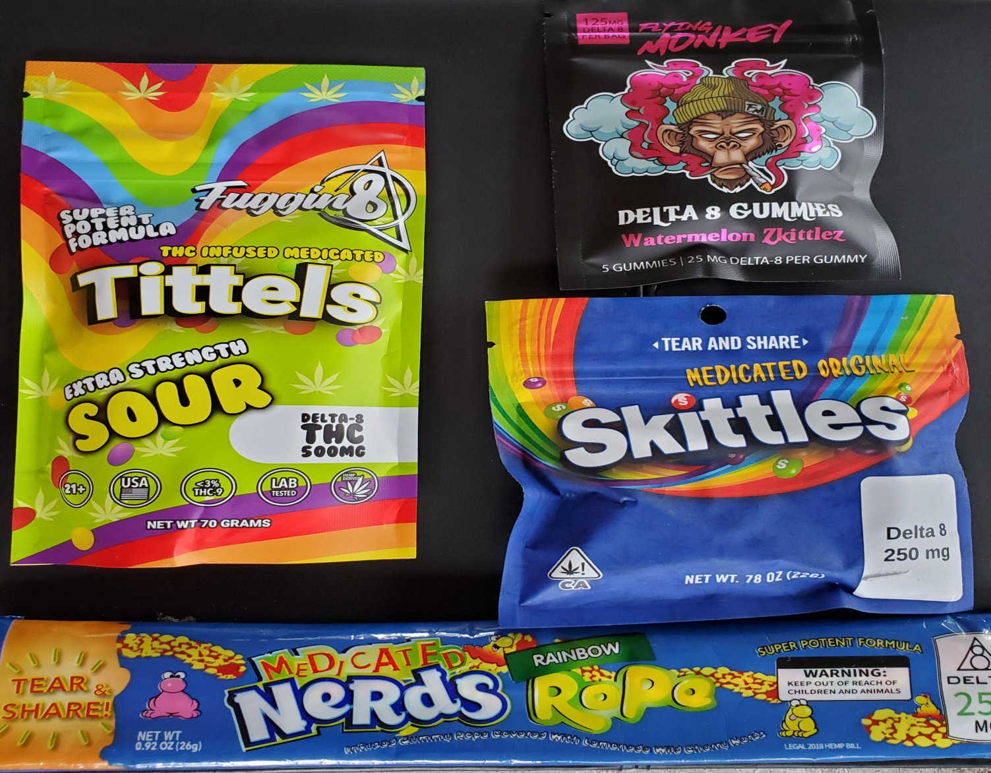
Candy Form

Slide 30
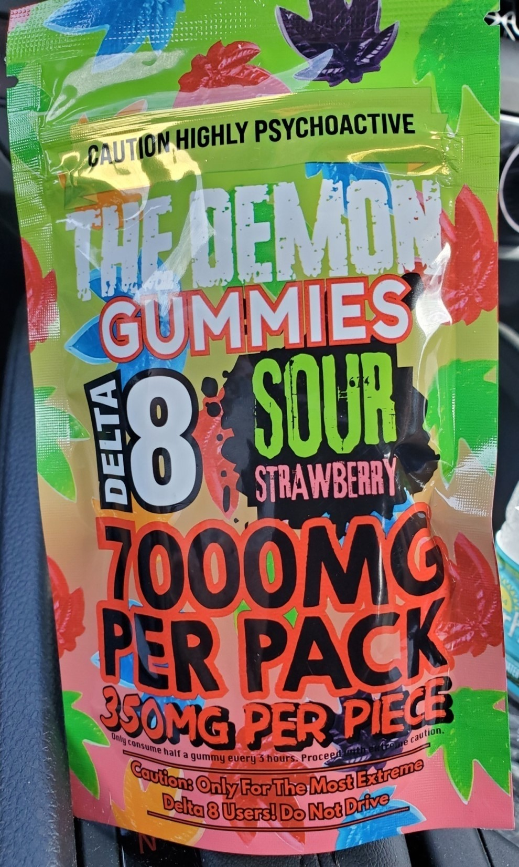
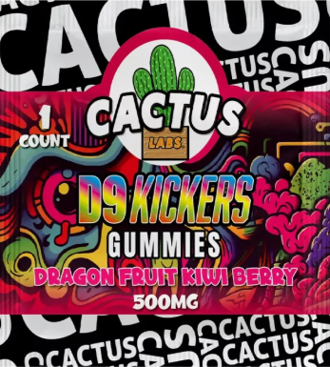
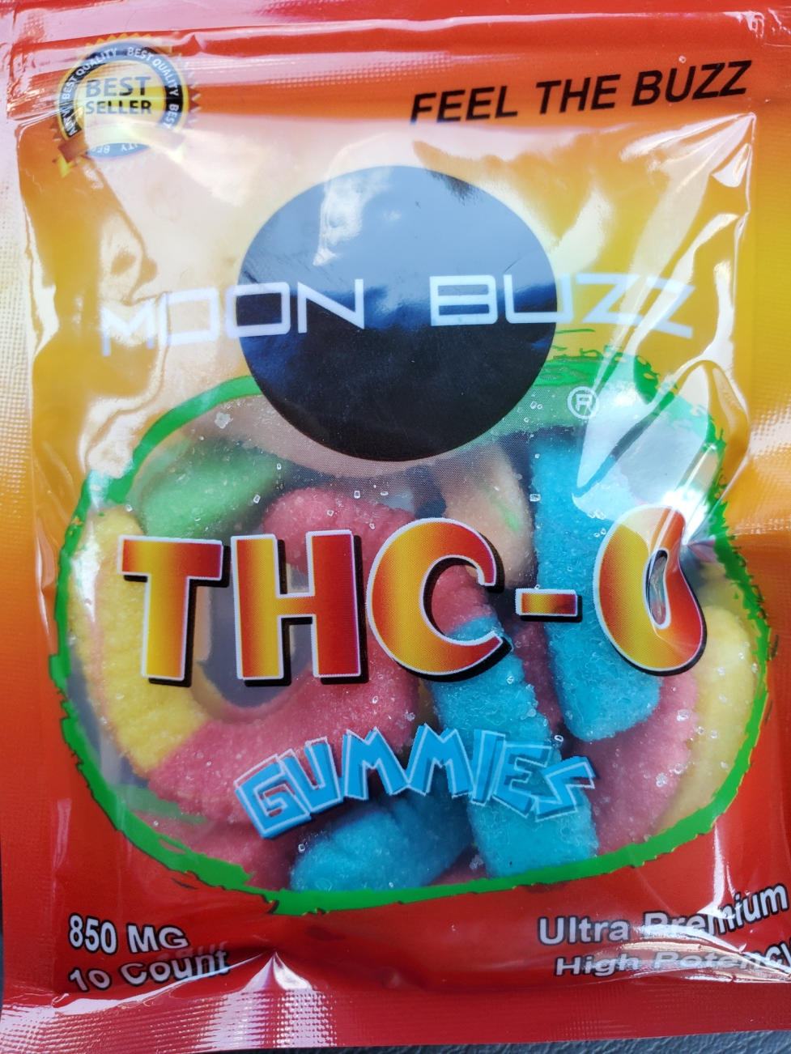
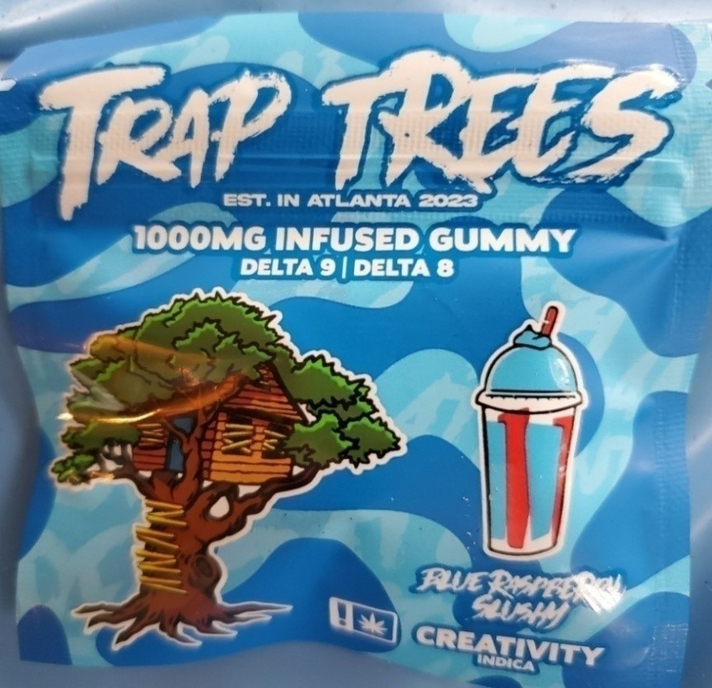
Gummies

Slide 31
VAPING
Notes:
Vaping is the act of inhaling and exhaling the aerosol, often referred to as vapor, which is produced by an e-cigarette or similar device. The term is used because e-cigarettes do not produce tobacco smoke, but rather an aerosol, often mistaken for water vapor, that consists of fine particles. ​
​
E-cigarettes are battery-operated device that is typically designed to resemble a traditional cigarette and is used to inhale a usually nicotine containing vapor.​
​
Juul is an e-cigarette, or electronic cigarette, which means it vaporizes nicotine and is battery-charged. The e-cigarette produces a vapor instead of smoke, and is one alternative for adults who wish to stop smoking regular cigarettes.​
​
The difference between Juuling and vaping is very small, but there is a difference. Vape is a slang term for the vaporizer used in e-cigarettes, and vaping refers to using a vaporizer or e-cigarette to inhale a vapor that contains nicotine. Juuling refers to using a Juul and is a method of vaping. ​

Slide 32
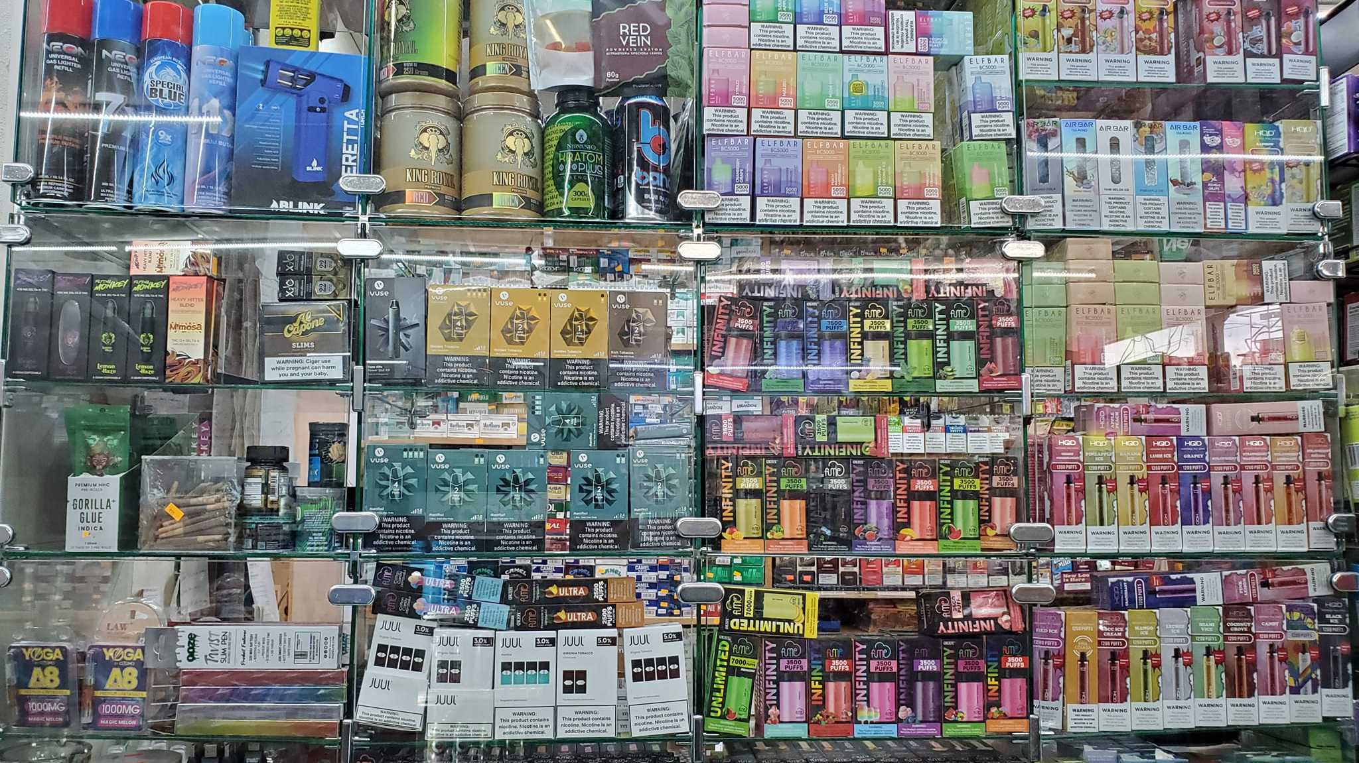

Slide 33
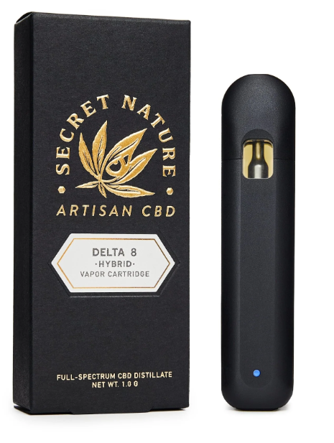
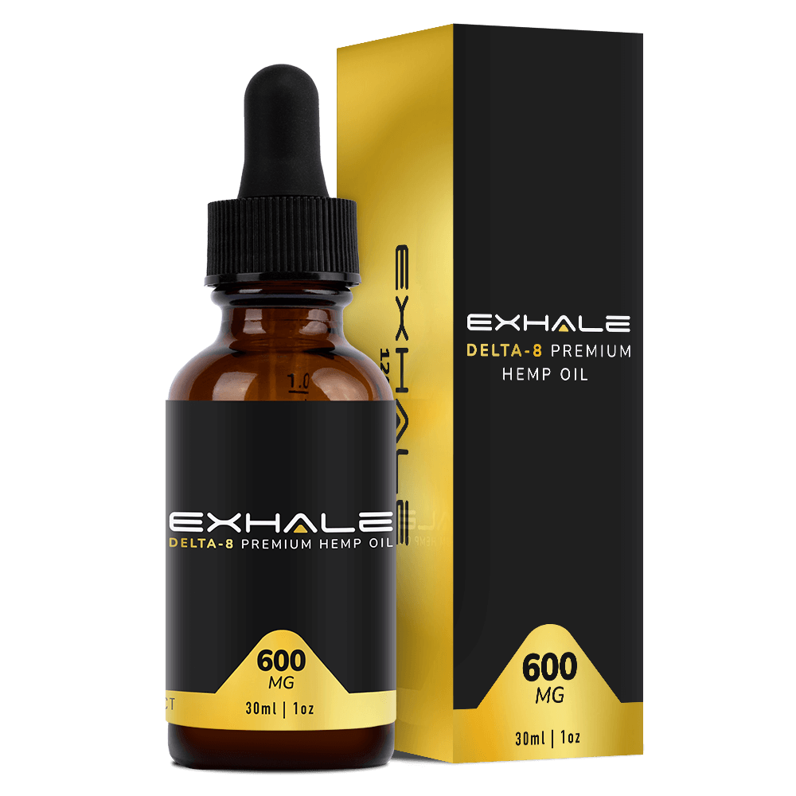
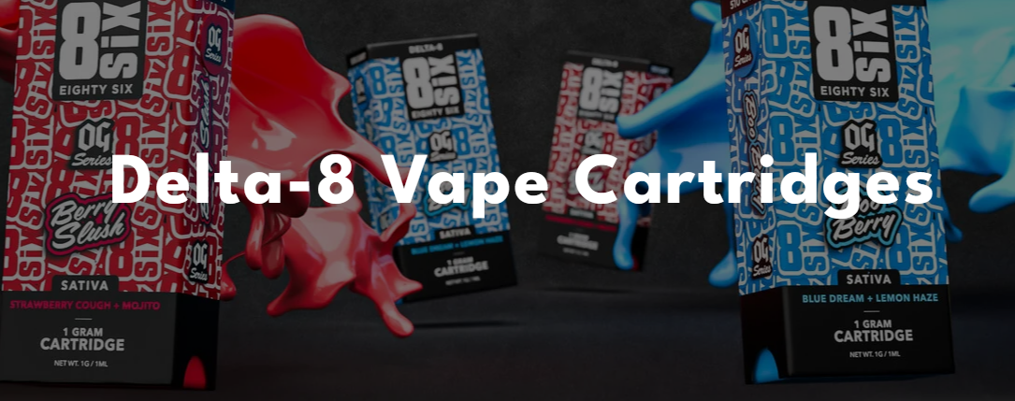
Vape Pens & Oils

Slide 34
VAPING
Florida Attorney General’s Office Launches Nicotine Dispensing Device Directory, Gives Retailers Until March 1 to Remove Listed Products
Nicotine Dispensing Devices | My Florida Legal
Notes:
Vaping is the act of inhaling and exhaling the aerosol, often referred to as vapor, which is produced by an e-cigarette or similar device. The term is used because e-cigarettes do not produce tobacco smoke, but rather an aerosol, often mistaken for water vapor, that consists of fine particles. ​
​
E-cigarettes are battery-operated device that is typically designed to resemble a traditional cigarette and is used to inhale a usually nicotine containing vapor.​
​
Juul is an e-cigarette, or electronic cigarette, which means it vaporizes nicotine and is battery-charged. The e-cigarette produces a vapor instead of smoke, and is one alternative for adults who wish to stop smoking regular cigarettes.​
​
The difference between Juuling and vaping is very small, but there is a difference. Vape is a slang term for the vaporizer used in e-cigarettes, and vaping refers to using a vaporizer or e-cigarette to inhale a vapor that contains nicotine. Juuling refers to using a Juul and is a method of vaping. ​

Slide 35
VAPING
Is designed to be attractive to minors, such as through the use of bright colors or cartoon characters;
Is designed so that it is easy for minors to use and to conceal;
Uses or resembles the trade dress of a branded food product, consumer food product, or logo of a food product;
Is marketed in a manner that uniquely appeals to minors; or
Uses actual copyrights, service marks, or trademarks or fake copyrights, service marks, or trademarks that resemble consumer or food products popular with minors, including the names of candy or cereal products.
Notes:
Vaping is the act of inhaling and exhaling the aerosol, often referred to as vapor, which is produced by an e-cigarette or similar device. The term is used because e-cigarettes do not produce tobacco smoke, but rather an aerosol, often mistaken for water vapor, that consists of fine particles. ​
​
E-cigarettes are battery-operated device that is typically designed to resemble a traditional cigarette and is used to inhale a usually nicotine containing vapor.​
​
Juul is an e-cigarette, or electronic cigarette, which means it vaporizes nicotine and is battery-charged. The e-cigarette produces a vapor instead of smoke, and is one alternative for adults who wish to stop smoking regular cigarettes.​
​
The difference between Juuling and vaping is very small, but there is a difference. Vape is a slang term for the vaporizer used in e-cigarettes, and vaping refers to using a vaporizer or e-cigarette to inhale a vapor that contains nicotine. Juuling refers to using a Juul and is a method of vaping. ​

Slide 36
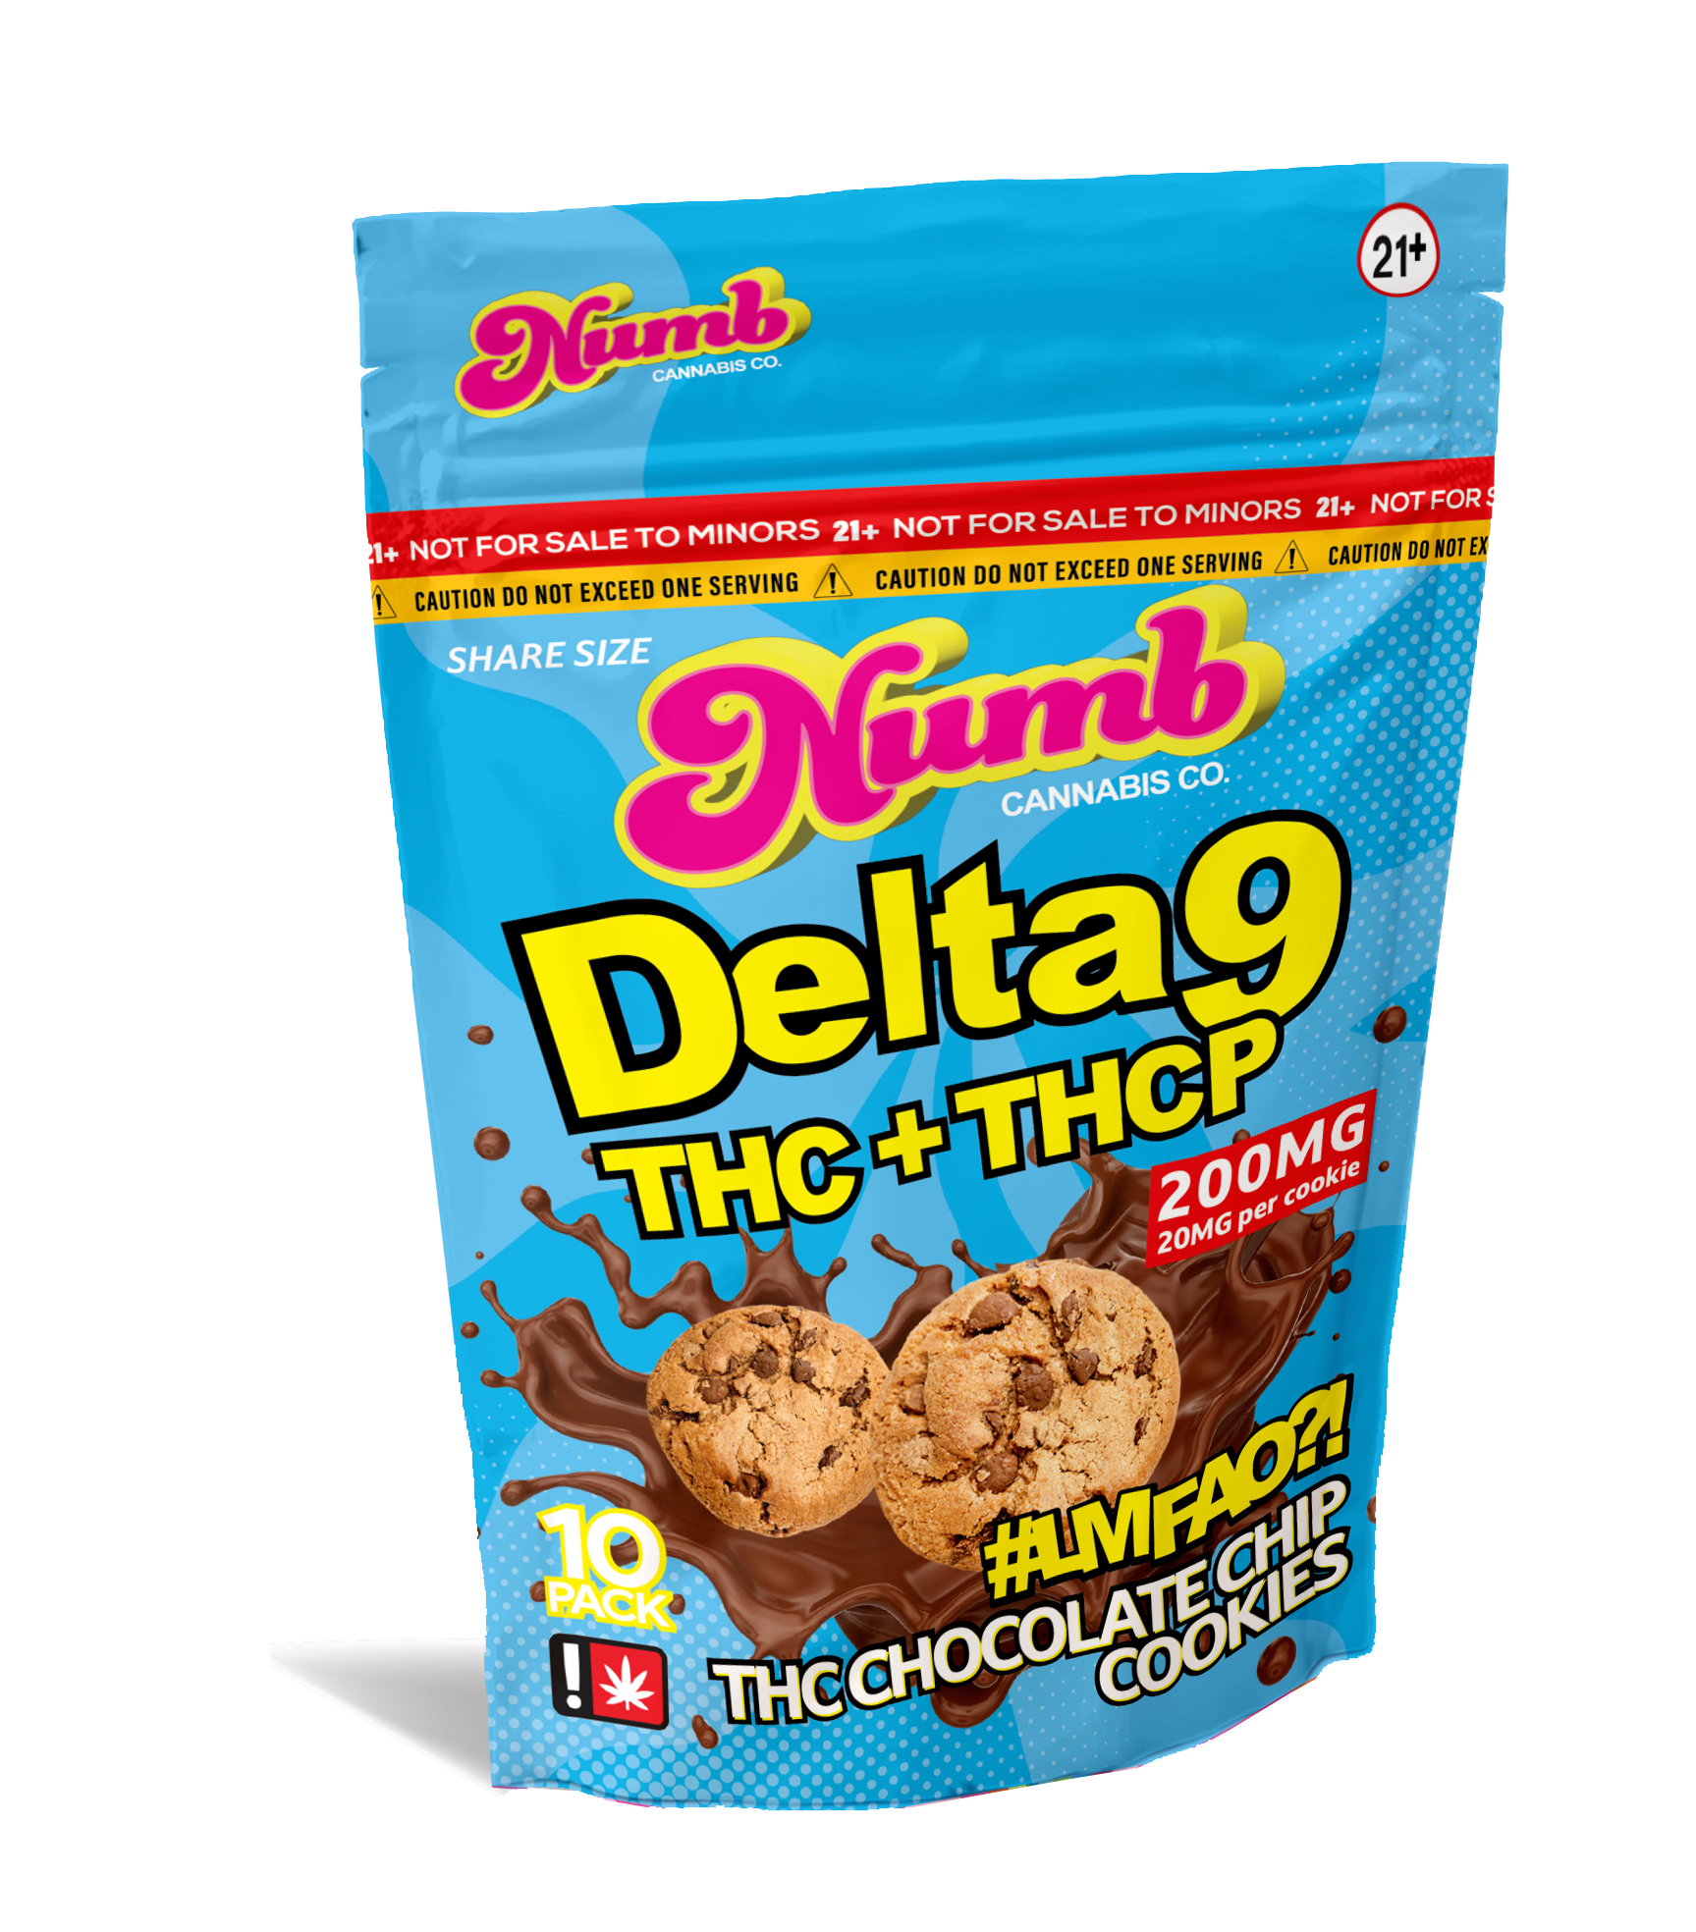
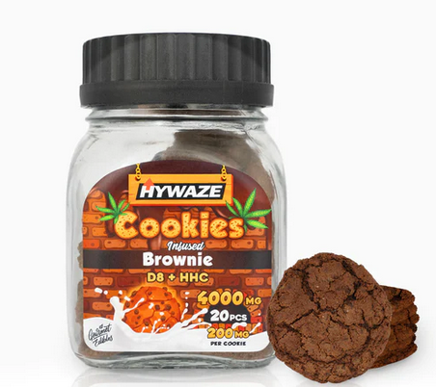
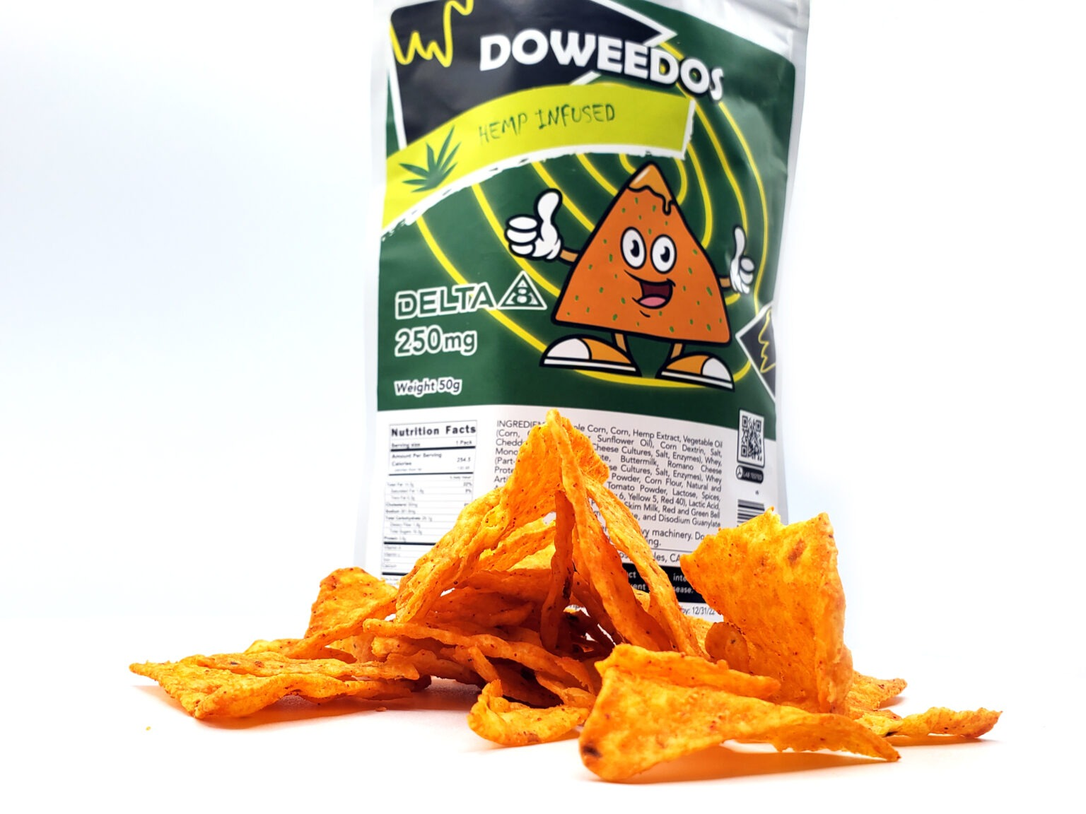
Other Snacks

Slide 37
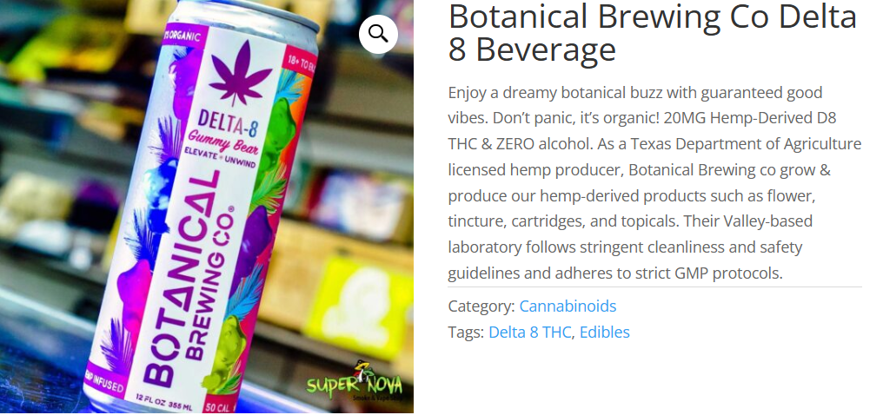
Drink Form

Slide 38
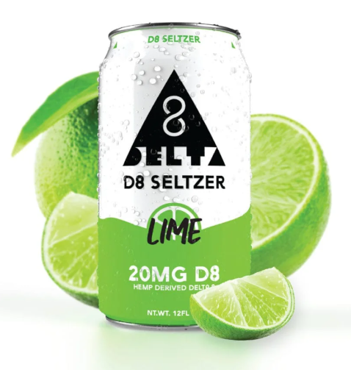
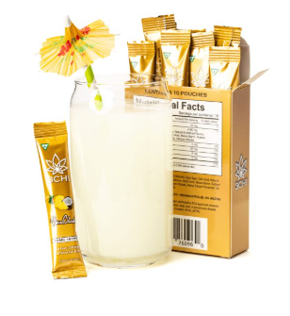
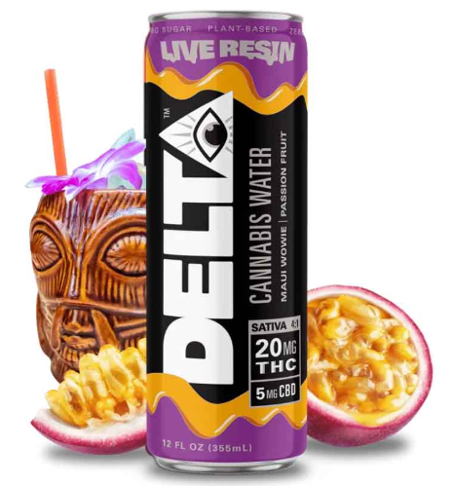
Delta 8
Delta 9 Mix

Slide 39
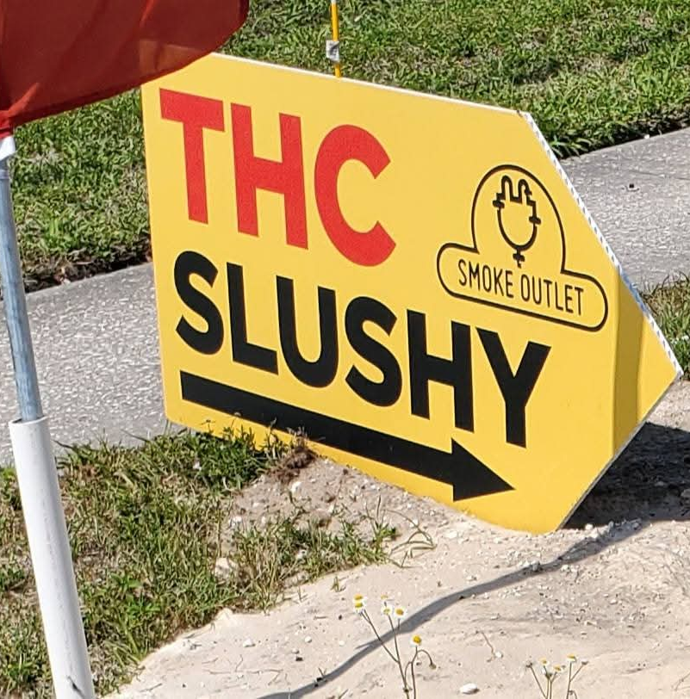
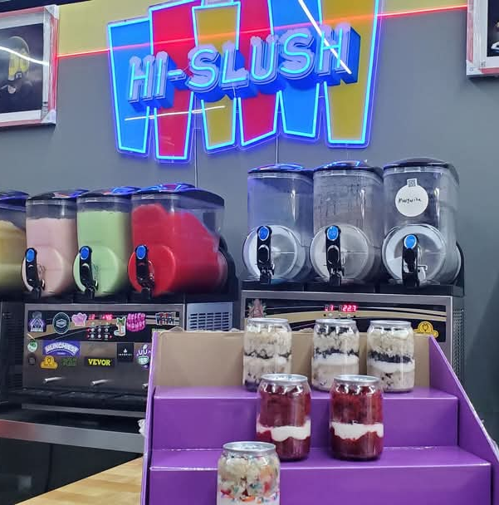

Slide 40
Why Does this Matter, Especially with Youth?
Psychological Effects: anxiety, paranoia, etc…
Physical Health Risk
Cognitive Development
And A lot Still Unknown

Slide 41
Hemp bill SB 438
The bill aims to limit the amount of THC in THC-infused beverages and require retailers to have liquor licenses to sell them.
It aims to restrict the packaging of hemp products to make them less appealing to children.
It also caps the amount of THC allowed in the drinks, which are often marketed as being healthier than booze.

Slide 42
QUESTIONS?

Slide 43
THANK YOU!

Slide 44
Babalonis, S., Raup-Konsavage, W. M., Akpunonu, P. D., Balla, A., & Vrana, K. E. (2021). 8-THC: Legal status, widespread availability, and safety concerns. Cannabis Cannabinoid Research, 6(5),
362-365. doi: 10.1089/can.2021.0097
Devitt, Tiffany. California Cannabis Industry Association. White Paper: PANDORA’S BOX The Dangers of a National, Unregulated, Hemp-Derived Intoxicating Cannabinoid Market. October 2022 https://www.projectcbd.org/sites/projectcbd/files/downloads/white-paper_hemp_2022-10-18.pdf
Federal Register. https://www.federalregister.gov/documents/2020/08/21/2020-17356/implementation-of-the-agriculture-improvement-act-of-2018
Florida State Statute 581.217 State Hemp Program. 2019 http://www.leg.state.fl.us/statutes/index.cfm?App_mode=Display_Statute&Search_String=&URL=0500-0599/0581/Sections/0581.217.html

Slide 45
FDA. 5 Things to Know about Delta-8 Tetrahydrocannabinol – Delta-8 THC. Updated May 2022. https://www.fda.gov/consumers/consumer-updates/5-things-know-about-delta-8-tetrahydrocannabinol-delta-8-thc
Florida Poison Information Network, Delta-8 Exposures - Query Builder 2023
Hillsborough County. Protect Children and Pets from Cannabis Poisoning. August 2022 https://www.hillsboroughcounty.org/en/newsroom/2022/08/11/protect-children-and-pets-from-cannabis-poisoning
National Institute on Drug Abuse, Cannabis (Marijuana) Drug Facts. nida.nih.gov Drug Enforcement Administration. (2020, August 21). Implementation of the Agriculture Improvement Act of 2018: A rule by the Drug Enforcement Administration on 8/21/2020.
Oleinik, Gleb. Is Delta 8 THC Legal in Your State? Laws and Map. CBD Thinker. January 2023 https://cbdthinker.com/is-delta-8-thc-legal/

Slide 46
U.S. Food and Drug Administration. (2022, May 5). 5 things to know about delta-8 tetrahydrocannabinol -
Delta-8 THC. Retrieved January 26, 2023, from https://www.fda.gov/consumers/consumer-updates/5-things-know-about-delta-8-tetrahydrocannabinol-delta-8-thc Florida Poison Information Network, Delta-8 Exposures – Query Builder 2023
University of Tampa Smoking, Vaping, Tobacco and THC Policy: University of Tampa added select tetrahydrocannabinol (THC) and hemp-based intoxicant products to policy on August 29, 2022. https://www.ut.edu/campus-life/student-services/wellness-services/smoking-vaping-tobacco-and-thc-policy
DEA. Implementation of the Agriculture Improvement Act of 2018, A Rule by the Drug Enforcement Administration on 08/21/2020 https://www.federalregister.gov/documents/2020/08/21/2020-17356/implementation-of-the-agriculture-improvement-act-of-2018

