Slide 1


Slide 2
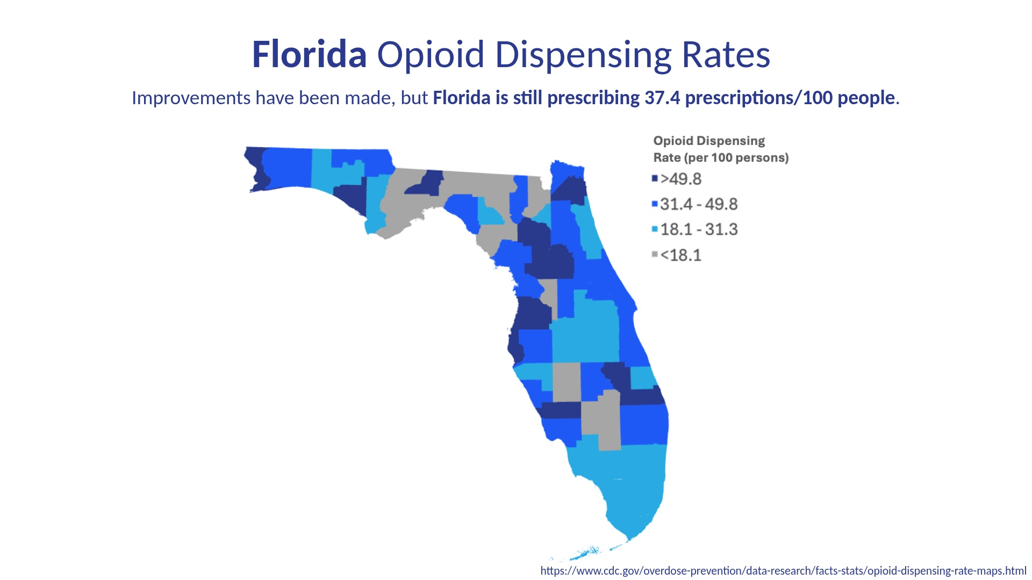
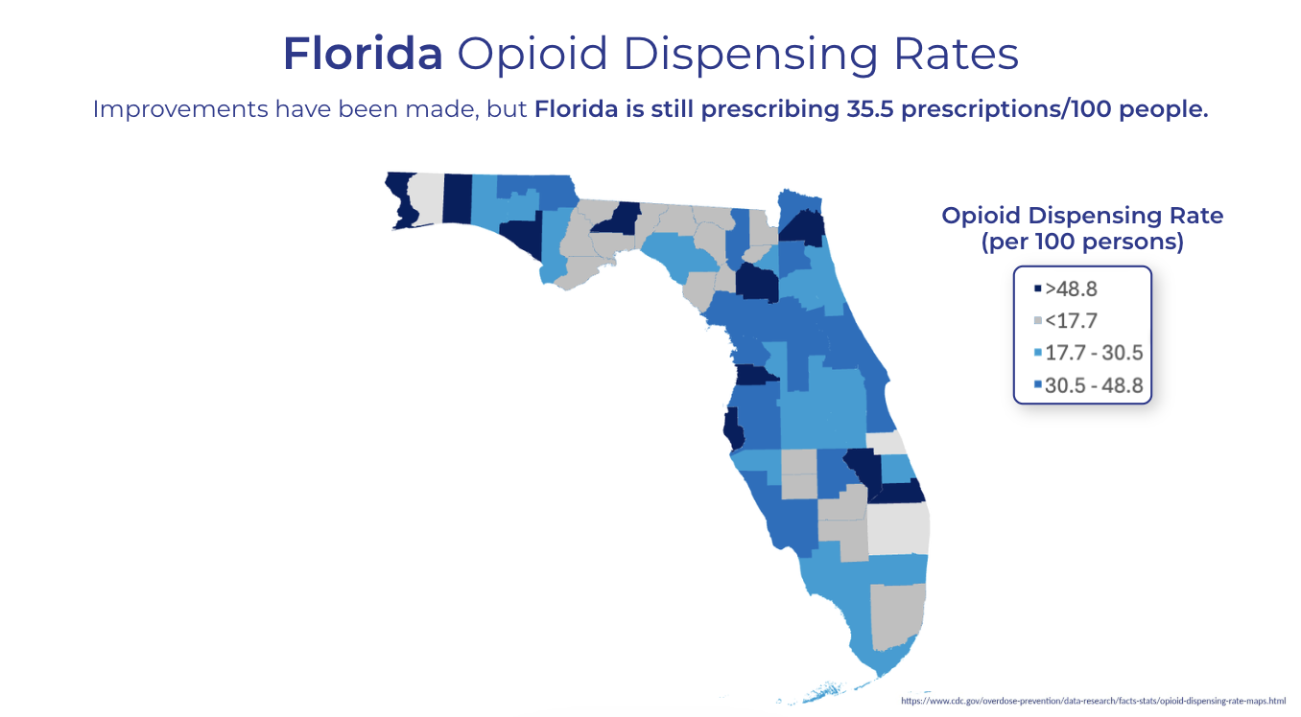

Slide 3
Pain medication: what is the “good stuff?”
“… in the majority of situations in which opioid painkillers are used today, they are not appropriate”
Don Teater, MD, National Safety Council
Number of people needed to treat for ONE patient to get 50% pain relief
8.3
5.5
2.9
2.7
1.6
Tramadol
Percocet (5mg)
Morphine 10mg (IM)
Ibuprofen OTC 200mg
Ibuprofen + Acetaminophen
(Bandolier, 2007) and (CJ Derry, Derry, & Moore, 2013)

Slide 4
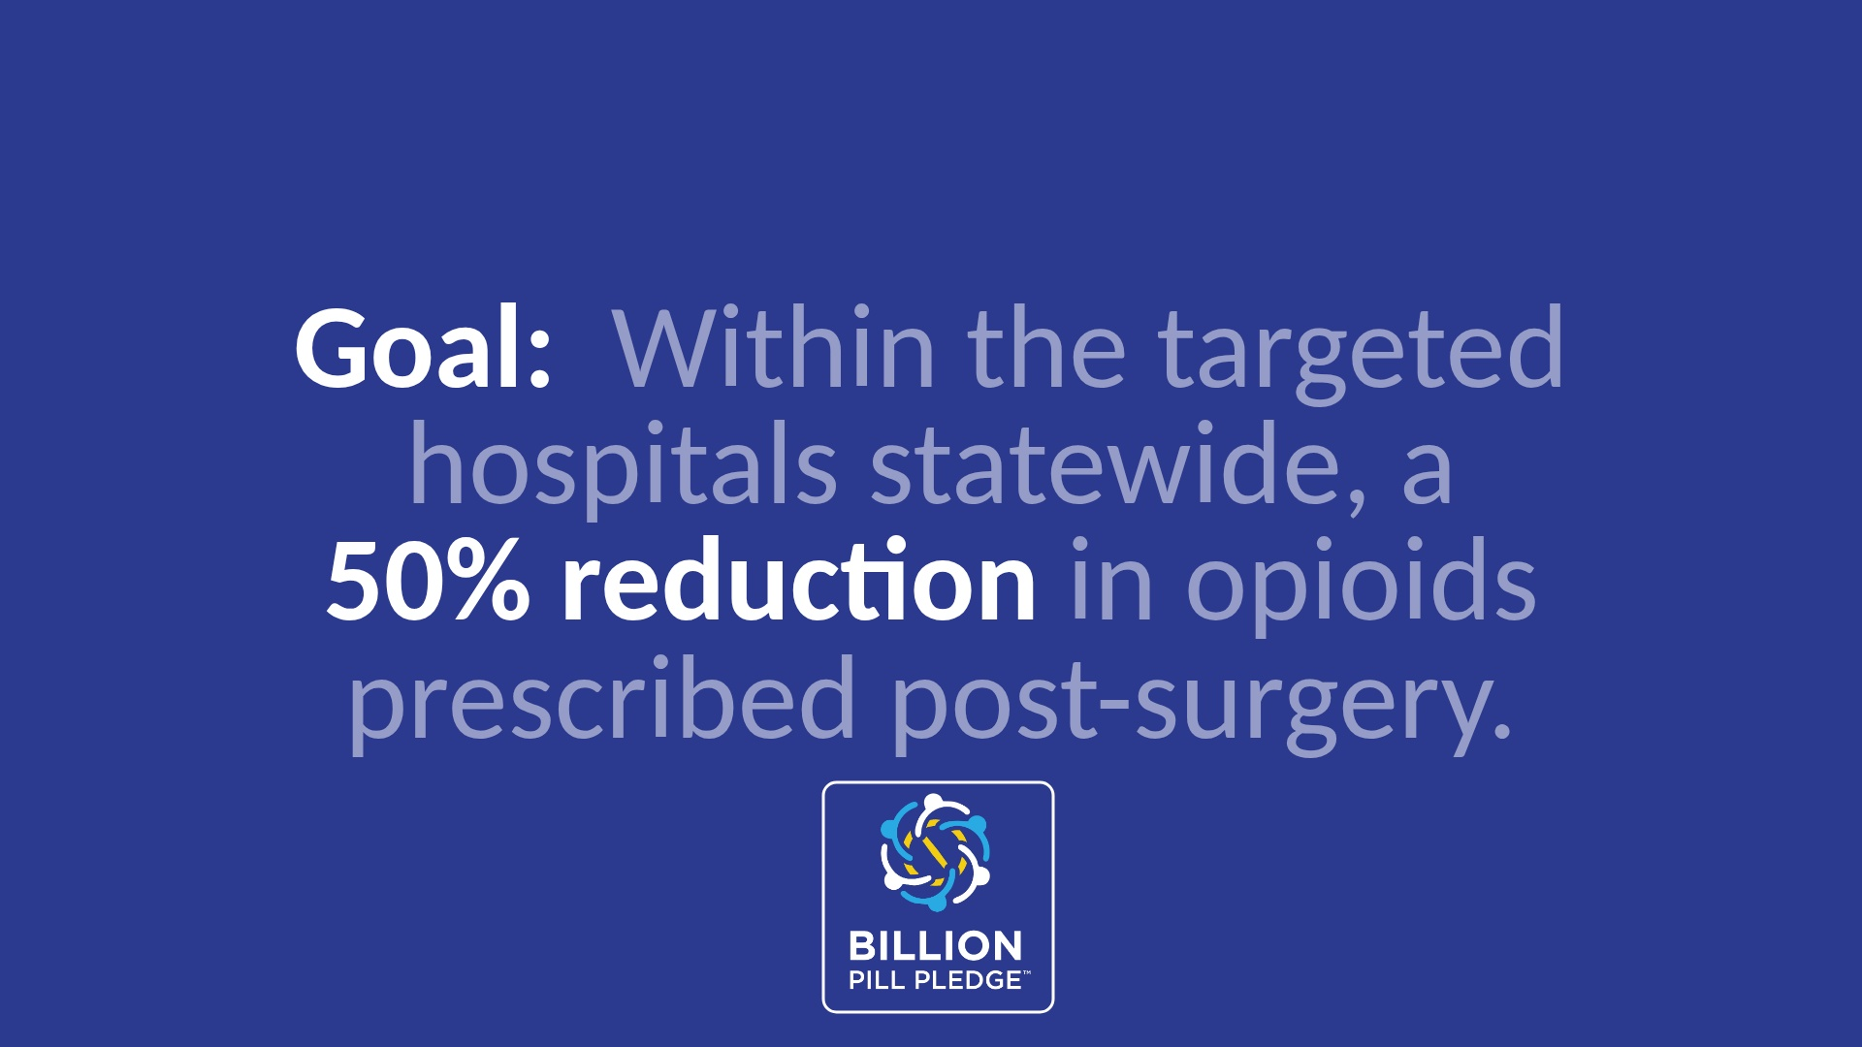

Slide 5
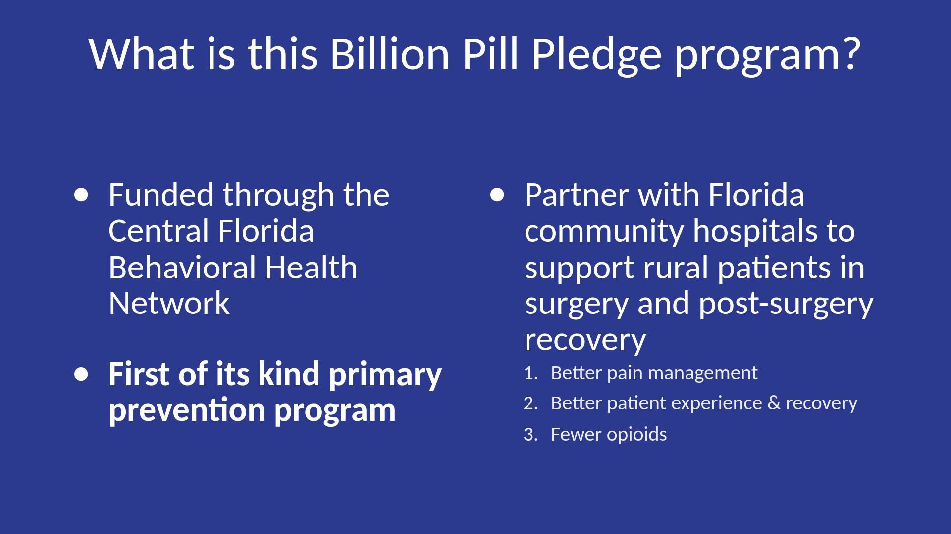

Slide 6
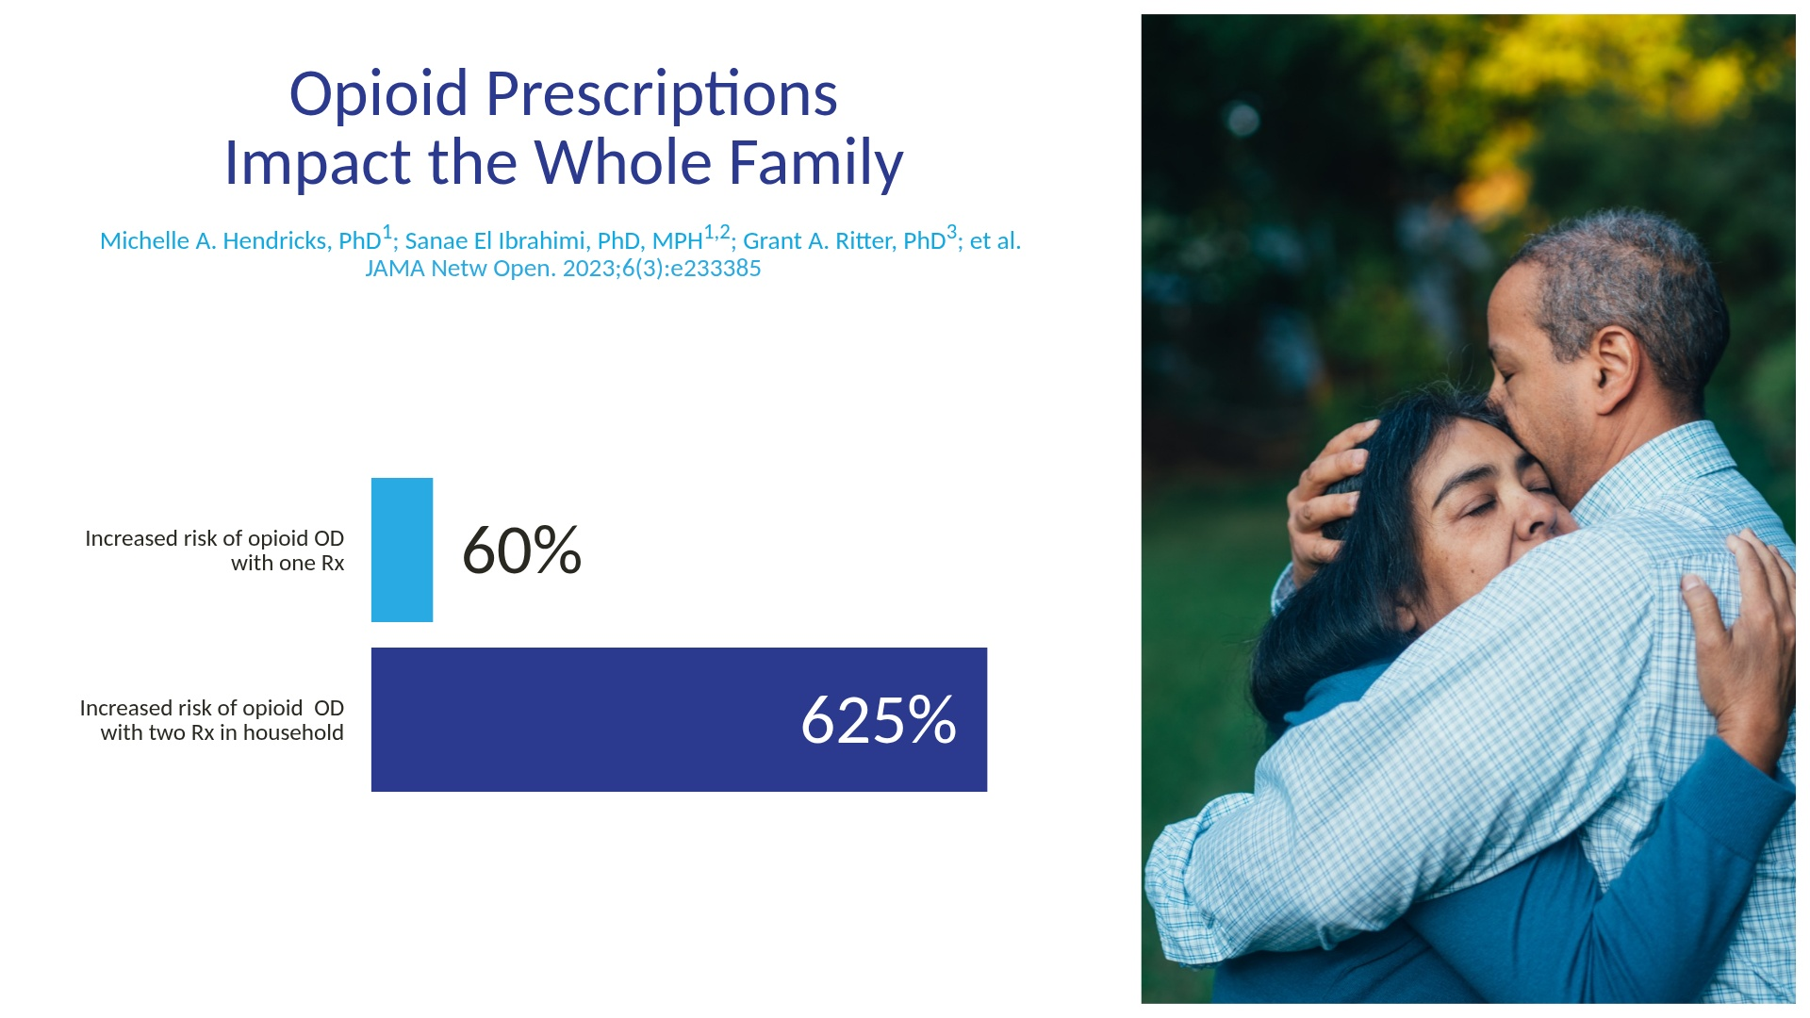

Slide 7
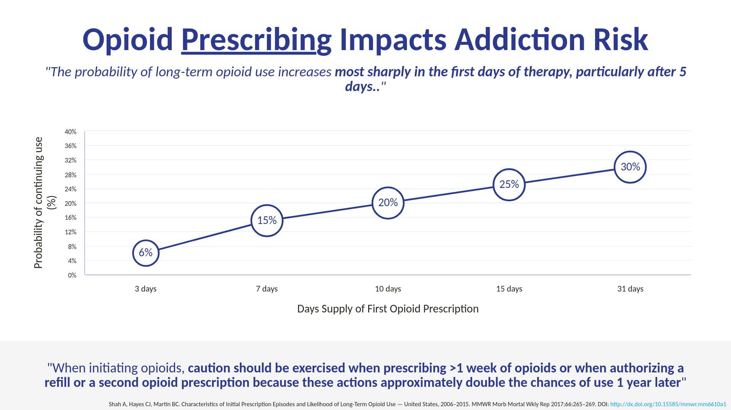
4x
4x
3x

Slide 8
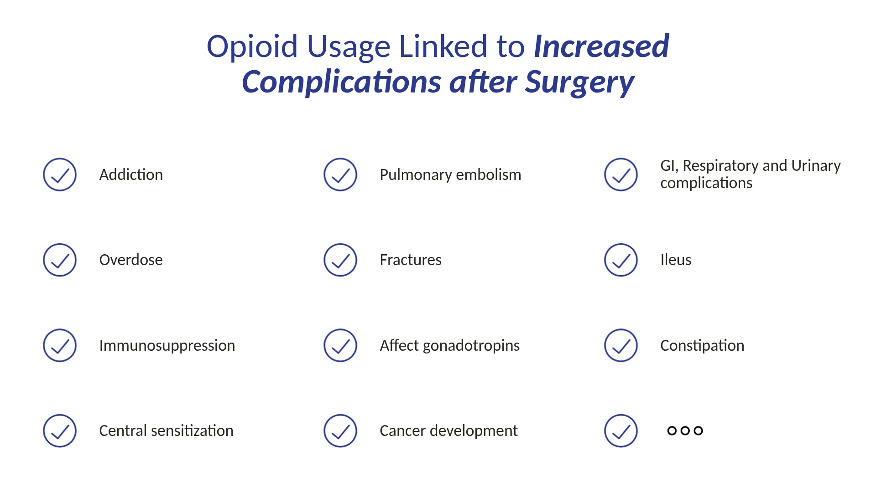

Slide 9
The recipe for success
A comprehensive approach to surgery and recovery.
Prior to
surgery
Surgery +
Hospital Stay
At-Home Recovery
Return to life
Tailored Pre-Op Nutrition Plan
Pre-Surgery Pain Management Plan
Minimally Invasive Approach
Multi-Modal Pain Management
Expectation Setting
Opioid-Sparing Pain Management
Recovery Support from a Nurse Navigator
Complication Monitoring
2X FASTER
RETURN TO WORK AND LIFE
Physical / psychological stress
optimized
Surgery + Recovery Experience
Traditional
Surgery experience
Open, invasive procedure
Opioids to control pain post-op
“Don’t eat or drink after midnight.”
Patient enters surgery in a weakened state
Opioids to control pain
Weeks without provider support
Prior to
Surgery
Surgery +
Hospital Stay
At-Home Recovery
Return to Life

Slide 10
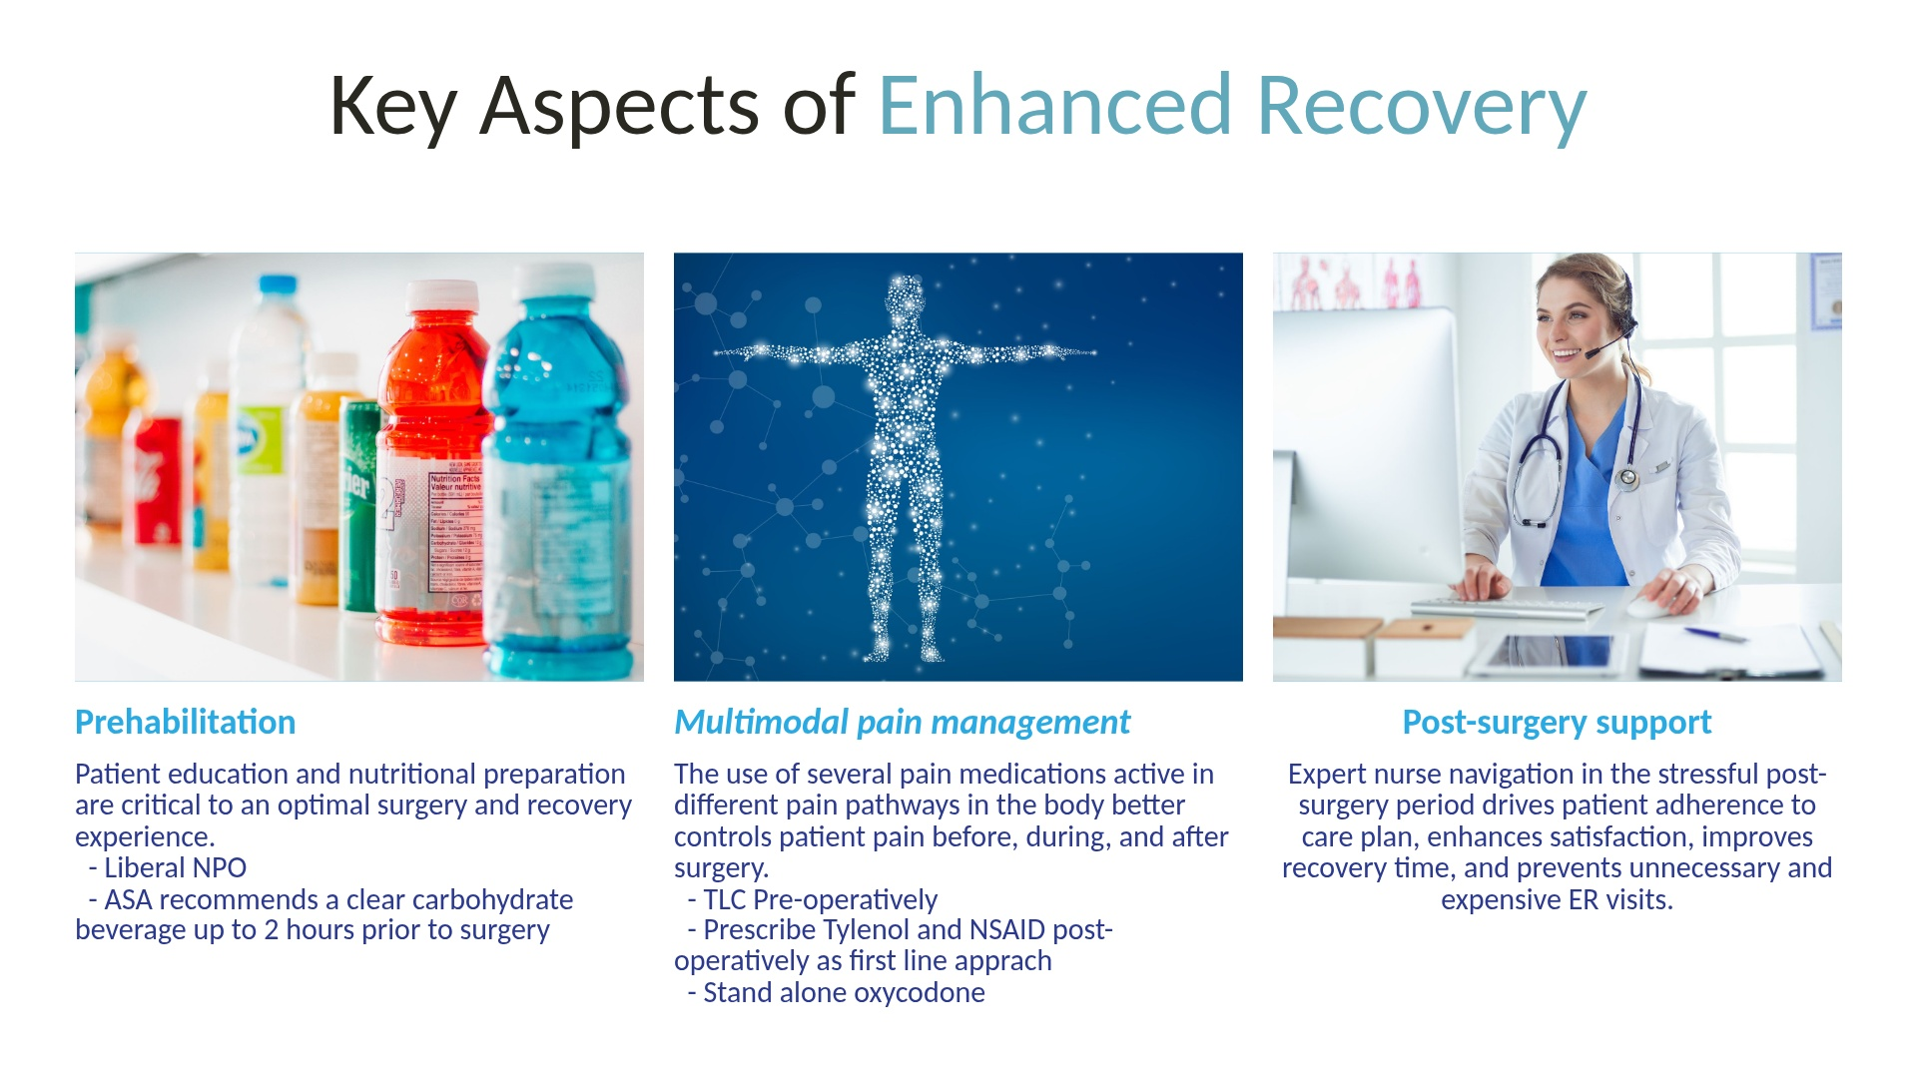

Slide 11
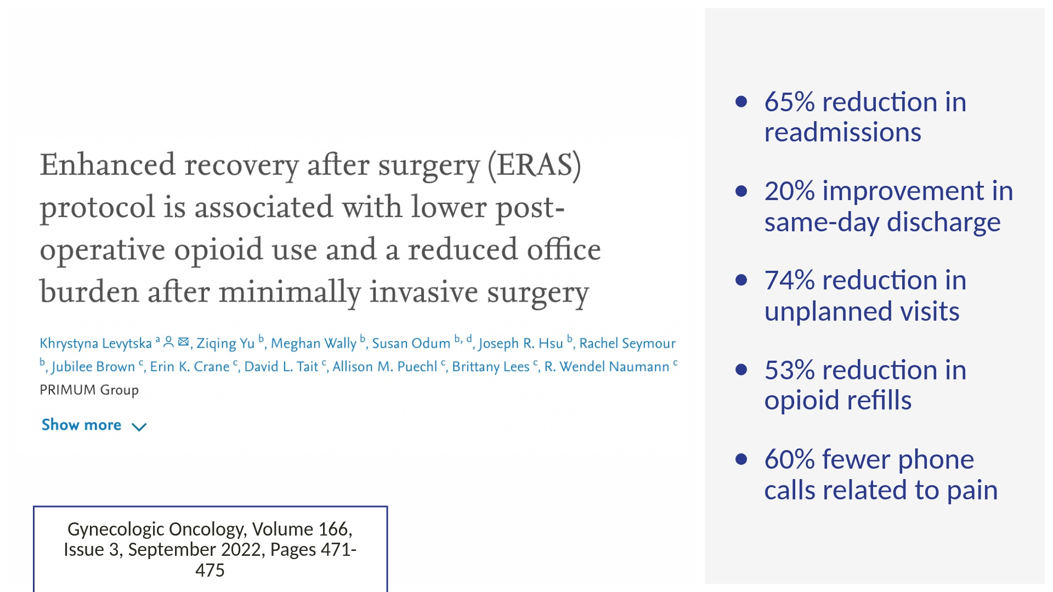

Slide 12
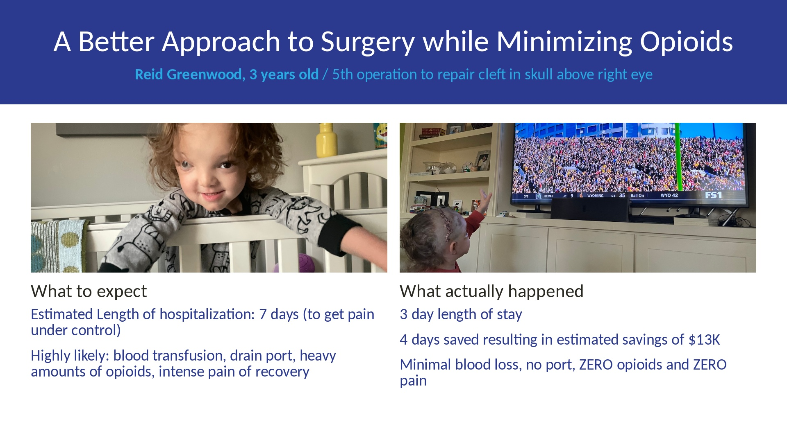

Slide 13
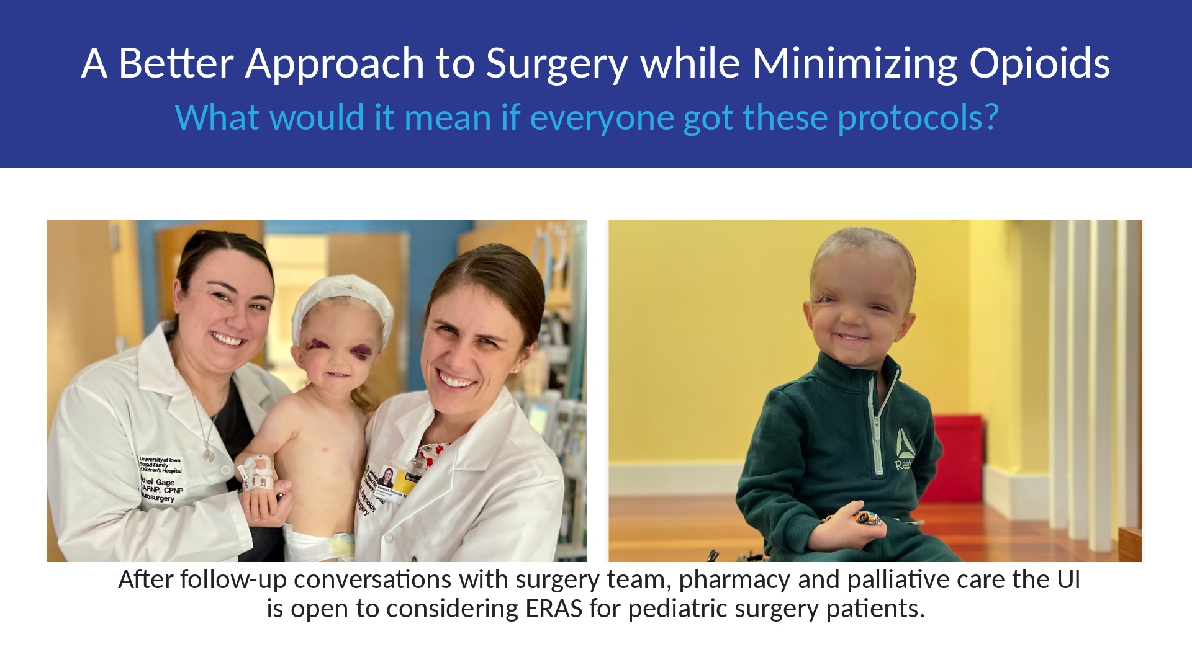

Slide 14
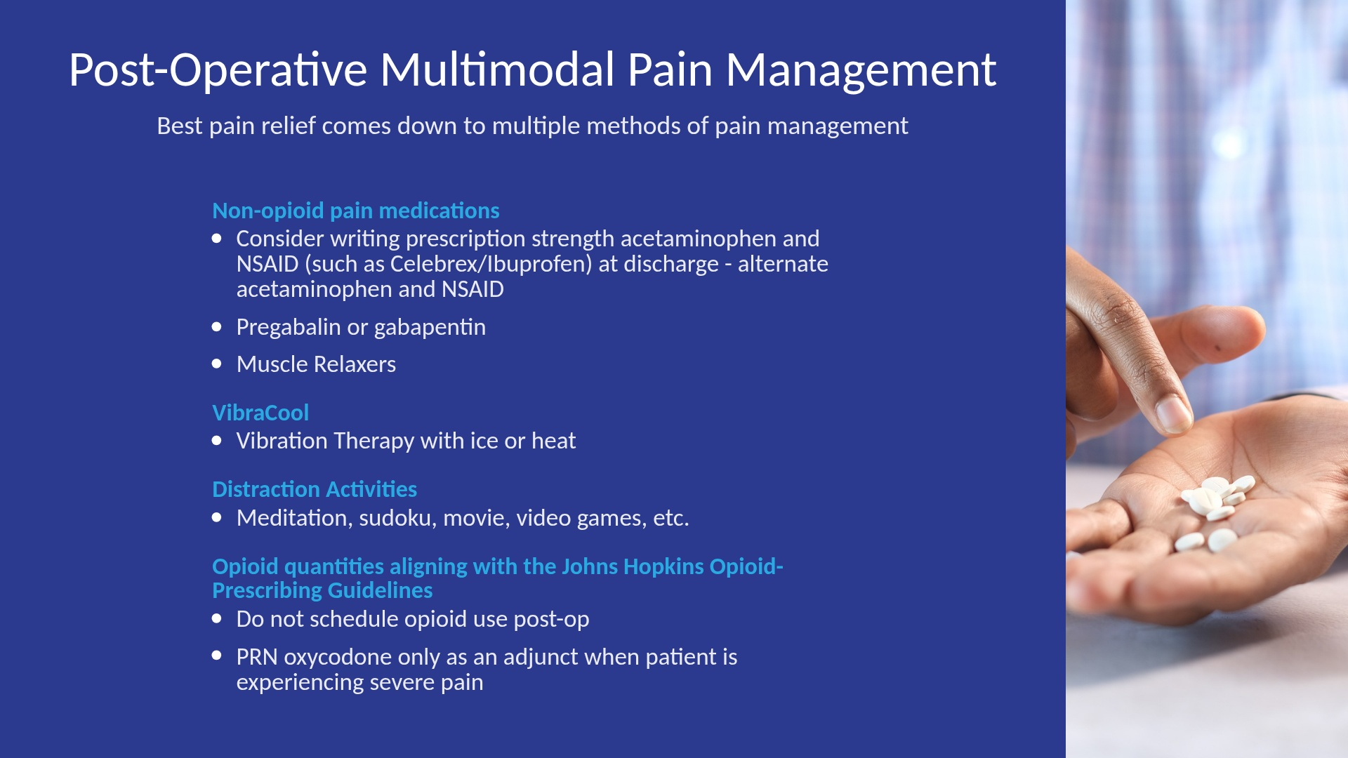

Slide 15
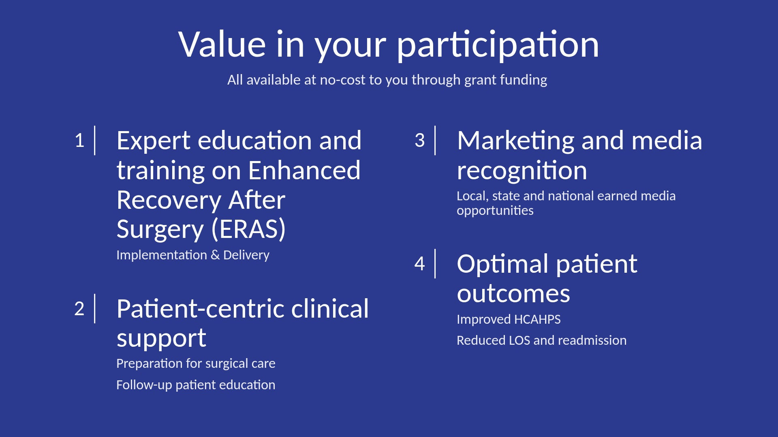

Slide 16
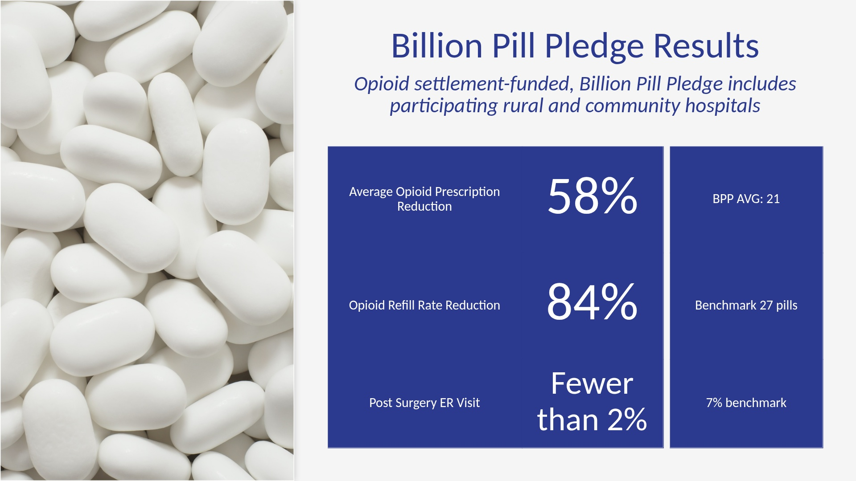

Slide 17
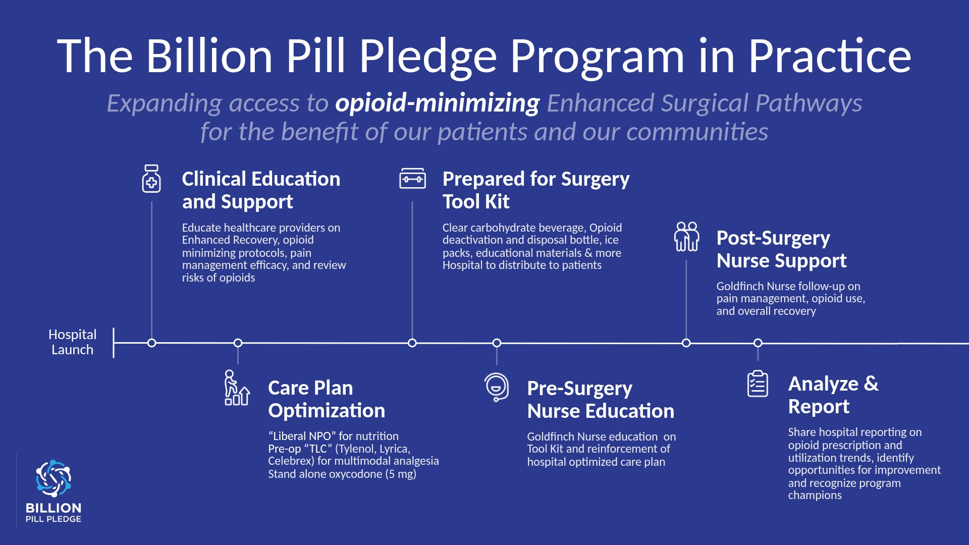

Slide 18
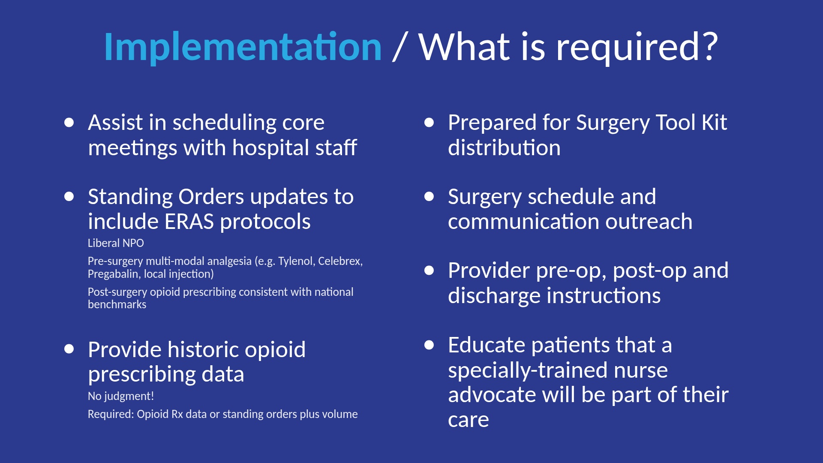

Slide 19
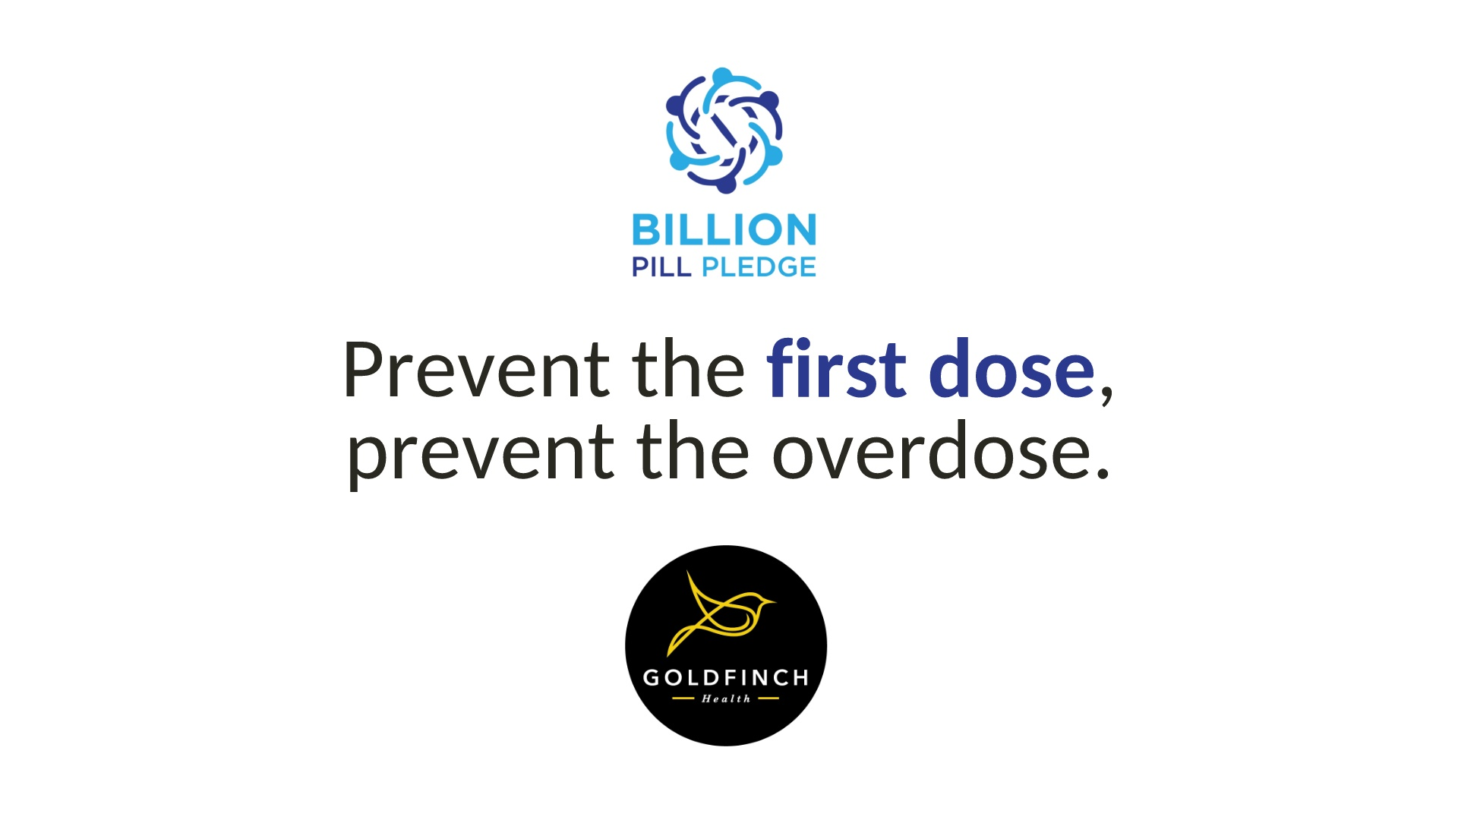

Slide 20
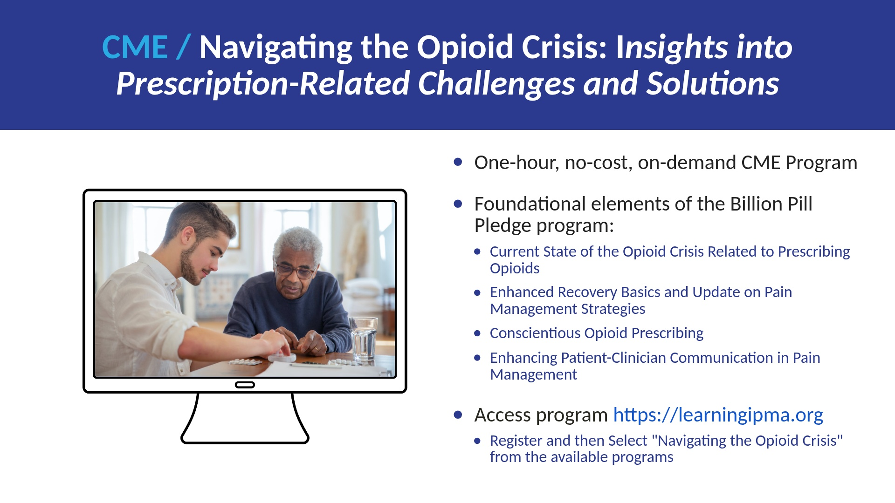

Slide 21


Slide 22
