Slide 1



Suicide Prevention
Without Barriers
How Here Tomorrow
Offers Help & Hope

Slide 2
Why we’re here
One person dies every 11 minutes by suicide.
HERE TOMORROW
There are twice as many suicides as homicides.
In 2023,
12.8 million
Adults seriously considered suicide.
3.7 million
Adults made a suicide plan.
1.5 million
Adults attempted suicide.
49,300
Americans died by suicide.

Slide 3
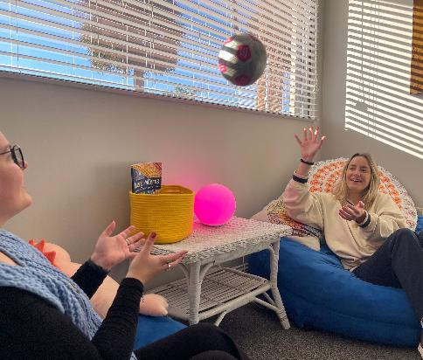
Here Tomorrow is filling the gap
Options for a mental health/suicide crisis:
WHY WE’RE HERE
Call a support hotline for emergency support.
Set a therapy appointment—an average of 6 weeks wait time.
This helps now, but what about the future?
This helps in the future, but what about now?
Waiting to talk to someone may be detrimental.
0
No-cost, no-wait mental health support from Certified Recovery Peer Specialists
Year-long non-clinical support is offered in-person or virtually
Notes:
As a testament to our mission, Here Tomorrow offers
No-cost, no-wait mental health support from Certified Recovery Peer Specialists
Year-long non-clinical support is provided in-person or virtually

Slide 4
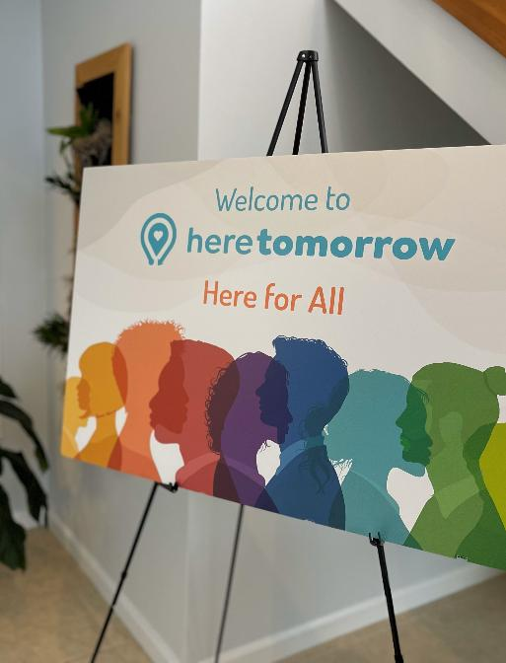
Peer support
SERVICES
Our Suicide Prevention Specialists are State-Certified Recovery Peer Specialists with lived experience
Peer Specialists support and inspire others through shared understanding and mutual respect
Our Suicide Prevention Specialists are Here to:
Listen with empathy because we understand;
De-escalate crisis situations;
Explore coping strategies & wellness tools;
Promote healing through connection;
Foster independence & respect autonomy;
Connect you with appropriate resources;
Set goals & provide encouragement;
Walk alongside you for 365 days

Slide 5
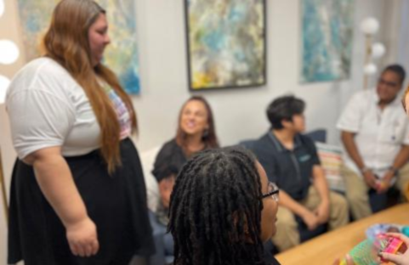

Who we support
SERVICES
Youth & Adults
Friend
People facing mental health crises, including hopelessness & suicidal thoughts
Family
People helping a loved one who may also need services

Slide 6
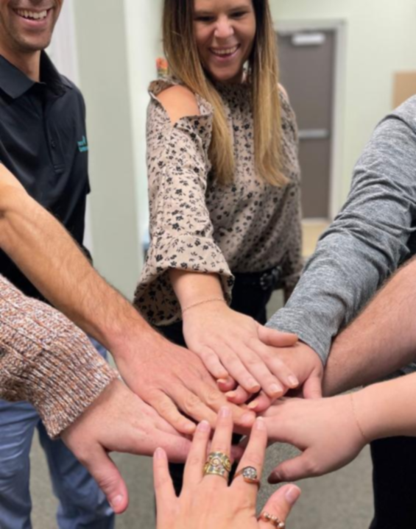
Supporting Loved Ones
Because caregivers deserve support, too!
Our Suicide Prevention Specialists are Here to:
Explore tools & strategies to support your loved one;
Provide space to focus on your own wellness;
Engage with topics like setting boundaries;
Offer connection, information, & encouragement;
Facilitate support groups & training opportunities

Slide 7

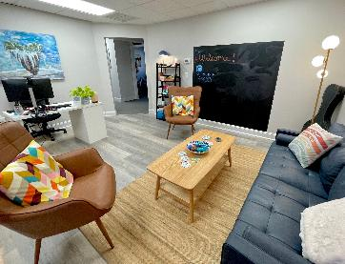
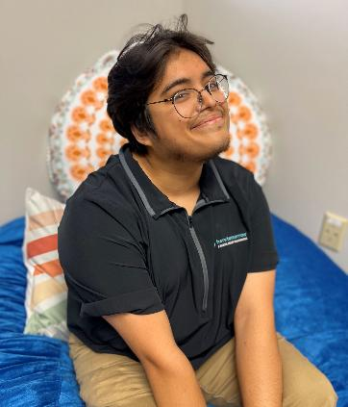
For youth under 18 experiencing hopelessness or suicidal thoughts
Guardian and teen sign consent to services
Walk-in, online, or telephone appointments
An empathetic, judgment-free environment for youth, where conversations about mental health are encouraged and supported
Dedicated space for teens to connect with Youth Peer Specialists who experienced their own struggles specifically during their youth​
Notes:
Since December of 2023, our Teen Peer Support Specialists have provided non-clinical mental health support to teens 13-17 experiencing hopelessness or thoughts of suicide.
They offer 365-day support, which helps empower teens to manage their mental health with individualized resources and coping skills
Enrollment
For teens, ages 13-17, facing hopelessness and/or suicidal thoughts
Walk in, online appointments, or telephone enrollment
Guardian and teen sign consent to services

Slide 8

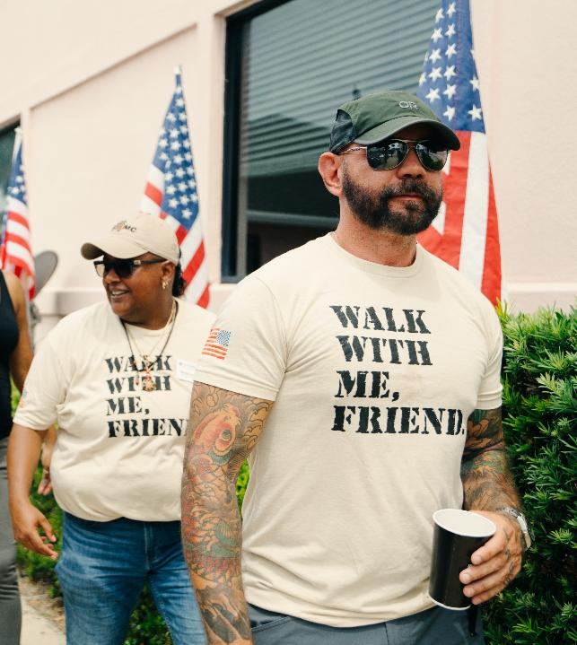
Support from experienced and former service members and first responders.
Confidential, individualized Peer Support for those seeking understanding of their experiences, regardless of discharge status
Support available for loved ones, family members, & children
Notes:
Since December of 2023, our Teen Peer Support Specialists have provided non-clinical mental health support to teens 13-17 experiencing hopelessness or thoughts of suicide.
They offer 365-day support, which helps empower teens to manage their mental health with individualized resources and coping skills
Enrollment
For teens, ages 13-17, facing hopelessness and/or suicidal thoughts
Walk in, online appointments, or telephone enrollment
Guardian and teen sign consent to services

Slide 9
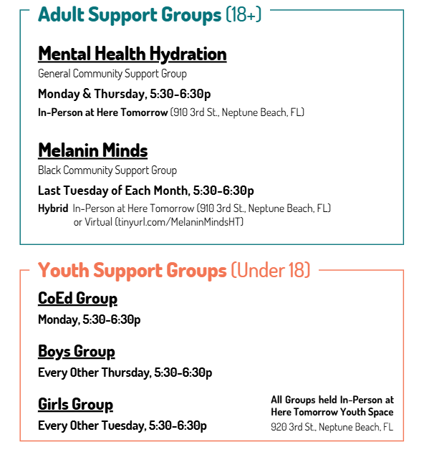

Beyond 1:1 Support
ADDITIONAL SERVICES
Support Groups
Funded Therapy
Resource Connection
Fostering a network of support to strengthen resiliency, promote recovery, & offer hope
Youth ECHO Sessions

Slide 10
Training & Community Education
help more people be here tomorrow
QPR Training
Mental Health
First Aid
The P.E.O.P.L.E.
Project
Question, Persuade, Refer Suicide Prevention Training
Develop skills to support those around you through mental health challenges
Certified Recovery Peer Specialist Training Program
Adult Mental Health First Aid:
Tuesday, April 14
10A – 4:00P, Virtual via Teams
Youth Mental Health First Aid:
Friday, May 15
10A – 3:30P @ Here Tomorrow
Notes:
Support groups
Facilitated by a Teen Peer
Alternating boys’ and girls’ groups based on gender-identity
Funded therapy
Network of clinicians serving adolescents
Required higher level of care
Experiencing barriers to affordable and timely mental health care
Teens receive therapy within 5 days
Community events and resources
Offered to all enrolled teens to build connections
Peers connect teens to individualized resources to support their wellbeing and encourage independence in maintaining their recovery

Slide 11
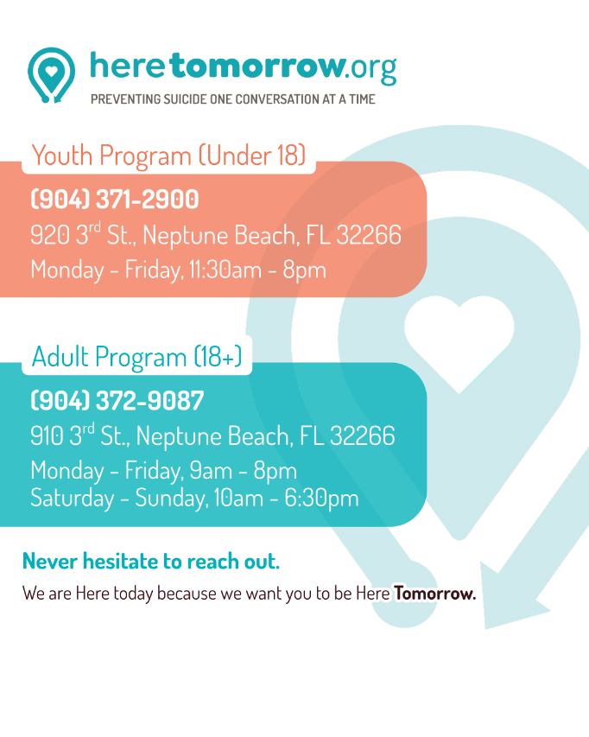


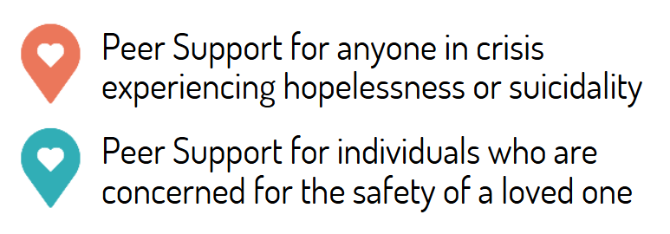
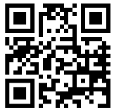
Welcome to Here Tomorrow
1:1 Crisis Support
Support Groups
Community-Building
Resource Connection
Training & Education
Notes:
This needs a call to action. What do we want people to do after they hear the presentation?
Tailor the ending to donors, partners and/or prospective friends.

