Slide 1
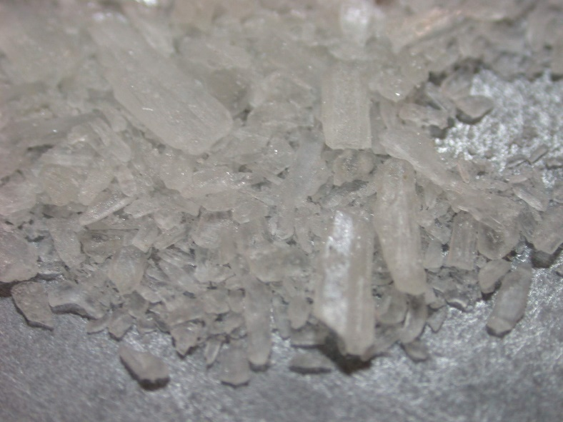
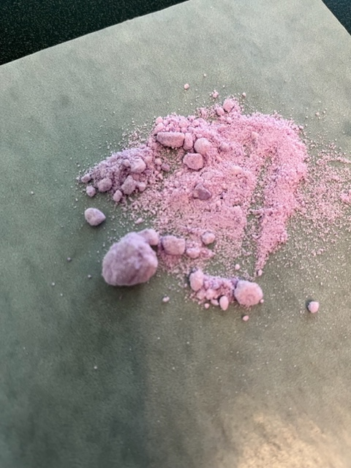
FDLE Seized Drugs Analysis & Regional Drug Trends
Troy Wolfer, ABC-DA
Crime Laboratory Analyst Supervisor (CLAS)
FDLE JROC

Slide 2
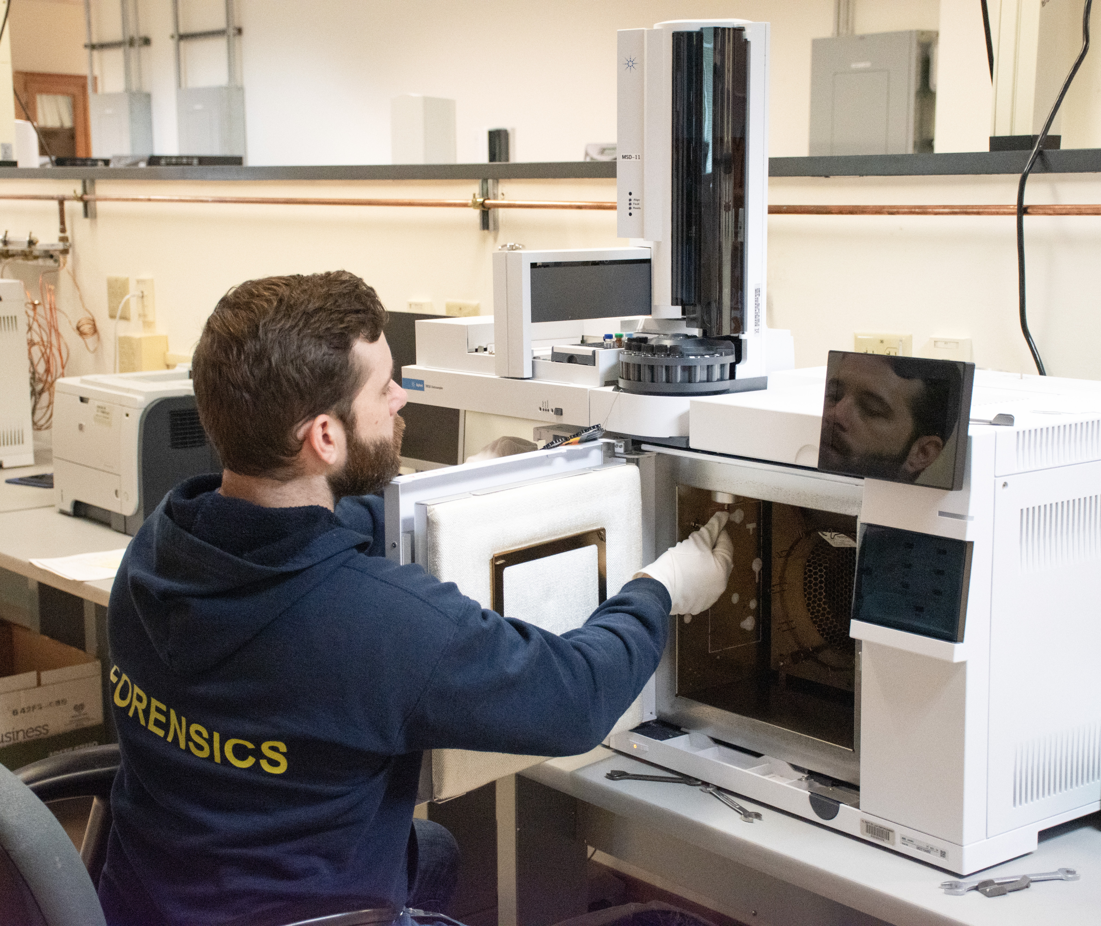
Instruments & Analytical Techniques
Gas Chromatography/Mass Spectrometry (GC/MS)
Chemical Color Tests
Thin Layer Chromatography (TLC)
Microscopic Examination
Gas Chromatography (GC)

Slide 3
Identification Requirements
Two tests are required – must be linked to a different fundamental property of the molecule
  Test #1 – GC/MS or IR (IR not present in Jacksonville)
  Test #2 – GC or TLC
For Cannabis identifications – Microscopic Examination, Duquenois-Levine Color Test, and (optional) GC/MS analysis to differentiate Cannabis from Hemp
  GC/MS Analysis - Performed on >20 grams of plant material or oils/liquids/resinous extracts
    Can be performed on smaller amounts with supervisor approval
    Not validated for food products

Slide 4
ANALYSIS TIMELINE
Analysts complete cases on average in 2-2.5 hours
  5 analysts full time working cases
    Complete ~300-350 cases per month
    1.65 items analyzed per case
  1 analyst currently training 3 analyst trainees – expected completion August-end of 2026
Currently completing cases submitted to the lab in November-December 2025
  TAT 110 days
  Additional lag for time between offense and submission by contributing agency
Routinely meeting court deadlines within 1 month of submission to laboratory

Slide 5
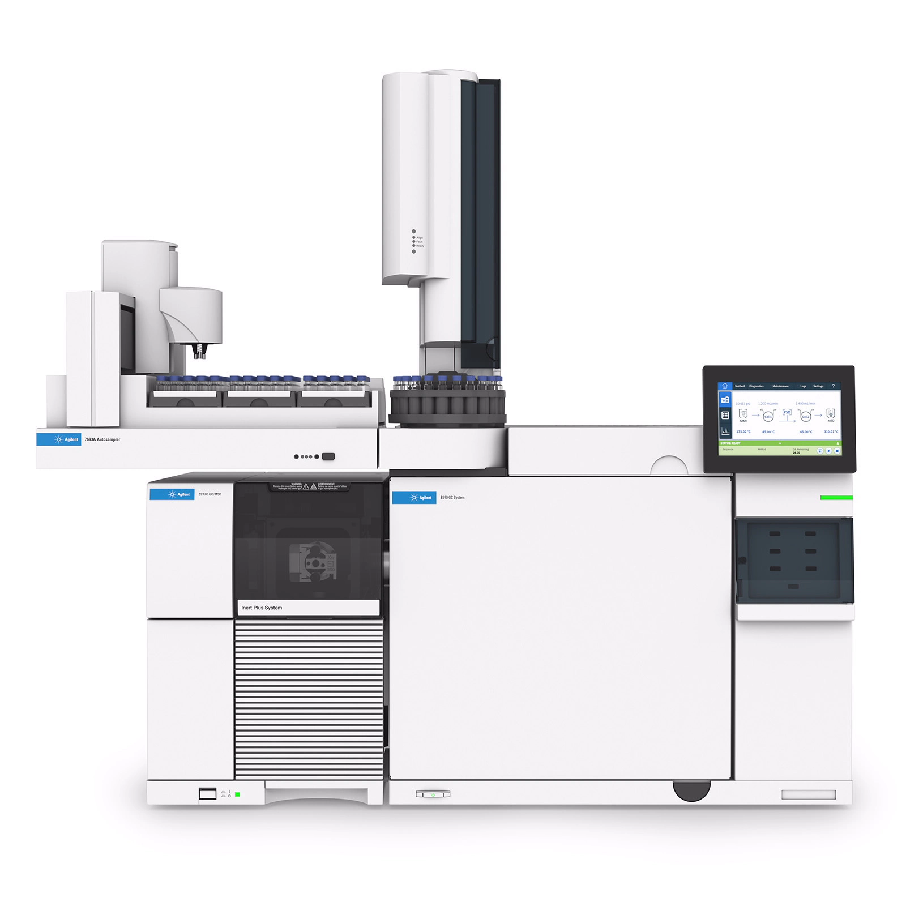
GC/MS
Separatory instrument (GC) coupled with Identification level instrument (MS)
A sample mixture is separated into individual components and then each component is broken apart to give structural information used for identification.
Two data graphs produced
  Total Ion Chromatogram of the overall sample
  Mass Spectrum of each component

Slide 6
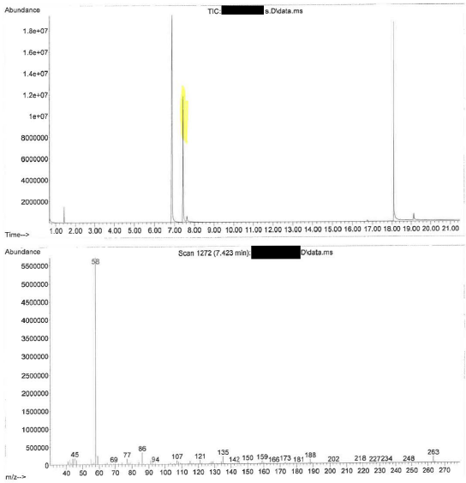
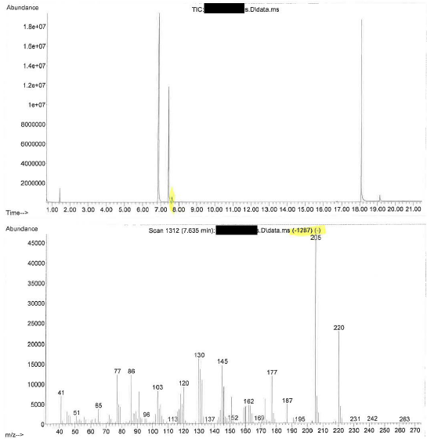
Example GC/MS Data
Fentanyl
Tramadol
Xylazine

Slide 7
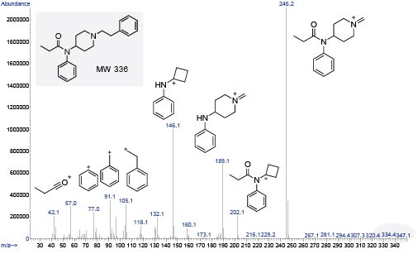
Mass Spectrum of Fentanyl
Each peak in this MS correlates to a fragment ion of Fentanyl
Fragmentation patterns are reproducible at the same ionization parameters (70 eV)

Slide 8
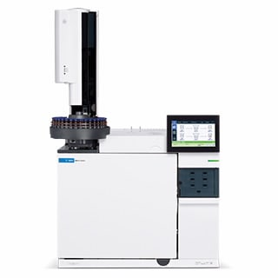
GC
A sample mixture is separated into individual components as they travel through the instrument
  Separation based on interaction with stationary phase and boiling point of compound
  Temperature programs can be adjusted to create better separation of sample components
As the components exit the column, they are detected and a retention time (RT) is recorded
The retention time of sample components is compared to controlled substance standards run on the same instrument under the same instrumental conditions (temperature program) within 24 hours

Slide 9
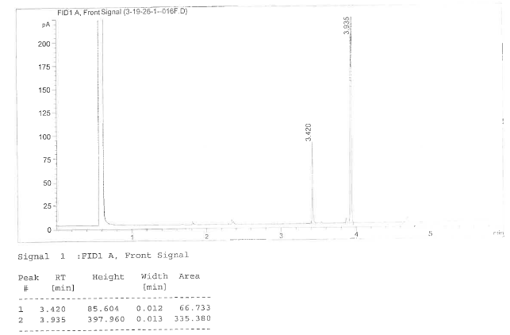
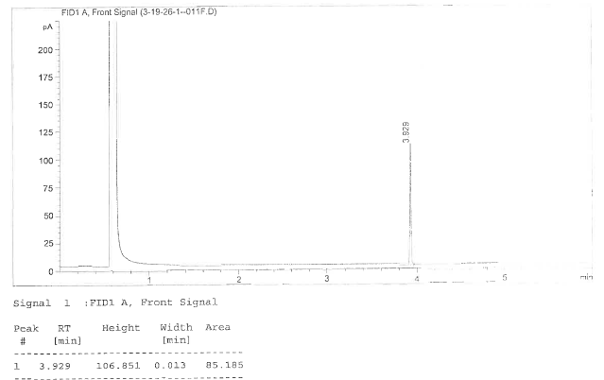
Example GC Data
Sample of Fentanyl
Fentanyl Standard

Slide 10
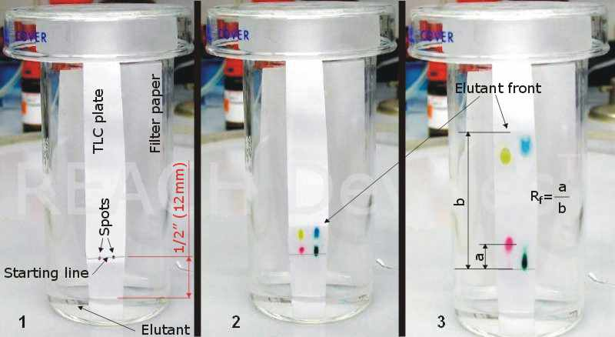
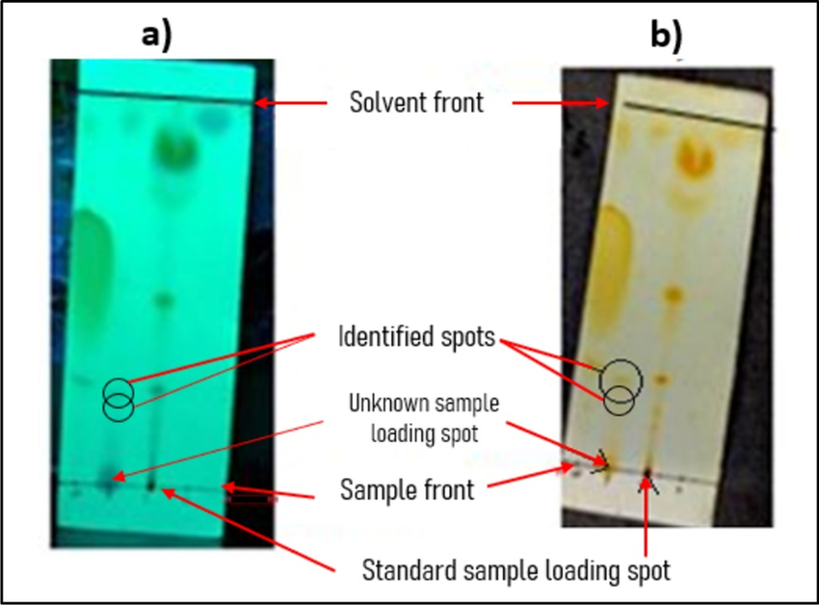
TLC
Separation of components based on affinity for stationary and mobile phase
Used only situationally
  Thermally labile compounds
    Psilocyn/Psilocybin
    Diazepam/Ketazolam
  Time consuming
  Non-automated

Slide 11
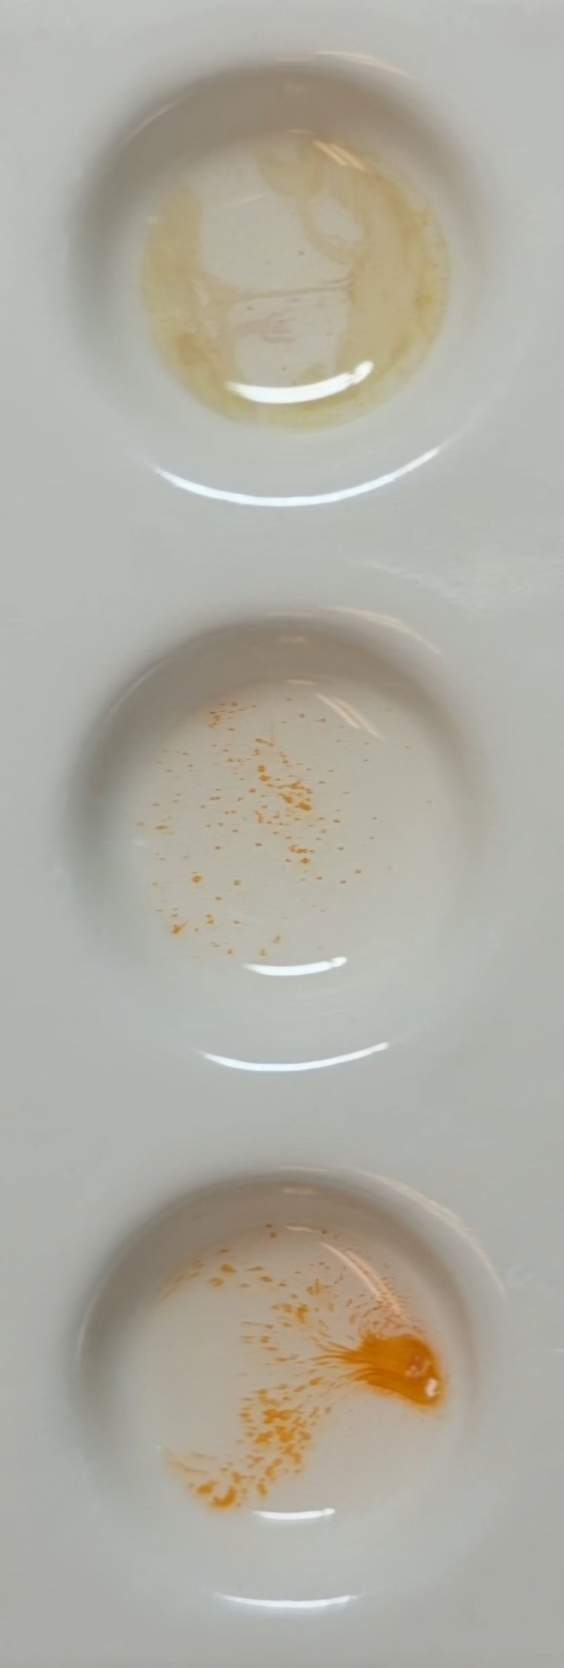
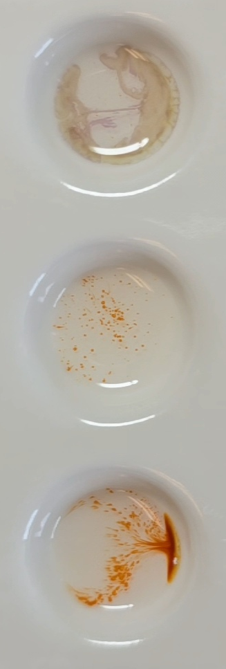
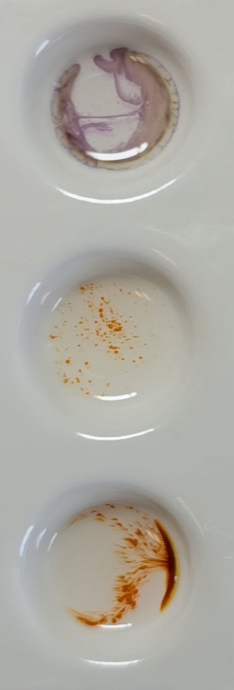
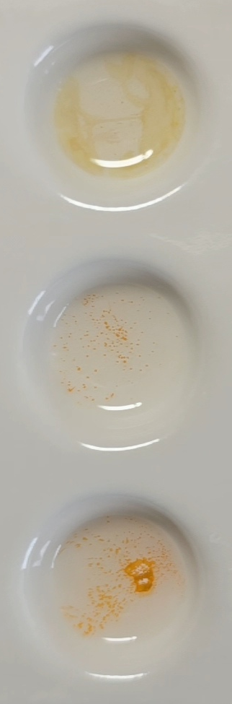
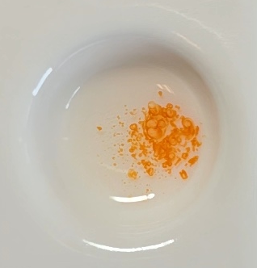
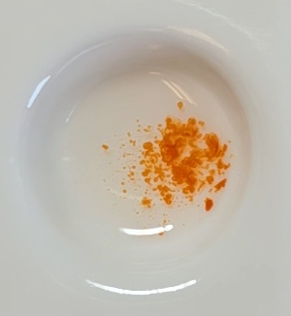
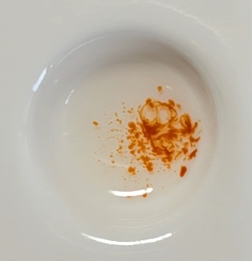
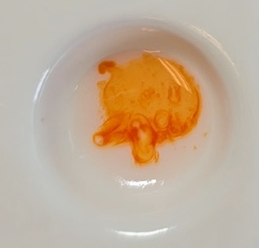
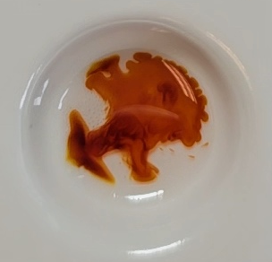
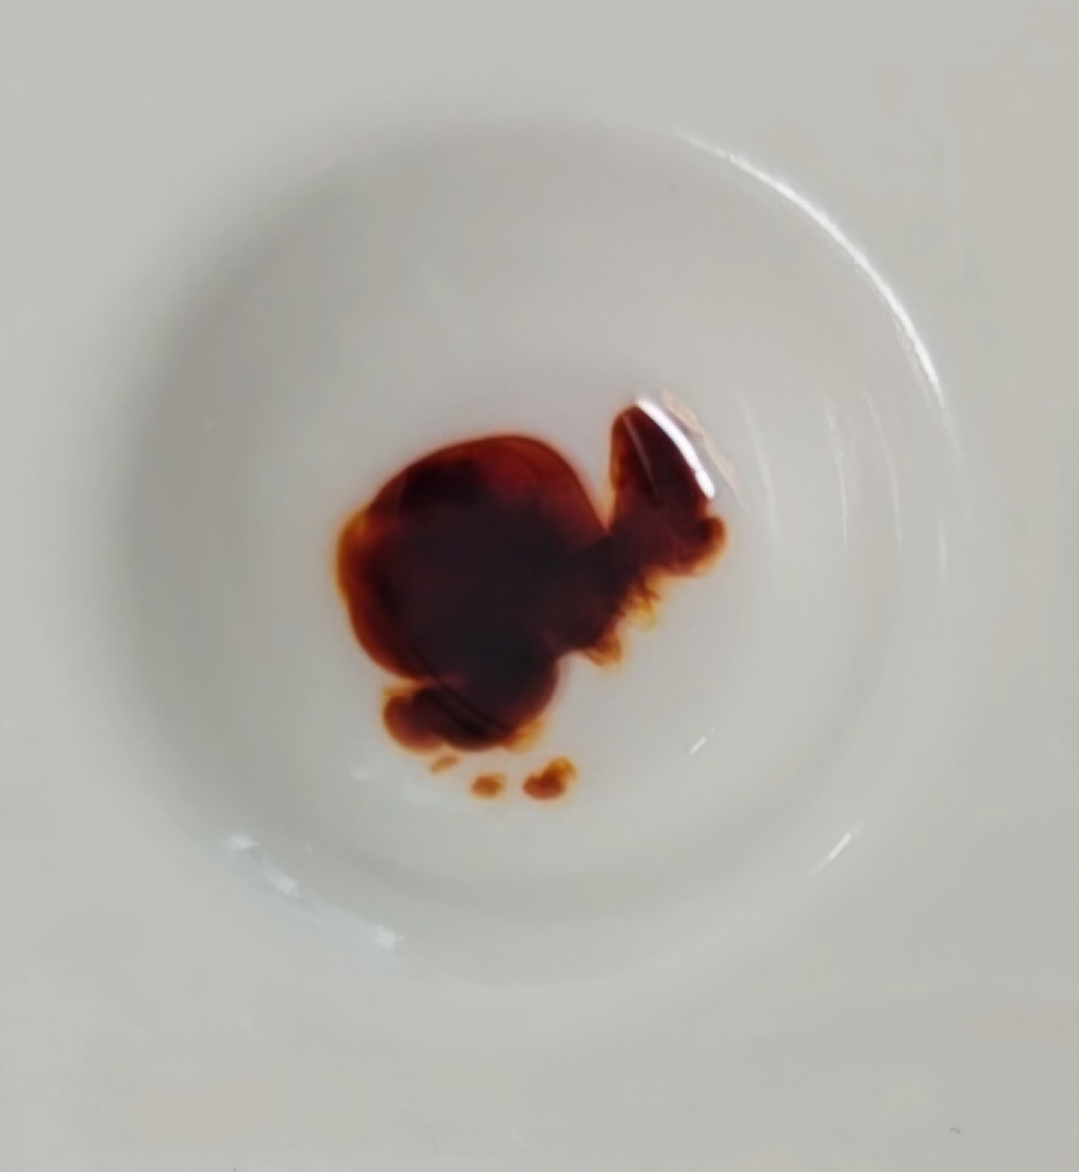
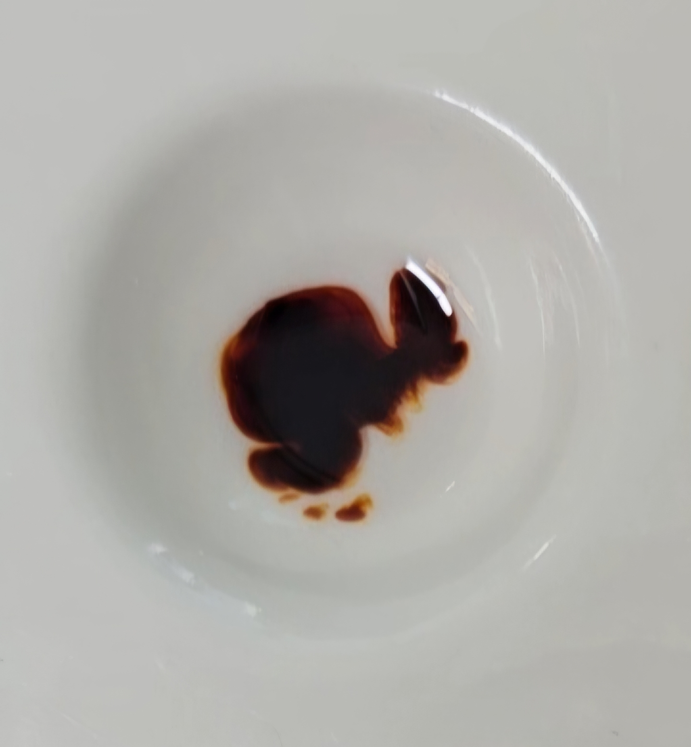
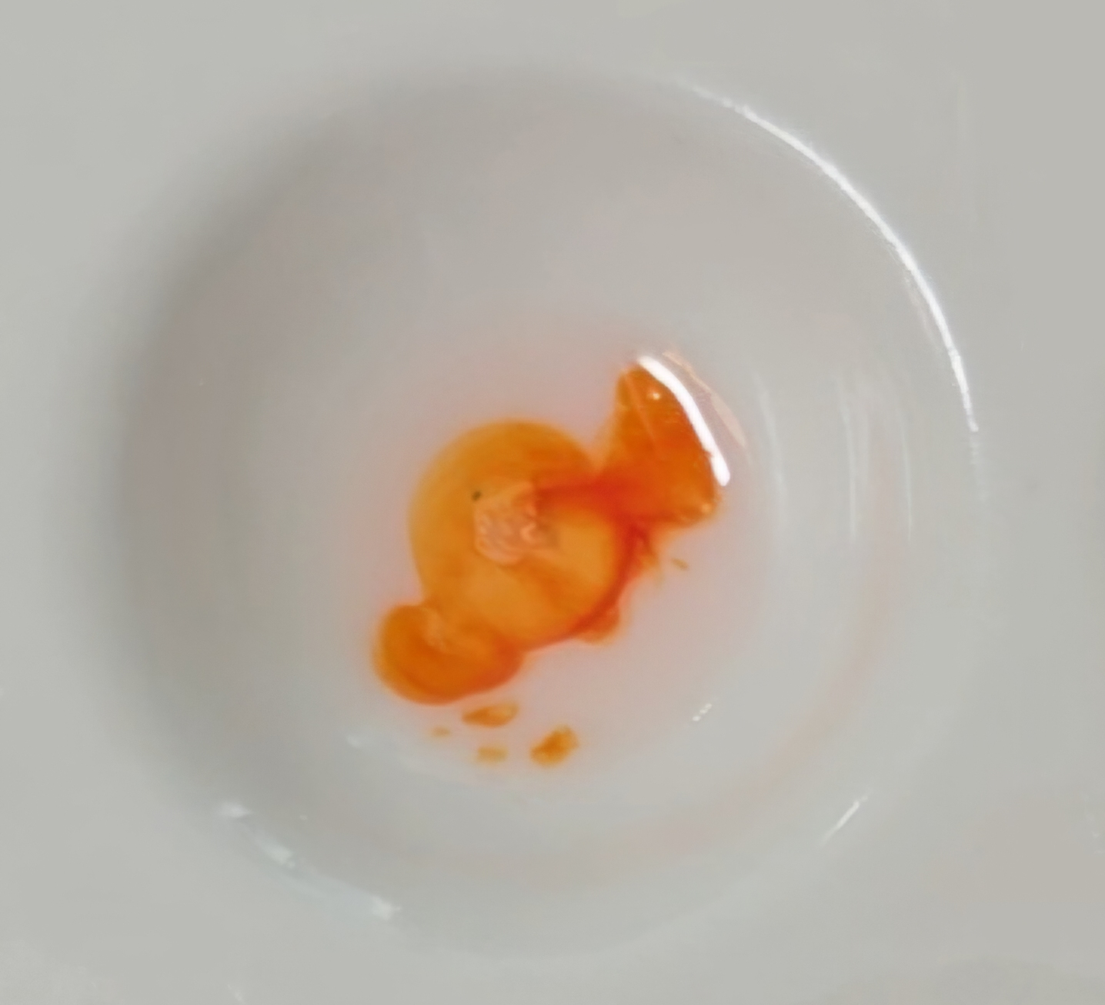
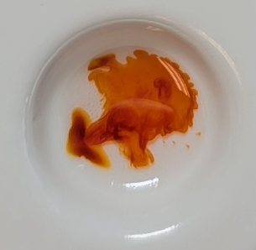
Chemical Color Tests
Give preliminary information about the structural class of a molecule
Certain color changes are extremely distinctive
FDLE only uses the Duquenois-Levine Test to formulate conclusions (Cannabis identification)
Other tests (Marquis, PDMB, Cobalt Thiocyanate)
← OXYCODONE →
← FENTANYL →
← METH →
← OXYCODONE →
← FENTANYL →
← METH →
Immediate
30 Seconds
1 Minute

Slide 12
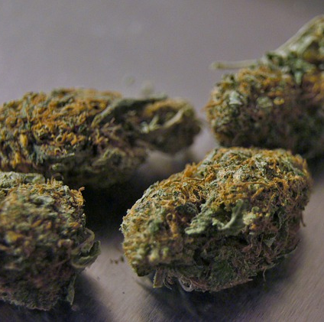
Cannabis and Hemp

Slide 13
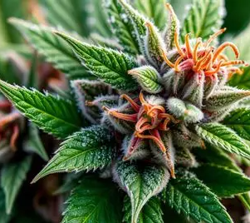
Analytical Challenges
Cannabis, hemp, and medical marijuana all describe the same plant (Cannabis) and its products – the only distinctions are:
  the concentration of THC in the plant/product
    can be used to differentiate Cannabis and medical marijuana from legal hemp
  Where the plant/product was obtained
    Medical marijuana must be dispensed from an MMTC
    A medical marijuana card is required
    Cannot be determined in the lab

Slide 14
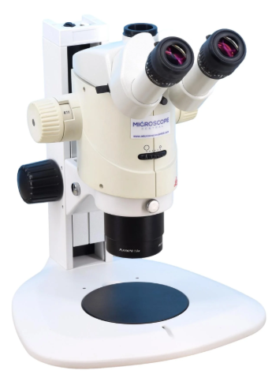
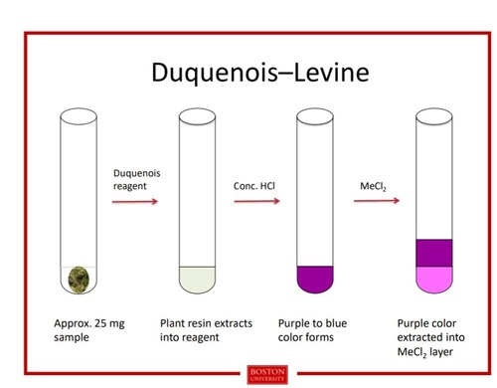
Testing Scheme for Cannabis plant material
Identification of Cannabis plant
1% THC Threshold Analysis
Macroscopic Examination
Microscopic Examination
Duquenois-Levine Test
Semi-quantitative analysis on GC/MS
Comparison to a 1% THC mixture
Response > mixture = meets the definition of illegal Cannabis
  Dispensed through a MMTC, this could still be medical marijuana
Response < mixture = cannot exclude hemp
Limitations: minimum of 2 grams of plant material needed to attempt

Slide 15
Field tests indicate other controlled substances
Commonly, plant material is suspected to be laced with fentanyl
  Plant material reaction in field test is similar to Fentanyl reaction
  Analysis with GC/MS to test for presence of non-THC controlled substances
Throughout Florida, since 2023:
  Fentanyl has only been identified with 1 Cannabis plant material case – where crystalline substance was visible to the naked eye
    The crystalline substance in all likelihood contained the Fentanyl and the Cannabis plant material just happened to be in the same bag with the crystalline substance. However, I cannot be certain as the mixture was analyzed together.
  Cannabis identified over 6000 times

Slide 16
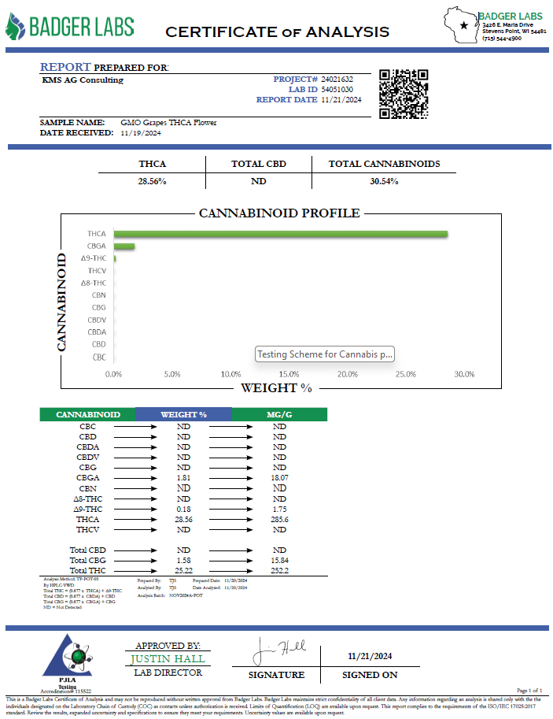
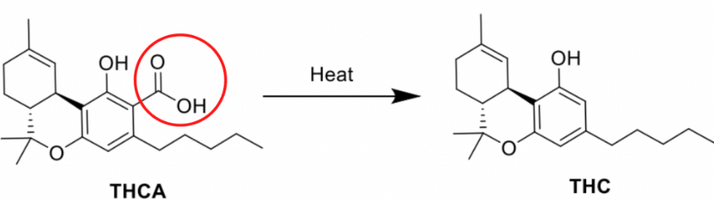
Certificates of Analysis
FL Dept of Agriculture issued rules for the State Hemp Program:
Definitions. The definitions provided in Sections 581.011, 581.217, F.S., and the following shall apply to this rule:
(i) “Total delta-9 tetrahydrocannabinol concentration” means [delta-9 tetrahydrocannabinol] + (0.877 x [tetrahydrocannabinolic acid]).

Slide 17
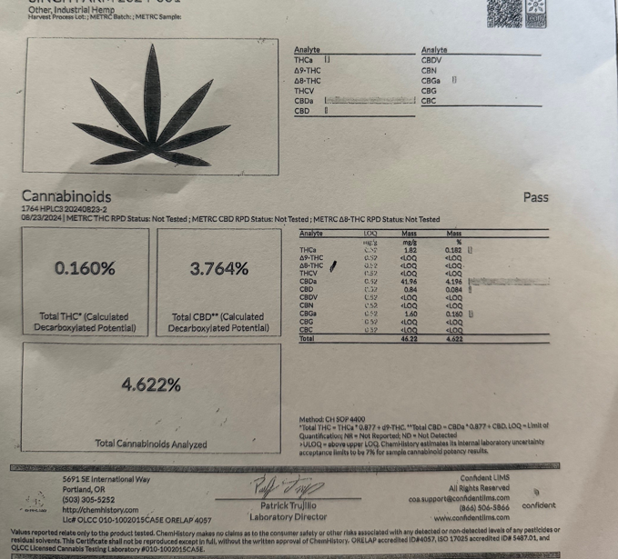
Can you trust it?
May 2025 – JSO detectives collected multiple 1-pound bags of plant material
The CoA with these bags presented as legal hemp from Oregon – 0.160% THC
Submitted to JROC for determination
CLA Amber Kulow analyzed a sample and found that it contained greater than 1% THC

Slide 18
Investigations into stores
Multiple counties – Stores selling “hemp” plant material
  Initial purchases of plant material made at multiple stores
  In one case, SCLA Scott Harder tested 7 exhibits with 1% analysis and all were above 1% and not legal hemp
  Analysis of additional cases in at least 2 other counties have shown plant material above 1% THC

Slide 19
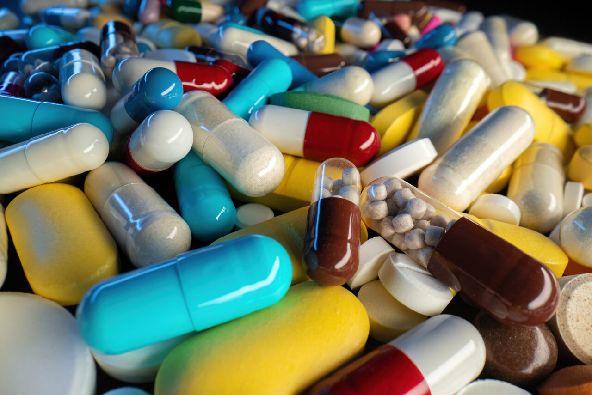
DrUG Trends

Slide 20
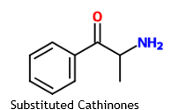
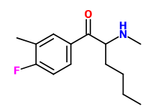
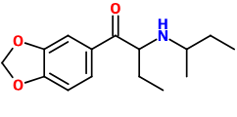
Newly Identified Substances
2025 - FDLE identified 8 controlled substances for the first time
  4 Substituted Cathinones
  3 Synthetic Cannabinoids
  1 Fentanyl Derivative
2024 – 10 newly identified substances
2023 – 12 newly identified substances
So far in 2026 – 2 new Substituted Cathinones have been seen multiple times and are awaiting drug standard comparisons to confirm identification
  Probable sec-Butyl Butylone
  Possible Fluoro-methyl-hexedrone or isomer
sec-Butyl Butylone
Fluoro-methyl-hexedrone

Slide 21
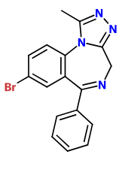
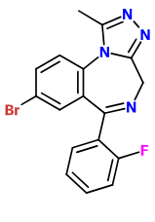
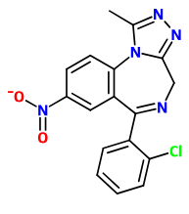
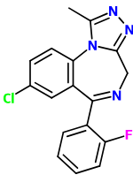
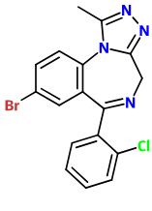
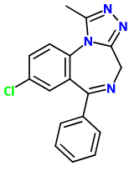
Non-controlled Substances and Precursors in Samples
2025 through February 2026
Designer Benzodiazepines
Gabapentin – 6 times
  prescription substance to treat nerve pain - generally seen with controlled substances
Adulterants/Precursors in Fentanyl Samples (831 IDs of Fentanyl and Fentanyl Derivatives in time period)
  BTMPS (Bis(2,2,6,6-tetramethyl-4-piperidyl)sebacate) – first regional indications in February 2025 – 130 times
    Public_Alert_BTMPS_and_TMF_Related_Substances_052025.pdf
    Also seen with other controlled substances or on its own
  Medetomidine – first regional indications in July 2025 – 10 times
    Veterinary tranquilizer
  Metamizole – first regional indications in October 2025 – 2 times
    Banned for human use in US; OTC substance in some other countries like Mexico
Bromazolam
Flubromazolam
Clonazolam
Flualprazolam
Phenazolam
Alprazolam (XANAX)
4 times
3 times
26/32 IDs

Slide 22
Regional Drug TrenDs – Most IdenTIFIEd
2023
2024
2025
Methamphetamine – 959 – 25.5%
Substituted Cathinones – 847 – 22.5%
Cocaine – 695 – 18.5%
Fentanyl + Derivatives – 591 – 15.7%
Cannabis and THC – 213 – 5.7%
Xylazine – 153 – 4.1%
Prescription Opiates – 139 – 3.7%
Heroin + Schedule I Opiates – 48 – 1.3%
Benzodiazepines – 30 – 0.8%
Other Prescription Drugs – 23 – 0.6%
Total Identifications – 3764
Methamphetamine – 1057 – 25.8%
Substituted Cathinones – 985 – 24.0%
Cocaine – 823 – 20.1%
Fentanyl + Derivatives – 671 – 16.4%
Cannabis and THC – 172 – 4.2%
Xylazine – 136 – 3.3%
Prescription Opiates – 119 – 2.9%
Synthetic Cannabinoids – 32 – 0.8%
Benzodiazepines – 24 – 0.6%
Heroin + Schedule I Opiates – 19 – 0.5%
10T. Other Prescription Drugs – 19 – 0.5%
Total Identifications – 4102
Methamphetamine – 1006 – 25.5%
Fentanyl + Derivatives – 720 – 19.5%
Cocaine – 700 – 18.9%
Substituted Cathinones – 488 – 13.2%
Cannabis and THC – 280 – 7.6%
Prescription Opiates – 148 – 4.0%
Xylazine – 131 – 3.5%
Synthetic Cannabinoids – 59 – 1.6%
Substituted Phenethylamines – 47 – 1.3%
Benzodiazepines – 31 – 0.8%
Total Identifications – 3695

Slide 23
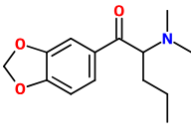
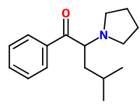
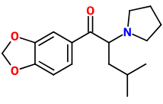
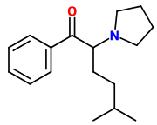
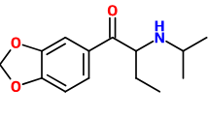
Trend Takeaways - Cathinones
The most common 4-5 drugs account for more than 80% of all IDs
Substituted Cathinones hit a peak in 2023-24, currently on the decline
  2023 – Dimethylpentylone (75%); PIHP (16.8%)
  2024 – Dimethylpentylone (73.8%); PIHP (13.1%); Isopropylbutylone (5.7%)
  2025 – Isopropylbutylone (33%); iso-PV8 (20.3%); Dimethylpentylone (14.1%); PIHP (13.3%)
  2026 – iso-PV8 (34.5%); Isopropylbutylone (19%); Dimethylpentylone (12.1%); MDPIHP (10.3%)
Dimethylpentylone
PIHP
Isopropylbutylone
MDPIHP
iso-PV8

Slide 24
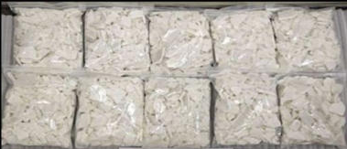


Why shifting Trends in Cathinones?
Most Substituted Cathinones are imported by mail from China
China periodically bans the newest RCS – cat and mouse game
Miami man arrested after conspiring to import Isopropylbutylone from 2022 to 2025
700 kg = more than 50x the weight of Isopropylbutylone analyzed by FDLE since its first ID in July 2024
Dimethylpentylone
Isopropylbutylone

Slide 25
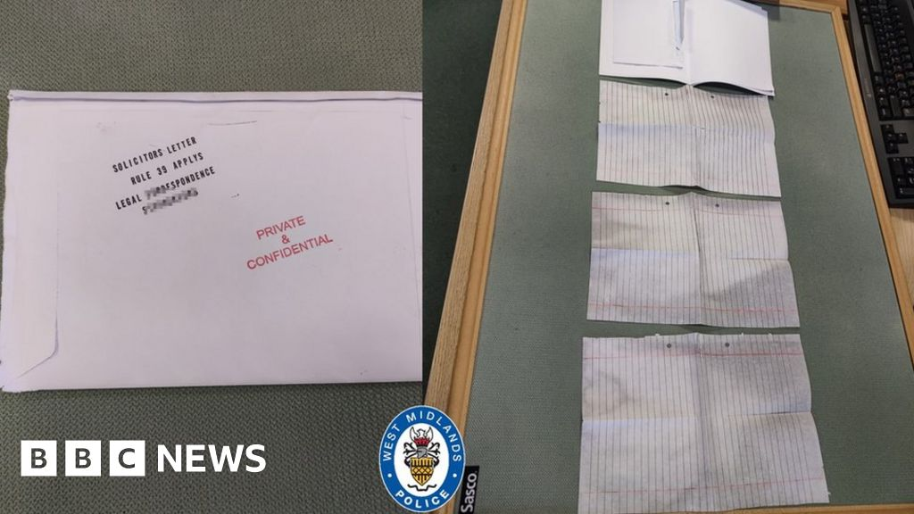
Trend Takeaways - Synthetic Cannabinoids
Increase in IDs 23-25 – on pace to increase in 2026
Mainly attributable to prison papers
  Letters or legal documents sent/smuggled into jail or prison
  The papers are soaked in Synthetic Cannabinoids
Multiple IDs per analysis – 59 IDs in 26 cases

Slide 26
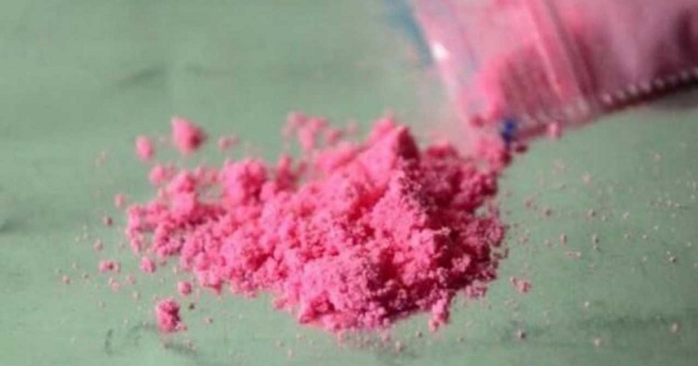
TusI
“Pink Cocaine”
Pink or red colored powder
Generally contains:
  MDMA and/or MDA and/or Substituted Cathinones
  Ketamine
Identified in Miami area many times in early 2025
Only 2 identified samples in North Florida region so far (once in a death investigation)

Slide 27
Regional Drug TrenDs – Death Investigations
2025 – ALL Results
2025 – Death Investigations
Notes
Methamphetamine – 1006 – 25.5%
Fentanyl + Derivatives – 720 – 19.5%
Cocaine – 700 – 18.9%
Substituted Cathinones – 488 – 13.2%
Cannabis and THC – 280 – 7.6%
Prescription Opiates – 148 – 4.0%
Xylazine – 131 – 3.5%
Synthetic Cannabinoids – 59 – 1.6%
Substituted Phenethylamines – 47 – 1.3%
Benzodiazepines – 31 – 0.8%
Total Identifications – 3695
Fentanyl + Derivatives – 39 – 5.4% of IDs
Methamphetamine – 5 – 0.5%
Xylazine – 2.3%
3T. Substituted Cathinones – 3 – 0.6%
3T. Cocaine – 3 – 0.4%
6. Ketamine – 2 – 14.3%
7. Prescription Opiates – 1 – 0.7%
7T. Cannabis and THC – 1 – 0.4%
Total DI Identifications – 88 (2.4%)
Statewide – 343 Death Investigation results (30238 total results – 1.13%)
NF results are twice as likely to be from a Death Investigation
The second most common result for DIs is “No controlled substances…”
Xylazine down from 2023-2025 (7-10% of NF results were DI)
Ketamine + Fentanyl ID’d in 1 NF DI case
Tusi (Ketamine, MDMA, Eutylone, Dimethylpentylone) in 2nd NF DI case
Cannabis – suspected to be laced with fentanyl; it was not

Slide 28
Additional Analytical Concerns
Counterfeit tablets – increasing prevalence, mainly for certain markings indicating Alprazolam, Oxycodone, and Amphetamine
How do we maintain certainty about populations?
  Statistical sampling of tablet populations – sample 3-30 tablets today vs. 1 in the past
    Implemented in November 2025
  Allows for inferences about the population as a whole – utilized by FDLE for tablet populations where trafficking weights may be present
    So far, no mixed populations have been encountered in North Florida

Slide 29

What IS a Counterfeit?
Counterfeit tablet – a tablet with pharmaceutical markings that correspond to a legitimate pharmaceutical preparation, but contain substances other than the indicated controlled substance
  Ex 1: “S903” tablet (Alprazolam) containing Etizolam or Clonazolam
  Ex 2: “K 9” tablet (Oxycodone) containing Cocaine and Oxycodone

Slide 30


ALPRAZOLAM Counterfeits
S903
R039
3 counterfeits (100%)
Phenazolam
2 counterfeits (66.7%)
Bromazolam
Other counterfeits: B707, V2090

Slide 31


Oxycodone Counterfeits
M 30
RP 10
23 counterfeits (88.5%)
Fentanyl and Fentanyl Derivatives (20), Heroin, N-Pyrrolidino Etonitazene, Methorphan, Xylazine, Isopropylbutylone
6 counterfeits (85.7%)
Fentanyl and Fentanyl Derivatives (including Carfentanil), Xylazine, Tramadol, N-Pyrrolidino Protonitazene
Other counterfeits: K56, K9, M15, M10

Slide 32

Amphetamine Counterfeits
AD 20
1 counterfeit (100%)
Methamphetamine

Slide 33


Principles of Statistical Sampling
FDLE definition of population: A group of substances that have the same visual characteristics (size, shape, color, markings, if applicable) within an exhibit

Slide 34


Population Hypothesis
Population Hypothesis
  A statement about a population which will be tested through statistical sampling
I believe that there are at least 86% of these bags that contain cocaine.

Slide 35

Math - Hypergeometric
Example: 50 tablets submitted suspected as Fentanyl
How many samples do we need to take to be 95% confident that at least 70% of the total samples contain the substance?
(n)

Slide 36
Hypothetical Reinforcement
Hypothetical scenario:
Fifty tablets marked “M30”
7.500 grams
Eight tablets were analyzed
Fentanyl was identified in all eight analyzed tablets.
What is the likelihood that we randomly selected the only eight positive tablets?
8 X 7 x 6 x 5 x 4 x 3 x 2 x 1
= 0.00000019%
50 49 48 47 46 45 44 43

Slide 37

Contact Us
someone@example.com

